Slide 1
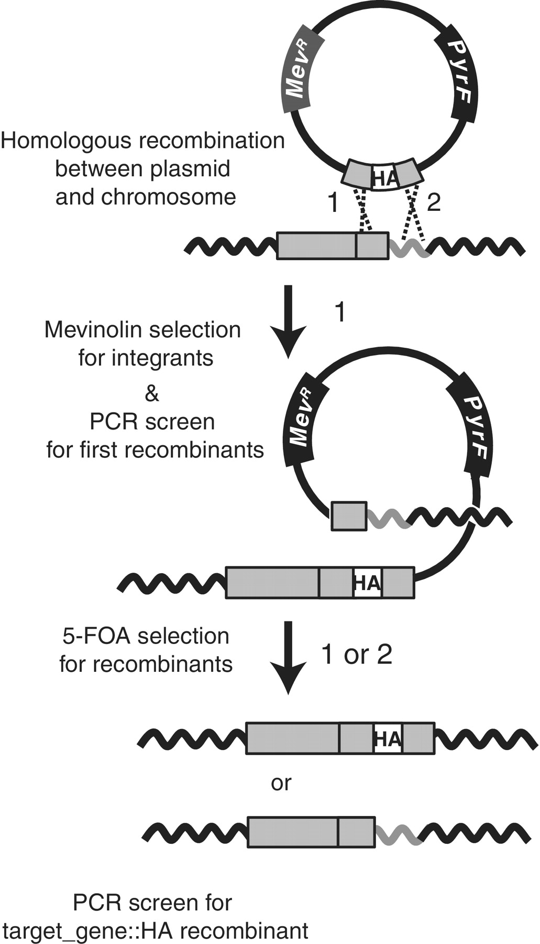
Figure 1. Epitope tag-in approach for Hb. NRC-1. The Hb. NRC-1 Δ pyrF strain is transformed with a plasmid containing ...
Notes:
Figure 1. Epitope tag-in approach for Hb. NRC-1. The Hb. NRC-1 Δ pyrF strain is transformed with a plasmid containing the mevinolin-resistance determinant (Mev R ; dark gray box) and the pyrF gene (black box) that confers 5-FOA sensitivity. The plasmid carries an engineered sequence containing the HA epitope sequence (white box) flanked by the last 500 bp of the target gene and the 500 bp downstream of the target gene (light gray boxes). Plasmid sequence is shown as solid line, chromosomal sequence is shown as solid, wavy lines. Cross-over can occur between target gene (light gray box) and flanking sequence (gray wavy line) in the chromosome and the homologous regions in the plasmid sequence, at either position 1 or 2 (position 1 example shown). PCR screening of mevinolin-resistant colonies is used to determine successful first recombinants. Subsequent plating on 5-FOA selects for second recombinants (via counter-selection with the pyrF gene). In this example, a second cross-over at site 2 produces the desired chromosomally integrated recombinant target_gene ::HA fusion. PCR screening of these colonies is required to distinguish this desired second recombinant from a second recombinant occurring at position 1. Drawing is not to scale.
Unless provided in the caption above, the following copyright applies to the content of this slide: © The Author(s) 2012. Published by Oxford University Press.This is an Open Access article distributed under the terms of the Creative Commons Attribution Non-Commercial License (http://creativecommons.org/licenses/by-nc/3.0), which permits unrestricted non-commercial use, distribution, and reproduction in any medium, provided the original work is properly cited.

Slide 2
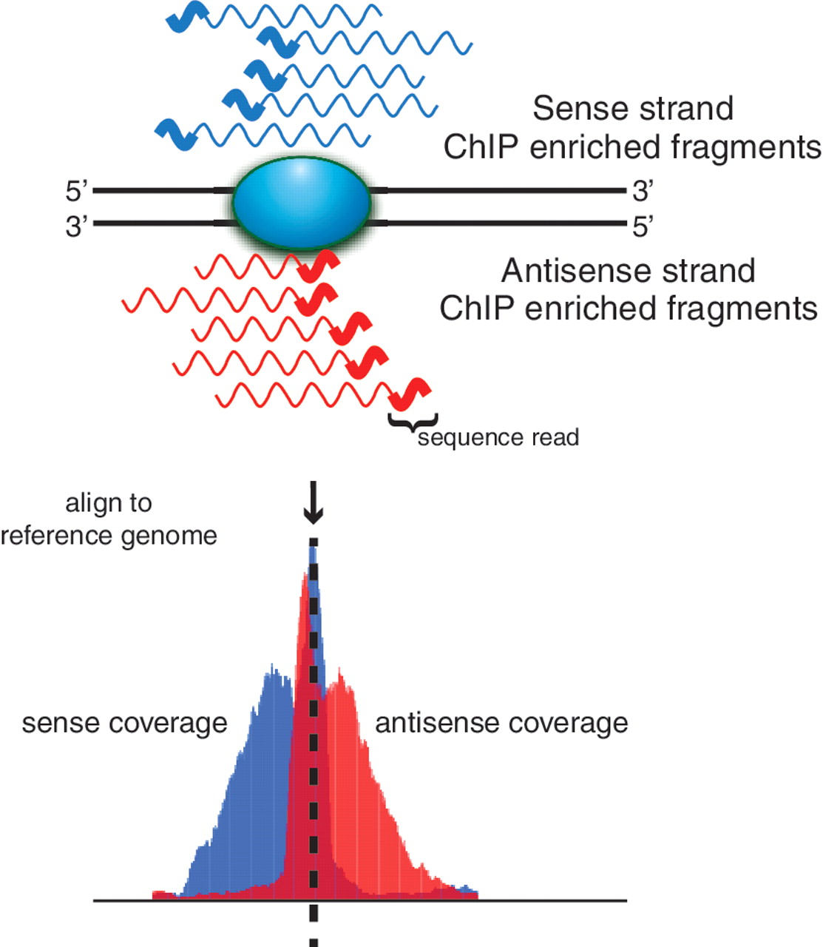
Figure 2. The 5′ to 3′ sequencing requirement and short read length produce stranded bias in sequence coverage. The ...
Notes:
Figure 2. The 5′ to 3′ sequencing requirement and short read length produce stranded bias in sequence coverage. The shaded blue oval represents the protein of interest bound to DNA (solid black lines). Wavy lines represent either sense (blue) or antisense (red) DNA fragments from ChIP enrichment. The thicker portion of the line indicates regions sequenced by short read sequencing technologies. Sequenced tags are aligned to a reference genome and shown below is the strand-specific sequence coverage at each position in the genome. Punctate-binding events (e.g. transcription factors) are characterized by well-defined strand-specific bimodality in sequence coverage.
Unless provided in the caption above, the following copyright applies to the content of this slide: © The Author(s) 2012. Published by Oxford University Press.This is an Open Access article distributed under the terms of the Creative Commons Attribution Non-Commercial License (http://creativecommons.org/licenses/by-nc/3.0), which permits unrestricted non-commercial use, distribution, and reproduction in any medium, provided the original work is properly cited.

Slide 3
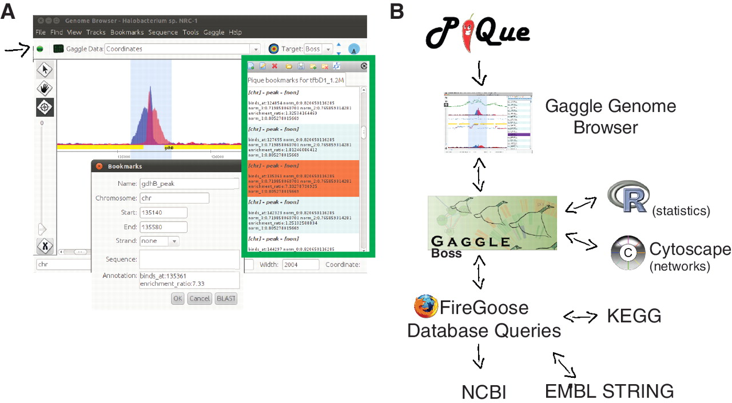
Figure 3. The Pique software package processes ChIP-seq coverage data to predict protein-binding sites. ...
Notes:
Figure 3. The Pique software package processes ChIP-seq coverage data to predict protein-binding sites. Strand-specific coverage data are output as tracks for the Gaggle Genome Browser, and putative-binding sites (peaks) are output as ‘bookmark files’. (A) Screenshot of data browsing in the Gaggle Genome Browser. Green box outlines the navigation window for clicking through bookmarks of predicted binding sites. Details of each site can be displayed (inset). The Gaggle toolbar (shown with black arrow) can be used to broadcast selected data to other ‘geese’ in the gaggle package, programs such as R, cytoscape, BLAST or KEGG. (B) Schematic overview of bioinformatics workflow.
Unless provided in the caption above, the following copyright applies to the content of this slide: © The Author(s) 2012. Published by Oxford University Press.This is an Open Access article distributed under the terms of the Creative Commons Attribution Non-Commercial License (http://creativecommons.org/licenses/by-nc/3.0), which permits unrestricted non-commercial use, distribution, and reproduction in any medium, provided the original work is properly cited.

Slide 4
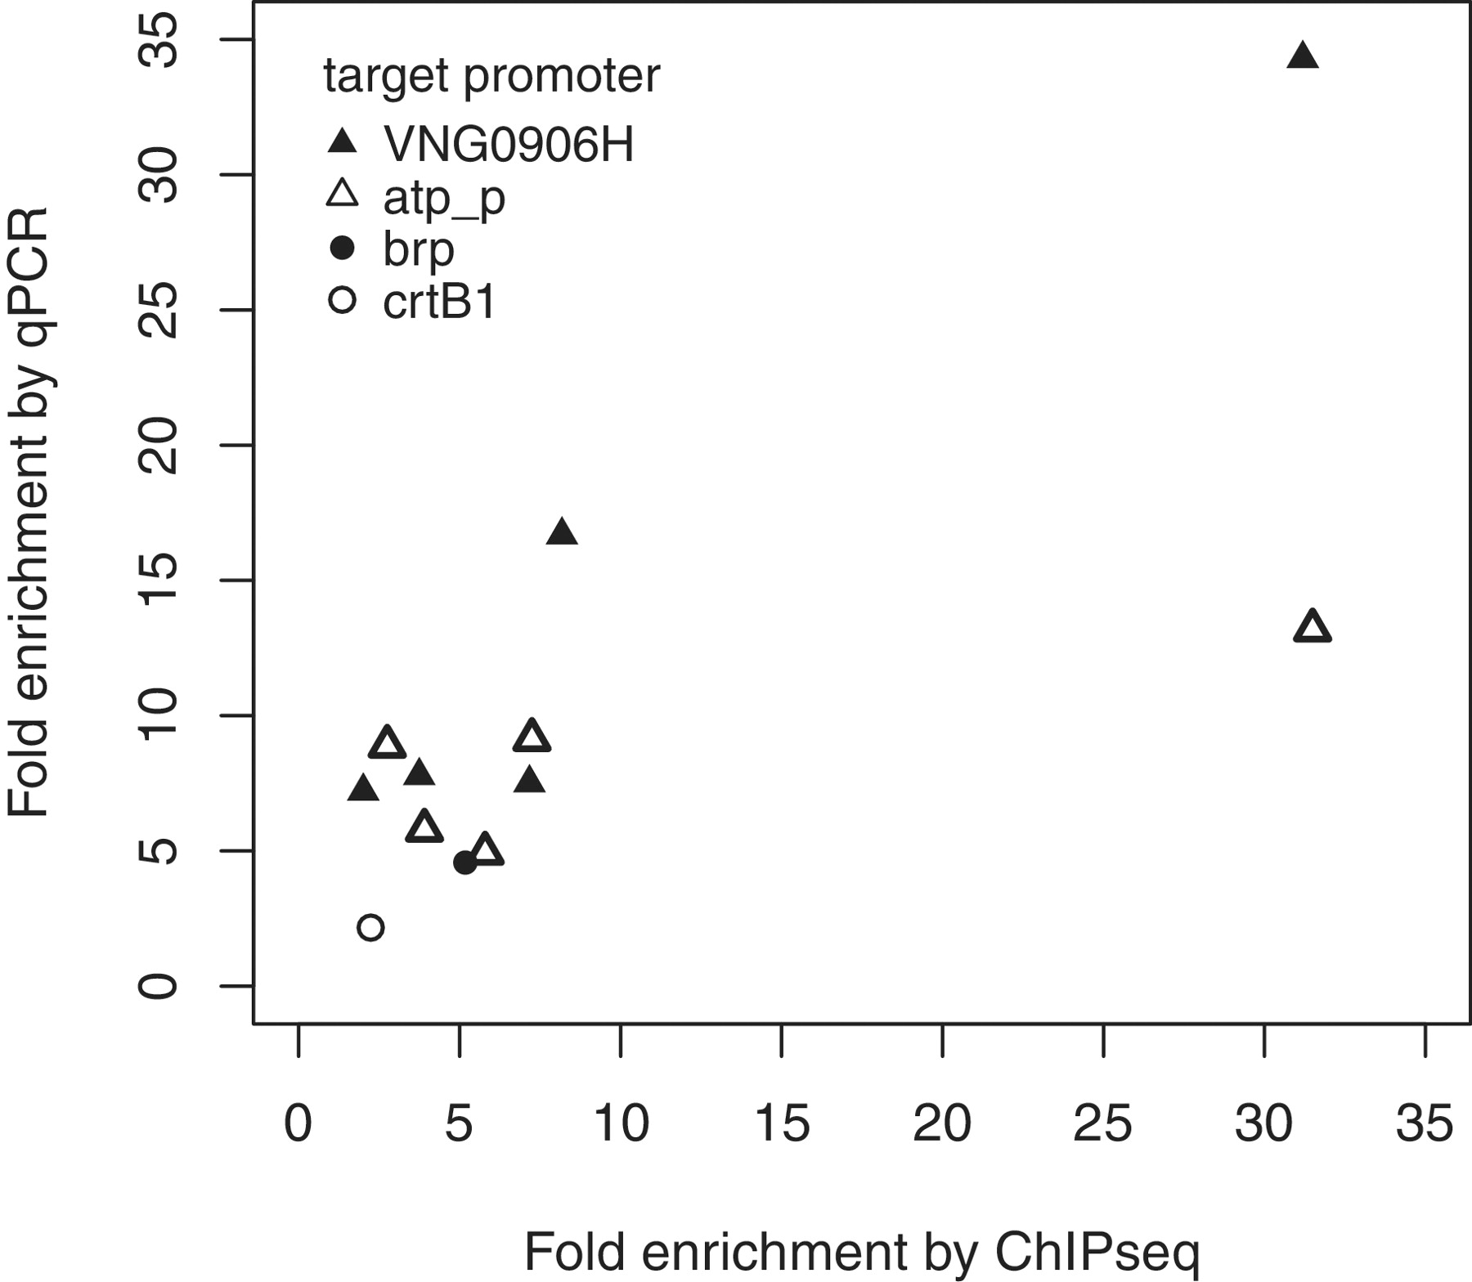
Figure 4. ChIP enrichment of binding sites determined by qPCR and sequencing show a linear relationship. Data shown ...
Notes:
Figure 4. ChIP enrichment of binding sites determined by qPCR and sequencing show a linear relationship. Data shown are drawn from multiple ChIP experiments: the Bat ChIP (P brp and P crtB1 closed and open circles) and the TfbD ChIP and the reduced cell number TfbD ChIPs (P VNG906H and P atp_p ; closed and open triangles). Differences in enrichment at the TfbD-bound promoters corresponded to changes produced by decreasing the number of cells in the ChIP reaction (see Figure 5 for further details).
Unless provided in the caption above, the following copyright applies to the content of this slide: © The Author(s) 2012. Published by Oxford University Press.This is an Open Access article distributed under the terms of the Creative Commons Attribution Non-Commercial License (http://creativecommons.org/licenses/by-nc/3.0), which permits unrestricted non-commercial use, distribution, and reproduction in any medium, provided the original work is properly cited.

Slide 5
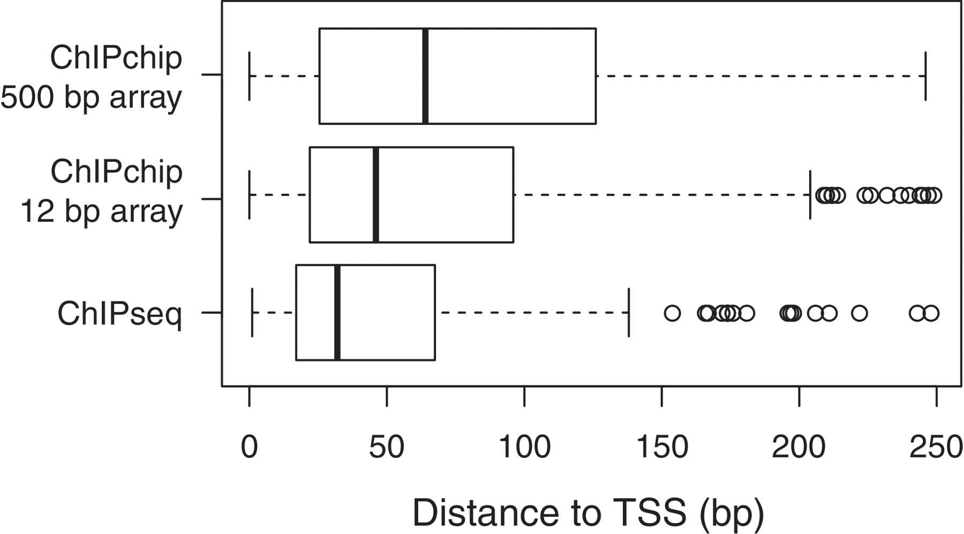
Figure 5. Distance from predicted TfbD-binding site for ChIP-seq (consensus between biological replicates), 500-bp ...
Notes:
Figure 5. Distance from predicted TfbD-binding site for ChIP-seq (consensus between biological replicates), 500-bp tiling microarray ChIP-Chip (consensus between biological replicates) and 12-bp tiling microarray ChIP-Chip experiments. The observed difference in means was statistically significant (Mann Whitney U-test, p value < 0.005), as is the observed difference in variance (Bartlett test, p value < 0.005).
Unless provided in the caption above, the following copyright applies to the content of this slide: © The Author(s) 2012. Published by Oxford University Press.This is an Open Access article distributed under the terms of the Creative Commons Attribution Non-Commercial License (http://creativecommons.org/licenses/by-nc/3.0), which permits unrestricted non-commercial use, distribution, and reproduction in any medium, provided the original work is properly cited.

Slide 6
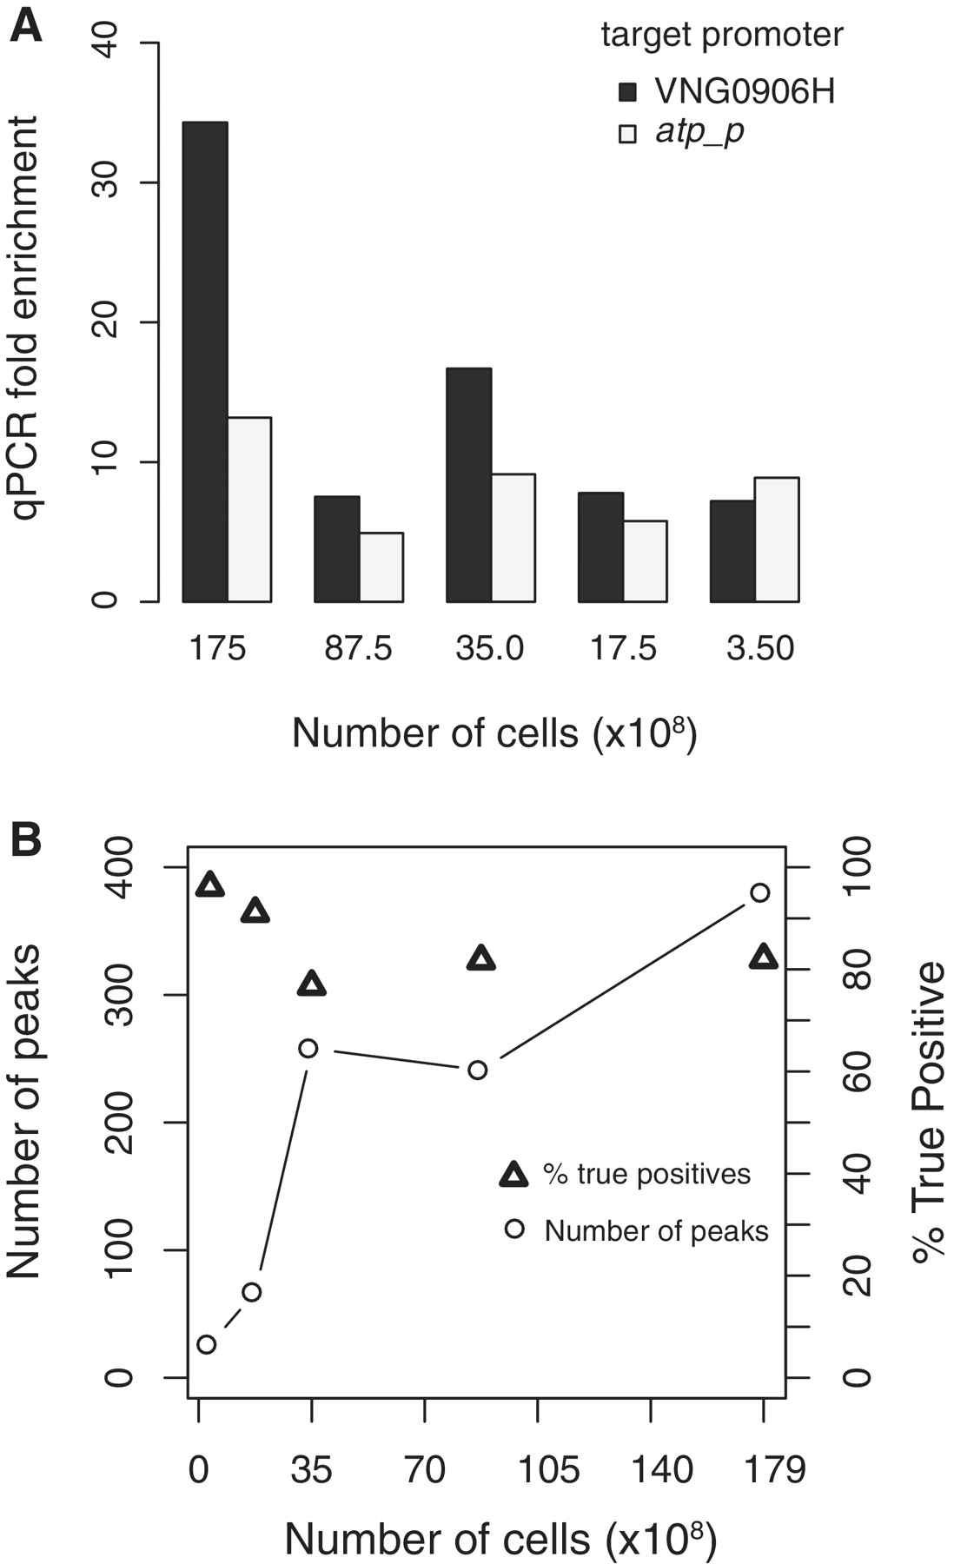
Figure 6. TfbD ChIP with decreasing numbers of cells. ( A ) ChIP-qPCR determined fold enrichment at two test promoters ...
Notes:
Figure 6. TfbD ChIP with decreasing numbers of cells. ( A ) ChIP-qPCR determined fold enrichment at two test promoters (VNG906H, dark bars and atp_p light bars) decreases with lower numbers of cells; however, strong (>5 x) enrichment is still observed with 3.5 × 10 8 cells. ( B ) For decreasing cell volume ChIP-seq experiments, fewer peaks could be identified (number of peaks identified, squares and lines), resulting in a significant loss in sensitivity. However, the percentage of identified peaks that were true positives stayed high (% true positives, triangles). True positives were defined as binding sites that were shared with at least one of the optimized 1.75 × 10 10 ChIP TfbD biological replicates.
Unless provided in the caption above, the following copyright applies to the content of this slide: © The Author(s) 2012. Published by Oxford University Press.This is an Open Access article distributed under the terms of the Creative Commons Attribution Non-Commercial License (http://creativecommons.org/licenses/by-nc/3.0), which permits unrestricted non-commercial use, distribution, and reproduction in any medium, provided the original work is properly cited.

Slide 7
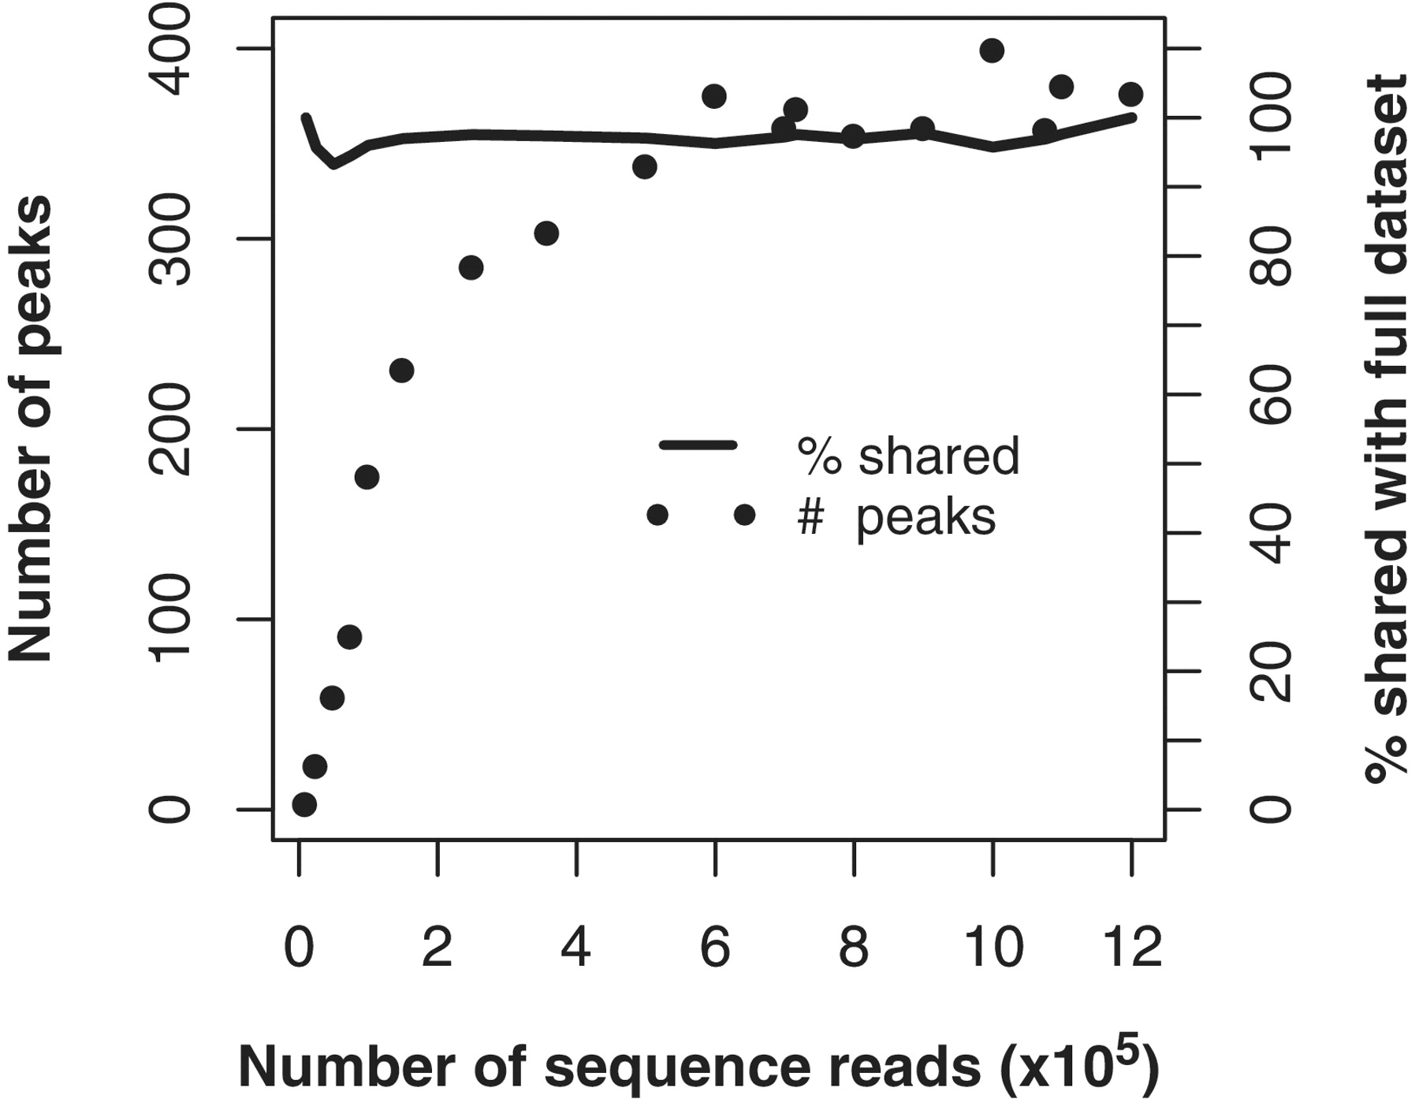
Figure 7. Subsampling sequence coverage. Sequences were randomly sampled from a TfbD ChIPseq dataset of 6 M reads to ...
Notes:
Figure 7. Subsampling sequence coverage. Sequences were randomly sampled from a TfbD ChIPseq dataset of 6 M reads to create subsampled datasets of decreasing coverage. The number of peaks that could be identified in each subset (filled circles) is shown as a function of the number of sequence reads in the dataset. The specificity of these smaller lists is assessed as the percentage of the identified peaks which overlapped the larger 1.2 M read dataset (solid line).
Unless provided in the caption above, the following copyright applies to the content of this slide: © The Author(s) 2012. Published by Oxford University Press.This is an Open Access article distributed under the terms of the Creative Commons Attribution Non-Commercial License (http://creativecommons.org/licenses/by-nc/3.0), which permits unrestricted non-commercial use, distribution, and reproduction in any medium, provided the original work is properly cited.

Slide 8
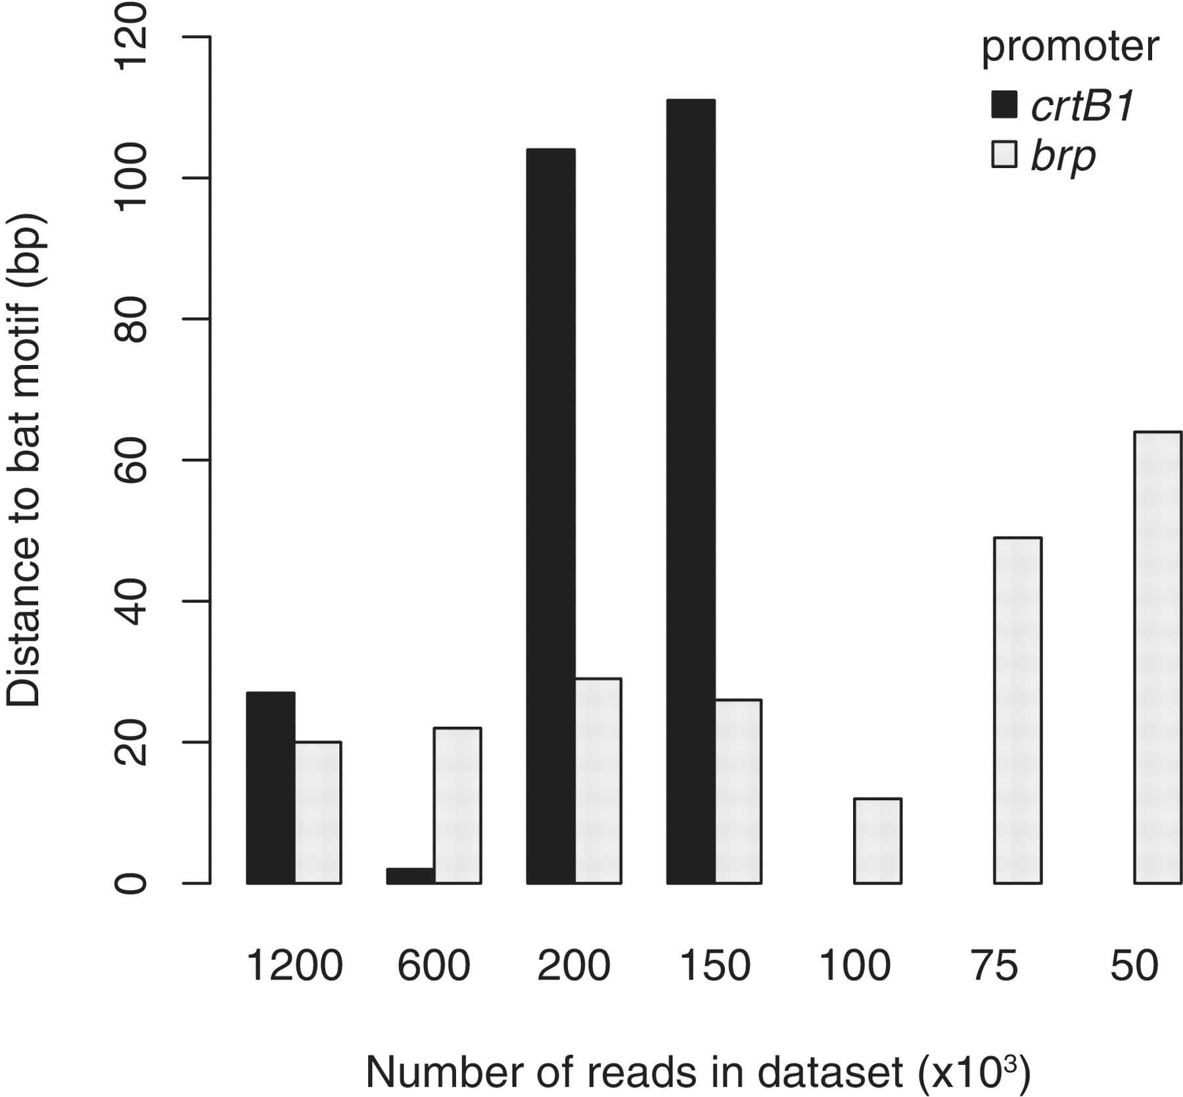
Figure 8. Spatial resolution of binding sites calculated from randomly subsampled Bat ChIP-seq datasets of decreasing ...
Notes:
Figure 8. Spatial resolution of binding sites calculated from randomly subsampled Bat ChIP-seq datasets of decreasing coverage. The distance from ChIPseq predicted binding site to nearest Bat-binding motif was calculated for both the crtB1 (dark gray bars) and brp (light gray bars) promoter regions. Binding sites for in the crtB1 promoter could not be detected for datasets with 100 000 reads and below (no bars in plot).
Unless provided in the caption above, the following copyright applies to the content of this slide: © The Author(s) 2012. Published by Oxford University Press.This is an Open Access article distributed under the terms of the Creative Commons Attribution Non-Commercial License (http://creativecommons.org/licenses/by-nc/3.0), which permits unrestricted non-commercial use, distribution, and reproduction in any medium, provided the original work is properly cited.

