Slide 1
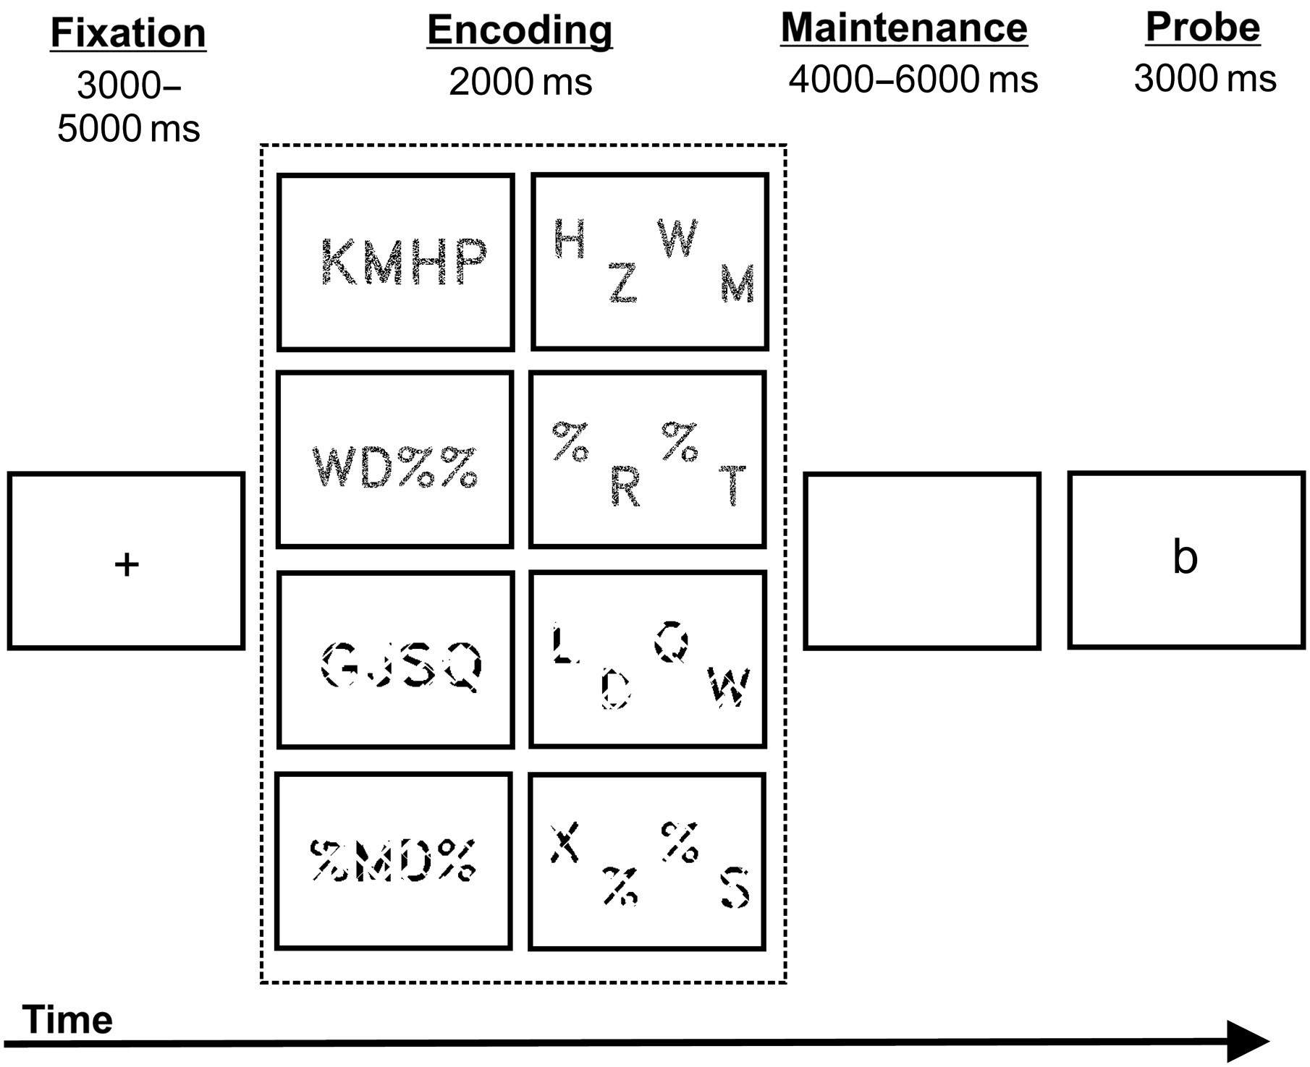
Figure 1. Time course of stimulus presentation in the Sternberg verbal working memory task, illustrating each of the 8 ...
Notes:
Figure 1. Time course of stimulus presentation in the Sternberg verbal working memory task, illustrating each of the 8 types of encoding stimuli that each subject received.
Unless provided in the caption above, the following copyright applies to the content of this slide: © The Author 2015. Published by Oxford University Press. All rights reserved. For Permissions, please e-mail: journals.permissions@oup.com

Slide 2
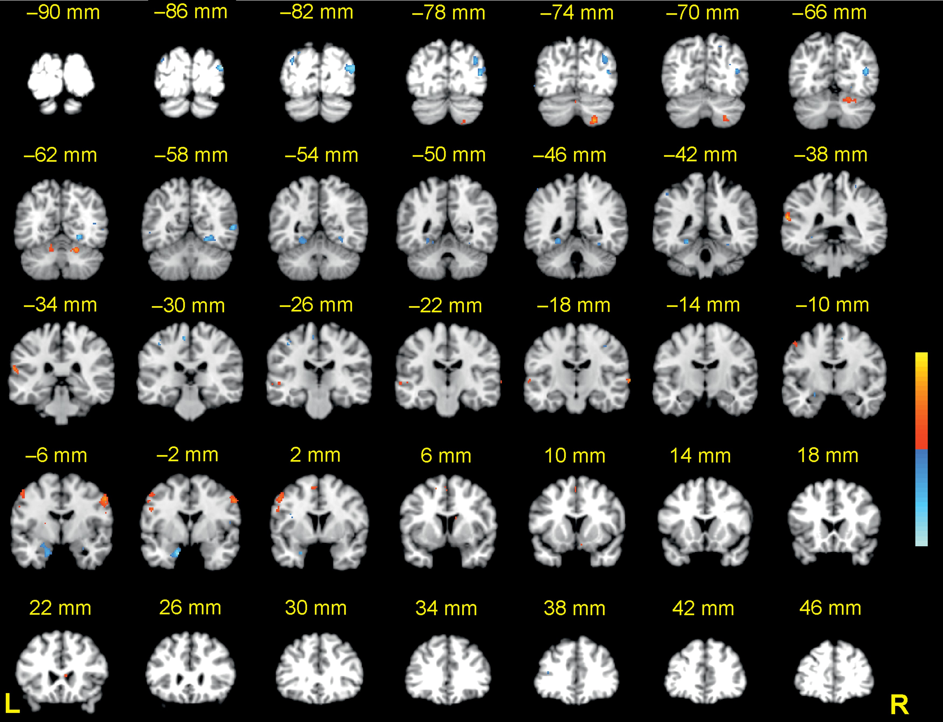
Figure 2. High versus low cognitive load in the conventional analysis (see Table 1 for peak coordinates). Coronal ...
Notes:
Figure 2. High versus low cognitive load in the conventional analysis (see Table 1 for peak coordinates). Coronal slices from Talairach y = +46 to −90 mm are depicted. Positive activations (high > low) are shown in red; negative activations (low > high) are shown in blue; P < 0.001−0.00001.
Unless provided in the caption above, the following copyright applies to the content of this slide: © The Author 2015. Published by Oxford University Press. All rights reserved. For Permissions, please e-mail: journals.permissions@oup.com

Slide 3
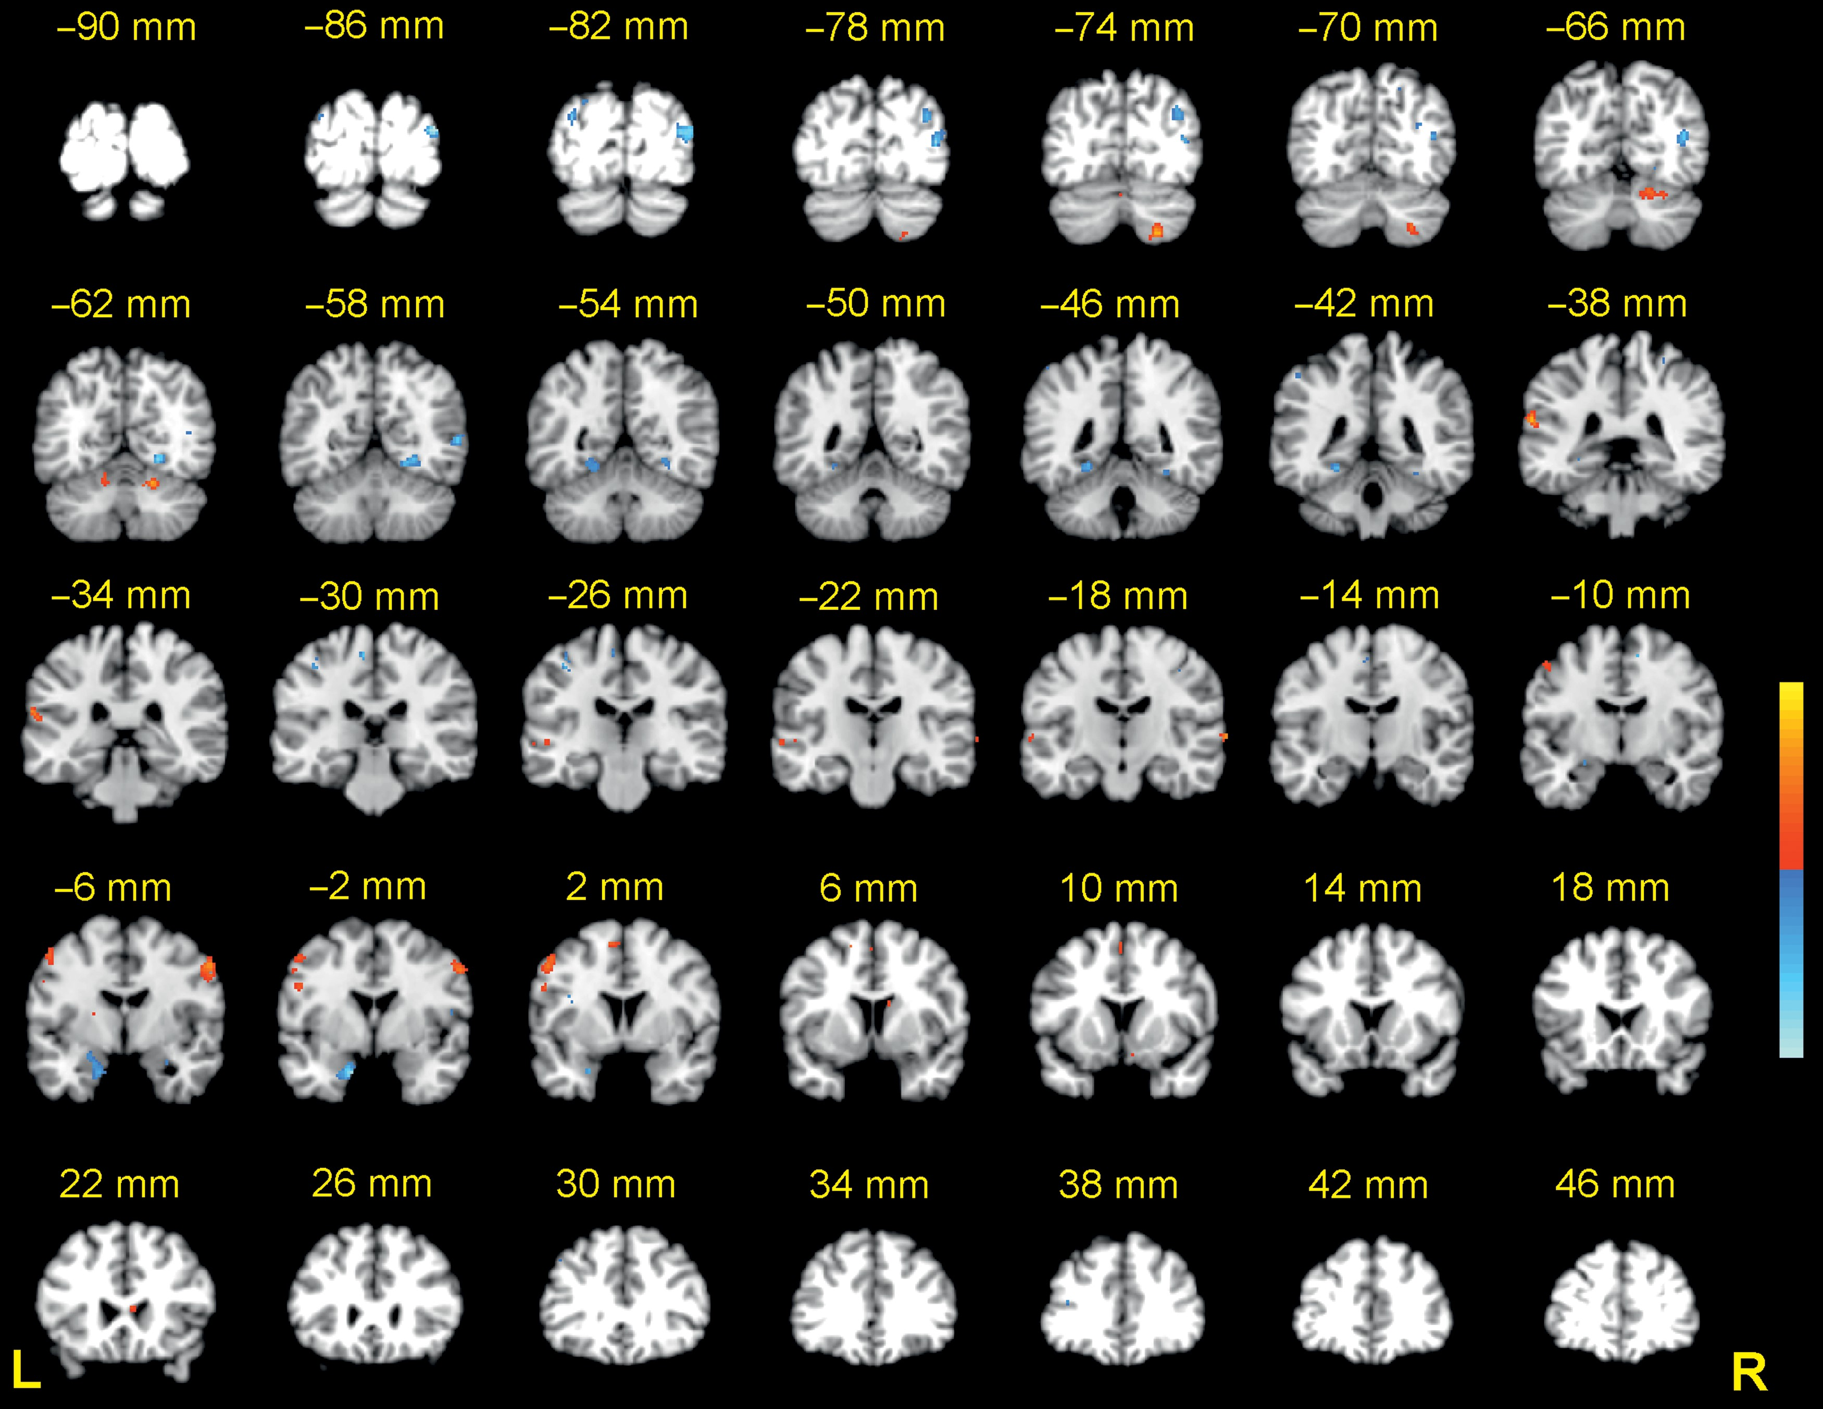
Figure 3. High versus low cognitive load with eye regressor (see Table 1 for peak coordinates). Coronal slices from ...
Notes:
Figure 3. High versus low cognitive load with eye regressor (see Table 1 for peak coordinates). Coronal slices from Talairach y = +46 to −90 mm are depicted. Positive activations (high > low) are shown in red; negative activations (low > high) are shown in blue; P < 0.001−0.00001.
Unless provided in the caption above, the following copyright applies to the content of this slide: © The Author 2015. Published by Oxford University Press. All rights reserved. For Permissions, please e-mail: journals.permissions@oup.com

Slide 4
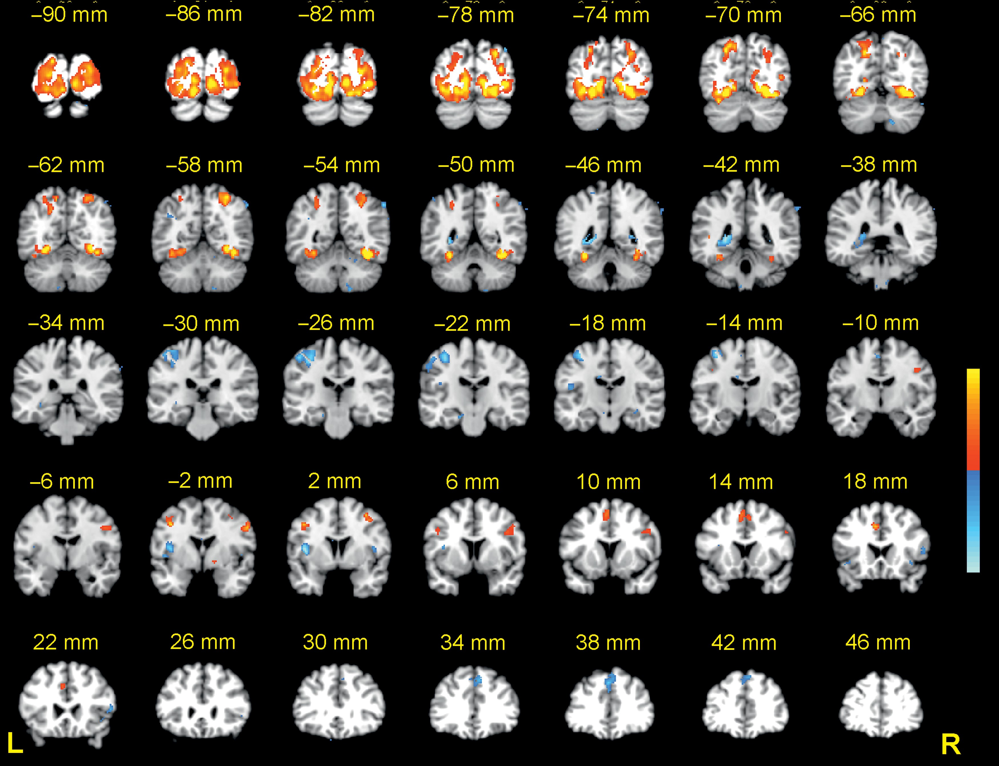
Figure 4. Eye regressor (see Table 2 for peak coordinates). Coronal slices from Talairach y = +46 to −90 mm are ...
Notes:
Figure 4. Eye regressor (see Table 2 for peak coordinates). Coronal slices from Talairach y = +46 to −90 mm are depicted. Positive activations are shown in red; negative activations are shown in blue; P < 0.001−0.00001.
Unless provided in the caption above, the following copyright applies to the content of this slide: © The Author 2015. Published by Oxford University Press. All rights reserved. For Permissions, please e-mail: journals.permissions@oup.com

Slide 5
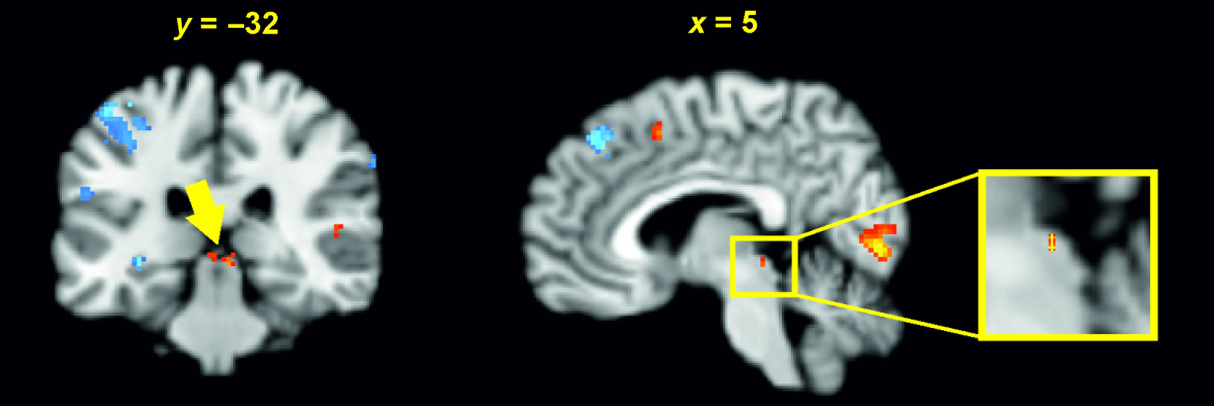
Figure 5. Signal increase in superior colliculus associated with the eye regressor as revealed by explorative analysis ...
Notes:
Figure 5. Signal increase in superior colliculus associated with the eye regressor as revealed by explorative analysis at P < 0.001−0.00001.
Unless provided in the caption above, the following copyright applies to the content of this slide: © The Author 2015. Published by Oxford University Press. All rights reserved. For Permissions, please e-mail: journals.permissions@oup.com

Slide 6
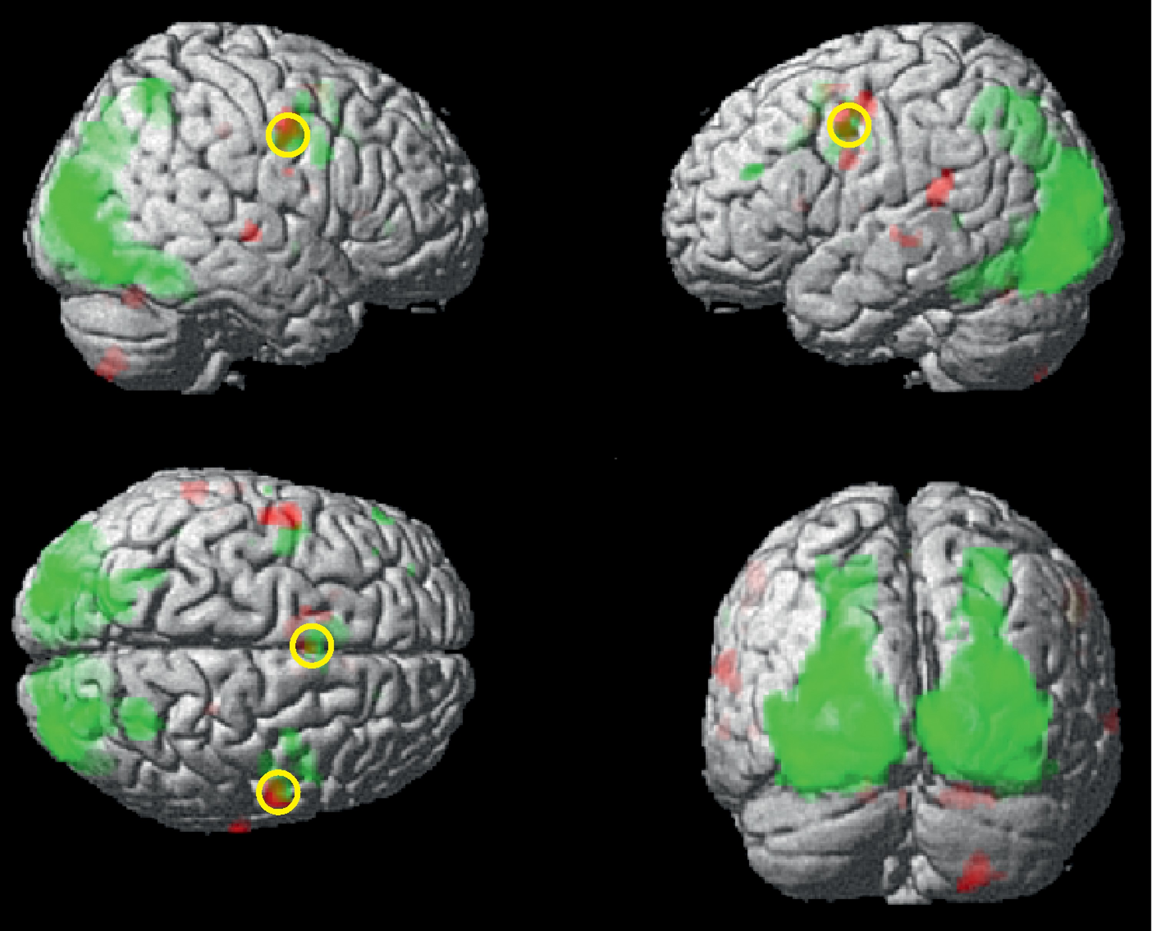
Figure 6. Surface rendering of regions with signal increase the load effect (red) and the eye regressor (green) and ...
Notes:
Figure 6. Surface rendering of regions with signal increase the load effect (red) and the eye regressor (green) and shared regions (yellow; circled) as revealed by conjunction analysis. P < 0.001−0.00001.
Unless provided in the caption above, the following copyright applies to the content of this slide: © The Author 2015. Published by Oxford University Press. All rights reserved. For Permissions, please e-mail: journals.permissions@oup.com

