Slide 1
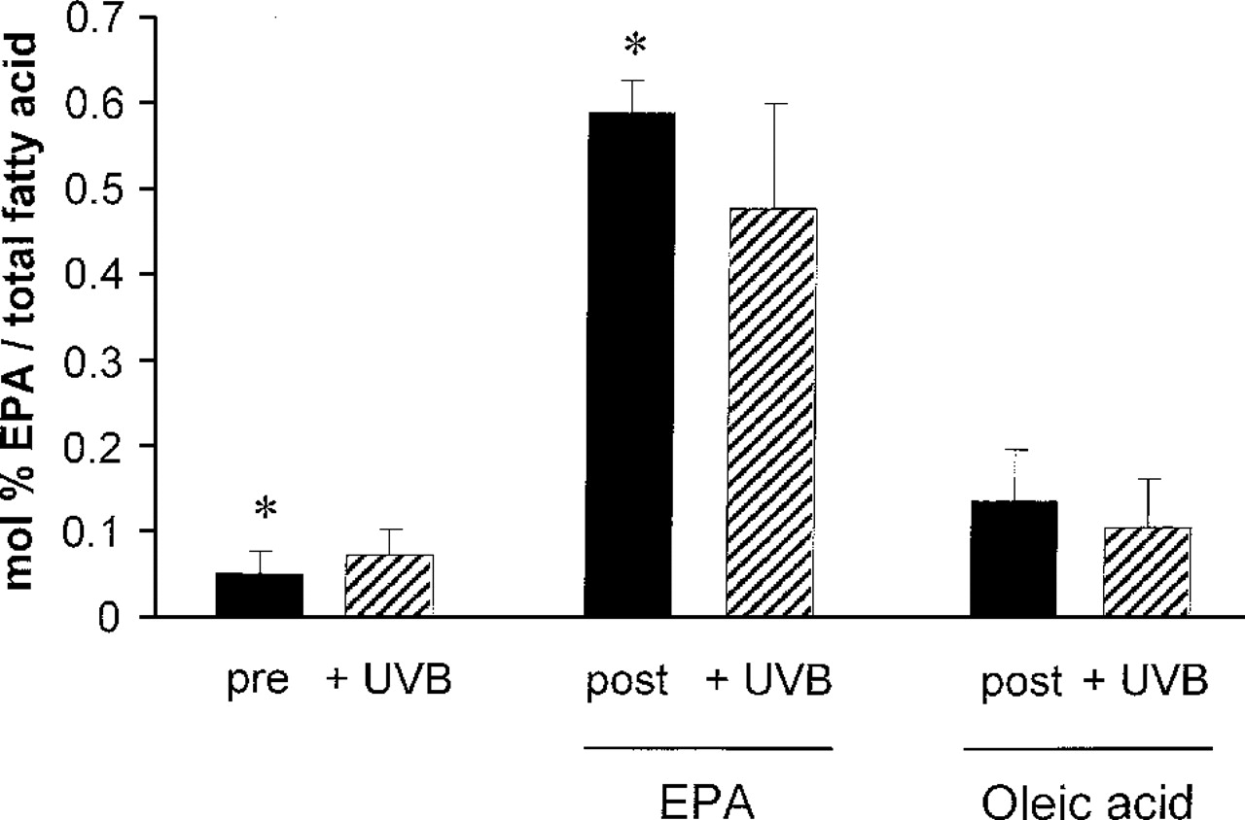
Fig. 1. The EPA content of skin, in mol% total fatty acids, increases after 3 months supplementation with EPA, but ...
Notes:
Fig. 1. The EPA content of skin, in mol% total fatty acids, increases after 3 months supplementation with EPA, but not OA, *P < 0.01. Solid columns are unexposed skin, hatched columns are skin at 1 h following exposure to UVR (2× MED). Data shown are mean ± SE; n = 7 in each supplementation group.
Unless provided in the caption above, the following copyright applies to the content of this slide: © Oxford University Press. All rights reserved

Slide 2
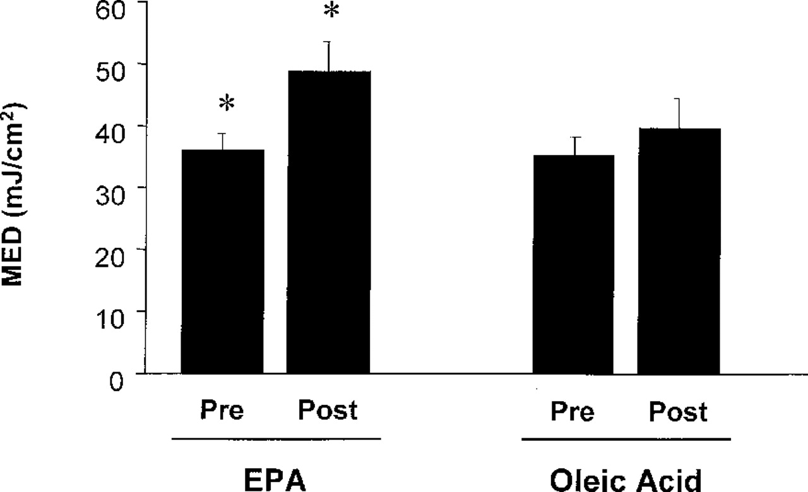
Fig. 2. The erythemal threshold to UVR (minimal erythema dose, MED, in mJ/cm ² ) rises after 3 months ...
Notes:
Fig. 2. The erythemal threshold to UVR (minimal erythema dose, MED, in mJ/cm 2 ) rises after 3 months dietary supplementation with EPA, but not OA, *P < 0.01. Data shown are mean ± SE; n = 14 in each supplementation group.
Unless provided in the caption above, the following copyright applies to the content of this slide: © Oxford University Press. All rights reserved

Slide 3
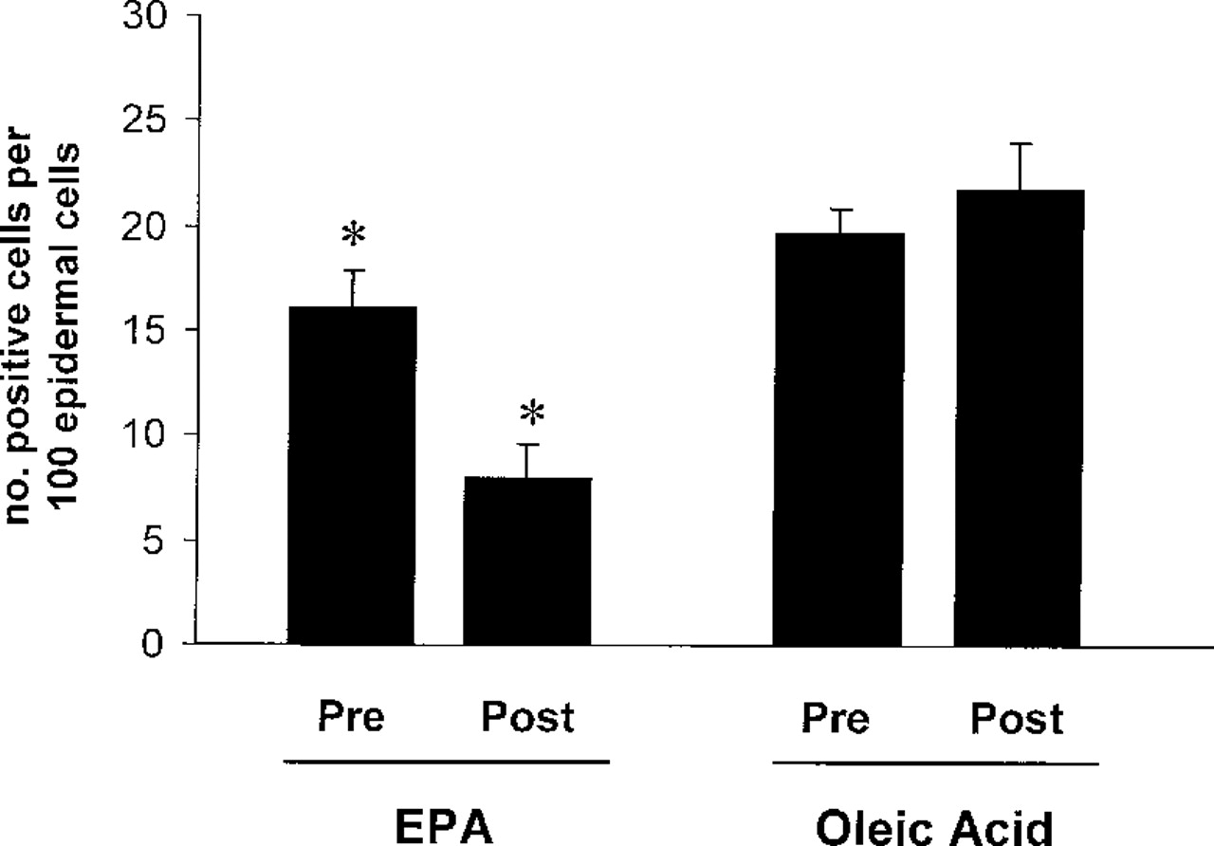
Fig. 3. UVR-induced p53 expression in skin is reduced after 3 months supplementation with EPA but not OA, ...
Notes:
Fig. 3. UVR-induced p53 expression in skin is reduced after 3 months supplementation with EPA but not OA, *P < 0.01. Data shown are mean ± SD; n = 7 in each supplementation group.
Unless provided in the caption above, the following copyright applies to the content of this slide: © Oxford University Press. All rights reserved

Slide 4
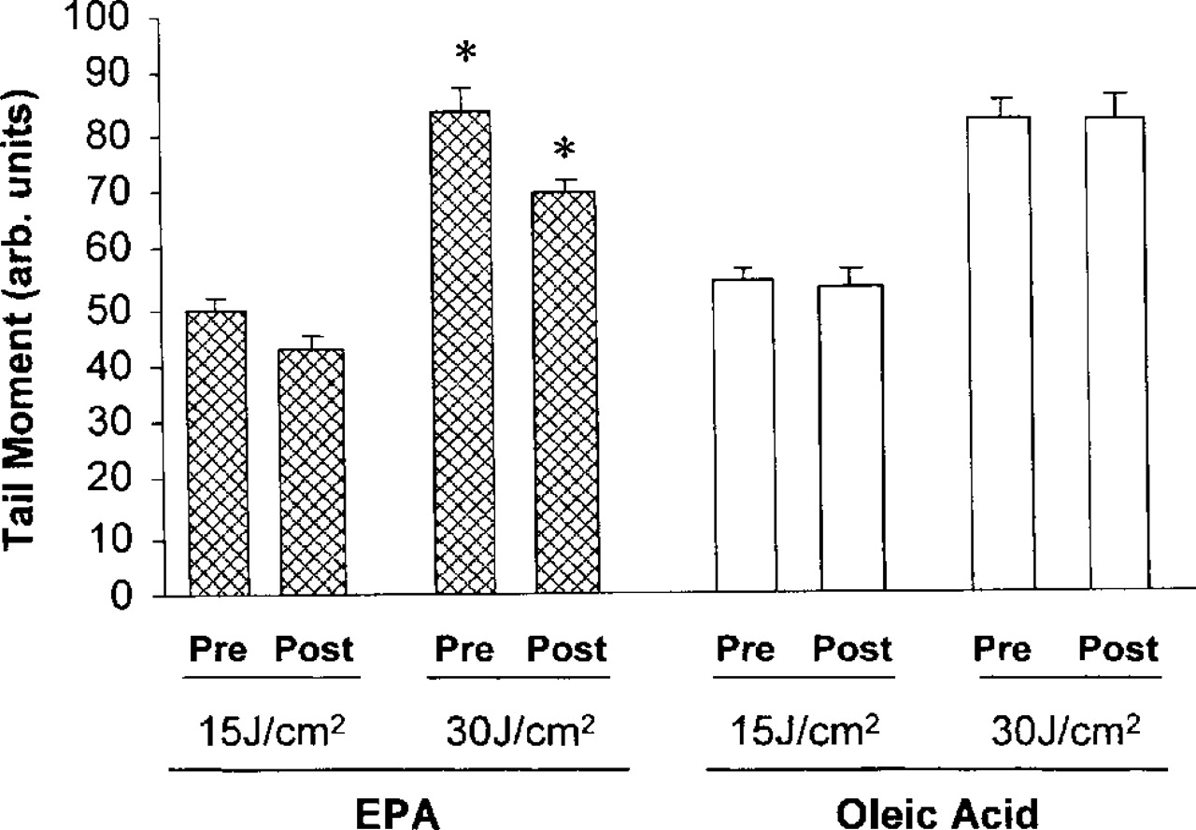
Fig. 4. The comet assay in UVR-exposed PBL before and after dietary EPA and OA supplementation. Tail moment due to ...
Notes:
Fig. 4. The comet assay in UVR-exposed PBL before and after dietary EPA and OA supplementation. Tail moment due to ex vivo UVR is reduced after supplementation with EPA (shaded columns), but not OA (open columns), *P < 0.05 for the 30 mJ/cm 2 UVR dose. Data are mean ± SD; n = 7 in each supplementation group. Results are the mean of three samples taken on consecutive days in each subject.
Unless provided in the caption above, the following copyright applies to the content of this slide: © Oxford University Press. All rights reserved

