Slide 1
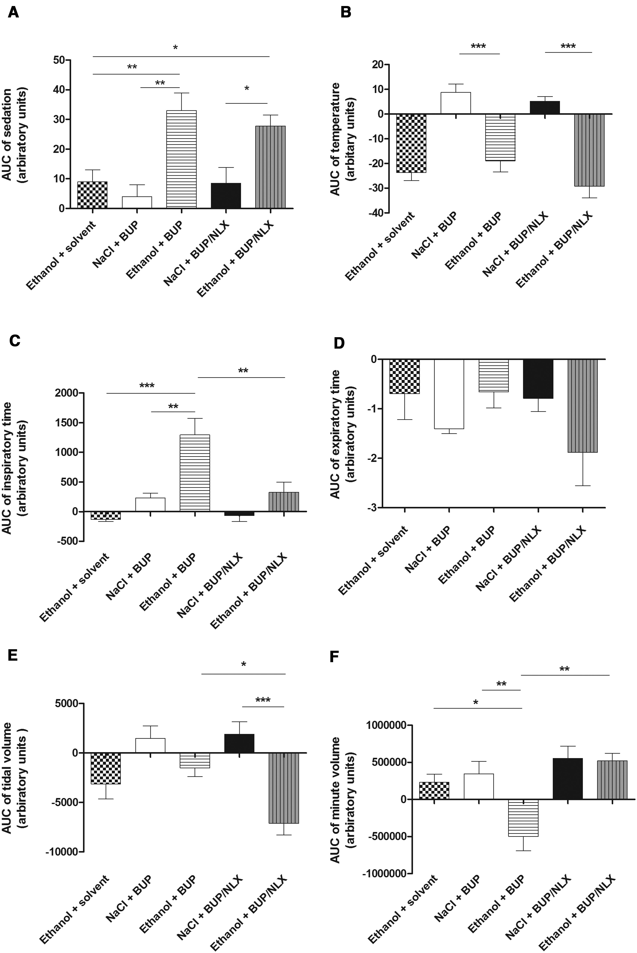
FIG. 1 Effects of intragastric (IG) 3 g/kg ethanol + intravenous (IV) solvent (4% Tween) (checked pattern), IG 0.9% ...
Notes:
FIG. 1 Effects of intragastric (IG) 3 g/kg ethanol + intravenous (IV) solvent (4% Tween) (checked pattern), IG 0.9% NaCl + IV 30 mg/kg buprenorphine (BUP) (white), IG 0.9% NaCl + IV 30 mg/kg BUP/7.5 mg/kg naloxone (NLX) (horizontal lines), IG 3 g/kg ethanol + IV 30 mg/kg BUP (black), and IG 3 g/kg ethanol + IV 30 mg/kg BUP/7.5 mg/kg NLX (grey with vertical lines) on rat sedation (A), temperature (B) and plethysmography parameters including inspiratory time (C), expiratory time (D), tidal volume (E) and minute volume (F). Each group consisted of 6 rats. Values represent mean ± SEM of the areas under the curve (AUC) of each parameter between the time before injection and time 20 min post-injection. Comparisons were performed using ANOVA followed by multiple tests with Bonferroni’s correction. *P < .05, **P < .01, ***P < .001.
Unless provided in the caption above, the following copyright applies to the content of this slide: © The Author 2016. Published by Oxford University Press on behalf of the Society of Toxicology. All rights reserved. For Permissions, please e-mail: journals.permissions@oup.com

Slide 2
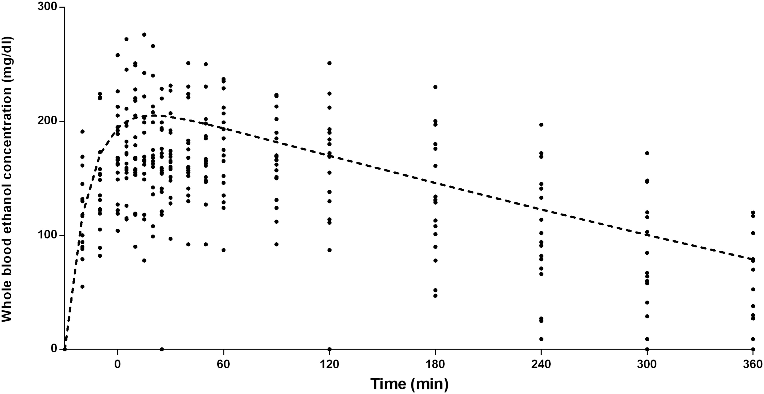
FIG. 2 Whole blood ethanol pharmacokinetics in the rat after the administration of intragastric 3g/kg ethanol ...
Notes:
FIG. 2 Whole blood ethanol pharmacokinetics in the rat after the administration of intragastric 3g/kg ethanol (N = 17 rats). A non-linear mono-compartmental model with oral delay was used (dashed line).
Unless provided in the caption above, the following copyright applies to the content of this slide: © The Author 2016. Published by Oxford University Press on behalf of the Society of Toxicology. All rights reserved. For Permissions, please e-mail: journals.permissions@oup.com

Slide 3
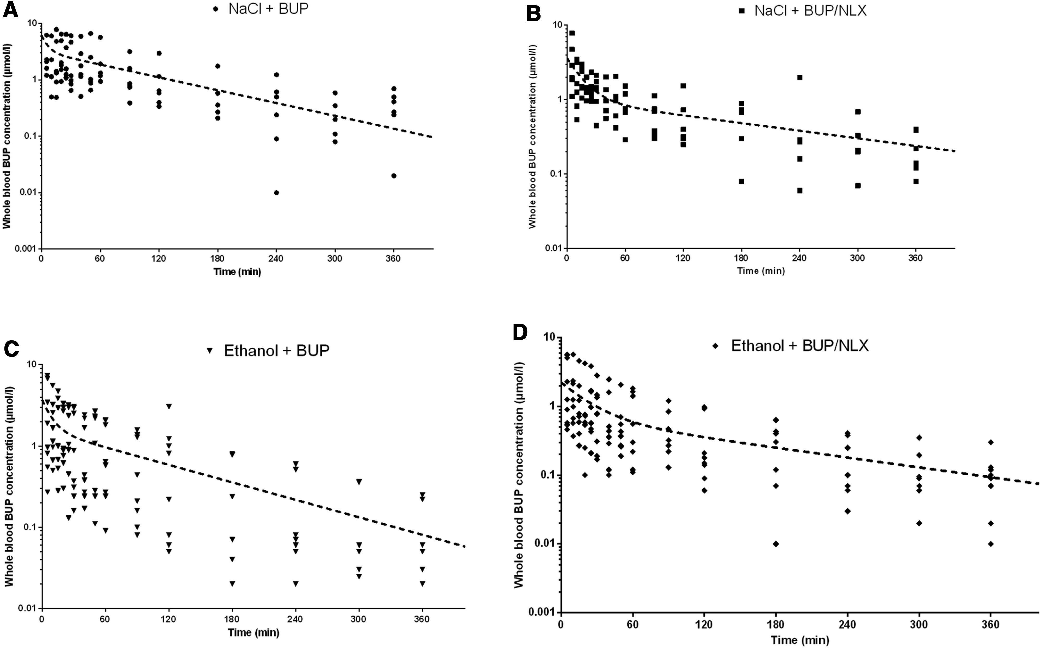
FIG. 3 Whole blood buprenorphine pharmacokinetics in the rat after the administration of intragastric (IG) 0.9% ...
Notes:
FIG. 3 Whole blood buprenorphine pharmacokinetics in the rat after the administration of intragastric (IG) 0.9% NaCl + intravenous (IV) 30 mg/kg buprenorphine (BUP) (A), IG 0.9% NaCl + IV 30 mg/kg BUP/7.5 mg/kg naloxone (NLX) (B), IG 3 g/kg ethanol + IV 30 mg/kg BUP (C) and IG 3 g/kg ethanol + IV 30 mg/kg BUP/7.5 mg/kg NLX (D). A 2-compartmental model was used (dashed-line). Each group consisted of 6–8 rats.
Unless provided in the caption above, the following copyright applies to the content of this slide: © The Author 2016. Published by Oxford University Press on behalf of the Society of Toxicology. All rights reserved. For Permissions, please e-mail: journals.permissions@oup.com

Slide 4
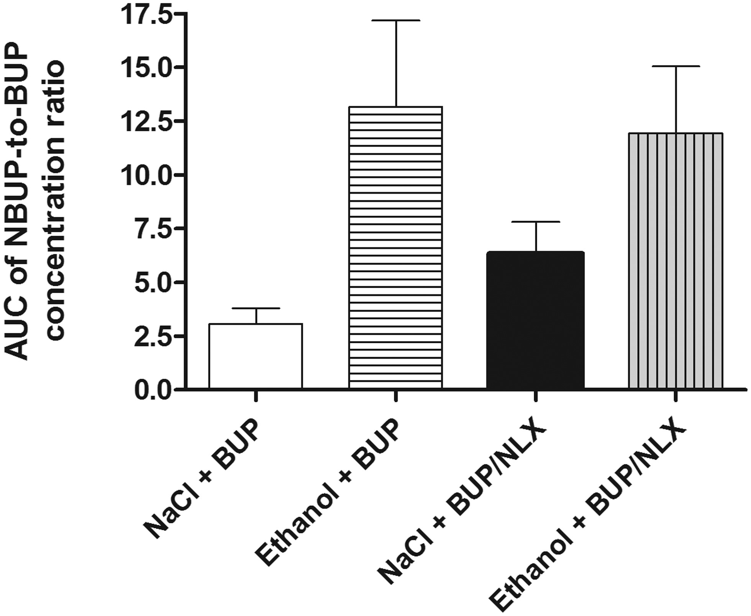
FIG. 4 Area under the curve of the norbuprenorphine (NBUP)-to-buprenorphine (BUP) concentration ratio in relation to ...
Notes:
FIG. 4 Area under the curve of the norbuprenorphine (NBUP)-to-buprenorphine (BUP) concentration ratio in relation to the treatments received by rats: intragastric (IG) 0.9% NaCl + intravenous (IV) 30 mg/kg BUP, IG 0.9% NaCl + IV 30 mg/kg BUP/7.5 mg/kg naloxone (NLX), IG 3 g/kg ethanol + IV 30 mg/kg BUP and IG 3 g/kg ethanol + IV 30 mg/kg BUP/7.5 mg/kg NLX. Each group consisted of 6–8 rats.
Unless provided in the caption above, the following copyright applies to the content of this slide: © The Author 2016. Published by Oxford University Press on behalf of the Society of Toxicology. All rights reserved. For Permissions, please e-mail: journals.permissions@oup.com

