Slide 1
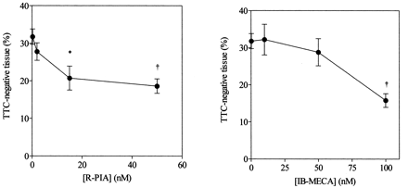
Fig. 1 Protective effect of R-PIA (left) and IB-MECA (right). Hearts were perfused with R-PIA and then subjected to ...
Notes:
Fig. 1 Protective effect of R-PIA (left) and IB-MECA (right). Hearts were perfused with R-PIA and then subjected to 30 min of global ischemia and 120 min of retrograde reperfusion. The amount of tissue that was not stained by TTC, which is an index of myocardial necrosis, is represented on the vertical axis as percentage of ventricular mass. Data points represent mean±S.E.M. of three to 11 hearts per group. *P<0.05, †P<0.01 vs. control, by ANOVA and Dunnett's test.
Unless provided in the caption above, the following copyright applies to the content of this slide: Copyright © 2001, European Society of Cardiology

Slide 2
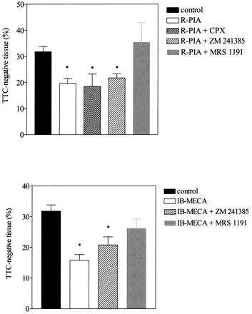
Fig. 2 Effect of adenosine receptor antagonists on the protective effect of R-PIA (upper panel) and IB-MECA (lower ...
Notes:
Fig. 2 Effect of adenosine receptor antagonists on the protective effect of R-PIA (upper panel) and IB-MECA (lower panel). Hearts were perfused with control buffer, 50 nmol/l R-PIA or 100 nmol/l IB-MECA, in the presence or in the absence of either A1 antagonist CPX (100 nmol/l), A2 antagonist ZM 241385 (20 nmol/l) or A3 antagonist MRS 1191 (1 μmol/l), before being subjected to 30 min of global ischemia and 120 min of retrograde reperfusion. The amount of tissue that was not stained by TTC is represented on the vertical axis as percentage of ventricular mass. Preliminary experiments showed that CPX, ZM 241385 or MRS 1191 alone had no effect on the extent of tissue injury. Bars represent mean±S.E.M. of three to 11 hearts per group. *P<0.05 vs. control, by ANOVA and Dunnett's test.
Unless provided in the caption above, the following copyright applies to the content of this slide: Copyright © 2001, European Society of Cardiology

Slide 3
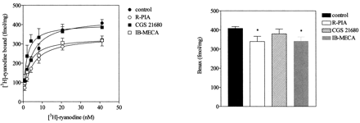
Fig. 3 Left: saturation binding curves for [³H]ryanodine (specific binding) obtained in homogenates ...
Notes:
Fig. 3 Left: saturation binding curves for [3H]ryanodine (specific binding) obtained in homogenates derived from hearts perfused under control conditions (●) or in the presence of 50 nmol/l R-PIA (○), 1 μmol/l CGS 21680 (▪), or 100 nmol/l IB-MECA (□). Bmax and Kd were calculated in each experiment by linear regression after Scatchard transformation. Bmax values are shown on the right. Bars represent mean±S.E.M. of three to 12 experiments in each group.*P<0.05 vs. control, by ANOVA and Dunnett's test. Kd values were not significantly different between groups (they averaged 2.5±0.4, 1.8±0.4, 2.3±1.2, and 2.6±0.5 nmol/l, respectively).
Unless provided in the caption above, the following copyright applies to the content of this slide: Copyright © 2001, European Society of Cardiology

Slide 4
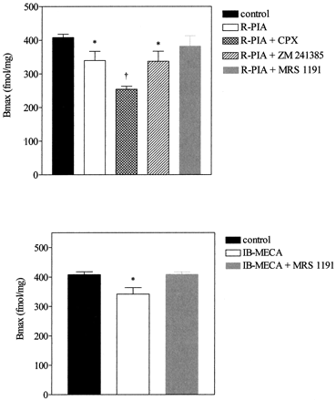
Fig. 4 Pharmacological characterization of the effect of R-PIA (upper panel) and IB-MECA (lower panel) on ...
Notes:
Fig. 4 Pharmacological characterization of the effect of R-PIA (upper panel) and IB-MECA (lower panel) on [3H]ryanodine binding. Hearts were perfused with control buffer, 50 nmol/l R-PIA or 100 nmol/l IB-MECA, in the presence or in the absence of either A1 antagonist CPX (100 nmol/l), A2 antagonist ZM 241385 (20 nmol/l) or A3 antagonist MRS 1191 (1 μmol/l). [3H]ryanodine binding was assayed in crude homogenate and Bmax values are represented on the vertical axis. No significant difference in Kd was observed. Preliminary experiments showed that perfusion with CPX, ZM 241385 or MRS 1191 alone had no effect on [3H]ryanodine binding. Bars represent mean±S.E.M. of three to 12 hearts per group. *P<0.05, †P<0.01 vs. control, by ANOVA and Dunnett's test.
Unless provided in the caption above, the following copyright applies to the content of this slide: Copyright © 2001, European Society of Cardiology

Slide 5
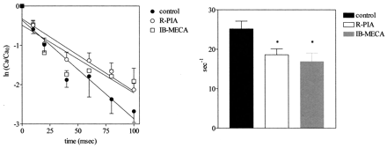
Fig. 5 Ca²⁺-induced Ca²⁺ release determined in crude homogenates derived from hearts perfused ...
Notes:
Fig. 5 Ca2+-induced Ca2+ release determined in crude homogenates derived from hearts perfused under control conditions (●), in the presence of 50 nmol/l R-PIA (○) or in the presence of 100 nmol/l IB-MECA (□). The vertical axis shows the logarithm of the ratio of 45Ca2+ to 45Ca2+ at time zero, after subtraction of the amount of 45Ca2+ not involved in quick Ca2+ release. Since release follows exponential kinetics, slope of regression lines represents rate constant of Ca2+-induced Ca2+ release. Rate constant values were calculated in each experiment and then averaged. Means±S.E.M. values are plotted on the right. The total amount of Ca2+ released over the first 200 ms, which corresponds to the Ca2+ pool subjected to Ca2+-induced Ca2+ release, averaged 3.8 nmol per mg of protein, without any significant difference between groups (for further details, see Methods and Ref. [21]). Data points represent mean±S.E.M. of four to five experiments in each group.*P<0.05 vs. control, by ANOVA and Dunnett's test.
Unless provided in the caption above, the following copyright applies to the content of this slide: Copyright © 2001, European Society of Cardiology

Slide 6
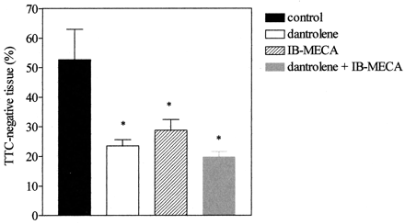
Fig. 6 Protective effect of IB-MECA and dantrolene. Hearts were perfused with IB-MECA (100 nmol/l), dantrolene (4 ...
Notes:
Fig. 6 Protective effect of IB-MECA and dantrolene. Hearts were perfused with IB-MECA (100 nmol/l), dantrolene (4 μmol/l) or both dantrolene and IB-MECA, and then subjected to 45 min of global ischemia and 120 min of retrograde reperfusion. The amount of tissue that was not stained by TTC is represented on the vertical axis as percentage of ventricular mass. Hemodynamic effects of dantrolene and IB-MECA were similar, i.e. no significant change was produced except for a slight increase in coronary flow. Data points represent mean±S.E.M. of four hearts per group. *P<0.05, vs. control, by ANOVA and Student–Neumann–Keul's test. All other pairwise comparisons did not yield statistical significance.
Unless provided in the caption above, the following copyright applies to the content of this slide: Copyright © 2001, European Society of Cardiology

