Slide 1
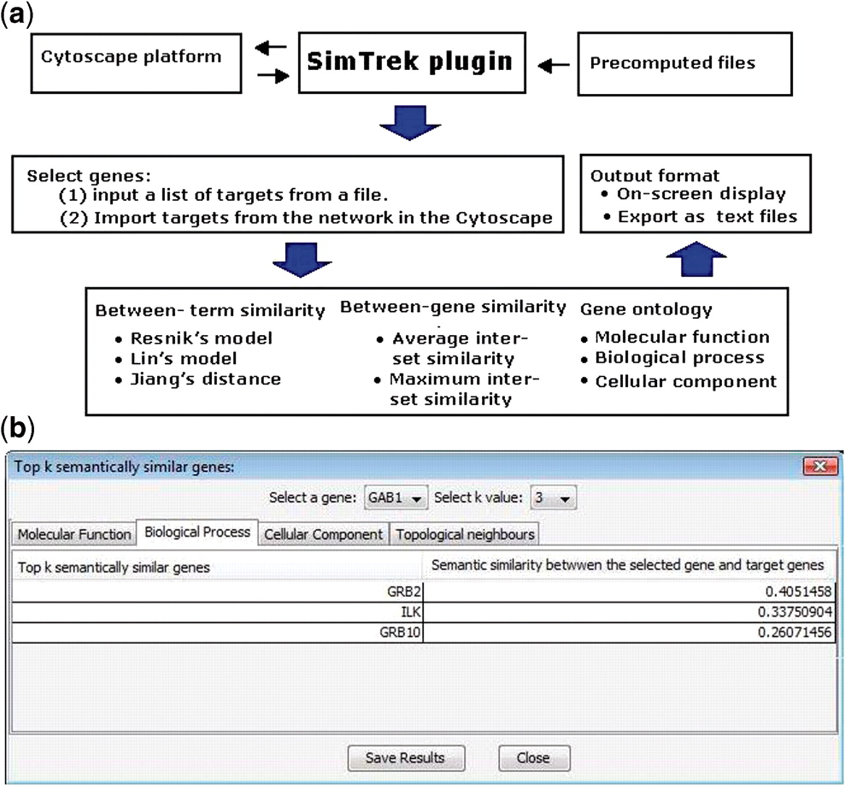
Fig. 1. Overview of SimTrek. (a) Software architecture. (b) Output panel screenshot.
Notes:
Fig. 1. Overview of SimTrek. (a) Software architecture. (b) Output panel screenshot.
Unless provided in the caption above, the following copyright applies to the content of this slide: © The Author 2010. Published by Oxford University Press. All rights reserved. For Permissions, please email: journals.permissions@oxfordjournals.org

