Slide 1
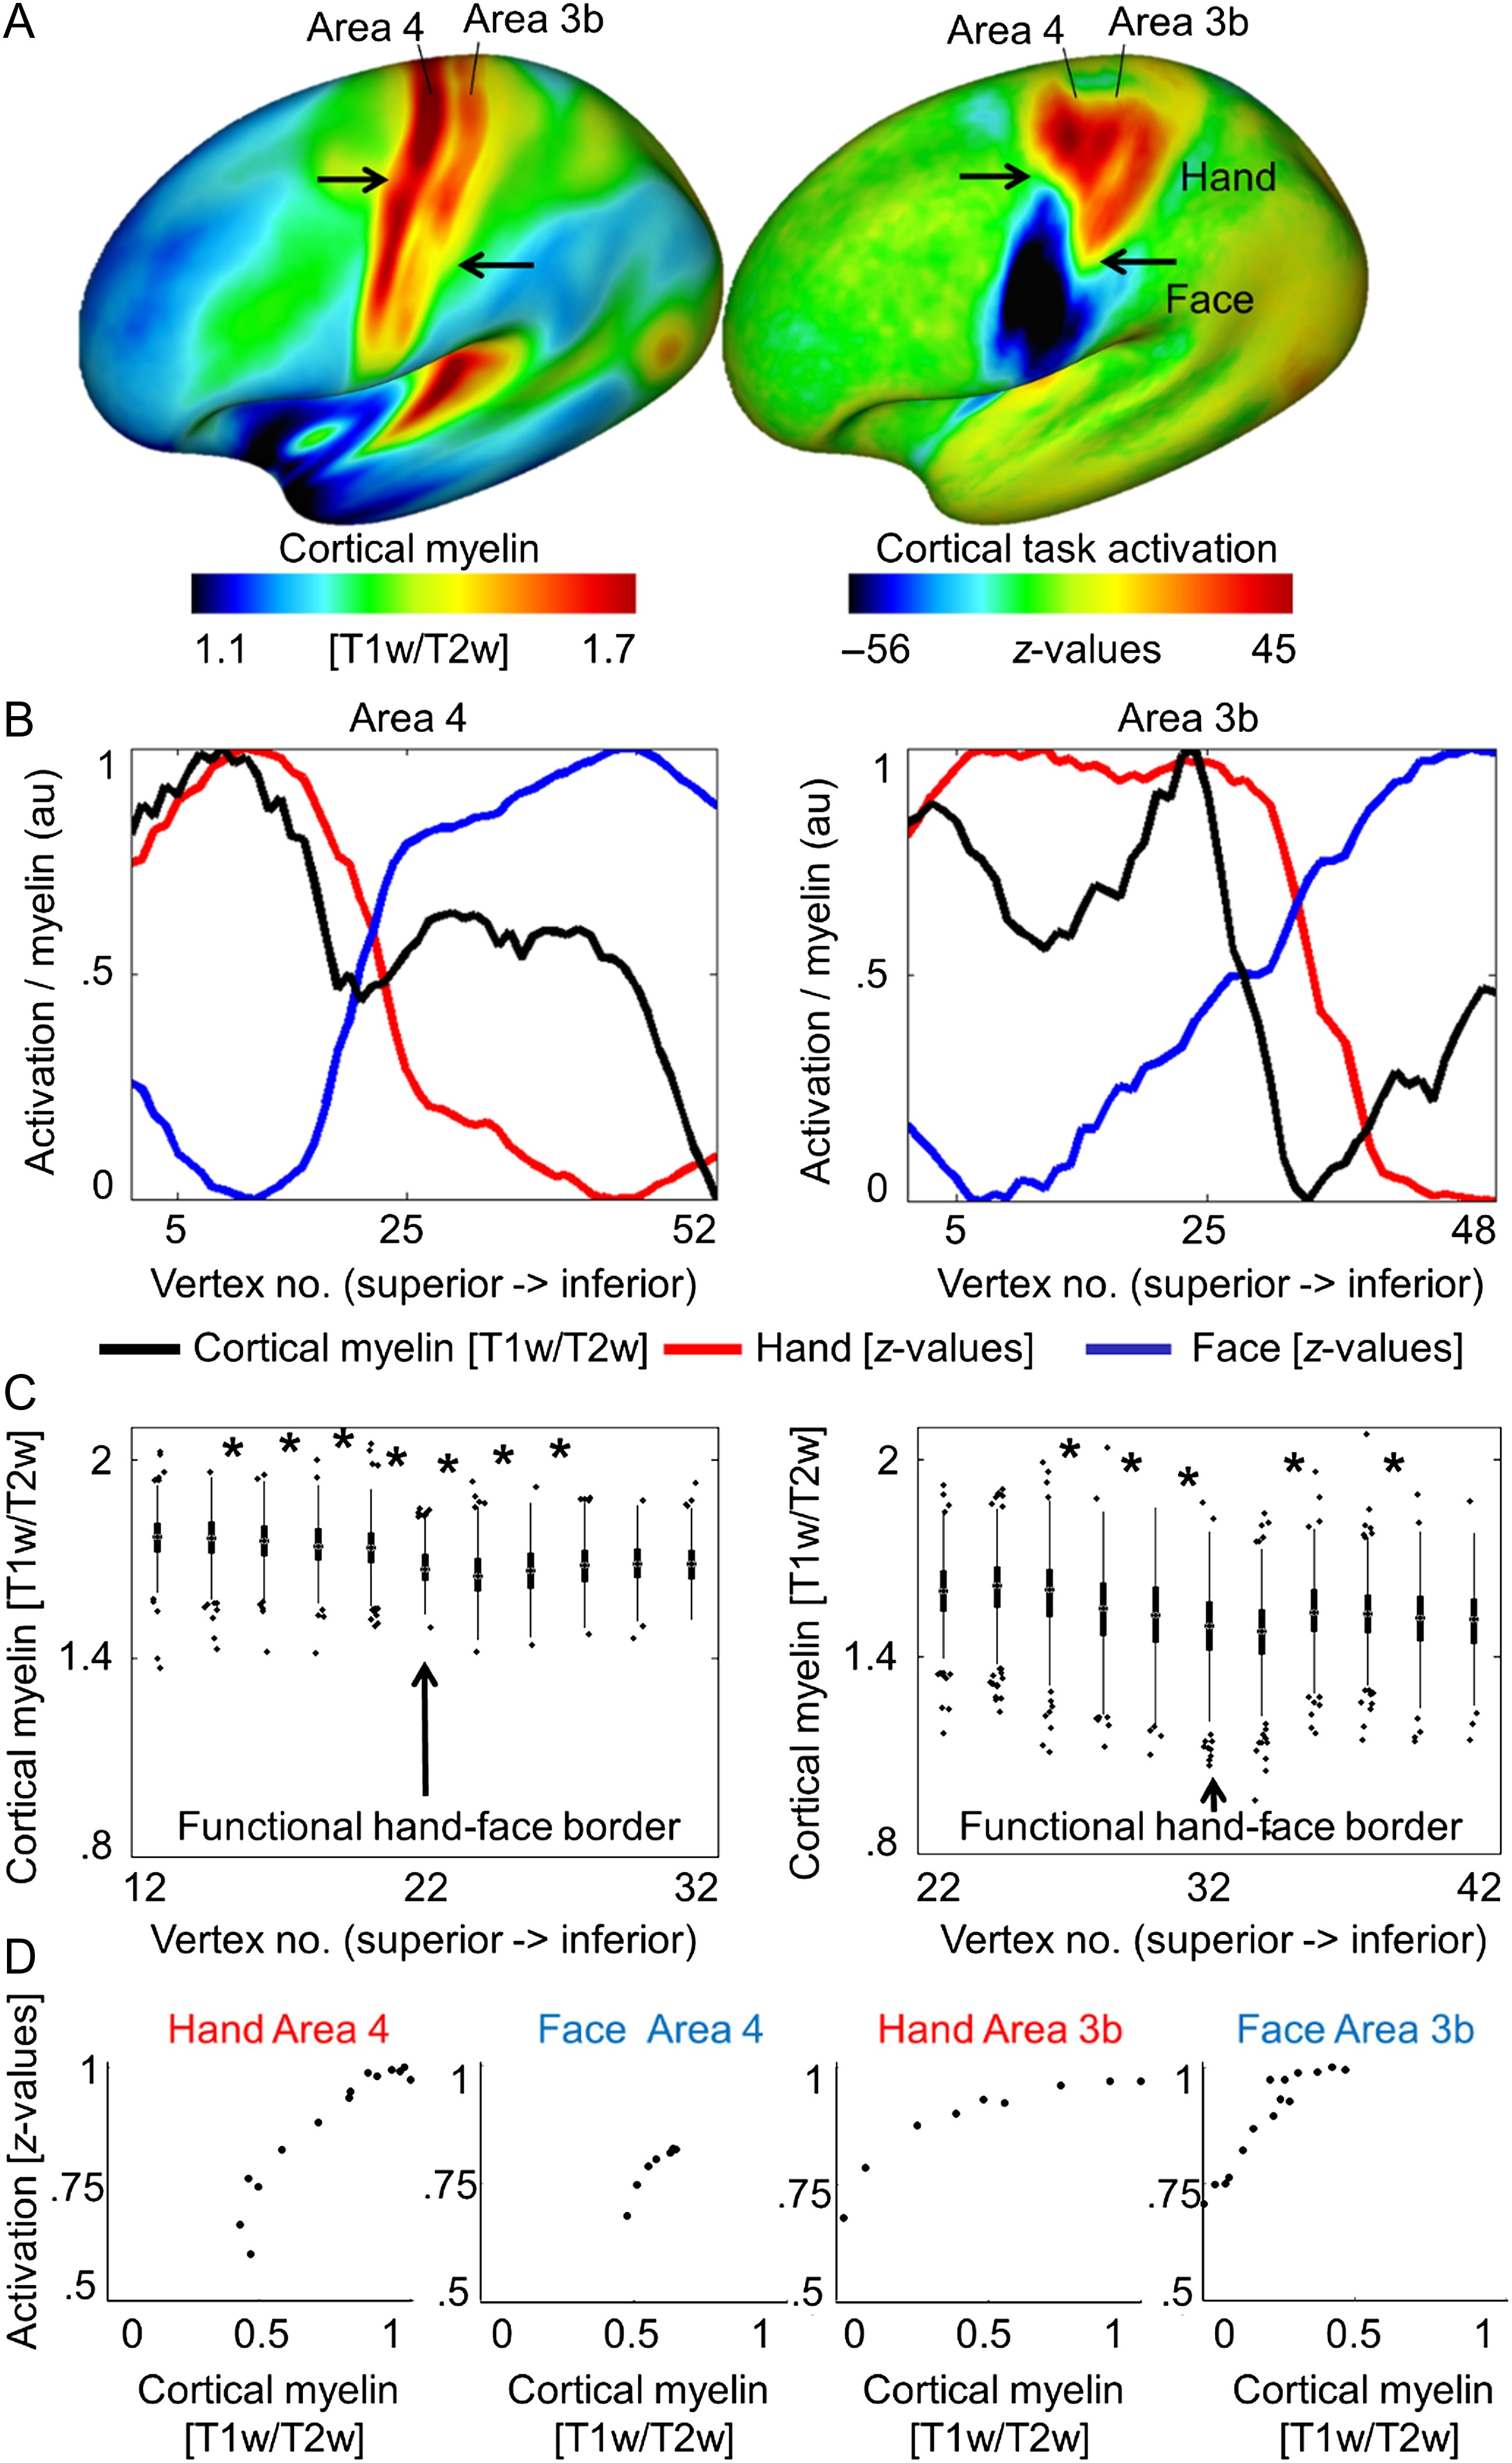
Figure 1. Relationship between cortical myelination and cortical task activation in large-cohort data set (HCP). (A) ...
Notes:
Figure 1. Relationship between cortical myelination and cortical task activation in large-cohort data set (HCP). (A) Cortical myelin content (T1w/T2w) and BOLD signal change (z-values, contrast: hand – [face + foot], face – [hand + foot]) averaged over a large group sample. Arrows indicate the S-shaped border separating hand and face representation areas (see Supplementary Fig. 2 for right hemispheric data). (B) Cortical myelin content (T1w/T2w) and BOLD signal change (z-values) sampled vertically from the superior border of the hand representation to the inferior border of the face representation, parallel to the central sulcus (see Supplementary Fig. 2 for sample paths). Values are normalized to 0–1 using arbitrary units (au). Supplementary Figure 2 shows corresponding right hemispheric plots. (C) Means of individual participants’ myelin content (T1w/T2w). Vertex numbers correspond to those in B, values are sampled from the hand–face intersection point ±10 vertices (values sampled from every second vertex, see Supplementary Fig. 2). Edges show 25th and 75th percentiles, whiskers extend to the most extreme data points not considered outliers, outliers are plotted individually. Significant pairwise comparisons (Bonferroni-corrected P < 0.0025) are marked with a star. (D) Correlations between cortical myelin content (T1w/T2w) and BOLD signal change (z-values) elicited by hand and face movements within the hand and face representations of area 3b and area 4. Values are sampled along cortical paths (see Supplementary Fig. 2), and normalized to values between 0 and 1 using arbitrary units (au). All 4 correlations reached significance (P < 0.005).
Unless provided in the caption above, the following copyright applies to the content of this slide: © The Author 2017. Published by Oxford University Press.This is an Open Access article distributed under the terms of the Creative Commons Attribution Non-Commercial License (http://creativecommons.org/licenses/by-nc/4.0/), which permits non-commercial re-use, distribution, and reproduction in any medium, provided the original work is properly cited. For commercial re-use, please contact journals.permissions@oup.com

Slide 2
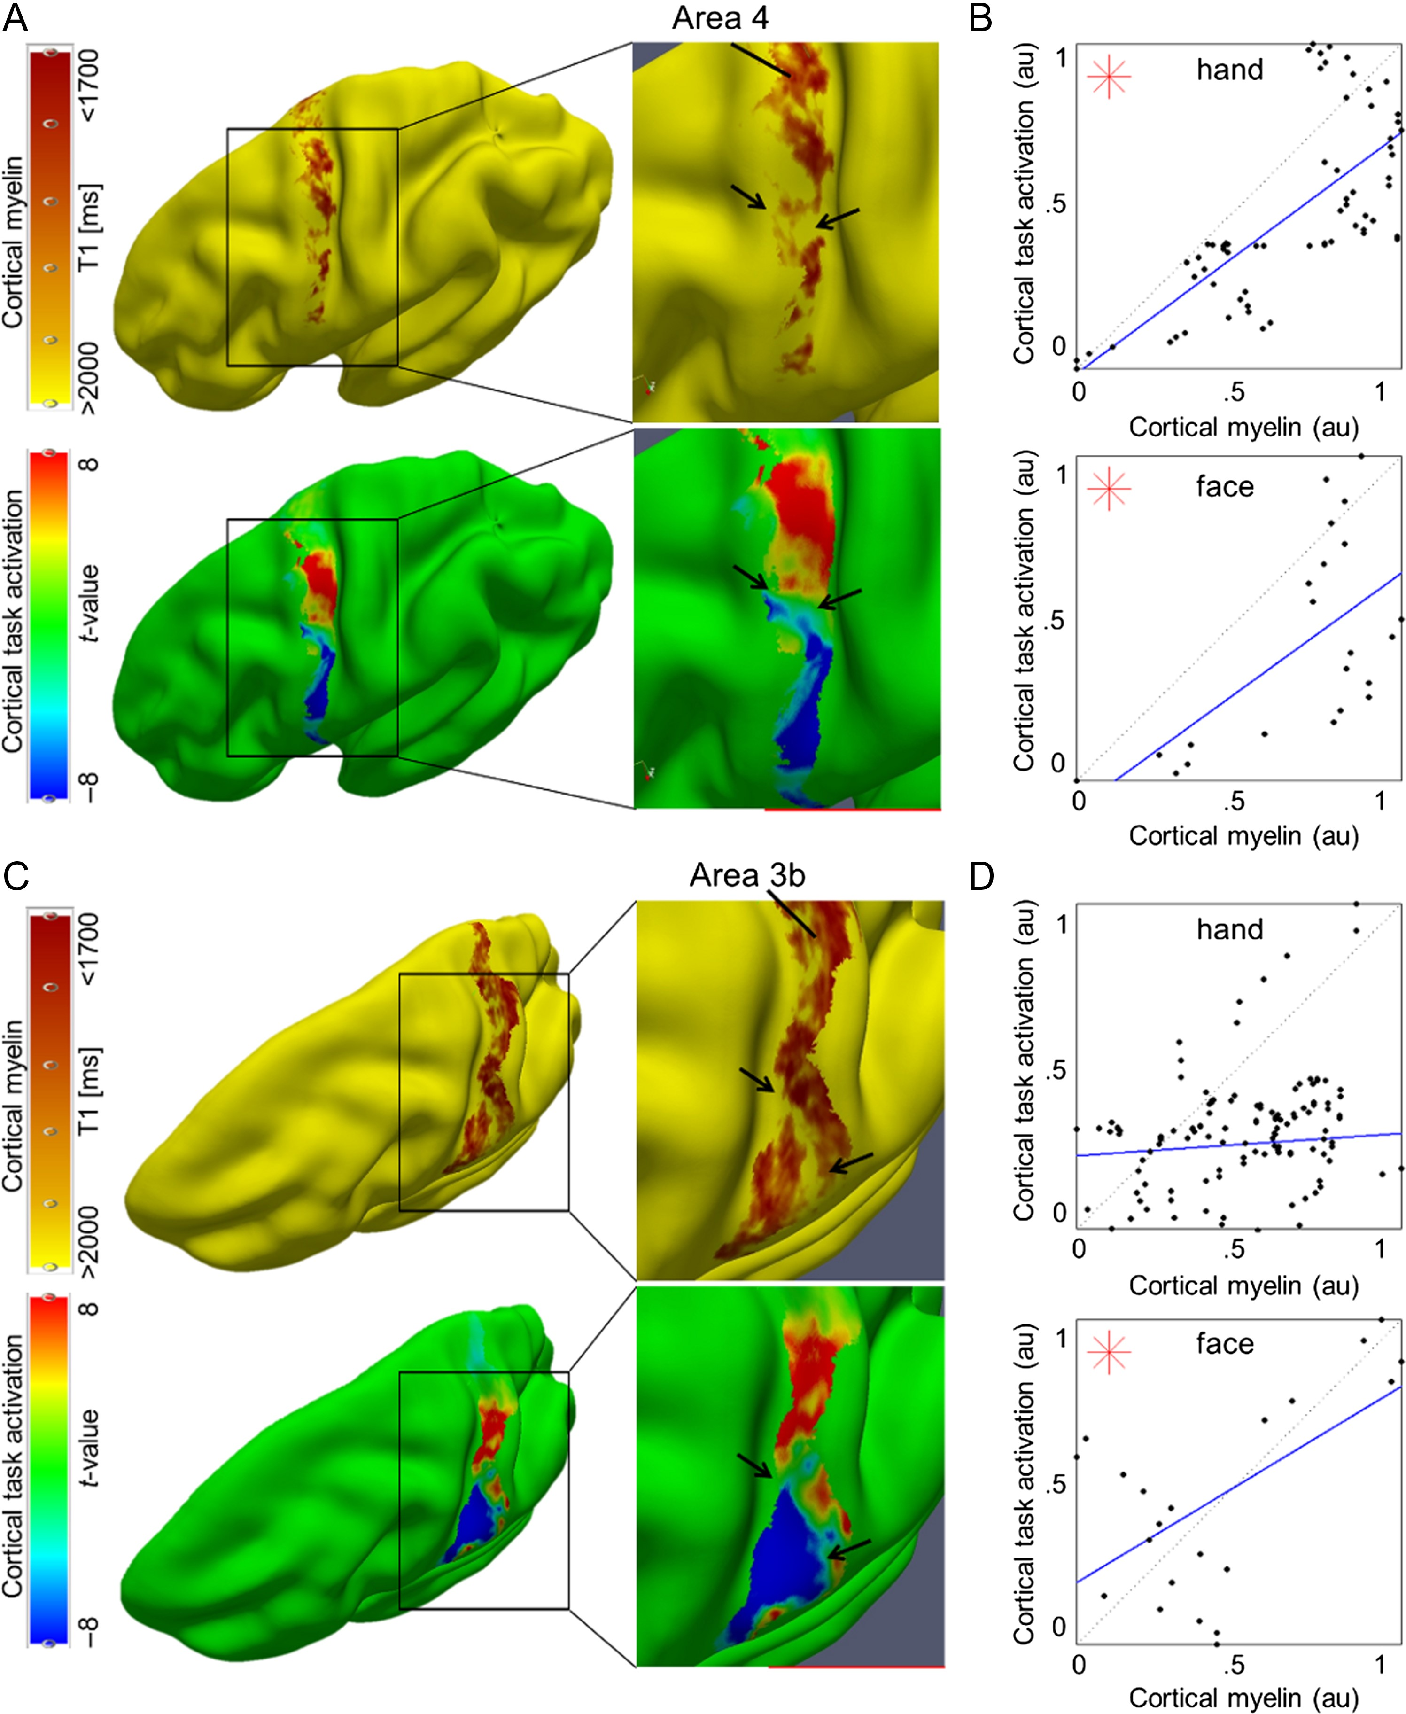
Figure 2. Relationship between cortical myelination and cortical task activation: (A, C) Cortical myelin content ...
Notes:
Figure 2. Relationship between cortical myelination and cortical task activation: (A, C) Cortical myelin content (T1 [ms], sampled at 25% cortical depth in A and at 50% cortical depth in (C) due to cortical depth-dependent myelin reductions, see Fig. 4) and BOLD signal change (t-values) within somatosensory cortex (area 3b) and primary motor cortex (area 4) elicited by hand and face (in particular tongue and lip) movements, respectively, of one individual participant (see Fig. 3 and Supplementary Fig. 4 for remaining participants). The contrast hand – (face + foot) is displayed in red color, the contrast face – (hand + foot) is displayed in blue color. Structural and functional data are masked with FreeSurfer surface labels of area 4 and area 3b, respectively. Two millimeter tangential smoothing (i.e., within cortical layers) was applied to T1 values for visualization purposes only. (B, D) Correlations between cortical myelin content (T1 values, normalized to [0 1], and inverted to correspond to high myelin) and BOLD signal change (t-values, normalized) sampled vertically from hand to face representations within area 4 and area 3b, respectively (see Supplementary Fig. 6C for sampling paths). Significant correlations (P < 0.0125) are marked with a star.
Unless provided in the caption above, the following copyright applies to the content of this slide: © The Author 2017. Published by Oxford University Press.This is an Open Access article distributed under the terms of the Creative Commons Attribution Non-Commercial License (http://creativecommons.org/licenses/by-nc/4.0/), which permits non-commercial re-use, distribution, and reproduction in any medium, provided the original work is properly cited. For commercial re-use, please contact journals.permissions@oup.com

Slide 3
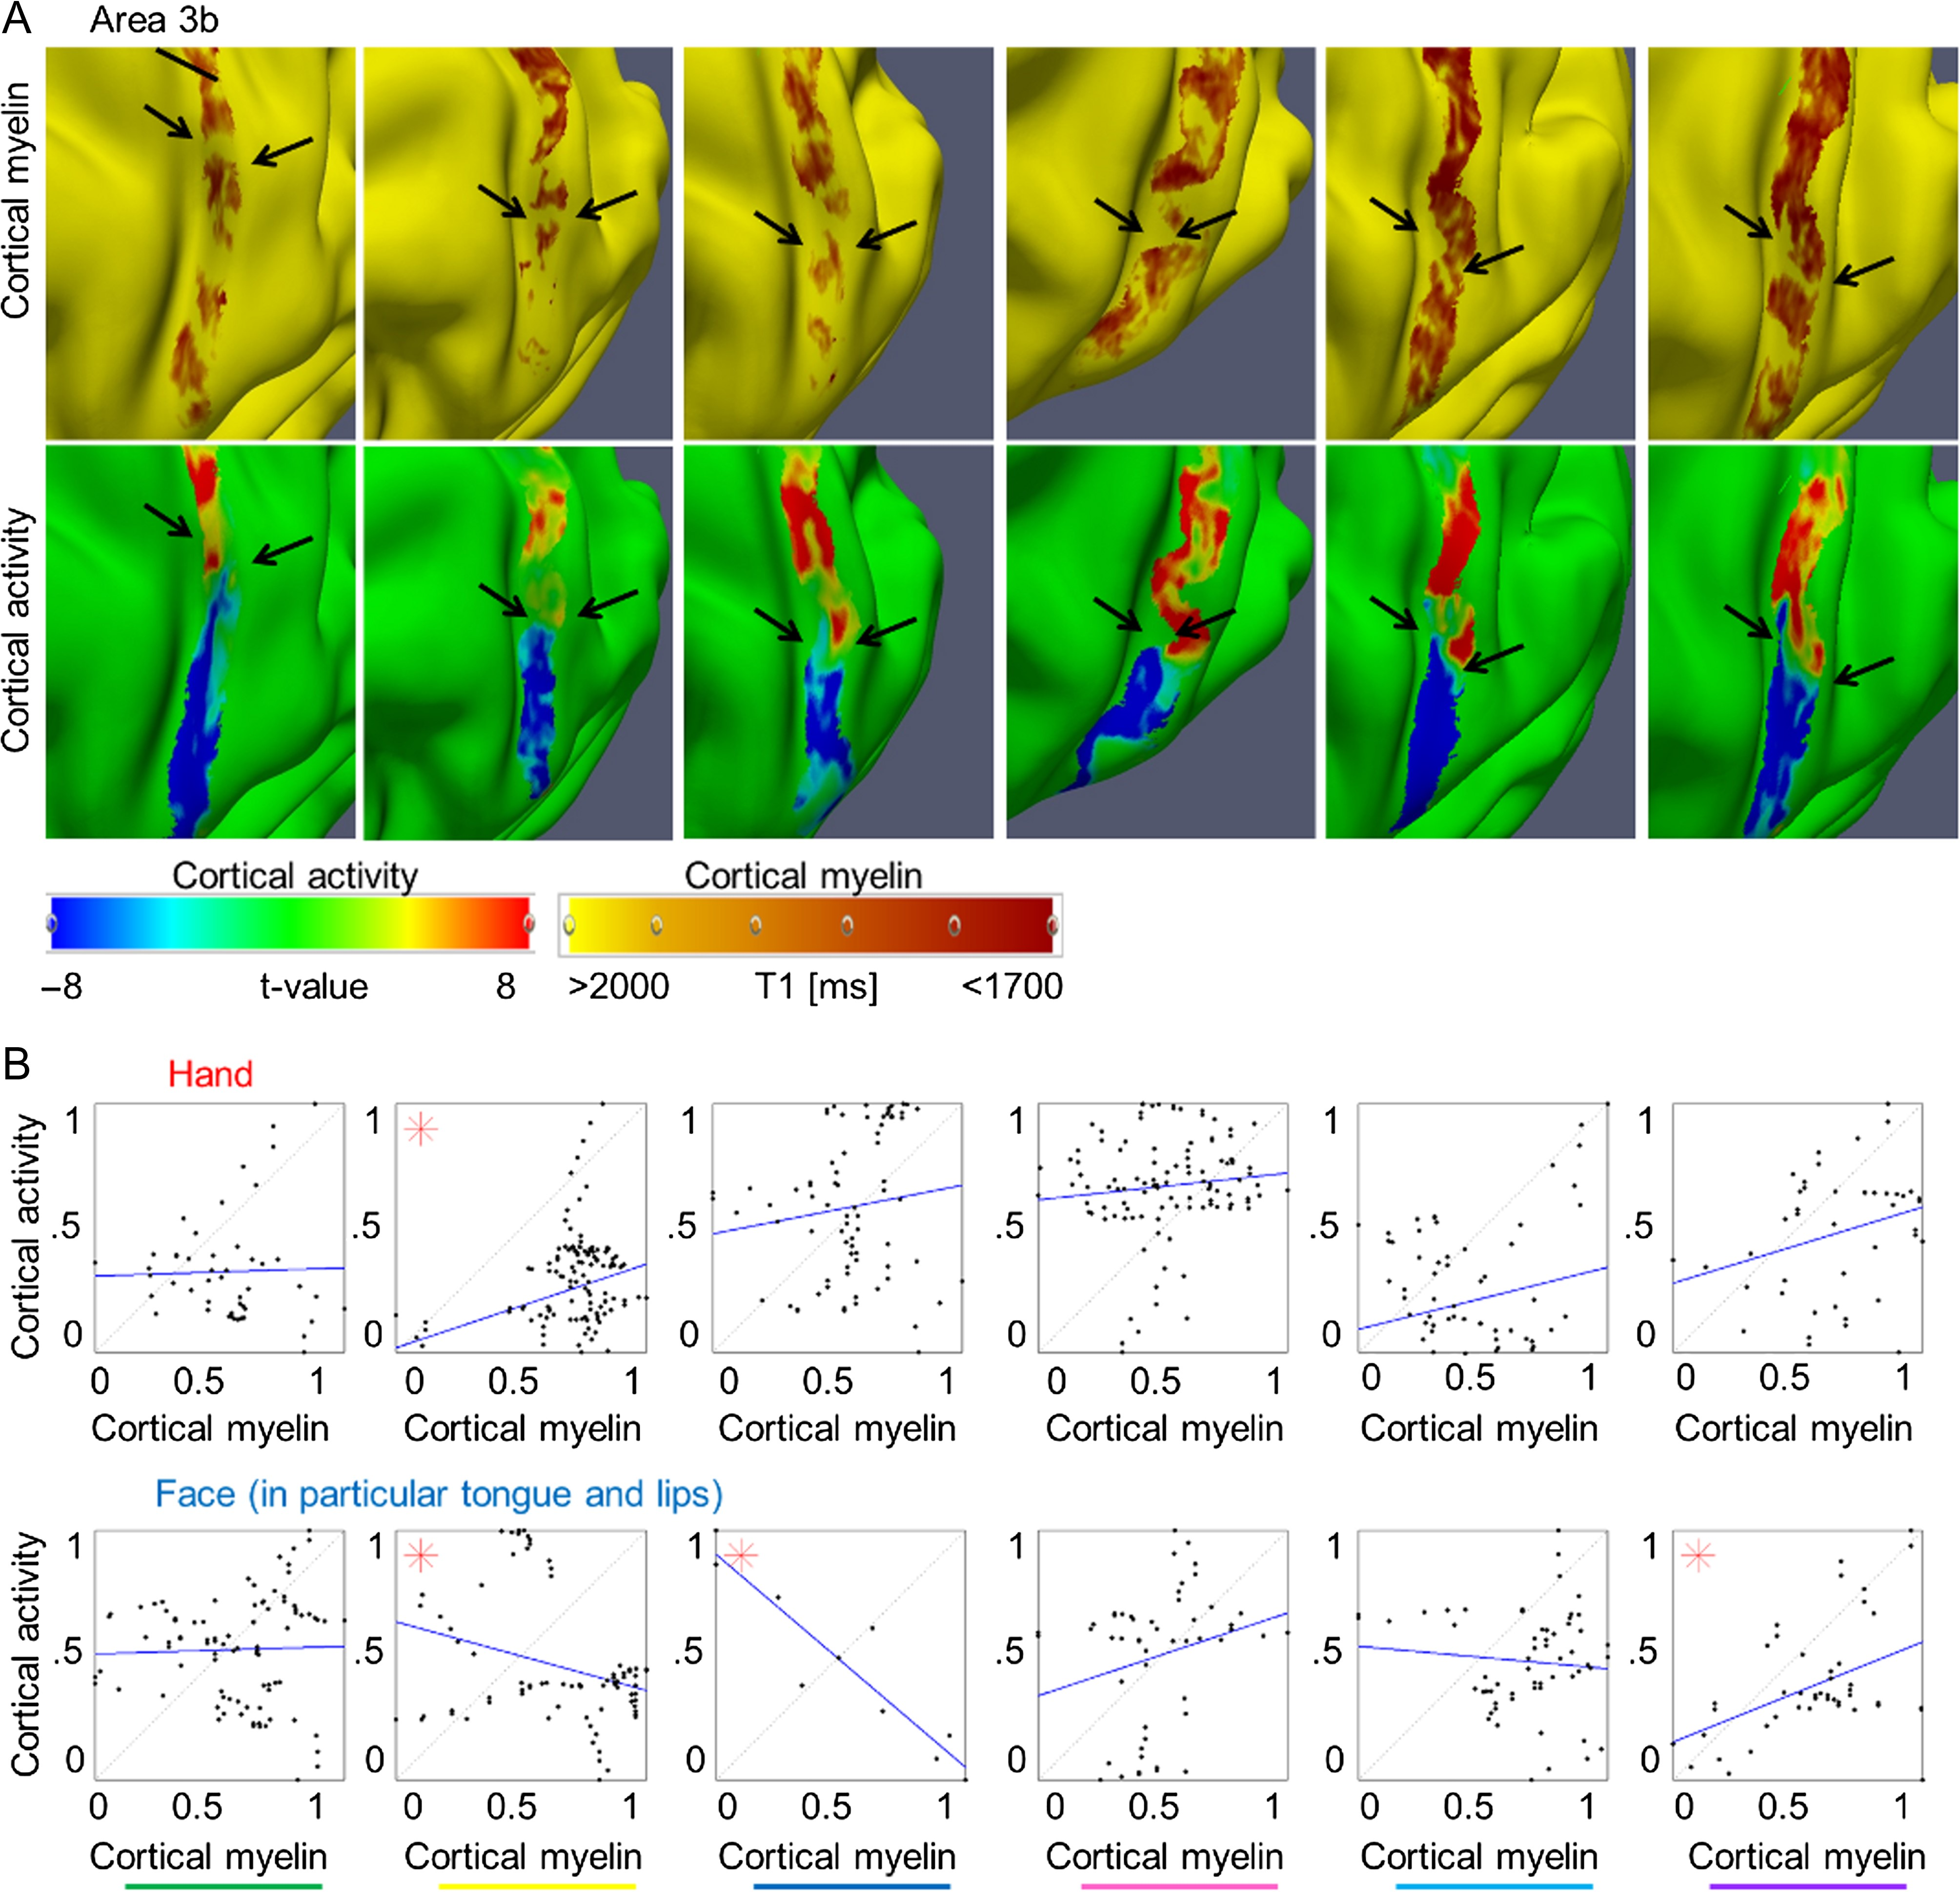
Figure 3. Relationship between cortical myelination and cortical task activation in primary somatosensory cortex: (A) ...
Notes:
Figure 3. Relationship between cortical myelination and cortical task activation in primary somatosensory cortex: (A) Cortical myelin content (T1 [ms]) and BOLD signal change (t-values) within primary somatosensory cortex elicited by hand and face (in particular tongue and lip) movements, respectively, of 6 individual participants (see Fig. 2 for remaining participant and see Supplementary Fig. 4 for area 4). The contrast hand – (face + foot) is displayed in red color, the contrast face – (hand + foot) is displayed in blue color. Structural and functional data are masked with the probabilistic FreeSurfer label of area 3b. Arrows indicate the hand–face border, and are placed at corresponding locations within functional and structural images. Cortical myelin content was sampled at 50% cortical depth, because the correspondence between the cortical myelination and the functional hand–face border was most evident in middle cortical layers of area 3b (see Fig. 4). Two millimeter tangential smoothing (i.e., smoothing within cortical layers) was applied to T1 values for visualization purposes only. (B) Correlations between cortical myelin content (T1 values, normalized to [0 1] and inverted to correspond to high myelin) and BOLD signal change (t-values, normalized) sampled vertically from hand to face representations (see Supplementary Fig. 6 for sampling paths) within area 3b. Significant correlations (P < 0.0125) are marked with a star. One column represents data of one participant; see Supplementary Figure 3E for color coding.
Unless provided in the caption above, the following copyright applies to the content of this slide: © The Author 2017. Published by Oxford University Press.This is an Open Access article distributed under the terms of the Creative Commons Attribution Non-Commercial License (http://creativecommons.org/licenses/by-nc/4.0/), which permits non-commercial re-use, distribution, and reproduction in any medium, provided the original work is properly cited. For commercial re-use, please contact journals.permissions@oup.com

Slide 4
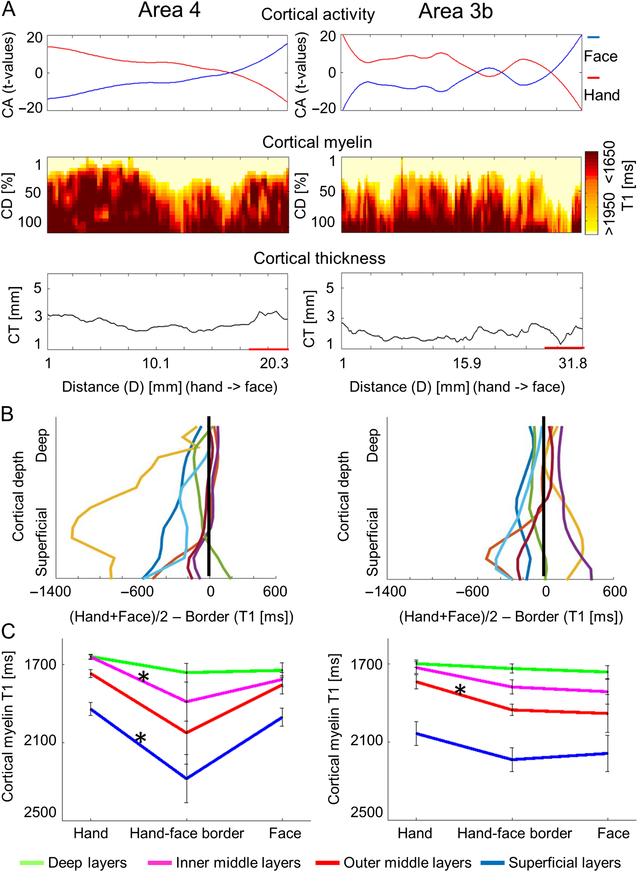
Figure 4. Cortical depth-dependent reduction of cortical myelination between hand and face representation areas using ...
Notes:
Figure 4. Cortical depth-dependent reduction of cortical myelination between hand and face representation areas using quantitative imaging. (A) Cortical activation (CA, t-values, upper panel), cortical depth-dependent myelination (CD, T1 [ms], middle panel), and CT ([mm], lower panel) sampled along cortical paths running from functionally defined hand representations to functionally defined face representations (D is the distance on cortical surface, see Supplementary Fig. 6 for sampling paths). Data are shown for primary somatosensory cortex (area 3b) and primary motor cortex (area 4). (B) Cortical depth-dependent myelin reductions between body part representations and hand–face border corrected for the global decrease of cortical myelination in inferior areas. Each line represents one participant. (C) Group-averaged (N = 7) cortical myelination (T1 [ms]) sampled from functionally defined hand representations, functionally defined hand–face borders, and functionally defined face representations (mean ± SEM). Different colors indicate different cortical depths. Each color represents averaged data of 4 modeled cortical layers. Significant comparisons (P < 0.05) are marked with a star. Note that higher T1 values reflect lower cortical myelin.
Unless provided in the caption above, the following copyright applies to the content of this slide: © The Author 2017. Published by Oxford University Press.This is an Open Access article distributed under the terms of the Creative Commons Attribution Non-Commercial License (http://creativecommons.org/licenses/by-nc/4.0/), which permits non-commercial re-use, distribution, and reproduction in any medium, provided the original work is properly cited. For commercial re-use, please contact journals.permissions@oup.com

Slide 5
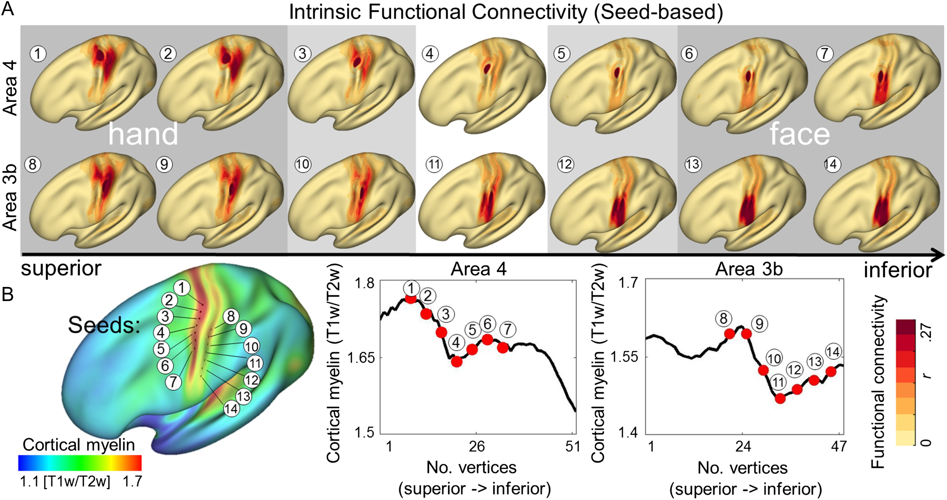
Figure 5. Relationship between cortical myelination and whole-brain intrinsic functional connectivity networks. (A) ...
Notes:
Figure 5. Relationship between cortical myelination and whole-brain intrinsic functional connectivity networks. (A) Intrinsic functional connectivity (seed-based) of averaged group images (HCP). Seeds were placed within primary somatosensory cortex (area 3b) and primary motor cortex (area 4). Numbers correspond to vertex locations as displayed in (B). (B) Cortical myelination (T1w/T2w) displayed on an averaged group image. Seeds were placed at every fourth vertex starting from the vertex with the global myelin minimum. Seed locations are marked as black dots on inflated surface.
Unless provided in the caption above, the following copyright applies to the content of this slide: © The Author 2017. Published by Oxford University Press.This is an Open Access article distributed under the terms of the Creative Commons Attribution Non-Commercial License (http://creativecommons.org/licenses/by-nc/4.0/), which permits non-commercial re-use, distribution, and reproduction in any medium, provided the original work is properly cited. For commercial re-use, please contact journals.permissions@oup.com

