Slide 1
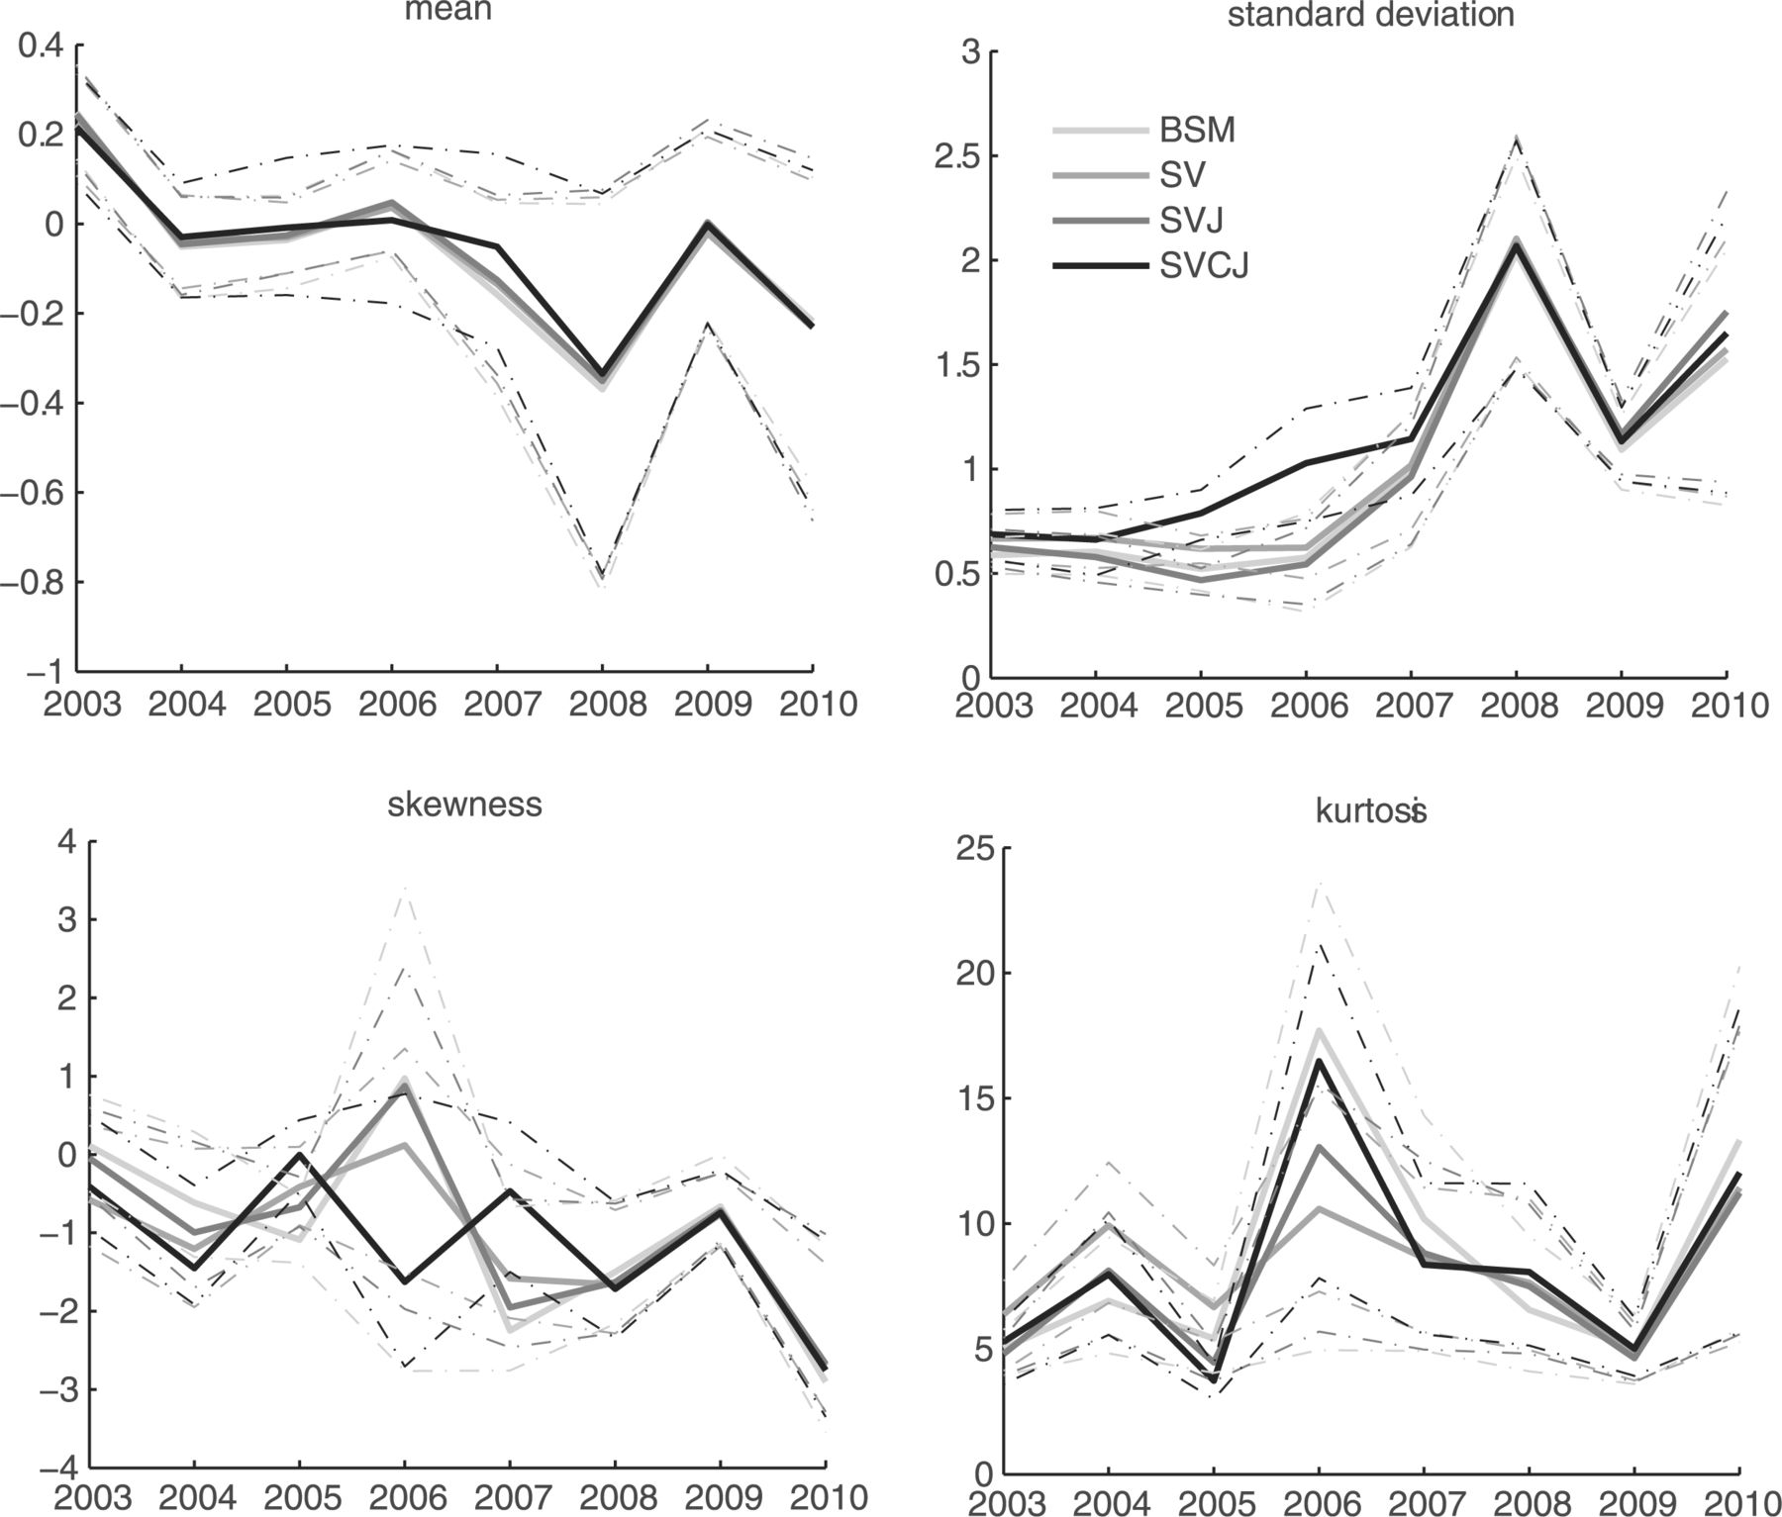
Figure 2. Moments of the hedging errors (futures hedge). This figure reports the estimated moments of the hedge error ...
Notes:
Figure 2. Moments of the hedging errors (futures hedge). This figure reports the estimated moments of the hedge error distribution over the sample period from 2003 until 2010 (solid lines). The hedge uses a futures contract (of the same maturity as the option) only and is rebalanced after 1 day. Confidence intervals (90%, displayed as dashed/dotted lines) are bootstrapped such that hedging errors for a single day are drawn as a block. The model abbreviation BSM stands for the practitioner Black–Scholes–Merton model hedge. The other models are abbreviated as in Section 2. The key for the mean, skewness, and kurtosis graph is identical to that for the standard deviation.
Unless provided in the caption above, the following copyright applies to the content of this slide: © The Author 2012. Published by Oxford University Press on behalf of the European Finance Association. All rights reserved. For Permissions, please email: journals.permissions@oup.com

Slide 2
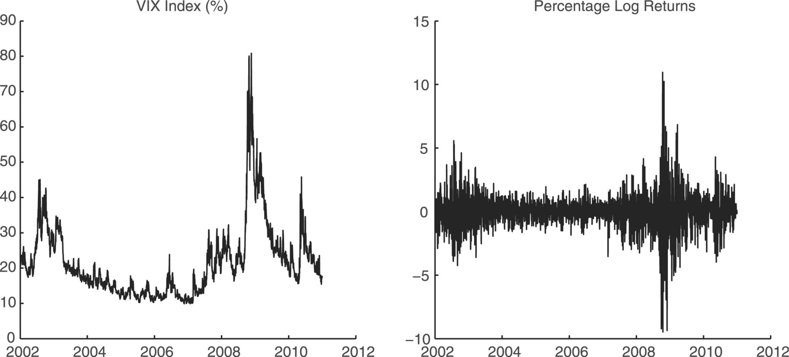
Figure 1. Data. This figure plots the VIX index and the percentage log returns of the S&P 500 over the sample period ...
Notes:
Figure 1. Data. This figure plots the VIX index and the percentage log returns of the S&P 500 over the sample period from 2002 until 2010.
Unless provided in the caption above, the following copyright applies to the content of this slide: © The Author 2012. Published by Oxford University Press on behalf of the European Finance Association. All rights reserved. For Permissions, please email: journals.permissions@oup.com

Slide 3
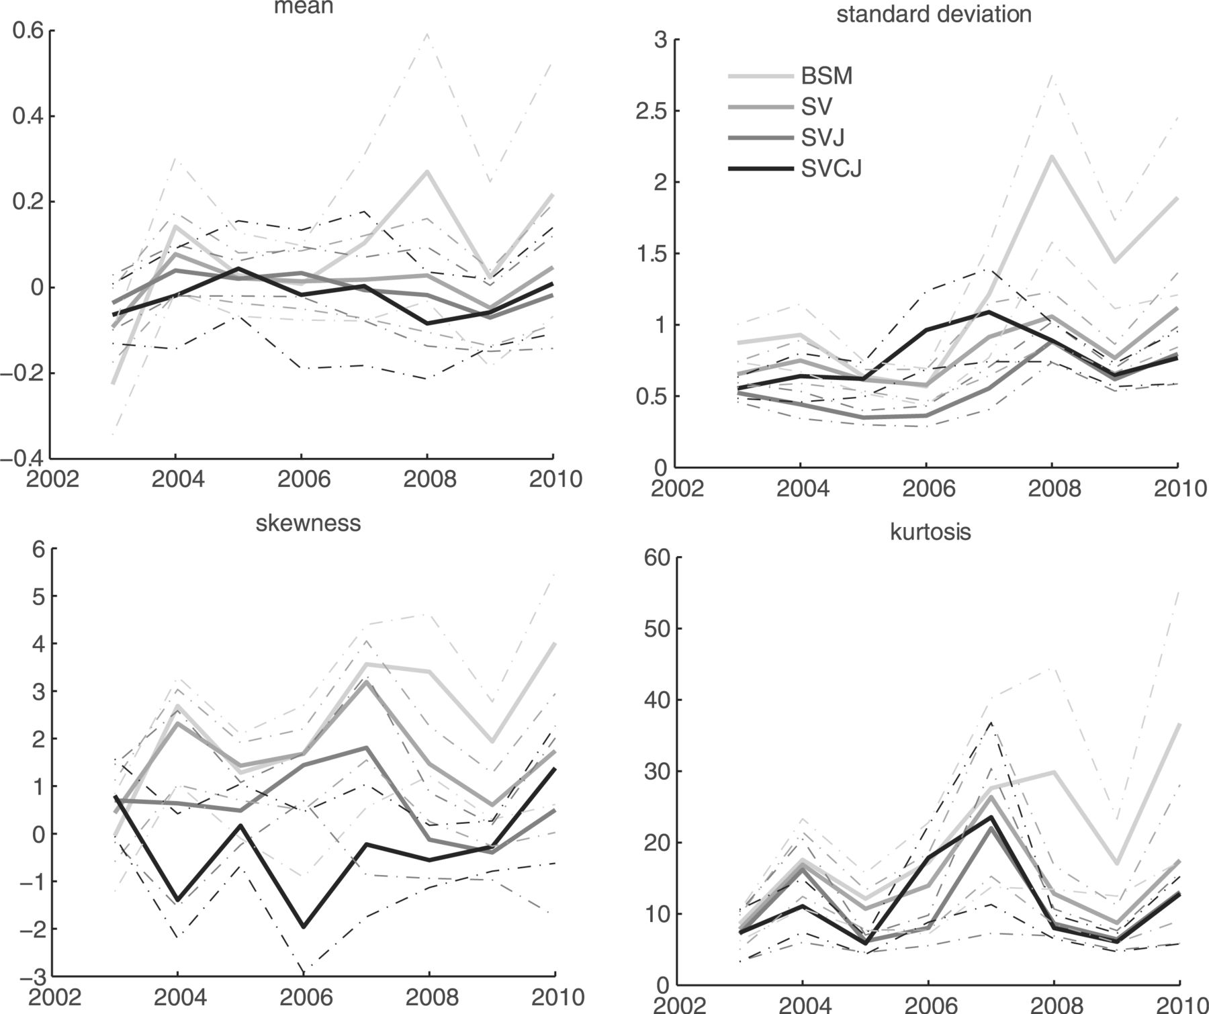
Figure 3. Moments of the hedging errors (two-instrument hedge). This figure reports the estimated moments of the hedge ...
Notes:
Figure 3. Moments of the hedging errors (two-instrument hedge). This figure reports the estimated moments of the hedge error distribution over the sample period from 2003 until 2010 (solid lines). The hedge uses a futures contract and a second option and is rebalanced after 1 day. The futures contract is of the same maturity as the option to be hedged and the second hedging instrument is an at-the-money option with a maturity close to 30 days. Confidence intervals (90%, displayed as dashed/dotted lines) are bootstrapped such that hedging errors for a single day are drawn as a block. The model abbreviation BSM stands for the practitioner Black–Scholes–Merton model hedge. The other models are abbreviated as in Section 2. The key for the mean, skewness, and kurtosis graph is identical to that for the standard deviation.
Unless provided in the caption above, the following copyright applies to the content of this slide: © The Author 2012. Published by Oxford University Press on behalf of the European Finance Association. All rights reserved. For Permissions, please email: journals.permissions@oup.com

Slide 4
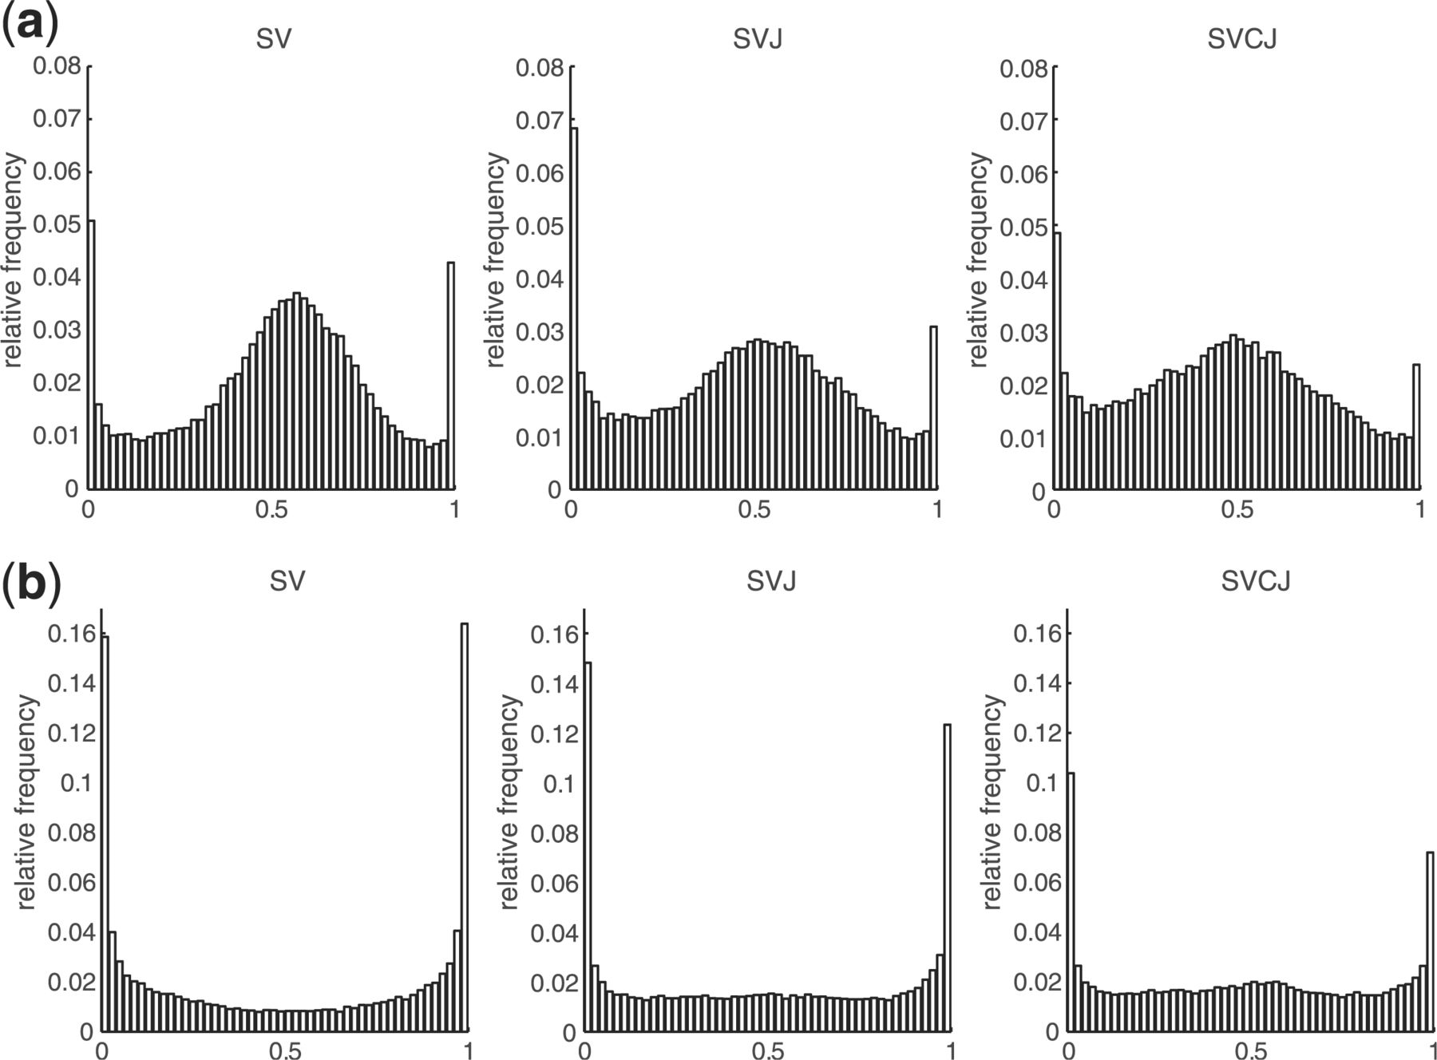
Figure 4. Specification tests. This figure reports the distribution of for different hedging models over the sample ...
Notes:
Figure 4. Specification tests. This figure reports the distribution of for different hedging models over the sample period from 2003 until 2010. (a) The hedge uses a futures contract only, whereas in (b) hedge portfolios consists of both a futures and a short-term ATM option. The rebalancing frequency of the hedge is 1 day. The models are abbreviated as in Section 2.
Unless provided in the caption above, the following copyright applies to the content of this slide: © The Author 2012. Published by Oxford University Press on behalf of the European Finance Association. All rights reserved. For Permissions, please email: journals.permissions@oup.com

