Slide 1
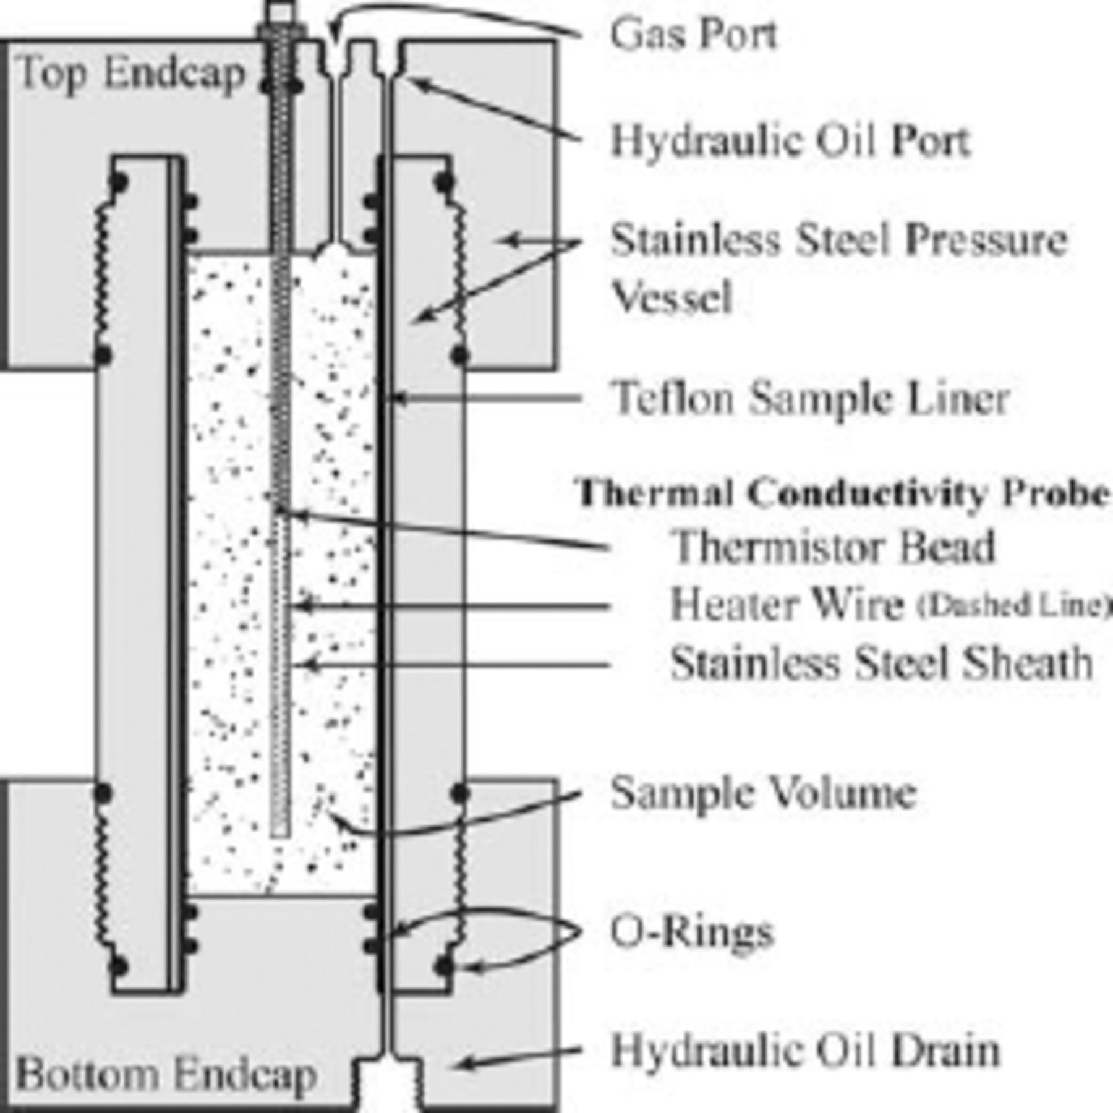
Figure 1. Pressure vessel and needle probe schematic, with needle probe enlarged to show detail. Probe diameter is 1.6 ...
Notes:
Figure 1. Pressure vessel and needle probe schematic, with needle probe enlarged to show detail. Probe diameter is 1.6 mm, sample diameter is 41 mm, sample length is 133 mm, and the thermistor is located 50 mm below the top of the sample. Needle probe seals against an o-ring in the top end cap and is held in place with an external brace (not pictured).
Unless provided in the caption above, the following copyright applies to the content of this slide: The Authors 507 Journal compilation © 2007 RAS

Slide 2
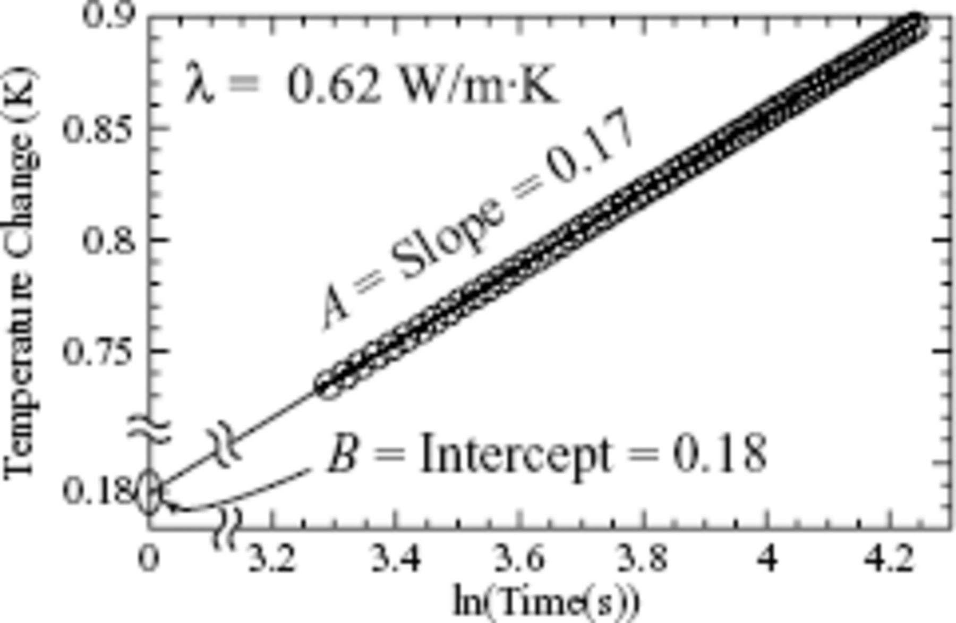
Figure 2. Measured temperature change for CH₄ hydrate at 9.6°C, showing every 20th data point of the nearly ...
Notes:
Figure 2. Measured temperature change for CH4 hydrate at 9.6°C, showing every 20th data point of the nearly 900 points used in the linear fit. From this log time plot, thermal conductivity is calculated from the linear slope, A. The extrapolated linear intercept, B, is used in determining thermal diffusivity.
Unless provided in the caption above, the following copyright applies to the content of this slide: The Authors 507 Journal compilation © 2007 RAS

Slide 3
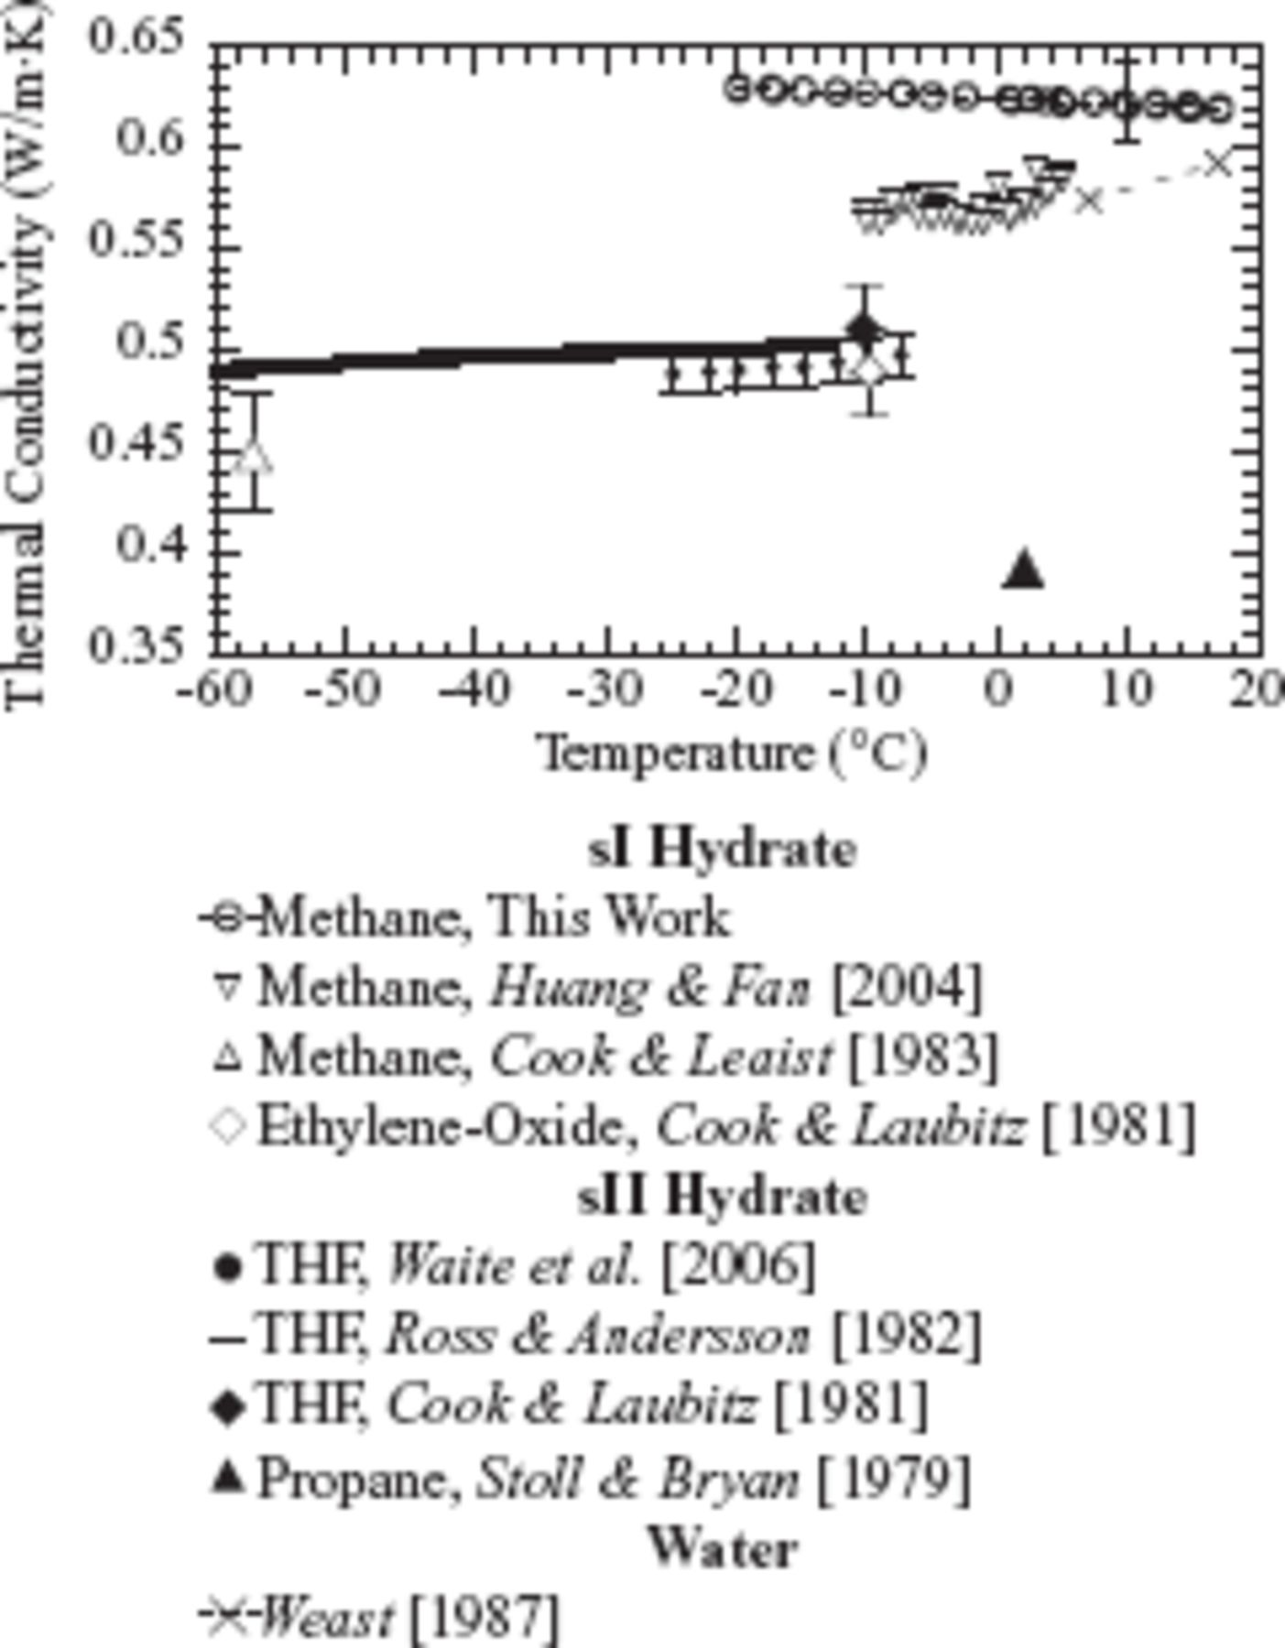
Figure 3. Temperature dependence of thermal conductivity for sI hydrates (open symbols), sII hydrates (closed symbols ...
Notes:
Figure 3. Temperature dependence of thermal conductivity for sI hydrates (open symbols), sII hydrates (closed symbols and heavy line) and water (crosses). The error bar at 10°C represents our sample-to-sample variability of ±0.02 Wm−1 K−1. The thermal conductivity of methane hydrate is closer to water than ice; the latter has a thermal conductivity exceeding 2.2 Wm−1 K−1 (Waite et al. 2006).
Unless provided in the caption above, the following copyright applies to the content of this slide: The Authors 507 Journal compilation © 2007 RAS

Slide 4
Table 1. CH₄ hydrate thermal property dependence on temperature, measured at 31.5 MPa confining pressure.
Notes:
Table 1. CH4 hydrate thermal property dependence on temperature, measured at 31.5 MPa confining pressure.
Unless provided in the caption above, the following copyright applies to the content of this slide: The Authors 507 Journal compilation © 2007 RAS

Slide 5
Table 2. CH₄ hydrate thermal property dependence on pressure, measured at 14.4°C between 31.5 and 102 MPa ...
Notes:
Table 2. CH4 hydrate thermal property dependence on pressure, measured at 14.4°C between 31.5 and 102 MPa confining pressure.
Unless provided in the caption above, the following copyright applies to the content of this slide: The Authors 507 Journal compilation © 2007 RAS

Slide 6
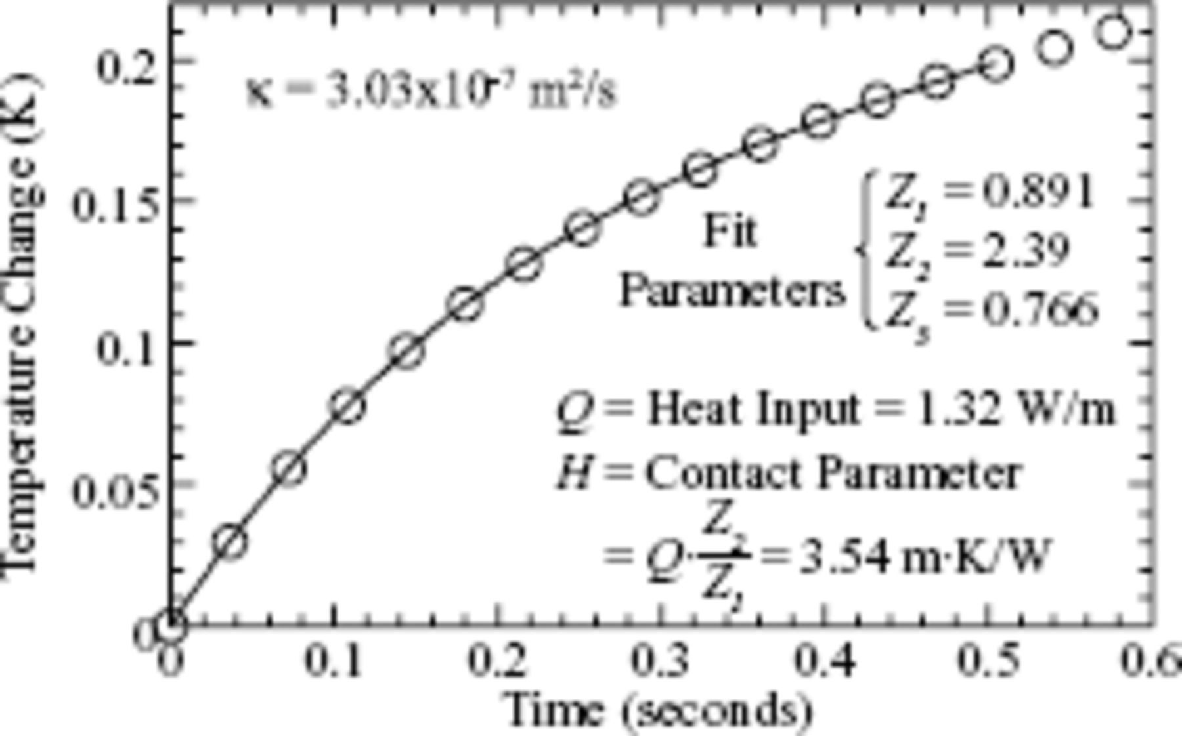
Figure 4. Transient initial temperature change for CH₄ hydrate at 9.6°C. The short duration of transient ...
Notes:
Figure 4. Transient initial temperature change for CH4 hydrate at 9.6°C. The short duration of transient heating limits data available (open circles) for the non-linear fit (solid curve) required for the thermal contact parameter, H (eq. 5). Low data acquisition rates further limit the number of data points, reducing the precision with which H and κ can be estimated (see Fig. 5).
Unless provided in the caption above, the following copyright applies to the content of this slide: The Authors 507 Journal compilation © 2007 RAS

Slide 7
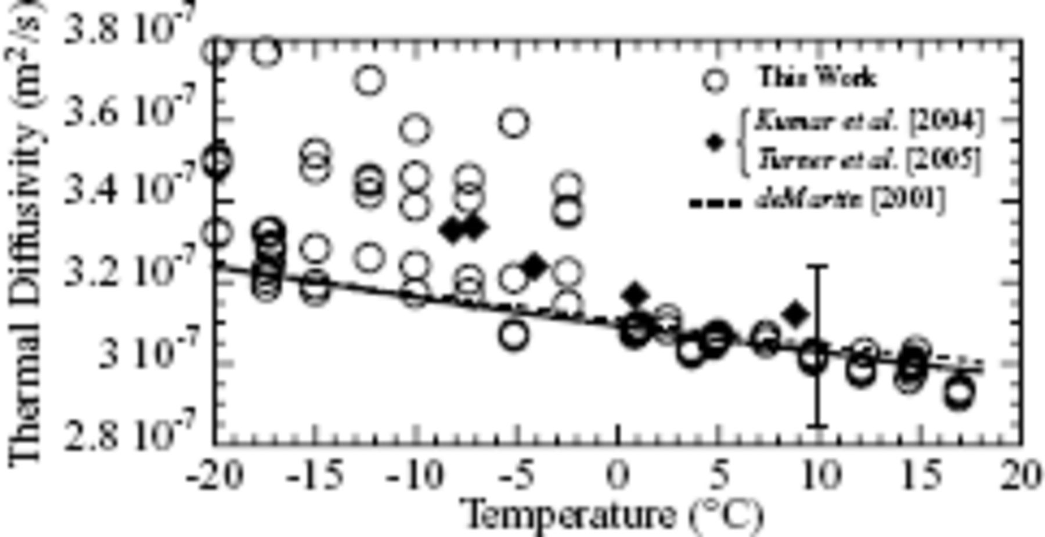
Figure 5. Temperature dependence of thermal diffusivity for sI CH₄ hydrate. Improved uncertainty in our ...
Notes:
Figure 5. Temperature dependence of thermal diffusivity for sI CH4 hydrate. Improved uncertainty in our measurements (open circles) above 0°C is due to a 50 per cent increase in our data acquisition rate for measurements above 0°C. The error bar at 10°C represents our sample-to-sample variability of ±0.2 × 10−7 m2 s−1 The solid line is a fit through our data above 0°C (see Table 2). The dotted line is an extrapolated fit from deMartin's (2001)−128°C to −106°C data. The samples of Kumar et al. (2004) and Turner et al. (2005) include ∼30 per cent methane gas-filled porosity (diamonds).
Unless provided in the caption above, the following copyright applies to the content of this slide: The Authors 507 Journal compilation © 2007 RAS

Slide 8
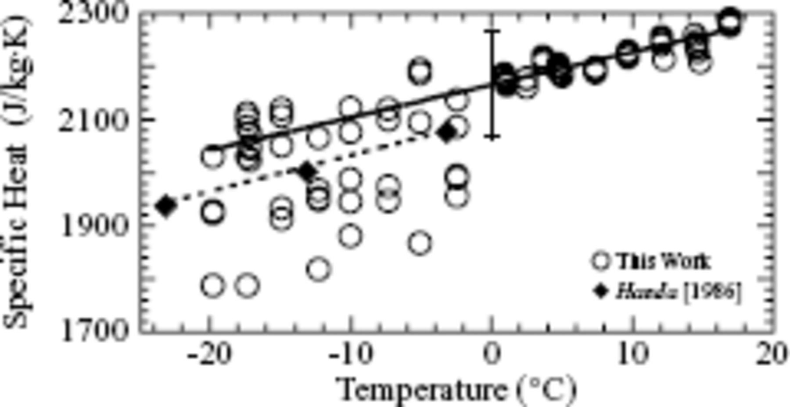
Figure 6. Temperature dependence of specific heat for sI CH₄ hydrate. Uncertainty in our measurements (open ...
Notes:
Figure 6. Temperature dependence of specific heat for sI CH4 hydrate. Uncertainty in our measurements (open circles) is due primarily to the uncertainty in thermal diffusivity (see Fig. 5). The error bar at 0°C represents our sample-to-sample variability of ±100 J kg−1 K−1. The solid line is a fit through our data above 0°C (see Table 1). The dotted line is a cubic fit presented by Handa (1986) for CH4 hydrate measured between −188°C and −3°C (diamonds).
Unless provided in the caption above, the following copyright applies to the content of this slide: The Authors 507 Journal compilation © 2007 RAS

Slide 9
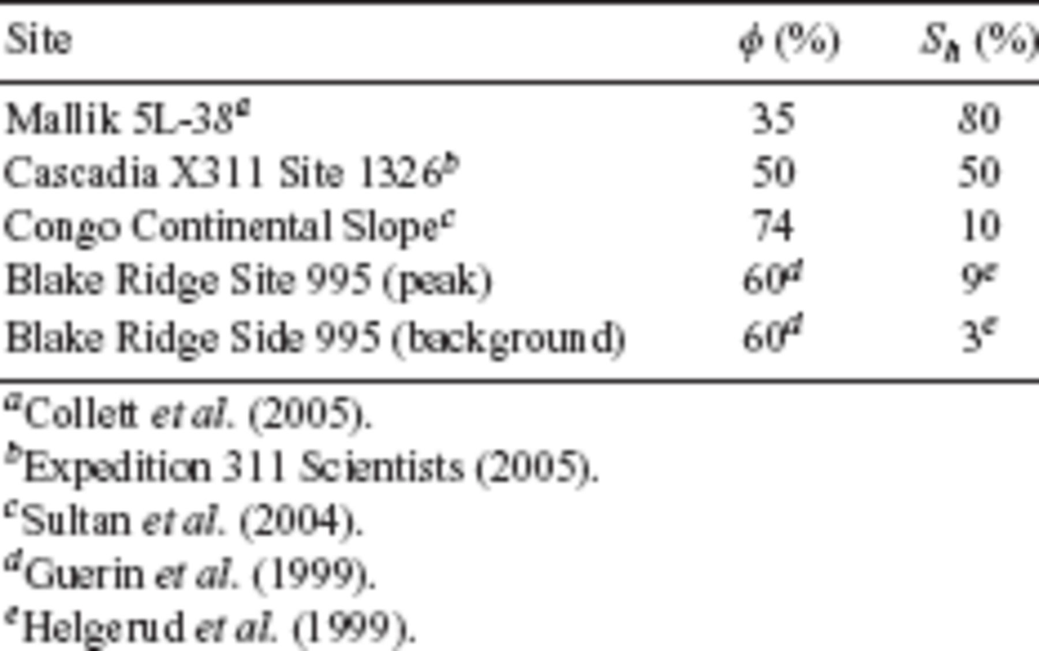
Table 3. Typical sediment porosity, φ, and hydrate saturation, S_{h}, for sites in comparative study.
Notes:
Table 3. Typical sediment porosity, φ, and hydrate saturation, Sh, for sites in comparative study.
Unless provided in the caption above, the following copyright applies to the content of this slide: The Authors 507 Journal compilation © 2007 RAS

Slide 10
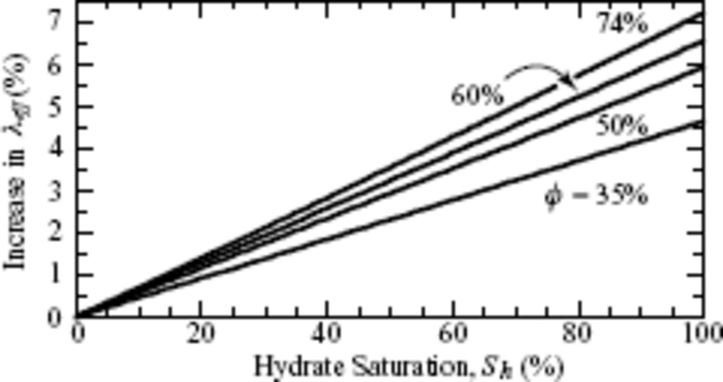
Figure 7. Change in effective thermal conductivity, λ_{eff}, as pore water is replaced by methane hydrate. ...
Notes:
Figure 7. Change in effective thermal conductivity, λeff, as pore water is replaced by methane hydrate. Increasing sediment porosity, ø (see Table 3), accentuates hydrate's effect on λeff, but the effect is less than ∼8 per cent even in fully-hydrate saturated, high-porosity sediment. Hydrate does not significantly impact sediment thermal conductivity.
Unless provided in the caption above, the following copyright applies to the content of this slide: The Authors 507 Journal compilation © 2007 RAS

Slide 11
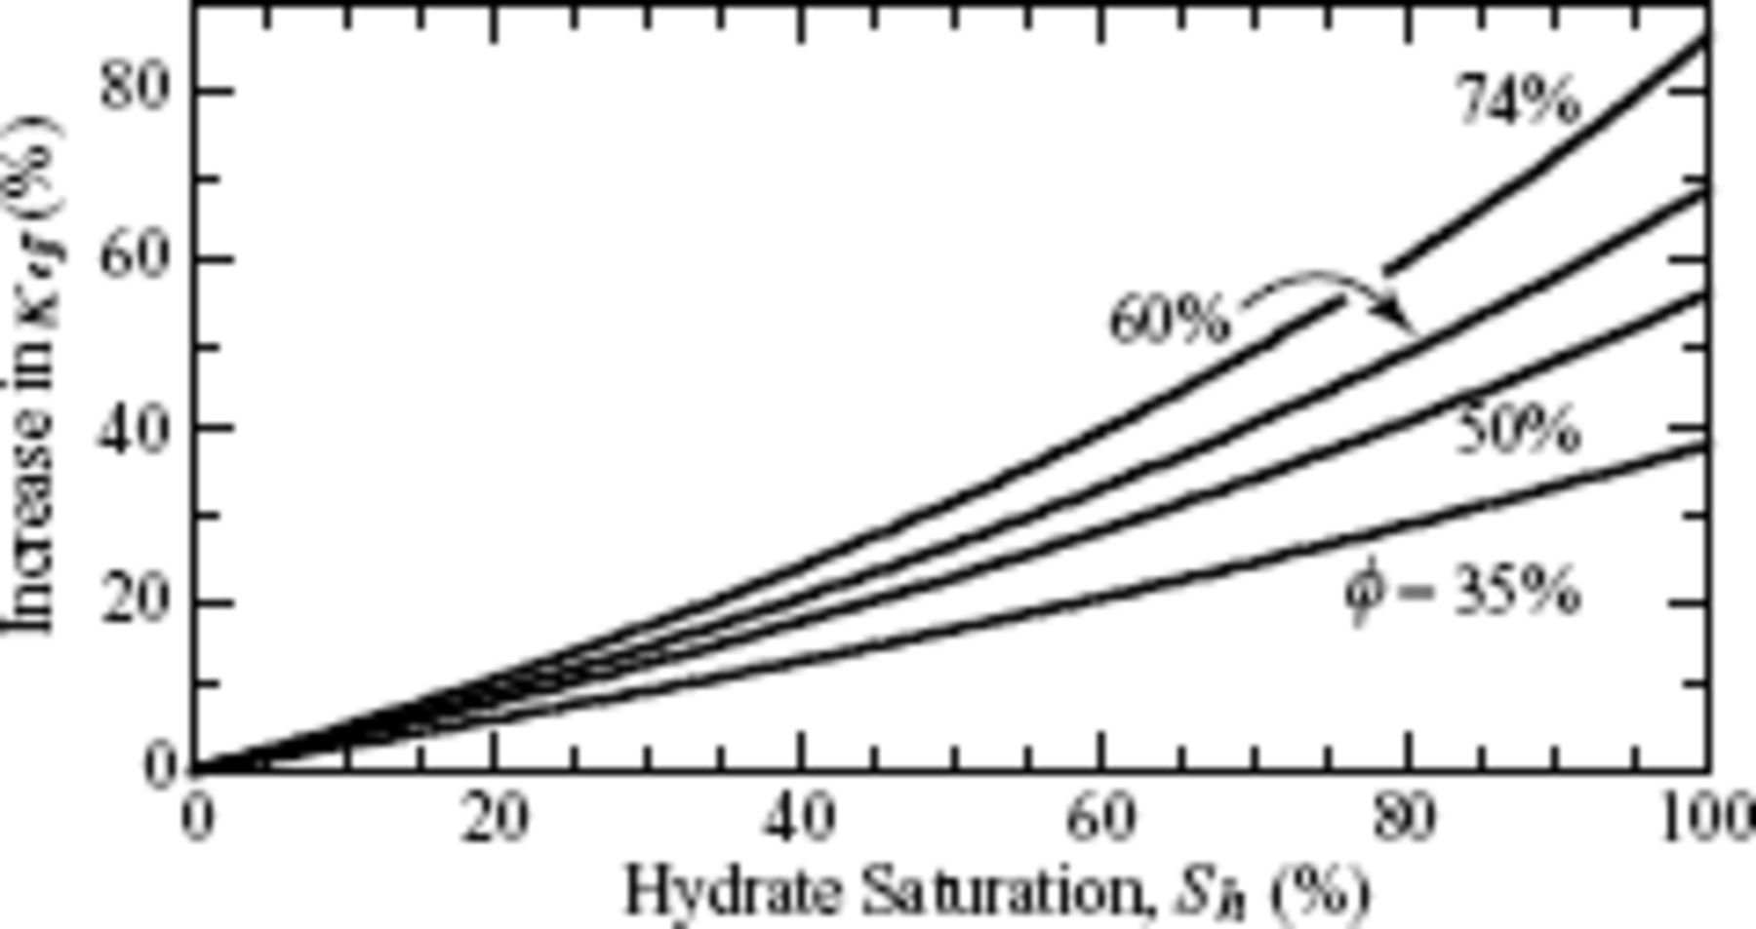
Figure 8. Change in effective thermal diffusivity, κ_{eff}, as pore water is replaced by methane hydrate. Even ...
Notes:
Figure 8. Change in effective thermal diffusivity, κeff, as pore water is replaced by methane hydrate. Even for sediment porosities, φ (see Table 3), and hydrate saturations, Sh, of 35 per cent, methane hydrate increases κeff by more than 10 per cent. Hydrate can significantly increase the propagation rate of a thermal front from a heat source such as a conventional hydrocarbon well, potentially reducing nearby sediment strength (Briaud & Chaouch 1997).
Unless provided in the caption above, the following copyright applies to the content of this slide: The Authors 507 Journal compilation © 2007 RAS

Slide 12
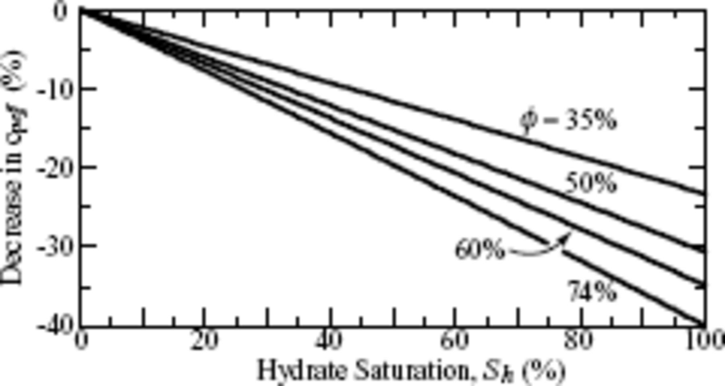
Figure 9. Change in effective specific heat, c_{peff}, as pore water is replaced by methane hydrate. For ...
Notes:
Figure 9. Change in effective specific heat, cpeff, as pore water is replaced by methane hydrate. For sediment porosities, φ (see Table 3), exceeding 35 per cent, and hydrate saturations, Sh, above 40 per cent, methane hydrate decreases cpeff by more than 10 per cent. Hydrate can significantly decrease the heat stored in hydrate-bearing sediment that is available for hydrate dissociation, reducing dissociation rates. This is particularly apparent at the high hydrate saturation characteristic of likely targets for methane production from hydrate and must be accounted for in production models (Moridis et al. 2005).
Unless provided in the caption above, the following copyright applies to the content of this slide: The Authors 507 Journal compilation © 2007 RAS

