Slide 1
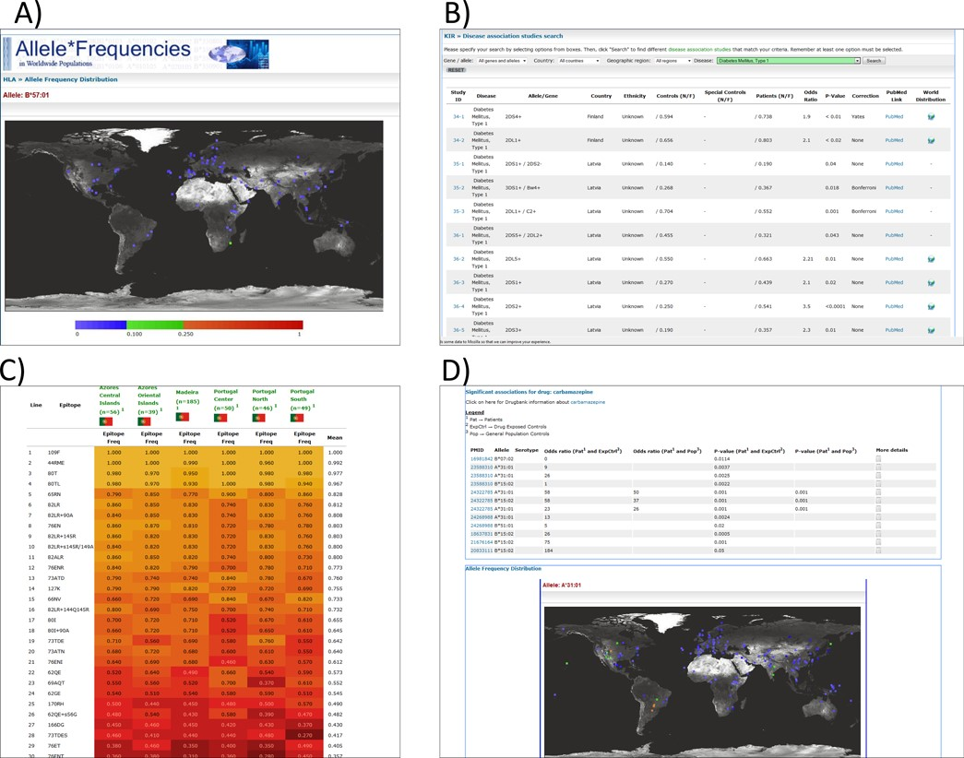
Figure 1. (A) A world map in AFND showing the global allele frequencies of HLA B*57:01, which, for example, has been ...
Notes:
Figure 1. (A) A world map in AFND showing the global allele frequencies of HLA B*57:01, which, for example, has been associated with adverse reactions to abacavir; (B) a query of KDDB for populations/studies in which associations between KIR genotypes have been made with Type 1 diabetes; (C) a heat map view of several populations in the HLA epitope database (filtered by epitopes from ‘locus A+B’); (D) a drug report in AFND showing all association data for carbamazepine.
Unless provided in the caption above, the following copyright applies to the content of this slide: © The Author(s) 2014. Published by Oxford University Press on behalf of Nucleic Acids Research.This is an Open Access article distributed under the terms of the Creative Commons Attribution License (http://creativecommons.org/licenses/by/4.0/), which permits unrestricted reuse, distribution, and reproduction in any medium, provided the original work is properly cited.

