Slide 1
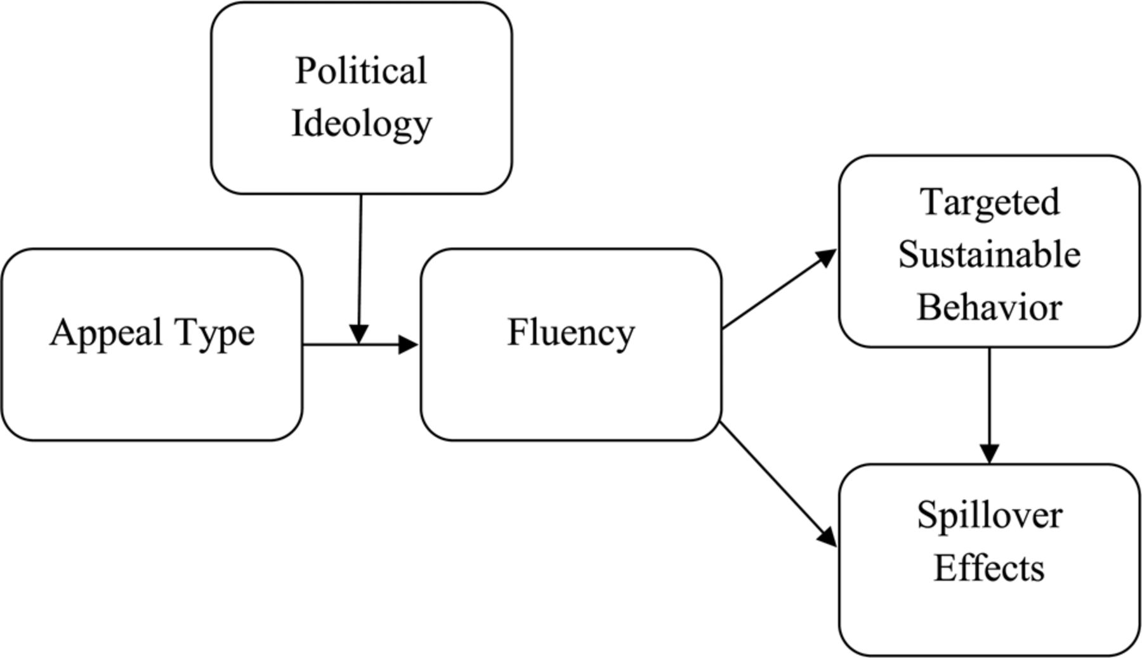
Figure 1. Conceptual Model of the Congruency of Appeal and Political Ideology on Sustainability Effects
Notes:
Figure 1. Conceptual Model of the Congruency of Appeal and Political Ideology on Sustainability Effects
Unless provided in the caption above, the following copyright applies to the content of this slide: © 2013 by JOURNAL OF CONSUMER RESEARCH, Inc.

Slide 2
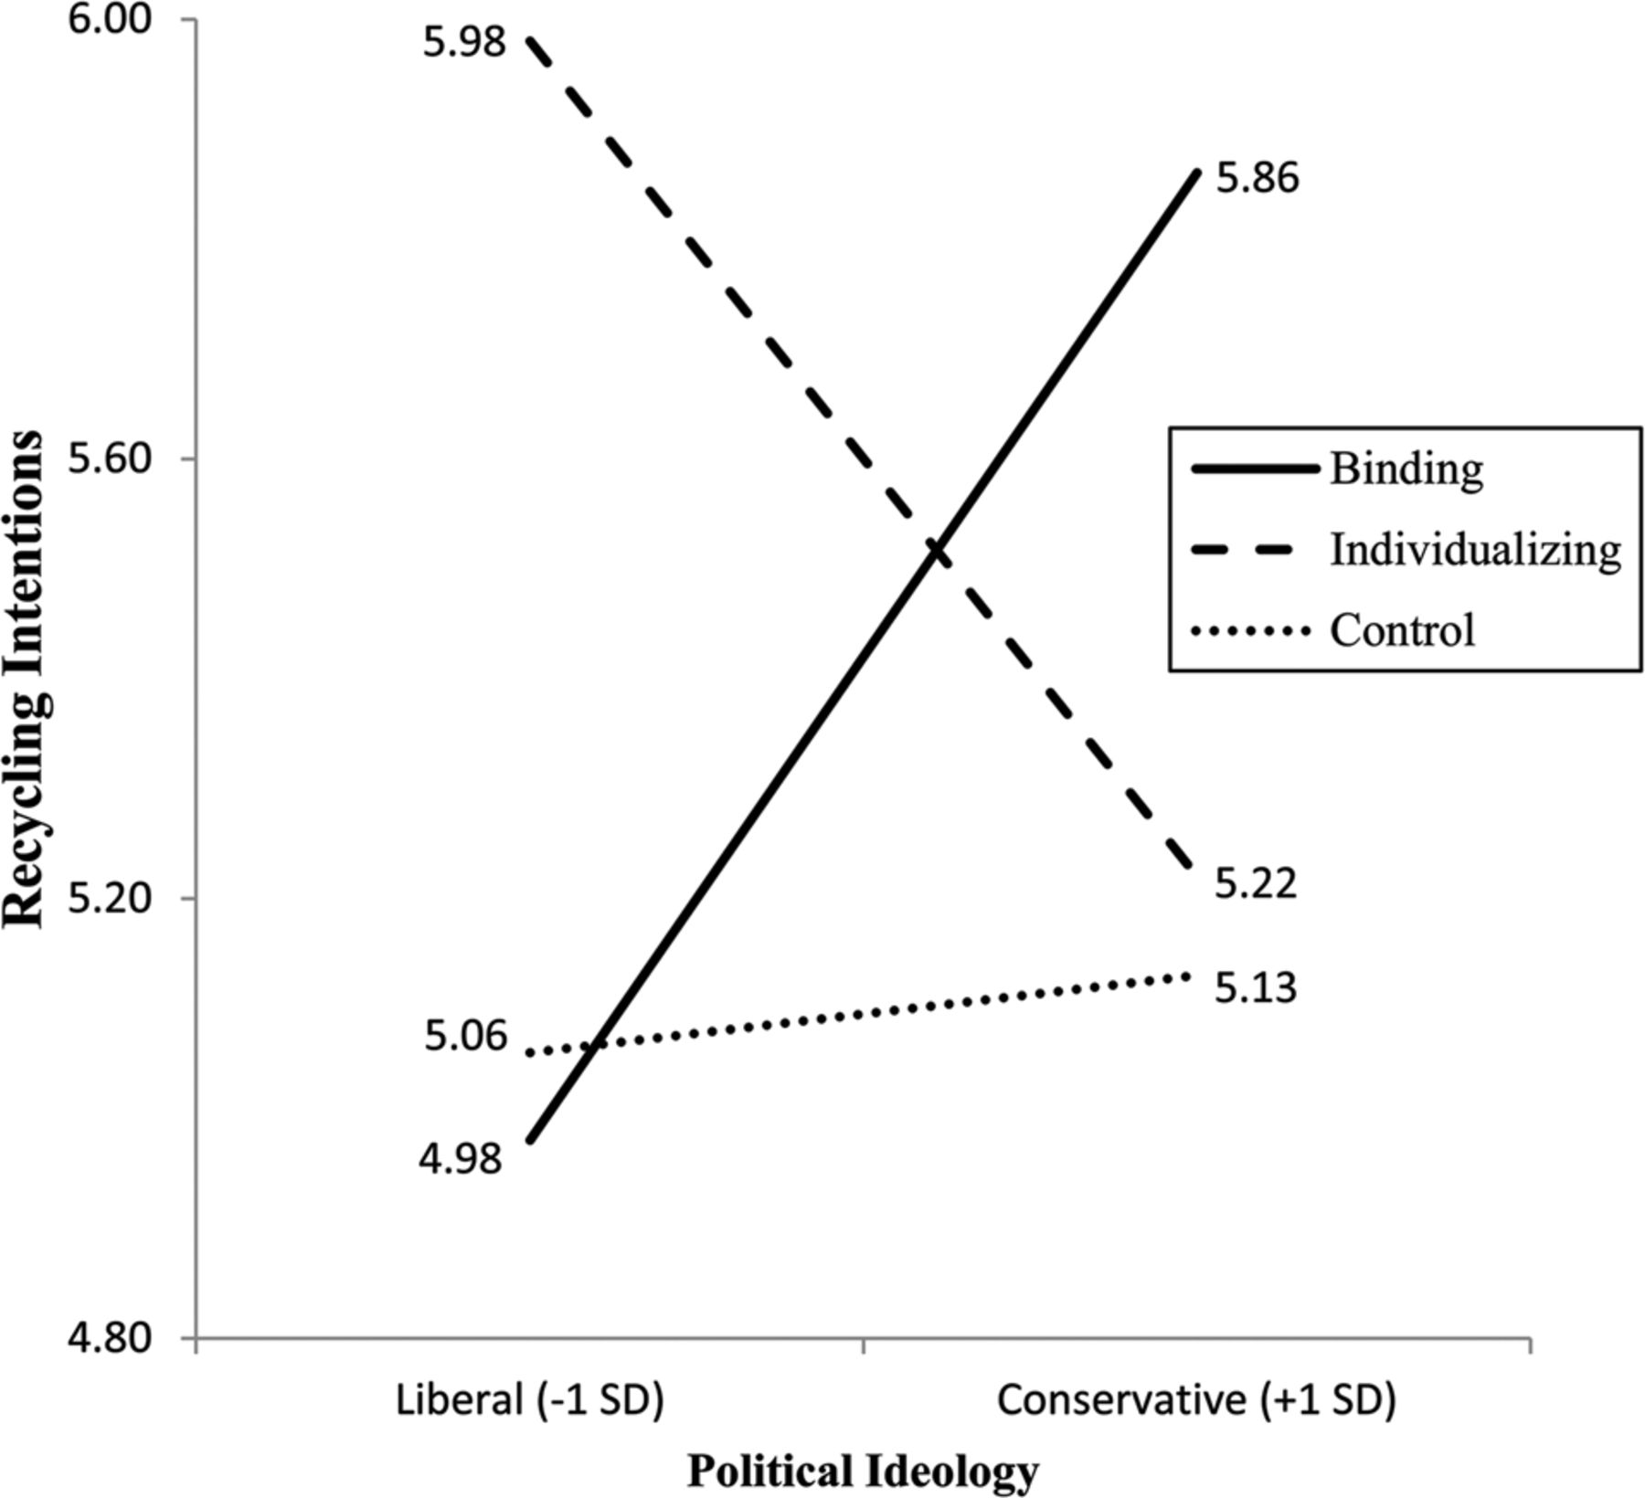
Figure 2. Study 1: Simple Slopes of Appeal Type by Political Ideology on Recycling Intentions
Notes:
Figure 2. Study 1: Simple Slopes of Appeal Type by Political Ideology on Recycling Intentions
Unless provided in the caption above, the following copyright applies to the content of this slide: © 2013 by JOURNAL OF CONSUMER RESEARCH, Inc.

Slide 3
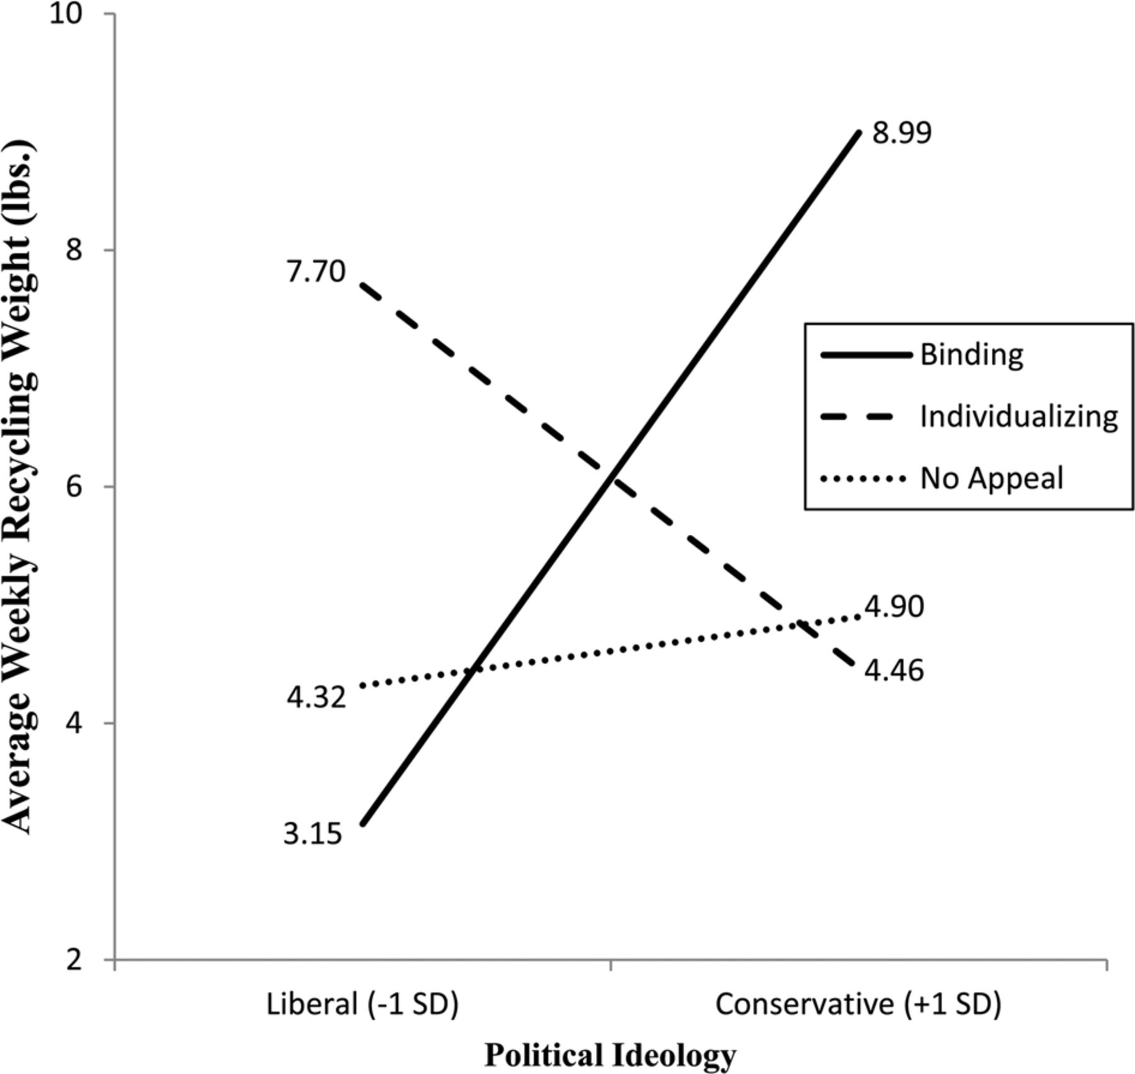
Figure 3. Study 2: Simple Slopes of Appeal Type by Political Ideology on Weekly Recycling
Notes:
Figure 3. Study 2: Simple Slopes of Appeal Type by Political Ideology on Weekly Recycling
Unless provided in the caption above, the following copyright applies to the content of this slide: © 2013 by JOURNAL OF CONSUMER RESEARCH, Inc.

Slide 4
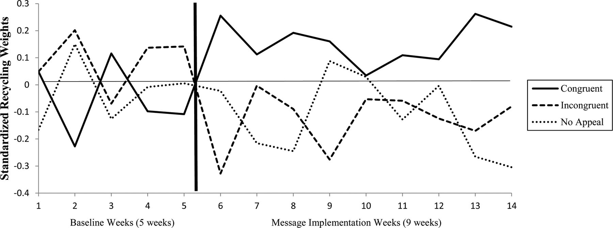
Figure 4. Study 2: Appeal Type by Political Ideology Over Time
Notes:
Figure 4. Study 2: Appeal Type by Political Ideology Over Time
Unless provided in the caption above, the following copyright applies to the content of this slide: © 2013 by JOURNAL OF CONSUMER RESEARCH, Inc.

Slide 5
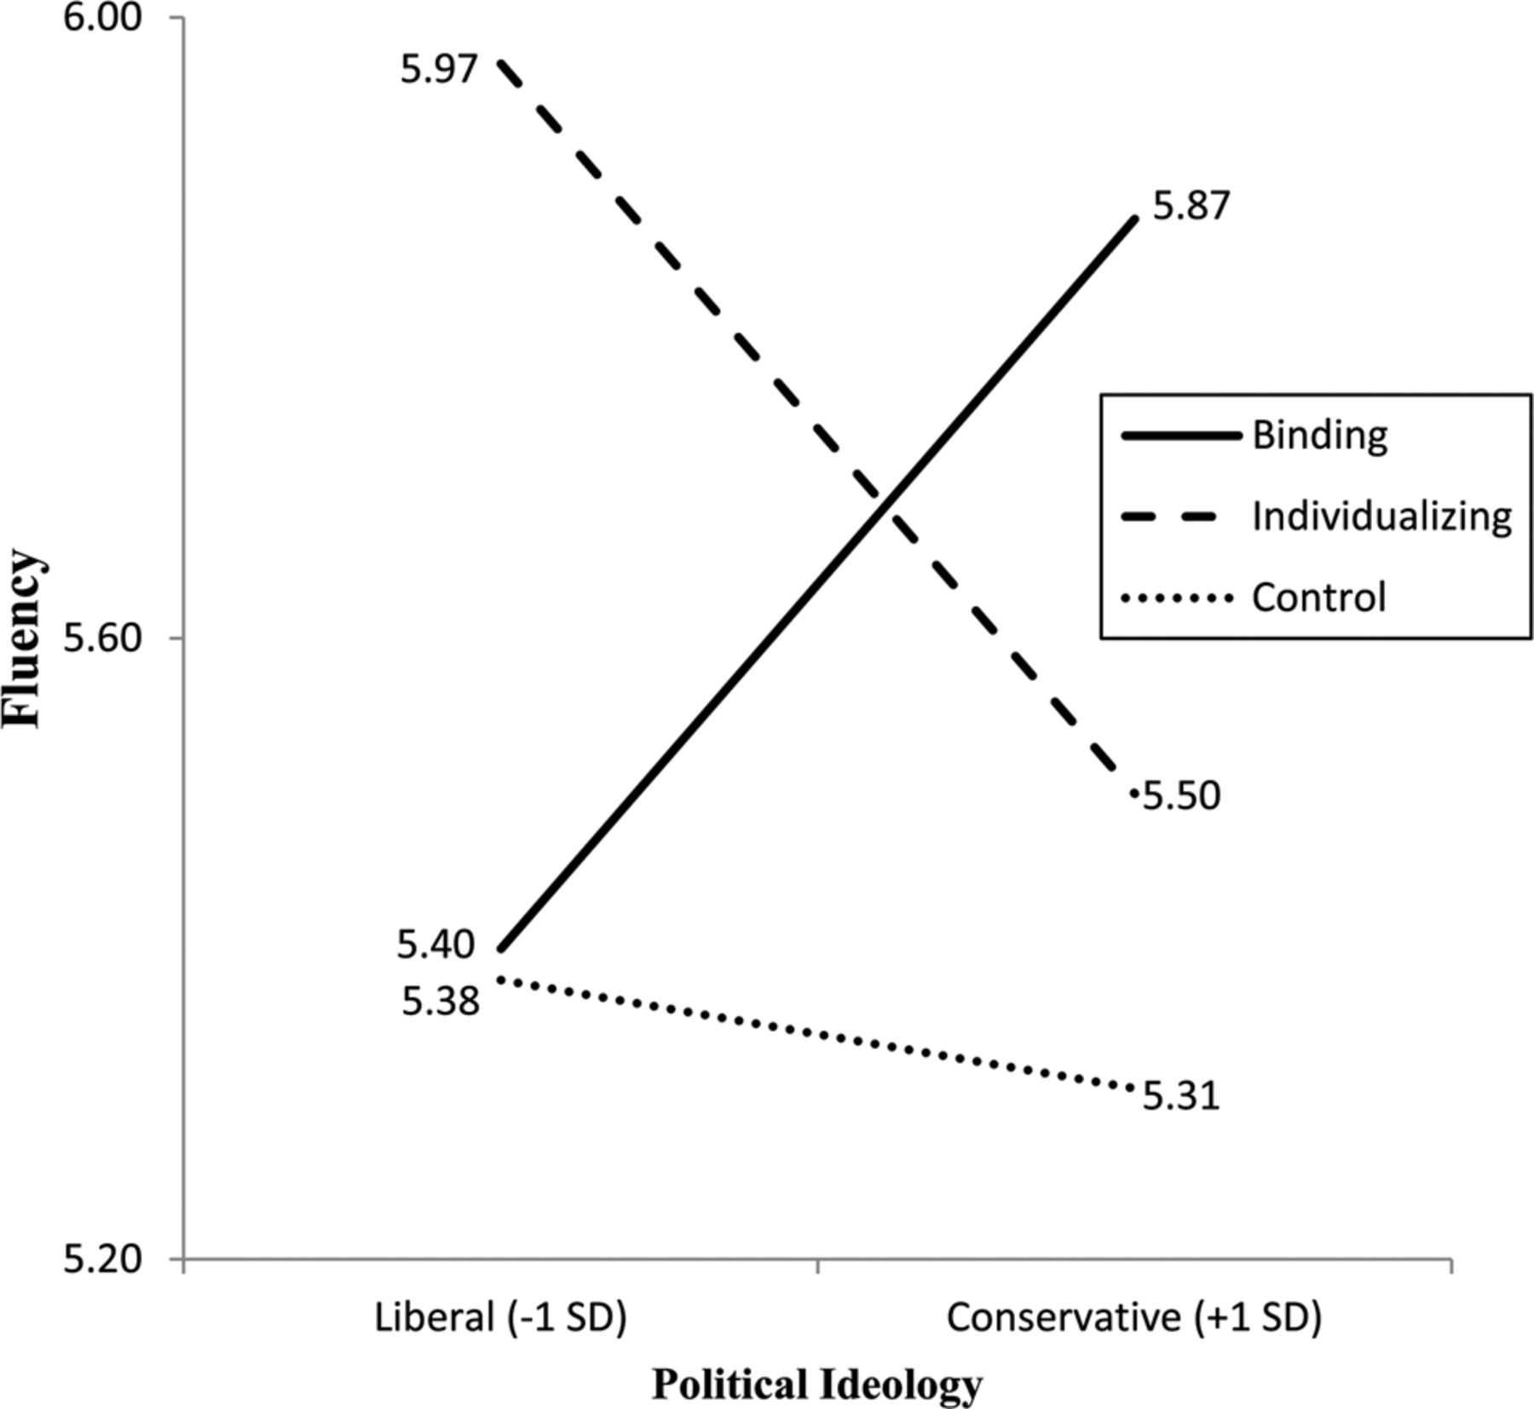
Figure 5. Study 3: Simple Slopes of Appeal Type by Political Ideology on Fluency
Notes:
Figure 5. Study 3: Simple Slopes of Appeal Type by Political Ideology on Fluency
Unless provided in the caption above, the following copyright applies to the content of this slide: © 2013 by JOURNAL OF CONSUMER RESEARCH, Inc.

Slide 6
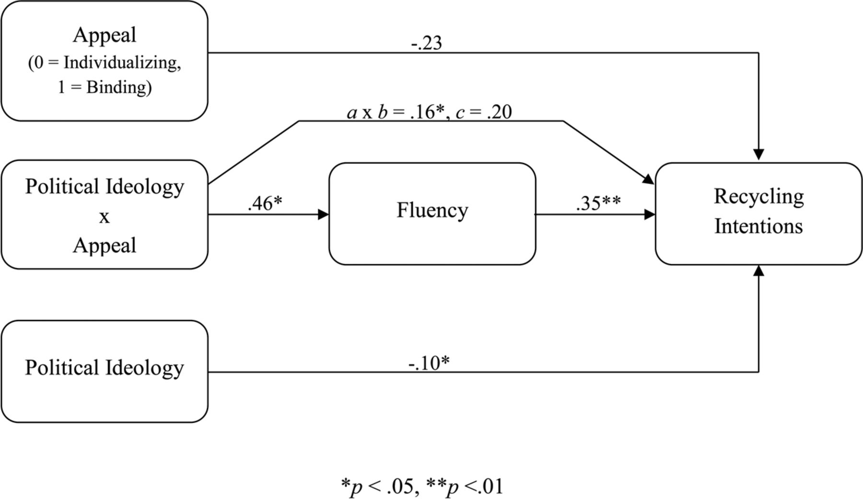
Figure 6. Study 3: Mediation Model of Appeal Type by Political Ideology to Recycling Intentions through Fluency
Notes:
Figure 6. Study 3: Mediation Model of Appeal Type by Political Ideology to Recycling Intentions through Fluency
Unless provided in the caption above, the following copyright applies to the content of this slide: © 2013 by JOURNAL OF CONSUMER RESEARCH, Inc.

Slide 7
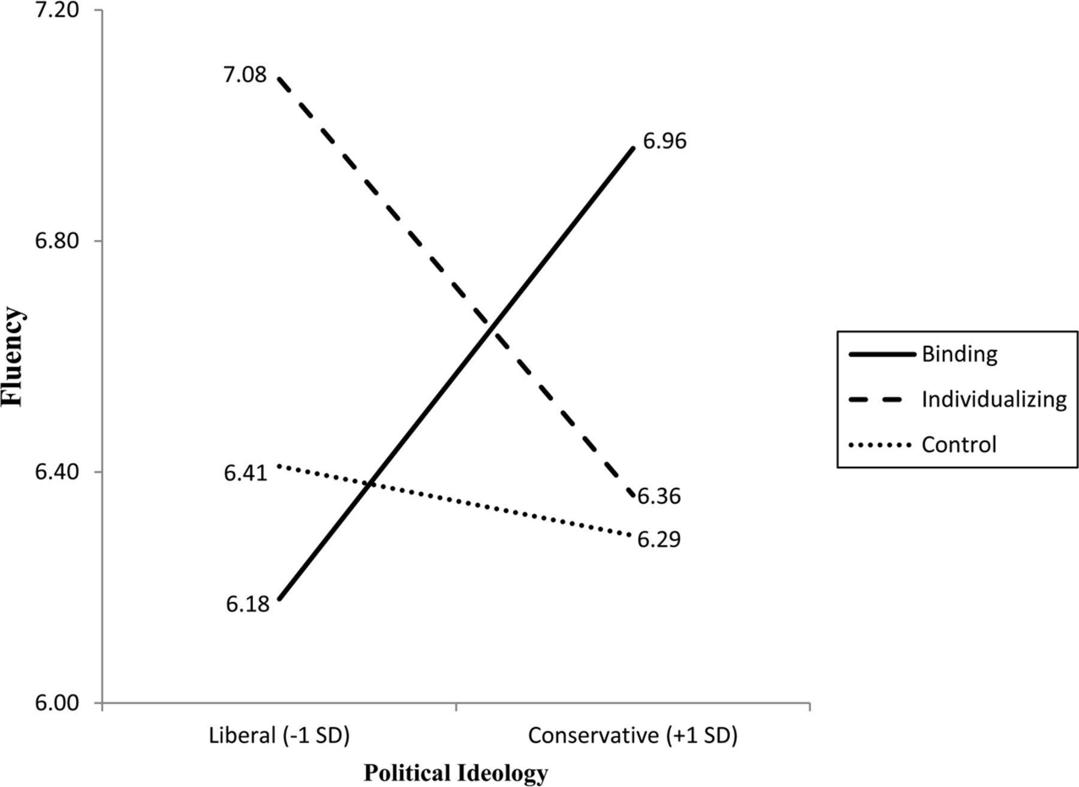
Figure 7. Study 4: Simple Slopes of Appeal Type by Political Ideology on Fluency
Notes:
Figure 7. Study 4: Simple Slopes of Appeal Type by Political Ideology on Fluency
Unless provided in the caption above, the following copyright applies to the content of this slide: © 2013 by JOURNAL OF CONSUMER RESEARCH, Inc.

Slide 8
Figure A1. Individualizing Appeal
Notes:
Figure A1. Individualizing Appeal
Unless provided in the caption above, the following copyright applies to the content of this slide: © 2013 by JOURNAL OF CONSUMER RESEARCH, Inc.

Slide 9
Figure A2. Binding Appeal
Notes:
Figure A2. Binding Appeal
Unless provided in the caption above, the following copyright applies to the content of this slide: © 2013 by JOURNAL OF CONSUMER RESEARCH, Inc.

Slide 10
Figure B1. Individualizing Appeal
Notes:
Figure B1. Individualizing Appeal
Unless provided in the caption above, the following copyright applies to the content of this slide: © 2013 by JOURNAL OF CONSUMER RESEARCH, Inc.

Slide 11
Figure B2. Binding Appeal
Notes:
Figure B2. Binding Appeal
Unless provided in the caption above, the following copyright applies to the content of this slide: © 2013 by JOURNAL OF CONSUMER RESEARCH, Inc.

Slide 12
Figure B3. Control Appeal
Notes:
Figure B3. Control Appeal
Unless provided in the caption above, the following copyright applies to the content of this slide: © 2013 by JOURNAL OF CONSUMER RESEARCH, Inc.

