Slide 1
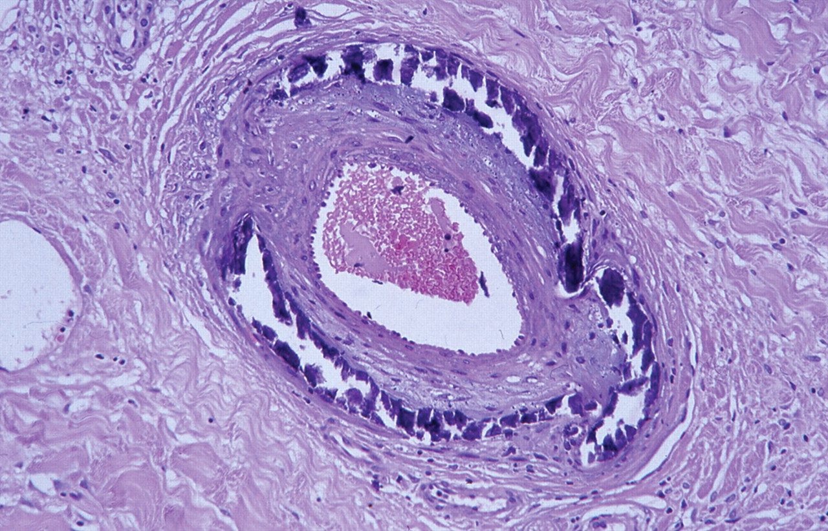
Fig. 1 Biopsy of Patient 1 revealing medial calcium deposition.
Notes:
Fig. 1 Biopsy of Patient 1 revealing medial calcium deposition.
Unless provided in the caption above, the following copyright applies to the content of this slide: © Oxford University Press 2008

Slide 2
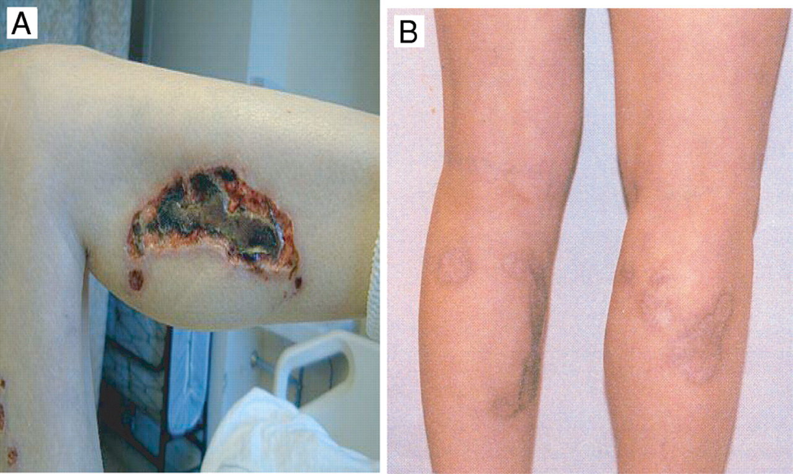
Fig. 2 Patient 1 before ( A ) and 18 months after ( B ) stem cell transplant.
Notes:
Fig. 2 Patient 1 before ( A ) and 18 months after ( B ) stem cell transplant.
Unless provided in the caption above, the following copyright applies to the content of this slide: © Oxford University Press 2008

Slide 3
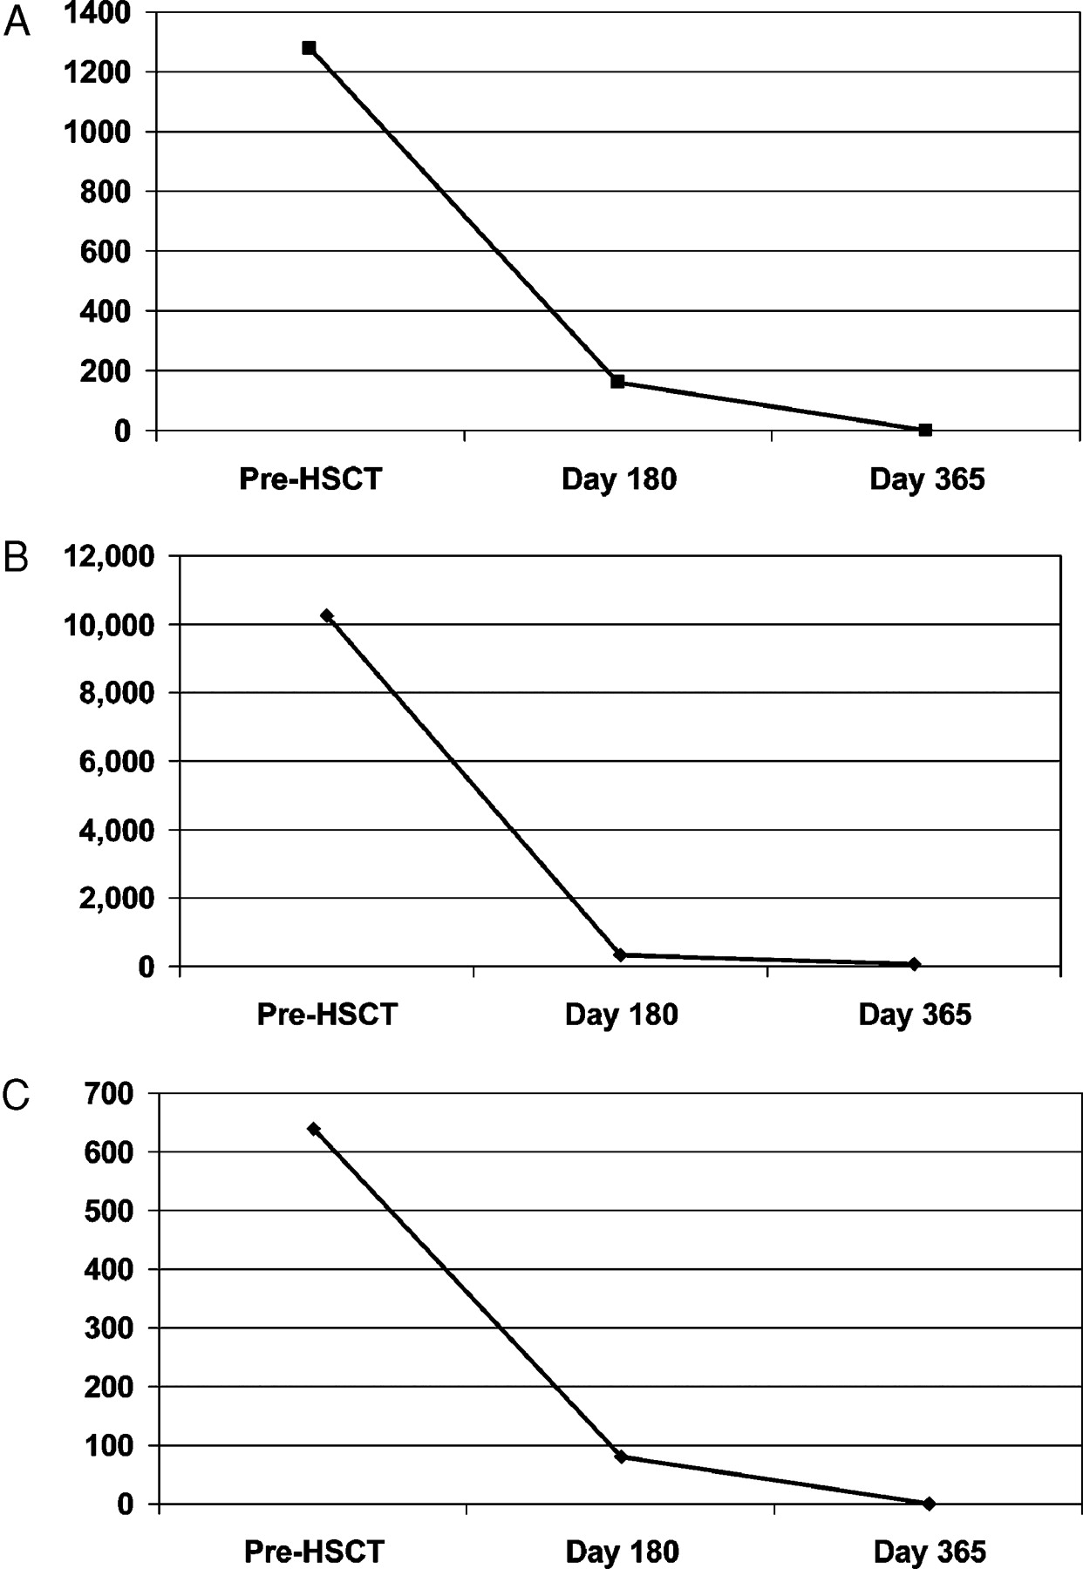
Fig. 3 SLE serologies before and after HSCT. ( A ) Anti-dsDNA titer of Patient 1. ( B ) Anti-dsDNA titer of Patient ...
Notes:
Fig. 3 SLE serologies before and after HSCT. ( A ) Anti-dsDNA titer of Patient 1. ( B ) Anti-dsDNA titer of Patient 2. ( C ) ANA titer of Patient 3 (anti-dsDNA undetectable at all time points).
Unless provided in the caption above, the following copyright applies to the content of this slide: © Oxford University Press 2008

Slide 4
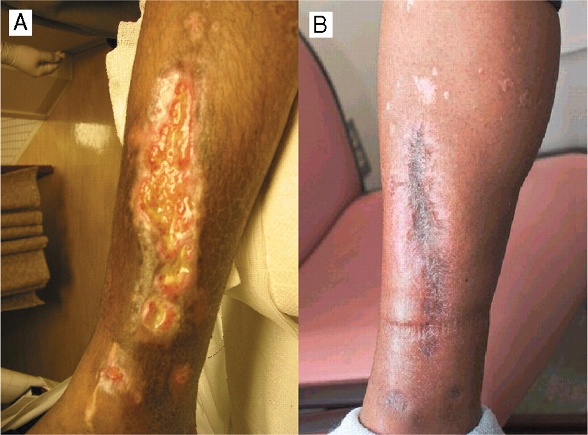
Fig. 4 Patient 2's right medial calf before ( A ) and 1 year after ( B ) HSCT.
Notes:
Fig. 4 Patient 2's right medial calf before ( A ) and 1 year after ( B ) HSCT.
Unless provided in the caption above, the following copyright applies to the content of this slide: © Oxford University Press 2008

Slide 5
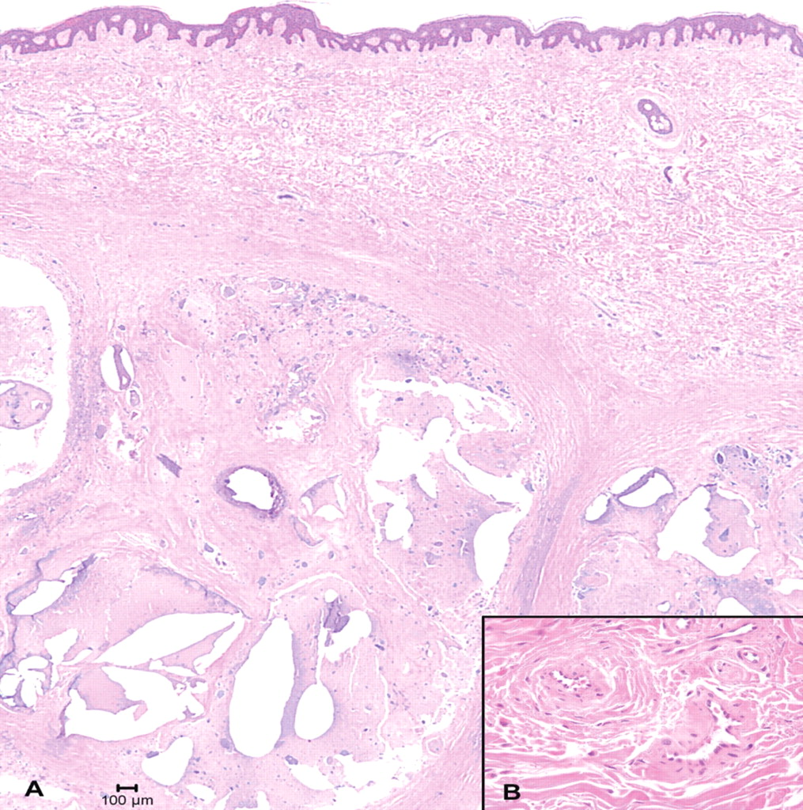
Fig. 5 Patient 3's biopsy of calcinosis universalis, showing dermal calcium deposition ( A ), without vessel ...
Notes:
Fig. 5 Patient 3's biopsy of calcinosis universalis, showing dermal calcium deposition ( A ), without vessel deposition (inset B ).
Unless provided in the caption above, the following copyright applies to the content of this slide: © Oxford University Press 2008

Slide 6
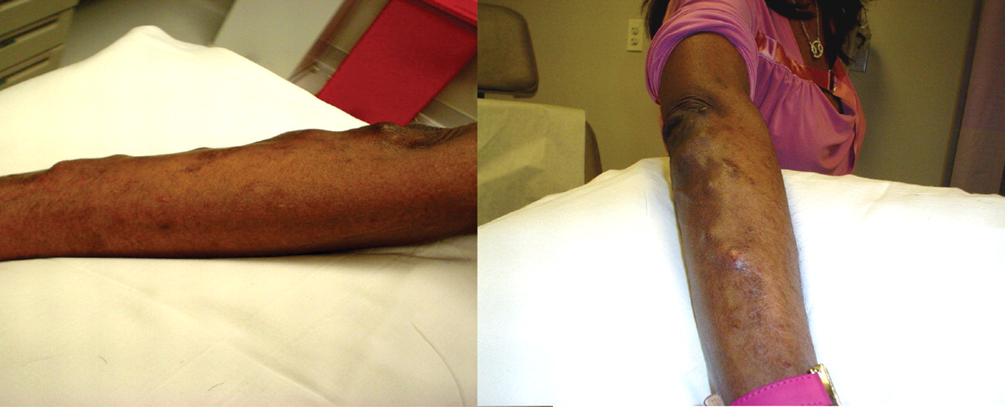
Fig. 6 Patient 3: right arm with calcinosis universalis before ( A ), and 1 year after ( B ) HSCT. Discoloration ...
Notes:
Fig. 6 Patient 3: right arm with calcinosis universalis before ( A ), and 1 year after ( B ) HSCT. Discoloration persisted, but many tumoural calcinoses resorbed and no new lesions developed.
Unless provided in the caption above, the following copyright applies to the content of this slide: © Oxford University Press 2008

