Slide 1
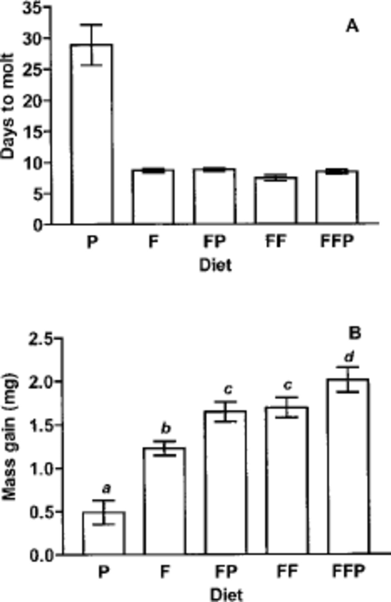
Fig. 1. The benefit of pollen feeding to hatchling T. a. sinensis nymphs raised on experimental diets until first ...
Notes:
Fig. 1. The benefit of pollen feeding to hatchling T. a. sinensis nymphs raised on experimental diets until first molt (treatment groups defined in text). Bars indicate mean and 95% confidence interval for each group. (A) Number of days from egg hatch to first molt. (B) Gain in dry body mass (mg) above dry mass mean of 20 nymphs weighed at hatch. Treatment groups based on diet: P =pollen only; F =flies only; FP =flies +pollen; FF =flies only, ad libitum; FFP =flies ad libitum +pollen. Treatments that share the same lower case letter are not significantly different (Tukey’s HSD comparisons among means).
Unless provided in the caption above, the following copyright applies to the content of this slide: © 2003 Entomological Society of AmericaThis is an Open Access article distributed under the terms of the Creative Commons Attribution Non-Commercial License (http://creativecommons.org/licenses/by-nc/3.0/), which permits non-commercial reuse, distribution, and reproduction in any medium, provided the original work is properly cited. For commercial re-use, please contact journals.permissions@oup.com

Slide 2
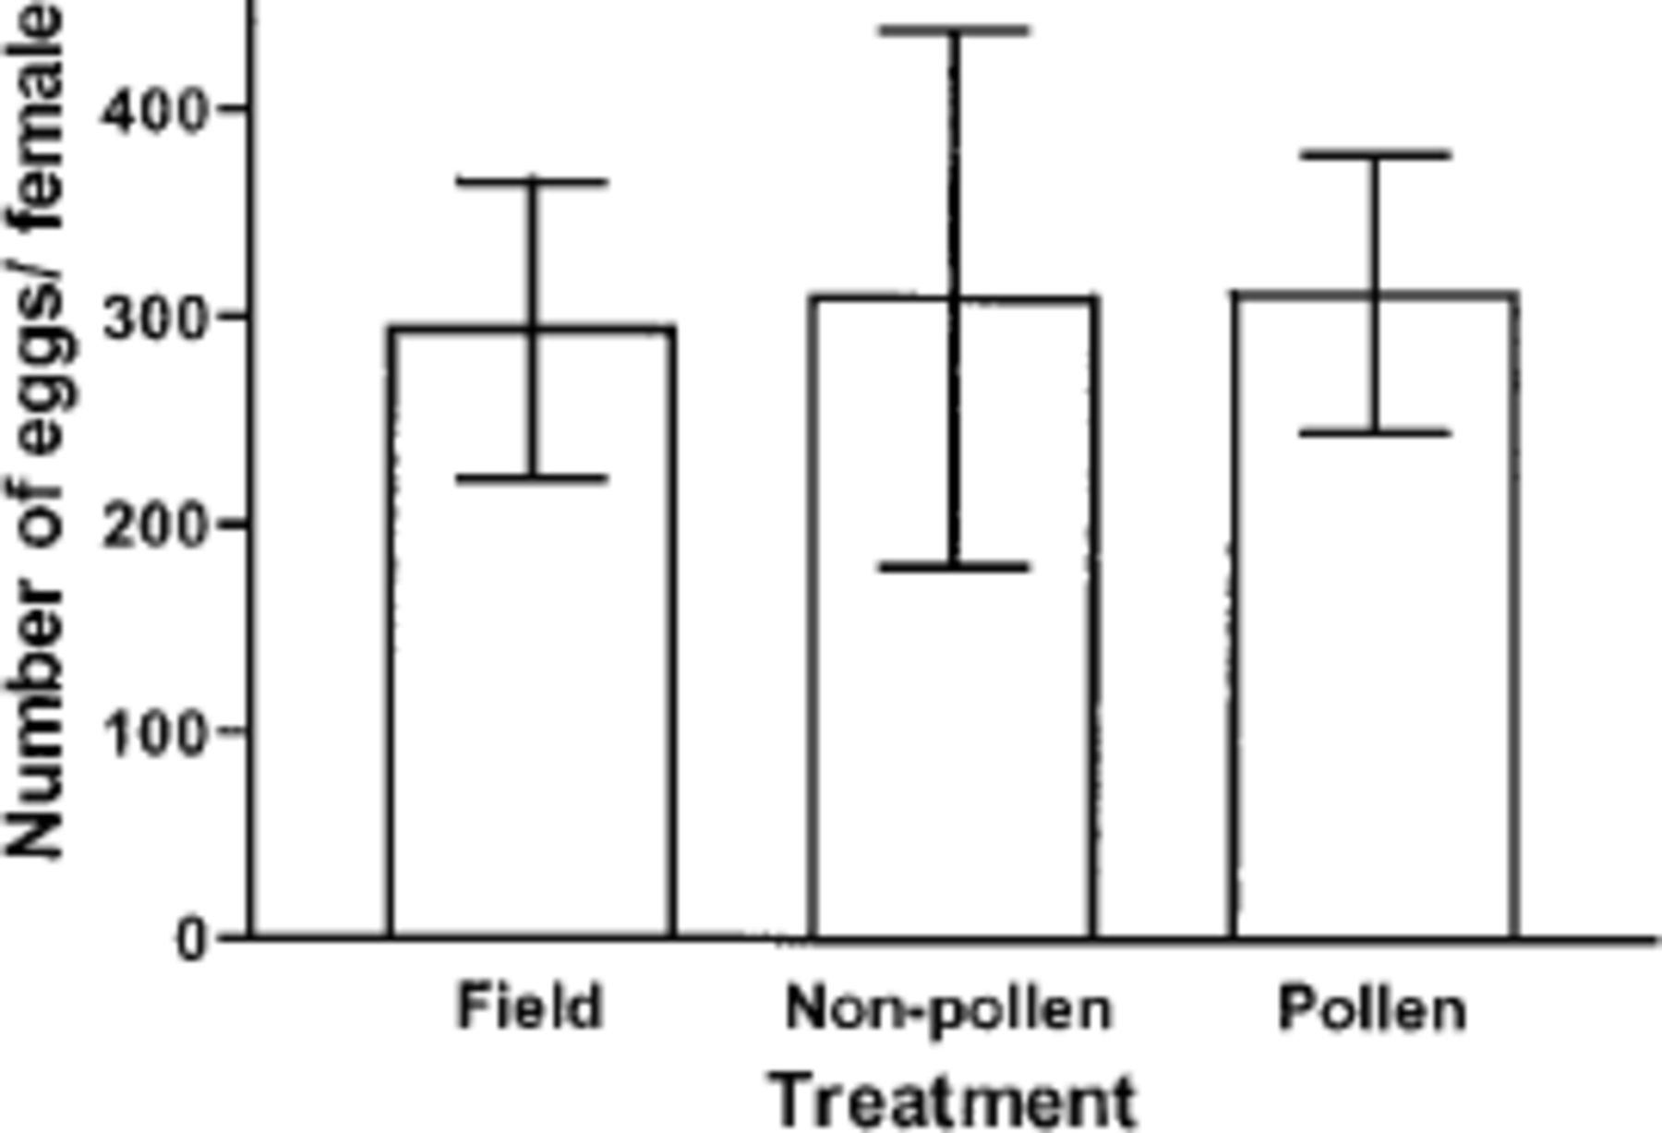
Fig. 2. Fecundity of adult T. a. sinensis in two laboratory treatment groups, nonpollen (n = 6) and pollen (n = 5) ...
Notes:
Fig. 2. Fecundity of adult T. a. sinensis in two laboratory treatment groups, nonpollen (n = 6) and pollen (n = 5) compared with mantids in the field (n = 6) from the same year cohort. Bars indicate mean and 95% confidence interval for each group.
Unless provided in the caption above, the following copyright applies to the content of this slide: © 2003 Entomological Society of AmericaThis is an Open Access article distributed under the terms of the Creative Commons Attribution Non-Commercial License (http://creativecommons.org/licenses/by-nc/3.0/), which permits non-commercial reuse, distribution, and reproduction in any medium, provided the original work is properly cited. For commercial re-use, please contact journals.permissions@oup.com

Slide 3
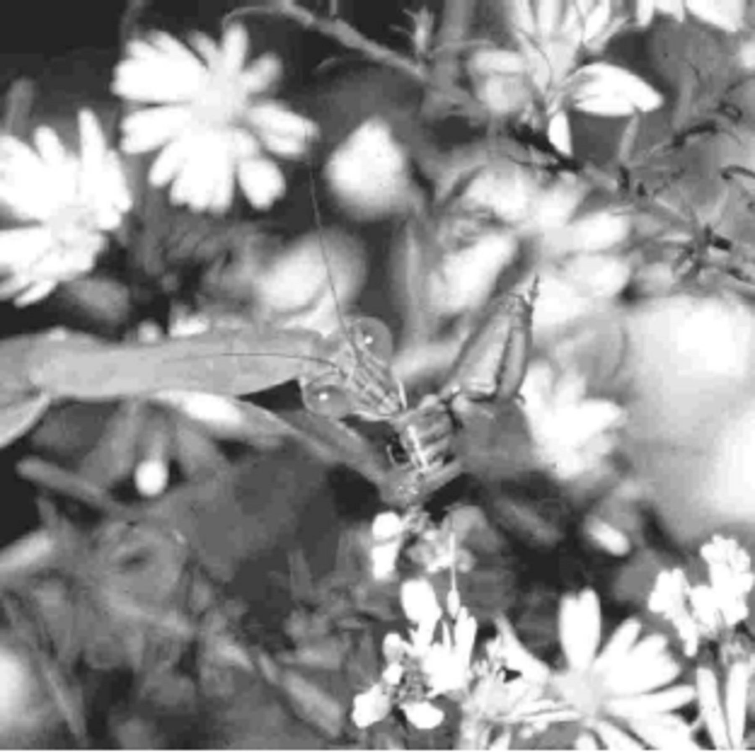
Fig. 3. Adult female mantid, T. a. sinensis, eating honey bee, Apis mellifera. A mantid will normally consume the ...
Notes:
Fig. 3. Adult female mantid, T. a. sinensis, eating honey bee, Apis mellifera. A mantid will normally consume the entire bee, including pollen sacs, but excepting wings.
Unless provided in the caption above, the following copyright applies to the content of this slide: © 2003 Entomological Society of AmericaThis is an Open Access article distributed under the terms of the Creative Commons Attribution Non-Commercial License (http://creativecommons.org/licenses/by-nc/3.0/), which permits non-commercial reuse, distribution, and reproduction in any medium, provided the original work is properly cited. For commercial re-use, please contact journals.permissions@oup.com

