Slide 1
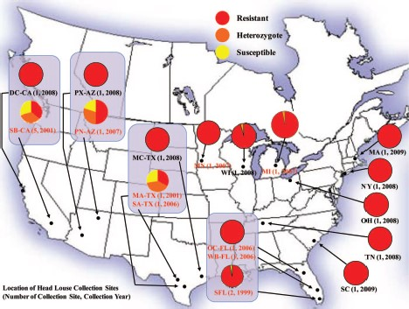
Fig. 1. The TI mutation frequency map of head lice collected in the United States. Each pie chart shows zygosity ...
Notes:
Fig. 1. The TI mutation frequency map of head lice collected in the United States. Each pie chart shows zygosity proportions of head lice collected from one or two locations. Proportions of homozygous resistant lice are represented in red, heterozygous lice are orange, and homozygous susceptible lice are yellow. The locations, number of collection sites, and collection year given in red indicate the collections made before 2008. Pie charts that are boxed indicate those states that were sampled at least twice from 1999 to 2008.
Unless provided in the caption above, the following copyright applies to the content of this slide: © 2014 Entomological Society of AmericaThis is an Open Access article distributed under the terms of the Creative Commons Attribution Non-Commercial License (http://creativecommons.org/licenses/by-nc/3.0/), which permits non-commercial reuse, distribution, and reproduction in any medium, provided the original work is properly cited. For commercial re-use, please contact journals.permissions@oup.com

Slide 2
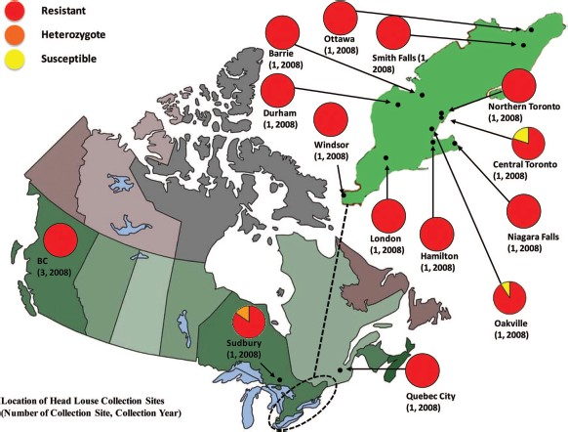
Fig. 2. The TI mutation frequency map of head lice collected in Canada. Each pie chart shows zygosity proportions of ...
Notes:
Fig. 2. The TI mutation frequency map of head lice collected in Canada. Each pie chart shows zygosity proportions of head lice collected from one or two locations. Proportions of homozygous resistant lice are represented in red, heterozygous lice are orange, and homozygous susceptible lice are yellow.
Unless provided in the caption above, the following copyright applies to the content of this slide: © 2014 Entomological Society of AmericaThis is an Open Access article distributed under the terms of the Creative Commons Attribution Non-Commercial License (http://creativecommons.org/licenses/by-nc/3.0/), which permits non-commercial reuse, distribution, and reproduction in any medium, provided the original work is properly cited. For commercial re-use, please contact journals.permissions@oup.com

