Slide 1
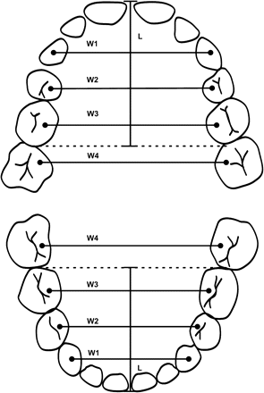
Figure 1 The methods used in dental arch measurements. Maxillary and mandibular arch length (L): arch length measured ...
Notes:
Figure 1 The methods used in dental arch measurements. Maxillary and mandibular arch length (L): arch length measured from the extreme labial surfaces of the incisors perpendicular to a line indicating the extreme distal point of the first primary molars or the second premolars. Maxillary and mandibular arch breadth: a line connecting the crown tips of the canines (W1), the mesiolingual cusps of the primary first (W2) and second (W3) molars and the permanent first molars (W4), and the lingual cusps of the first permanent premolars (W2) or the second permanent premolars (W3).
Unless provided in the caption above, the following copyright applies to the content of this slide: © The Author 2008. Published by Oxford University Press on behalf of the European Orthodontic Society. All rights reserved. For permissions, please email: journals.permissions@oxfordjournals.org.

Slide 2
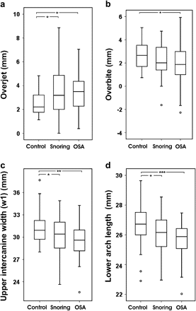
Figure 2 Box plot presentation of measurements of (a) overjet, (b) overbite, (c) maxillary intercanine width, and (d) ...
Notes:
Figure 2 Box plot presentation of measurements of (a) overjet, (b) overbite, (c) maxillary intercanine width, and (d) mandibular arch length in control, snoring, and obstructive sleep apnoea (OSA) children and the significances of the difference (multiple comparisons test according to Duncan's method, *P < 0.05, **P < 0.01, ***P < 0.001). Each box plot represents the median and 25th and 75th percentile.
Unless provided in the caption above, the following copyright applies to the content of this slide: © The Author 2008. Published by Oxford University Press on behalf of the European Orthodontic Society. All rights reserved. For permissions, please email: journals.permissions@oxfordjournals.org.

