Slide 1
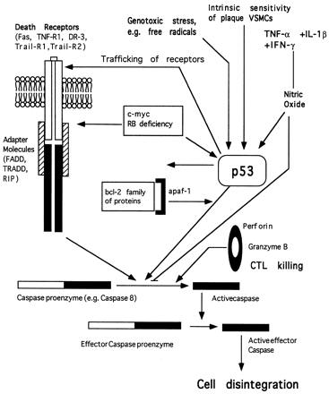
Fig. 2 Simplified schematic representation of the major pathways regulating apoptosis. Apoptosis may be triggered ...
Notes:
Fig. 2 Simplified schematic representation of the major pathways regulating apoptosis. Apoptosis may be triggered via ligand binding to specific death receptors (Fas, TNF-R1, Death receptors (DR) -3, -4 and -5.). Ligand binding to receptor recruits adapter proteins (FADD, TRADD, RIP) to the death receptor. Regulatory caspases such as caspase 8 bind to this receptor/adapter molecule complex, resulting in the cleavage and activation of caspase 8. This triggers off a caspase enzyme cascade, with the downstream "effector caspases" inducing cleavage of proteins necessary for cell structure, such as nuclear lamins, with the resultant disintegration of the cells. Apoptosis can also be triggered by external stimuli such as growth factor withdrawal, cytotoxic stress, or agents such as nitric oxide, often acting via interaction between the bcl-2 family of proteins, the protein apaf-1 (and homologues), and the tumour suppressor gene p53, to also activate caspases. Caspases can also be activated via Granzyme B from cytotoxic T lymphocytes (CTLs). Proto-oncogenes such as c-myc can induce apoptosis via Fas signalling, and also via modulation through p53, as can deficiency of the tumour suppressor gene RB (retinoblastoma). Nitric oxide can induce apoptosis, possibly via p53, but can also directly nitrosylate and inhibit caspases such as caspase 3 (CPP32).
Unless provided in the caption above, the following copyright applies to the content of this slide: Copyright © 1999, European Society of Cardiology

Slide 2
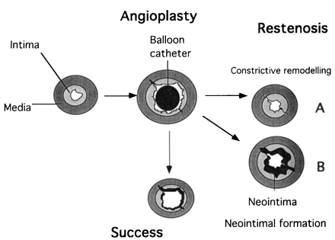
Fig. 1 Illustration of constrictive remodelling after angioplasty. The angioplasty balloon induces intimal plaque ...
Notes:
Fig. 1 Illustration of constrictive remodelling after angioplasty. The angioplasty balloon induces intimal plaque rupture, with tears often extending into the media and a dilation of the vessel (as assessed by the circumference of the internal elastic lamina). The artery can restenose by a combination of constrictive remodelling, where the whole vessel narrows down to its pre-angioplasty size without any significant change in the overall intimal size (A), or an increase in neointima, with little change in arterial circumference after angioplasty (B). In human restenosis, the likely mechanisms include a combination of both processes.
Unless provided in the caption above, the following copyright applies to the content of this slide: Copyright © 1999, European Society of Cardiology

