Slide 1
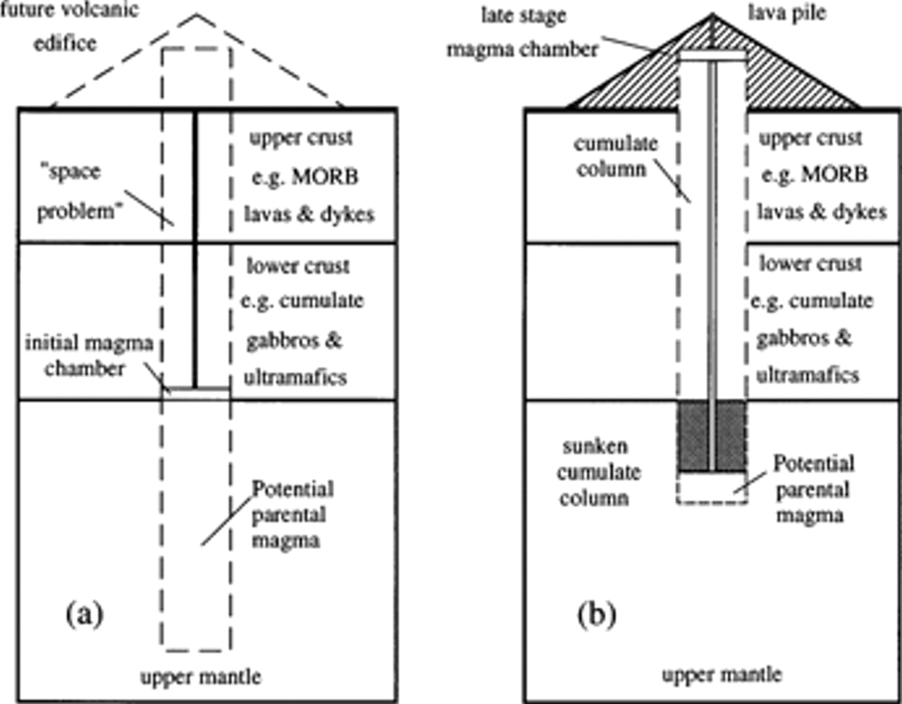
Fig. 1. Schematic illustration of (a) the initial and (b) the late stages of the postulated model for ocean island ...
Notes:
Fig. 1. Schematic illustration of (a) the initial and (b) the late stages of the postulated model for ocean island volcano development.
Unless provided in the caption above, the following copyright applies to the content of this slide: © Oxford University Press 1998

Slide 2
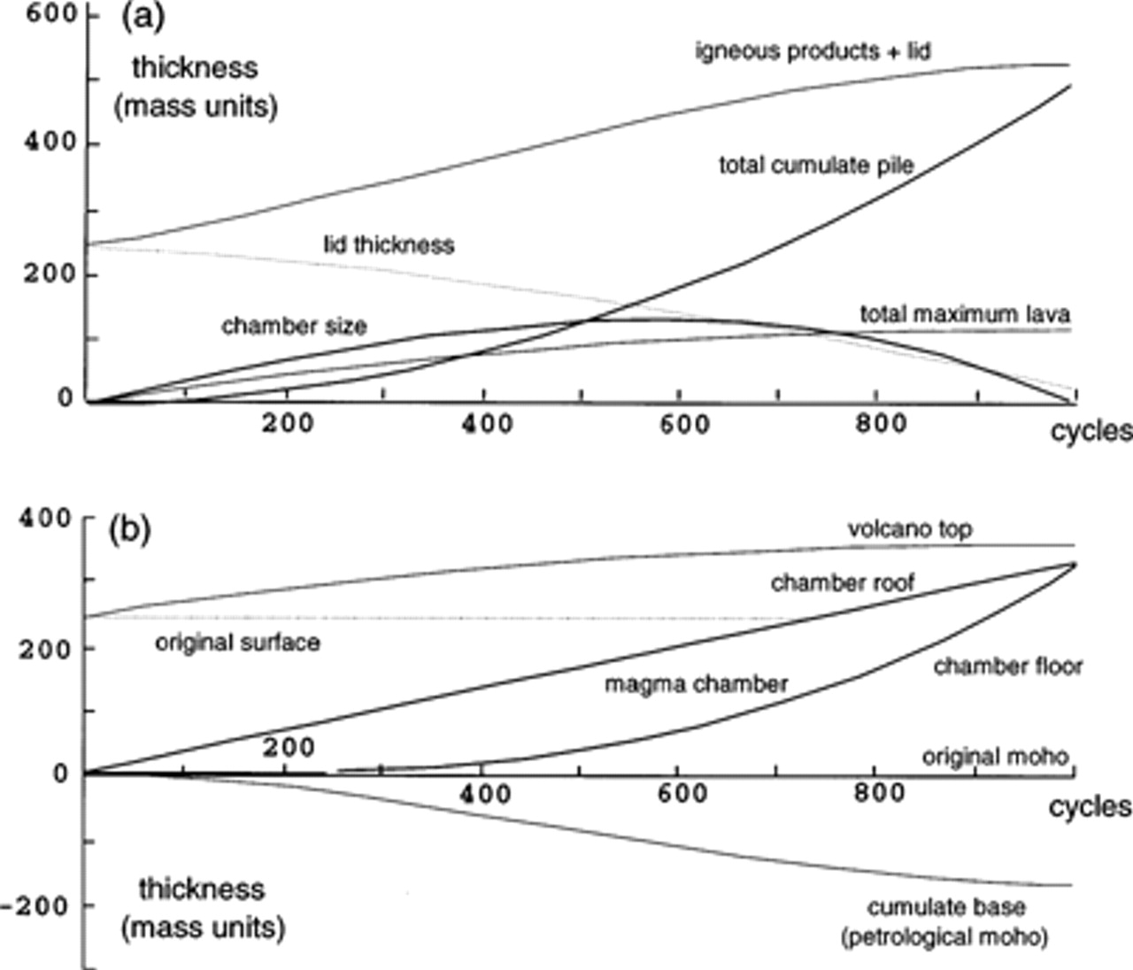
Fig. 2. Evolution of selected aspects of unit thicknesses in the evolving model volcano in model A as a function of ...
Notes:
Fig. 2. Evolution of selected aspects of unit thicknesses in the evolving model volcano in model A as a function of the number of replenishment–assimilation–crystallization–eruption cycles. Further description is given in the text.
Unless provided in the caption above, the following copyright applies to the content of this slide: © Oxford University Press 1998

Slide 3
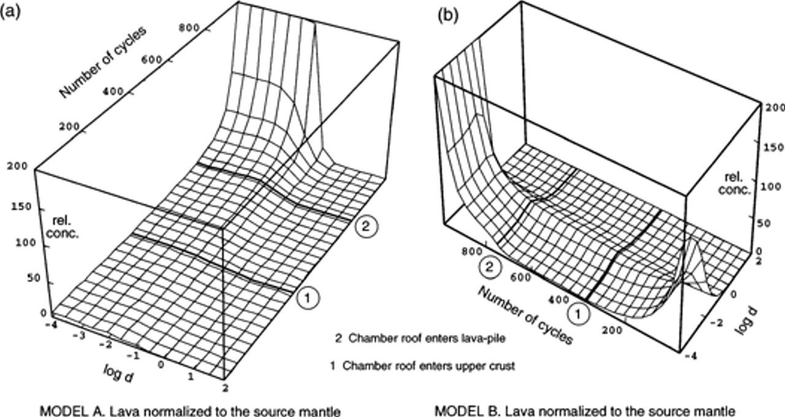
Fig. 3. Concentrations of ideally behaved trace elements in the products of models A and B, all normalized to the ...
Notes:
Fig. 3. Concentrations of ideally behaved trace elements in the products of models A and B, all normalized to the source mantle composition and expressed as functions of the number of cycles and of the distribution coefficient (the latter plotted on a logarithmic scale). Values of the relative concentration are here expressed as simple ratios. Further discussion is given in the text.
Unless provided in the caption above, the following copyright applies to the content of this slide: © Oxford University Press 1998

Slide 4
Fig. 4. Ideally behaved trace element concentrations in the products as a function of the crystal–liquid distribution ...
Notes:
Fig. 4. Ideally behaved trace element concentrations in the products as a function of the crystal–liquid distribution coefficient (logarithmic scales), and of the number of replenishment–assimilation–crystallization–eruption cycles, normalized to the initial source mantle composition. The close relationship between these plots and primitive mantle normalized trace element plots is emphasized by the inclusion of more conventionally labelled scales of concentration and distribution coefficient. The temptation to insert approximate positions of bulk distribution coefficients for some incompatible elements against the scale of crystal–liquid distribution coefficients has been resisted, because they differ substantially between the peridotite partial melting stage and the gabbro-crystallization stage (this is a persistent weakness of ‘spidergrams’ if gabbro fractionation has been involved in the evolution of the liquids portrayed). It should be recalled also that the values plotted are not the effective distribution coefficients in these models during either the partial melting stage (because of the trapped liquid component, which ensures that no bulk distribution coefficient is less than 0.005) or the partial crystallization stage (because of the small packet crystallization effect, which in this specific case approximately doubles the simple crystal–liquid distribution coefficients). Lava products are shown as light continuous curves, crustal contaminants as heavy continuous curves, parental liquid inputs as dashed curves. Further description is given in the text.
Unless provided in the caption above, the following copyright applies to the content of this slide: © Oxford University Press 1998

Slide 5
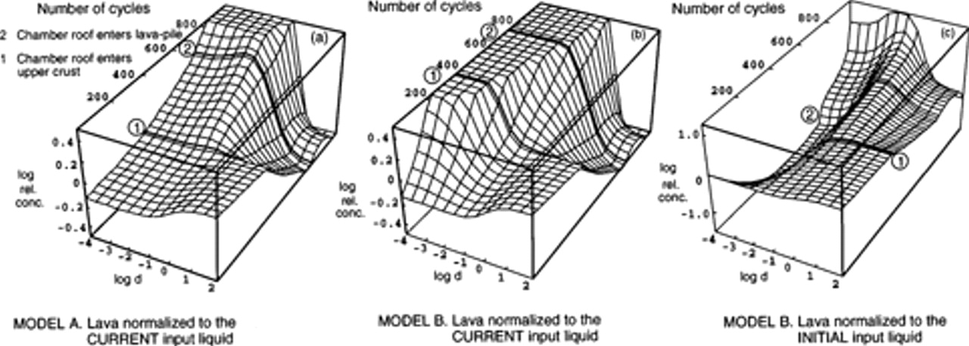
Fig. 5. Ideally behaved trace element behaviour in the products as a function of the number of ...
Notes:
Fig. 5. Ideally behaved trace element behaviour in the products as a function of the number of replenishment–assimilation–small packet crystallization–eruption cycles, normalized to the current or initial input magma compositions. (Note the logarithmic scales for distribution coefficient and relative concentration.) The surfaces are plotted from tables of values calculated at intervals of 37 cycles in (a) and (b), and 27 cycles in (c). These intervals do not coincide exactly with major events in the advance of the roof of the magma chamber. Further description is given in the text.
Unless provided in the caption above, the following copyright applies to the content of this slide: © Oxford University Press 1998

