Slide 1
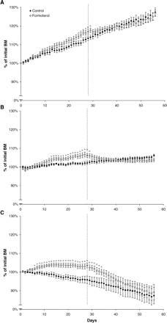
Figure 1. Graphs depicting the changes in body mass (BM) (relative to initial) throughout the formoterol treatment (28 ...
Notes:
Figure 1. Graphs depicting the changes in body mass (BM) (relative to initial) throughout the formoterol treatment (28 days) and withdrawal period (a further 28 days) in young (A), adult (B), and old (C) rats. Note that at 28 days following treatment, BM was greatest in formoterol-treated groups, and immediately following the withdrawal of formoterol, BM decreased in all age groups. *p <.05, treated versus age-matched control
Unless provided in the caption above, the following copyright applies to the content of this slide: Copyright 2007 by The Gerontological Society of America

Slide 2
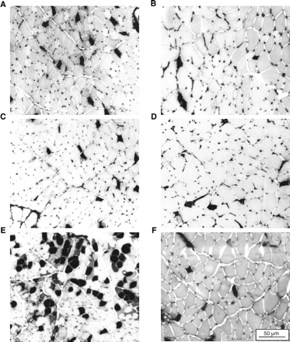
Figure 2. Extensor digitorum longus (EDL) muscle sections from young, adult, and old control rats (A, C, and E) and ...
Notes:
Figure 2. Extensor digitorum longus (EDL) muscle sections from young, adult, and old control rats (A, C, and E) and formoterol-treated rats (B, D, and F) reacted for mATPase at a preincubation pH of 4.3. Dark stained fibers are slow type I, and light gray fibers are fast-type II isoforms. EDL muscles from old control rats had a greater proportion of type I fibers, and formoterol treatment resulted in a decrease in the proportion of type I fibers
Unless provided in the caption above, the following copyright applies to the content of this slide: Copyright 2007 by The Gerontological Society of America

Slide 3
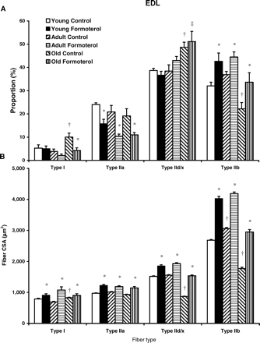
Figure 3. Fiber type proportions (A) and corresponding fiber cross-sectional area (CSA; B) in the extensor digitorum ...
Notes:
Figure 3. Fiber type proportions (A) and corresponding fiber cross-sectional area (CSA; B) in the extensor digitorum longus (EDL) muscles of control and formoterol-treated young, adult, and old rats. EDL muscles from old control rats had a significantly greater proportion of type I fibers, whereas formoterol treatment resulted in a shift toward the fast-type IIb fibers at all ages. *p <.05, treated versus age-matched control; †p <.05 versus preceding age control; ‡p <.05, old formoterol versus adult control
Unless provided in the caption above, the following copyright applies to the content of this slide: Copyright 2007 by The Gerontological Society of America

Slide 4
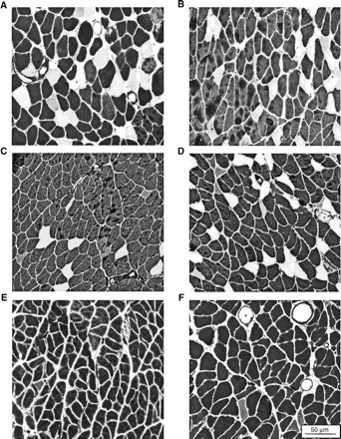
Figure 4. Soleus muscle sections from young, adult, and old control rats (A, C, and E) and formoterol-treated rats (B, ...
Notes:
Figure 4. Soleus muscle sections from young, adult, and old control rats (A, C, and E) and formoterol-treated rats (B, D, and F) reacted for mATPase at a preincubation pH of 4.3. Soleus muscles from old control rats had a greater proportion of type I fibers, and in soleus muscles from young and adult rats formoterol treatment caused a decrease in the proportion of type I fibers
Unless provided in the caption above, the following copyright applies to the content of this slide: Copyright 2007 by The Gerontological Society of America

Slide 5
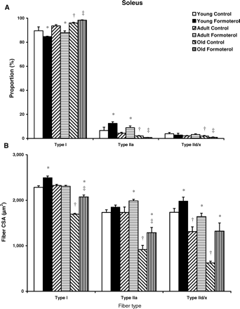
Figure 5. Fiber type proportions (A) and corresponding fiber cross-sectional area (CSA; B) in the soleus muscles of ...
Notes:
Figure 5. Fiber type proportions (A) and corresponding fiber cross-sectional area (CSA; B) in the soleus muscles of control and formoterol-treated young, adult, and old rats. Soleus muscles from old rats exhibited an increased proportion of type I fibers. Formoterol treatment increased the proportion of type IIa fibers in soleus muscles from young and adult, but not old rats. *p <.05, treated versus age-matched control; †p <.05, versus preceding age control; ‡p <.05, old formoterol versus adult control
Unless provided in the caption above, the following copyright applies to the content of this slide: Copyright 2007 by The Gerontological Society of America

Slide 6
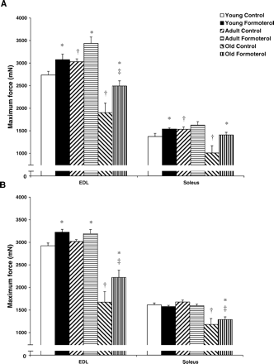
Figure 6. Maximum force-producing capacity of extensor digitorum longus (EDL) and soleus muscles following 28 days of ...
Notes:
Figure 6. Maximum force-producing capacity of extensor digitorum longus (EDL) and soleus muscles following 28 days of formoterol treatment (A) and 28 days of withdrawal (B). Even after 28 days of withdrawal, EDL force-producing capacity was significantly greater following formoterol treatment at all age groups. *p <.05, treated versus age-matched control; †p <.05, versus preceding age control; ‡p <.05, old formoterol versus adult control
Unless provided in the caption above, the following copyright applies to the content of this slide: Copyright 2007 by The Gerontological Society of America

Slide 7
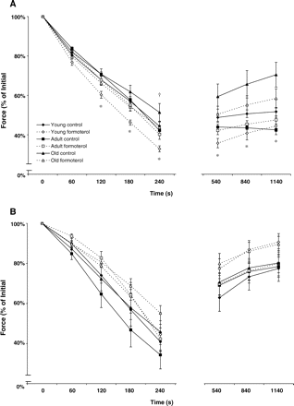
Figure 7. Fatigue and recovery for extensor digitorum longus (EDL) muscles (A) and soleus muscles (B) from control and ...
Notes:
Figure 7. Fatigue and recovery for extensor digitorum longus (EDL) muscles (A) and soleus muscles (B) from control and formoterol-treated young, adult, and old rats. Formoterol treatment was associated with a decrease in fatigue resistance and recovery in EDL muscles from young and old rats. *p <.05, young treated versus age-matched control; †p <.05, versus preceding age control; ‡p<.05, old formoterol versus adult control
Unless provided in the caption above, the following copyright applies to the content of this slide: Copyright 2007 by The Gerontological Society of America

