Slide 1
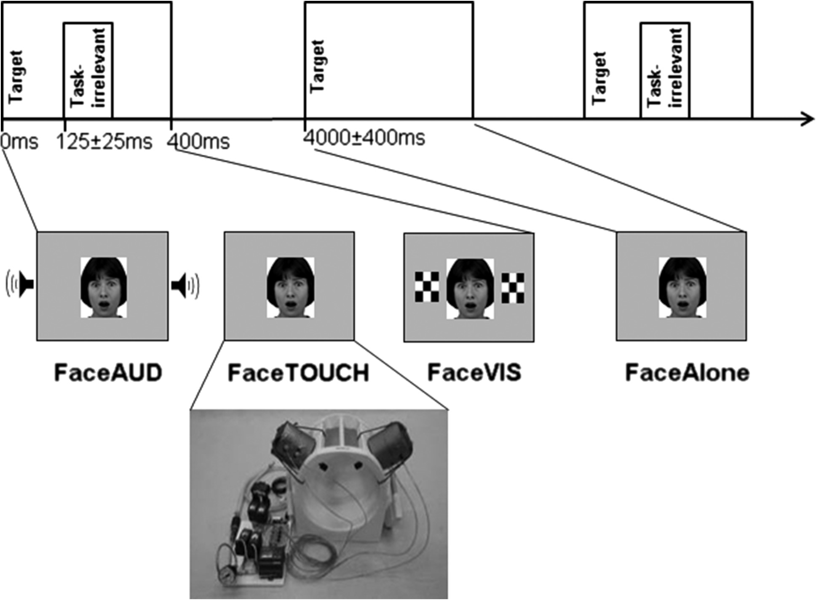
Figure 1. Trial structure. Participants judged the gender of a face (the target), which could be either neutral (NEU ...
Notes:
Figure 1. Trial structure. Participants judged the gender of a face (the target), which could be either neutral (NEU condition) or fearful (NEG condition). Faces were presented either alone (FaceAlone condition) or concomitantly with one of the three task-irrelevant sensory stimuli, which subjects were instructed to ignore. These consisted of either a binaural complex tone (FaceAud condition), a single nonpainful tap applied to both lower cheeks (FaceTouch condition), or 2 flickering checkerboards on screen (FaceVis condition).
Unless provided in the caption above, the following copyright applies to the content of this slide: © The Author 2016. Published by Oxford University Press.This is an Open Access article distributed under the terms of the Creative Commons Attribution Non-Commercial License (http://creativecommons.org/licenses/by/4.0/), which permits non-commercial re-use, distribution, and reproduction in any medium, provided the original work is properly cited. For commercial re-use, please contact journals.permissions@oup.com

Slide 2
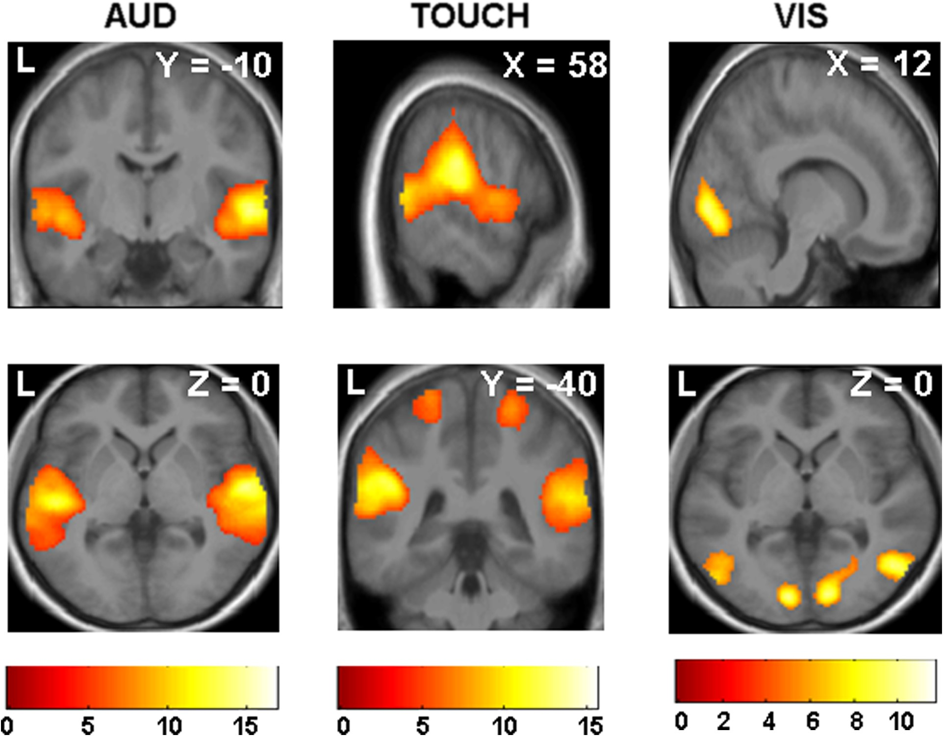
Figure 2. Processing of task-irrelevant stimuli across emotion conditions. Main BOLD activations for all FaceAud versus ...
Notes:
Figure 2. Processing of task-irrelevant stimuli across emotion conditions. Main BOLD activations for all FaceAud versus FaceAlone trials (left) were located in bilateral Heschl's gyrus and higher auditory regions. Main BOLD activations for all FaceTouch versus FaceAlone trials (middle) were located in bilateral S1 and left S2. Main BOLD activations for all FaceVis versus FaceAlone trials (right) were located in bilateral visual cortex. The plane coordinates of each slice are indicated in the upper right-hand corner. Bright colors represent significance levels of contrasts, as indicated by the scale bars (T values). BOLD responses are rendered on an average anatomical image from all participants.
Unless provided in the caption above, the following copyright applies to the content of this slide: © The Author 2016. Published by Oxford University Press.This is an Open Access article distributed under the terms of the Creative Commons Attribution Non-Commercial License (http://creativecommons.org/licenses/by/4.0/), which permits non-commercial re-use, distribution, and reproduction in any medium, provided the original work is properly cited. For commercial re-use, please contact journals.permissions@oup.com

Slide 3
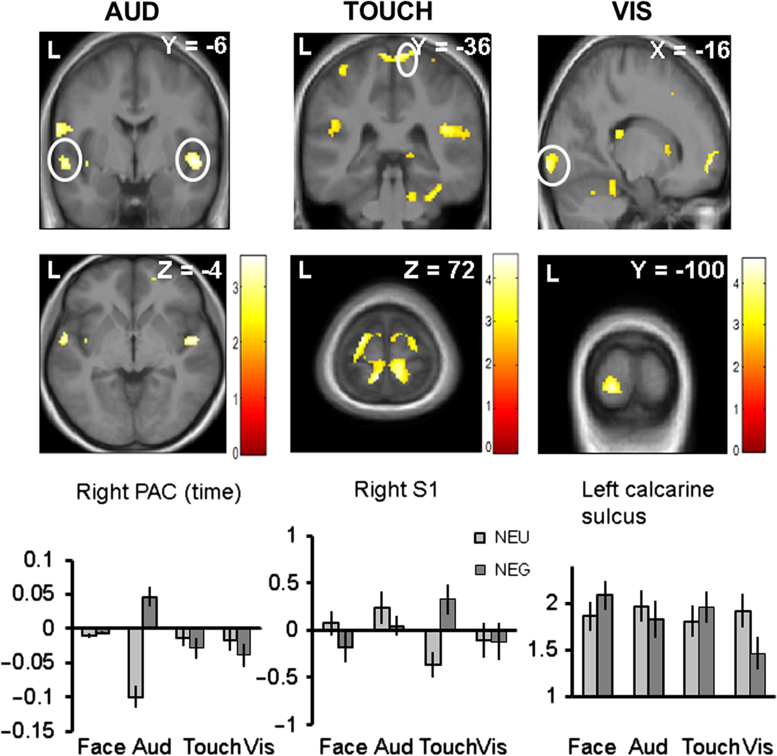
Figure 3. Emotion effects on sensory responses. Left: auditory processing (FaceAud > FaceAlone with fearful ...
Notes:
Figure 3. Emotion effects on sensory responses. Left: auditory processing (FaceAud > FaceAlone with fearful faces) > (FaceAud > FaceAlone with neutral faces). Bilateral activations in PAC (upper panel), representing selective increase to tones during fearful faces which habituated over time, together with the plot of time-dependent responses (±SEM, bottom panel) across conditions for the right PAC peak (mean x y z, 52 −6 −4; P FaceAlone with fearful faces) > (FaceTouch > FaceAlone with neutral faces). Bilateral increases in primary somatosensory cortex (S1) during fearful faces and average activity (±SEM, bottom middle) across conditions for the right S1 peak (mean x y z, 10 −36 72; P FaceAlone with neutral faces) > (FaceVis > FaceAlone with fearful faces) and average activity (±SEM, bottom right) across conditions for the left calcarine sulcus peak (mean x y z, −16 −100 −6; P < 0.005 for illustration). Aud: FaceAud condition; Touch: FaceTouch condition; Vis: FaceVis condition. The plane coordinates of each slice are indicated in the upper right-hand corner. Bright colors represent significance levels of contrasts, as indicated by the scale bars (T values). BOLD responses are rendered on an average anatomical image from all participants.
Unless provided in the caption above, the following copyright applies to the content of this slide: © The Author 2016. Published by Oxford University Press.This is an Open Access article distributed under the terms of the Creative Commons Attribution Non-Commercial License (http://creativecommons.org/licenses/by/4.0/), which permits non-commercial re-use, distribution, and reproduction in any medium, provided the original work is properly cited. For commercial re-use, please contact journals.permissions@oup.com

Slide 4
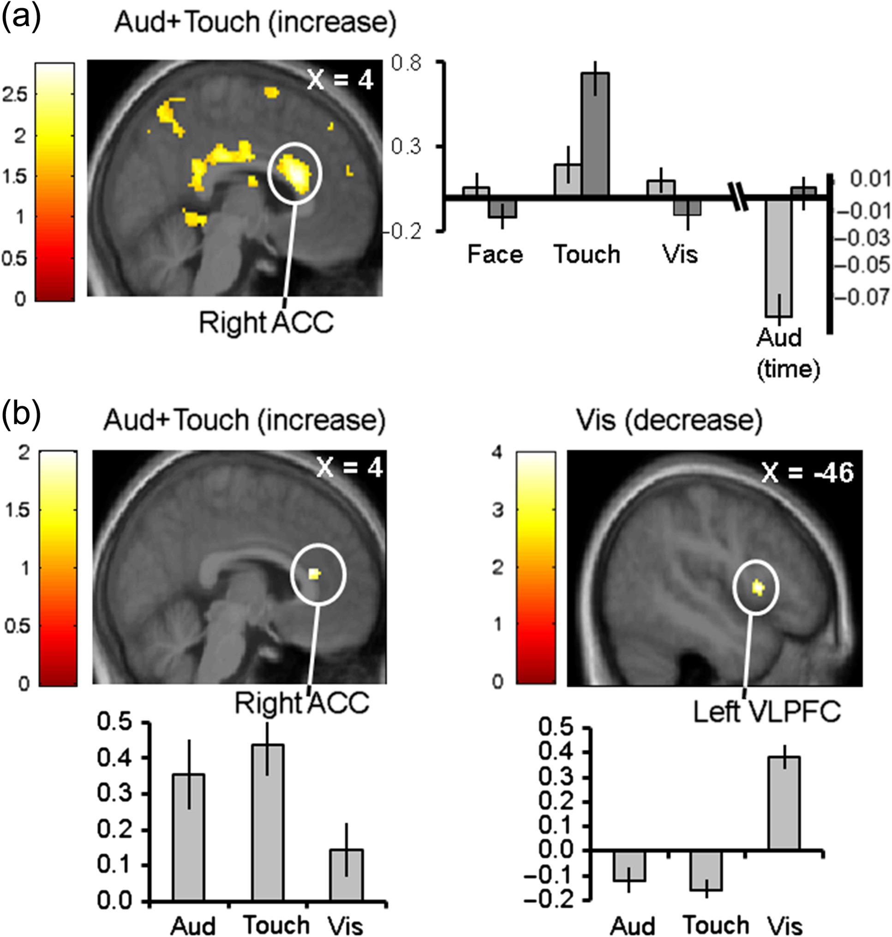
Figure 4. Conjunction effects and functional connectivity. (a) Conjunction analysis of the main emotion effects for the ...
Notes:
Figure 4. Conjunction effects and functional connectivity. (a) Conjunction analysis of the main emotion effects for the Auditory and Touch conditions (NEG > NEU), the 2 sensory modalities showing an increase in the modality-specific contrasts. Average neural activity (±SEM) is plotted (right panel) across conditions for the right anterior cingulate cortex (ACC) peak (mean x y z, 4 20 20; P < 0.005 for illustration). The auditory condition is plotted using a different scale to illustrate the time-dependent responses (see Fig. 3 and Materials and Methods), which reflect habituation effects observed in this modality (i.e., showing greater habituation for NEU compared with NEG trials). (b) PPI maps identifying brain regions functionally connected to the sensory areas that exhibited increased response in the emotional condition (Auditory and Touch; left panel), or decreased response during the emotional condition (Visual; right panel). PPI parameters (±SEM, bottom panel) are plotted across conditions for the right ACC peak (x y z, 4 30 14; P < 0.005 for illustration) that correlated with sensory increases (Audition and Touch), and for the left VLPFC peak (x y z, −46 12 6; P NEU for FaceAud and FaceTouch but NEU > NEG for the FaceVis condition). The functional contrasts used as psychological variables for PPI computation where NEG > NEU in all 3 sensory conditions, but considering the negative correlation effects for the visual seed. Coordinates of the depicted brain slice are indicated in the upper right-hand corner. Bright colors represent significance levels of contrasts, as indicated by the scale bars (T values). BOLD responses are rendered on an average anatomical image from all participants.
Unless provided in the caption above, the following copyright applies to the content of this slide: © The Author 2016. Published by Oxford University Press.This is an Open Access article distributed under the terms of the Creative Commons Attribution Non-Commercial License (http://creativecommons.org/licenses/by/4.0/), which permits non-commercial re-use, distribution, and reproduction in any medium, provided the original work is properly cited. For commercial re-use, please contact journals.permissions@oup.com

