Slide 1
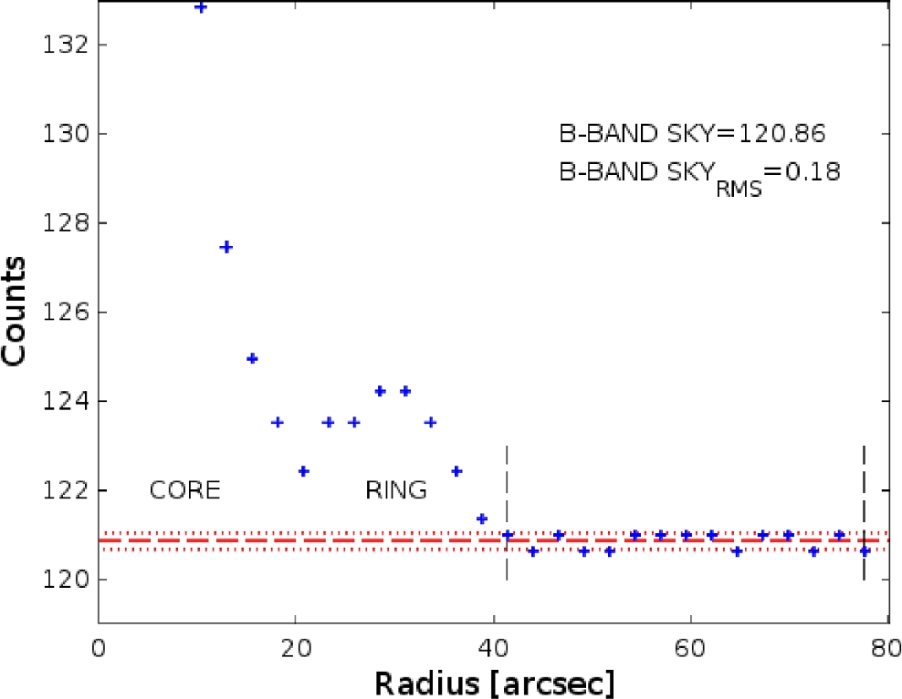
Figure 1. This figure illustrates our sky estimation. The isophotal intensity in counts of fixed ellipses fitted every ...
Notes:
Figure 1. This figure illustrates our sky estimation. The isophotal intensity in counts of fixed ellipses fitted every 10 pixels. The region between the vertical dashed lines is used to estimate the sky value, which is indicated as horizontal dashed line together with the two dotted lines at ±1σ.
Unless provided in the caption above, the following copyright applies to the content of this slide: © 2016 The Authors Published by Oxford University Press on behalf of the Royal Astronomical Society

Slide 2
Figure 2. The images of PGC 1000714 in the NUV, B, I, J and W3-band are shown from left to right, respectively. For ...
Notes:
Figure 2. The images of PGC 1000714 in the NUV, B, I, J and W3-band are shown from left to right, respectively. For each image, the size is 75 arcsec × 90 arcsec, and the north is up while the east is on the left. The appearance of the galaxy in the NUV and optical bands is fairly similar to Hoag's Object.
Unless provided in the caption above, the following copyright applies to the content of this slide: © 2016 The Authors Published by Oxford University Press on behalf of the Royal Astronomical Society

Slide 3
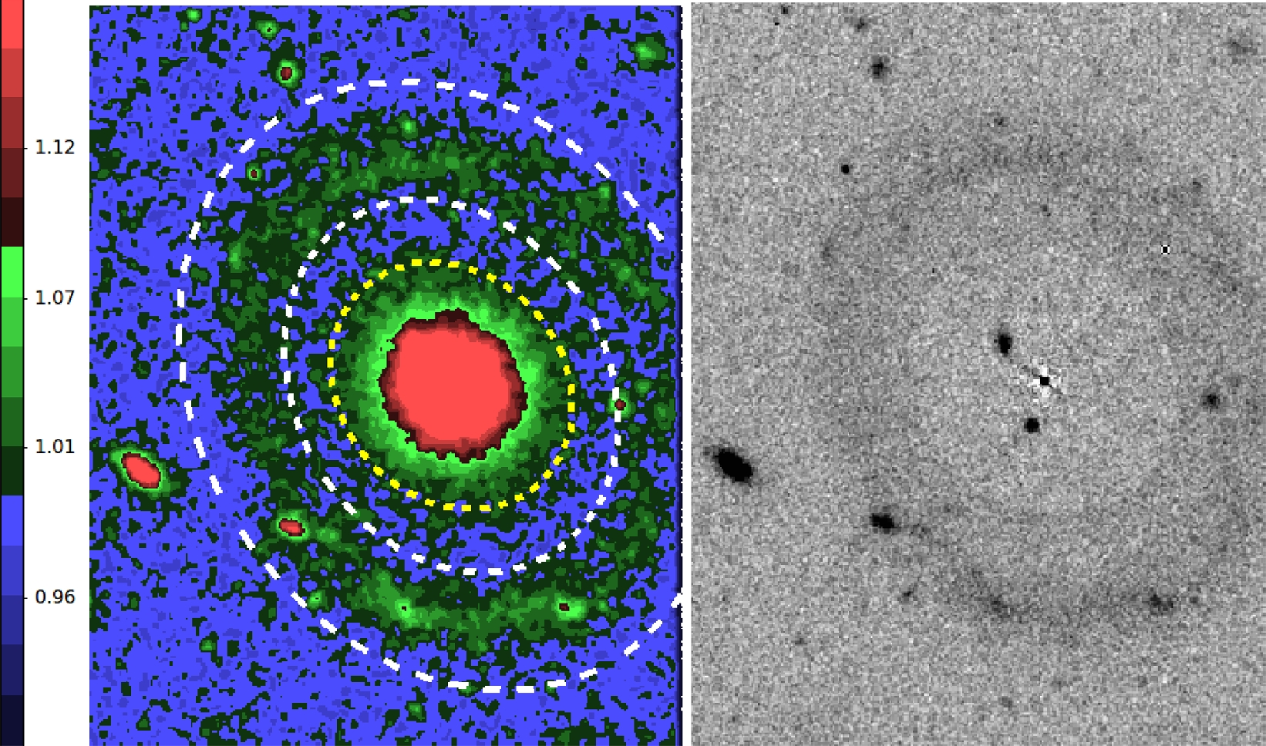
Figure 3. Left-hand panel shows the high-frequency residual B-band image of PGC 1000714, which is obtained using a ...
Notes:
Figure 3. Left-hand panel shows the high-frequency residual B-band image of PGC 1000714, which is obtained using a window size of 301 × 301 pixels in order to get the optimum enhancement of the galaxy prominent structures. Any prominent component appears as a region with a value greater than 1. The bright central object appears as star like (or bulge like). The length of the semimajor axis (SMA) for the yellow ellipse is 18 arcsec, while those of the white ones are 25 and 41 arcsec. All three ellipses share the same centre. Right-hand panel shows the residual image that was produced by fitting ellipses to the core and subtracting the bmodel image from B-band image. Two background sources can be seen in the region where the bulge was subtracted, within the outer ring. The core does not show any underlying structure.
Unless provided in the caption above, the following copyright applies to the content of this slide: © 2016 The Authors Published by Oxford University Press on behalf of the Royal Astronomical Society

Slide 4
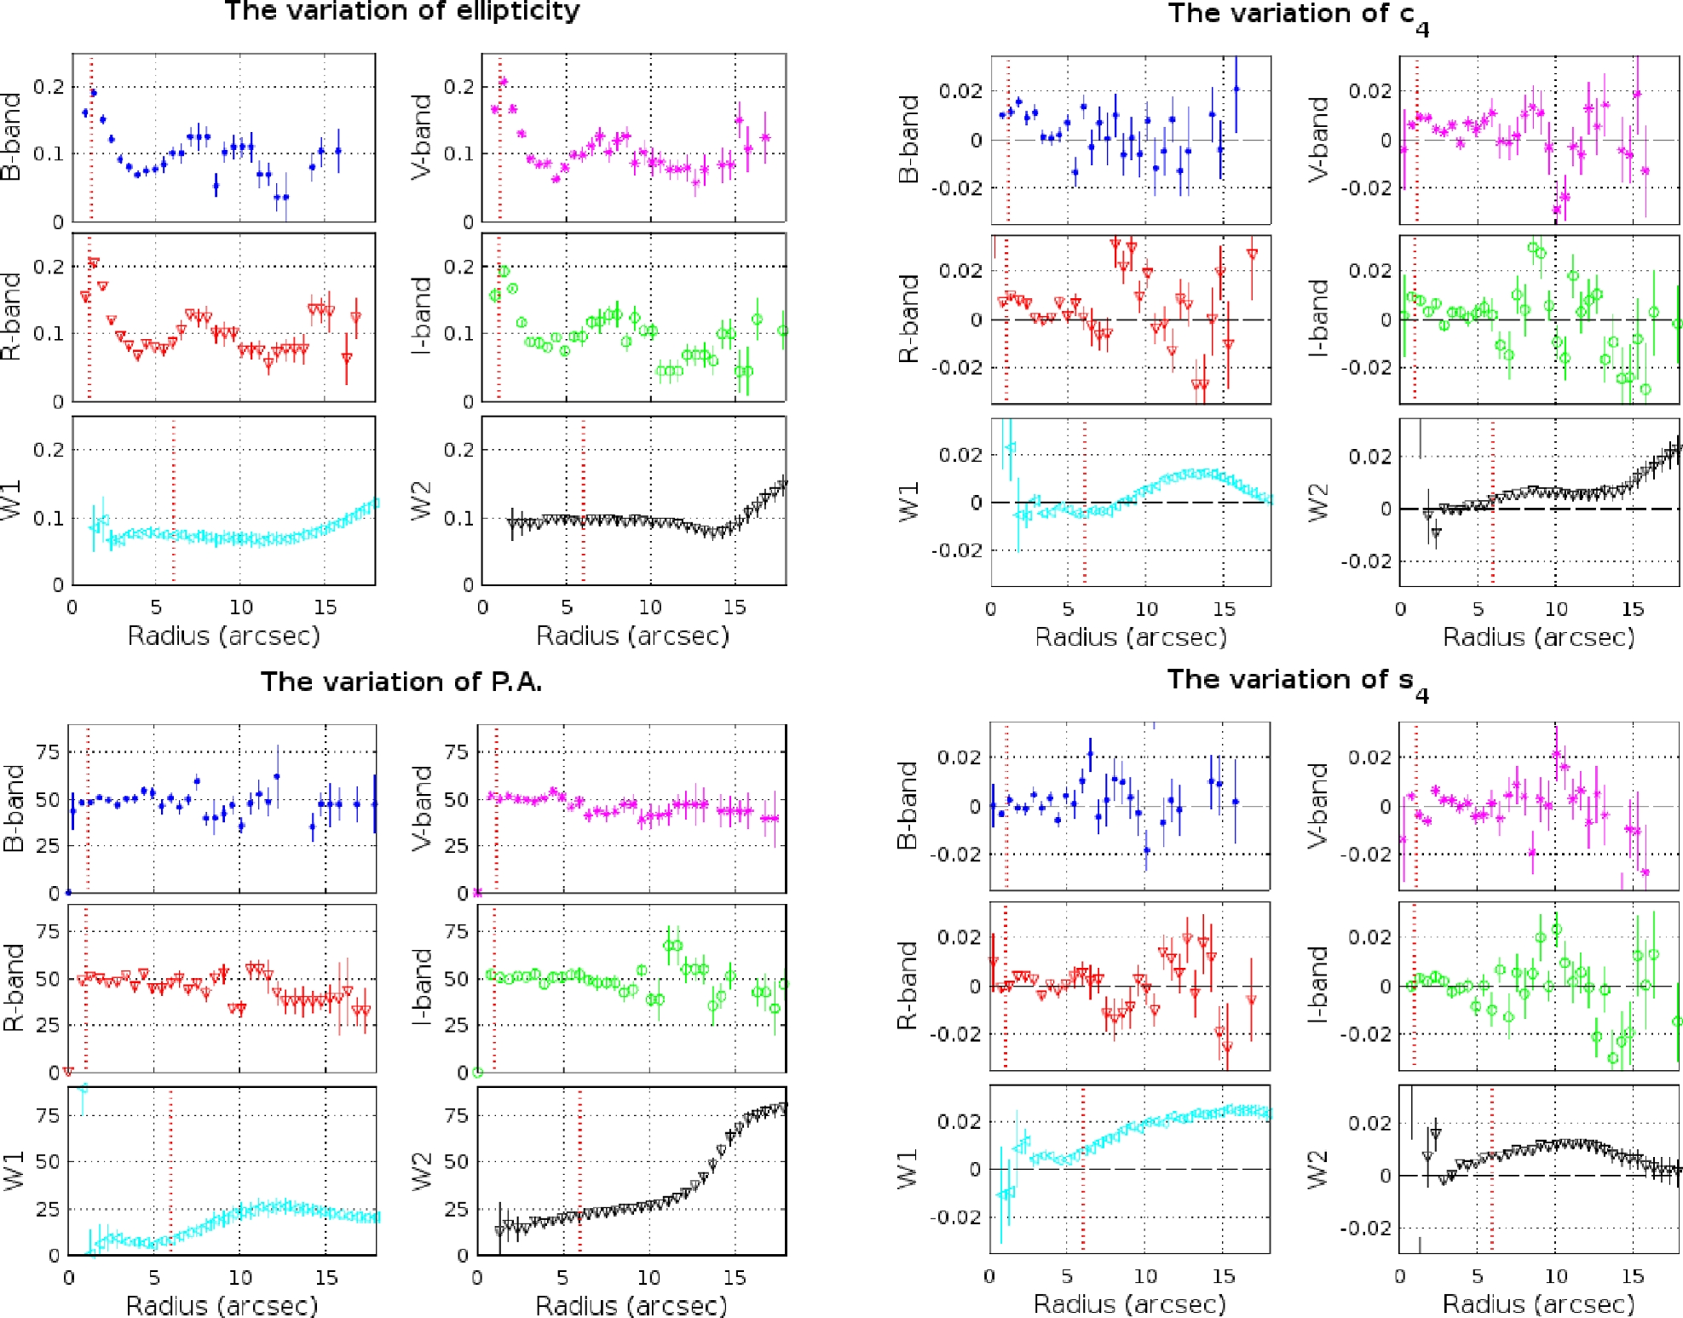
Figure 4. Left-top panel shows the variation of ellipticity. We only display the data whose error is less than 0.04 in ...
Notes:
Figure 4. Left-top panel shows the variation of ellipticity. We only display the data whose error is less than 0.04 in ε. Left-bottom panel shows the variation of PA. We only display the data whose error is less than 20$^\circ$ in PA. Both profiles are fairly smooth. Right-top panel shows the variation of c4. We only display the data whose error is less than 0.02 in c4. Right-bottom panel shows the variation of s4. We only display the data whose error is less than 0.02 in s4. Both c4 and s4 profiles are close to zero within inner 5 arcsec, then they start to experience some higher variations towards the outer radii. The FWHM of the PSF for each band is shown with the red vertical dotted line.
Unless provided in the caption above, the following copyright applies to the content of this slide: © 2016 The Authors Published by Oxford University Press on behalf of the Royal Astronomical Society

Slide 5
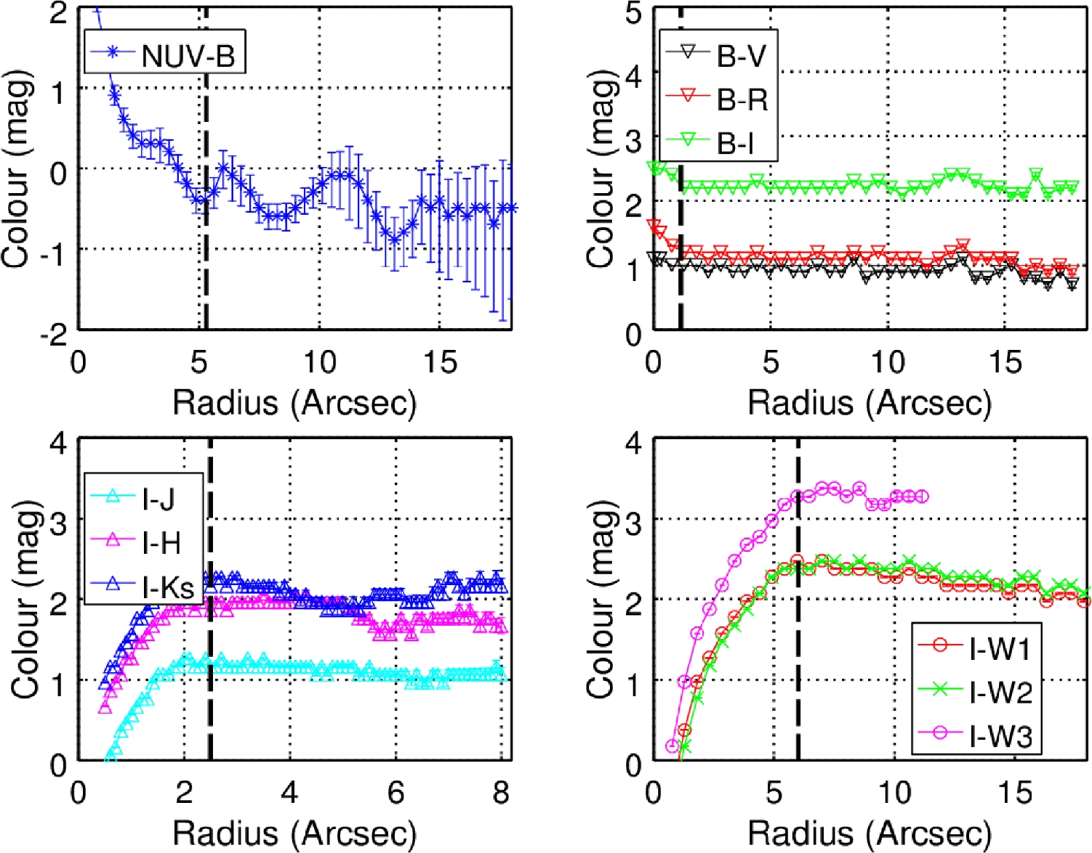
Figure 5. The colour gradients are shown: the NUV-B, optical (B−V, B−R, B−I), NIR (I−J, I−H and I−Ks) and MIR (I − W1, ...
Notes:
Figure 5. The colour gradients are shown: the NUV-B, optical (B−V, B−R, B−I), NIR (I−J, I−H and I−Ks) and MIR (I − W1, I − W2 and I − W3) colour plots. In the JHKs bands, the outer parts of the galaxy are unseen beyond ∼8 arcsec. The vertical red dashed line indicates the FWHM of the PSF in each band, e.g. top-left: ∼5 arcsec for NUV, ∼1 arcsec for optical, ∼2.5 arcsec for NIR and ∼6 arcsec for MIR. The optical colour indices of the galaxy present fairly constant radial profile, the others are not reliable due to the larger seeing FWHM.
Unless provided in the caption above, the following copyright applies to the content of this slide: © 2016 The Authors Published by Oxford University Press on behalf of the Royal Astronomical Society

Slide 6
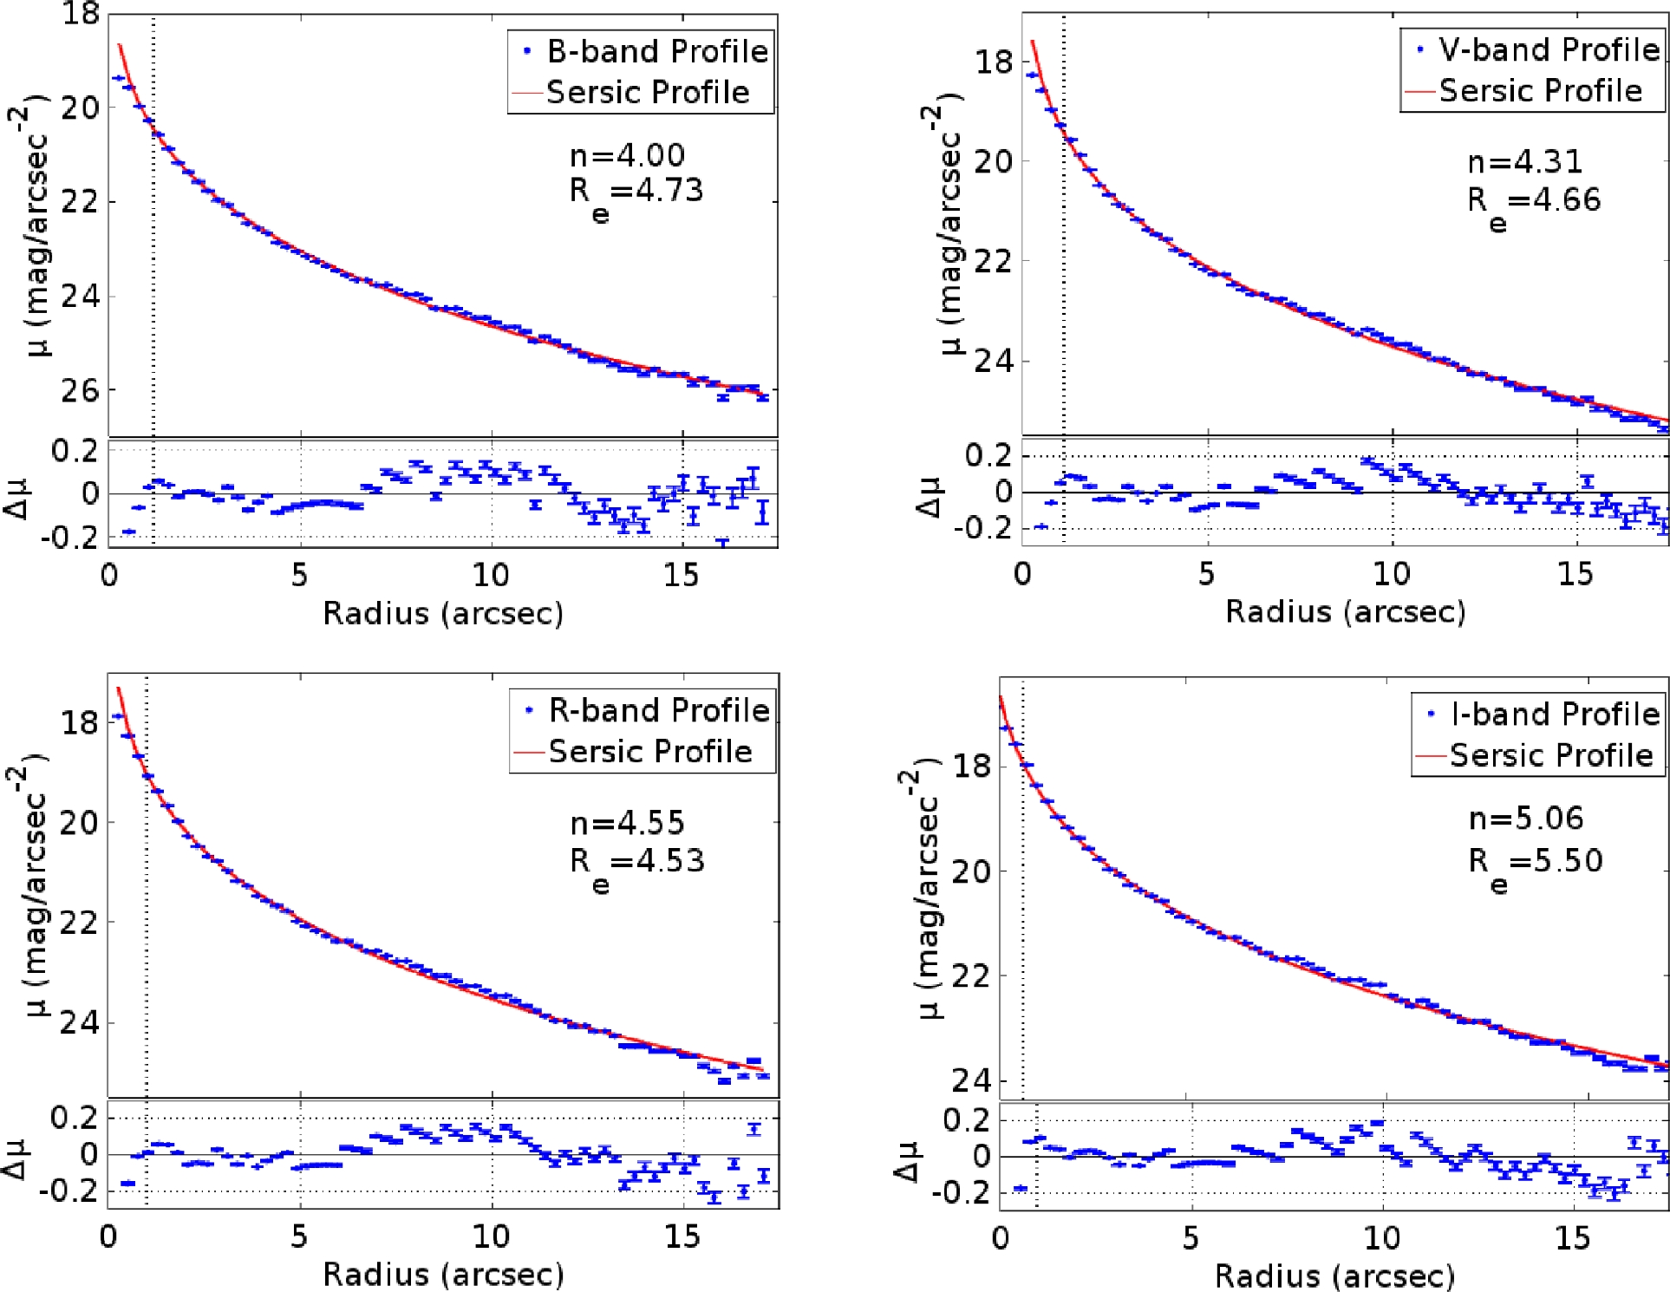
Figure 6. The best Sérsic model fit for the BVRI bands. The best-fitting r^{1/n} model in the B band gives ...
Notes:
Figure 6. The best Sérsic model fit for the BVRI bands. The best-fitting r1/n model in the B band gives n = 4, and the best fits in other bands give n values very close to 4. Re is the effective half light radius of the galaxy. The lower panels show the residuals from the best-fitting Sérsic profile to highlight deviations from the model.
Unless provided in the caption above, the following copyright applies to the content of this slide: © 2016 The Authors Published by Oxford University Press on behalf of the Royal Astronomical Society

Slide 7
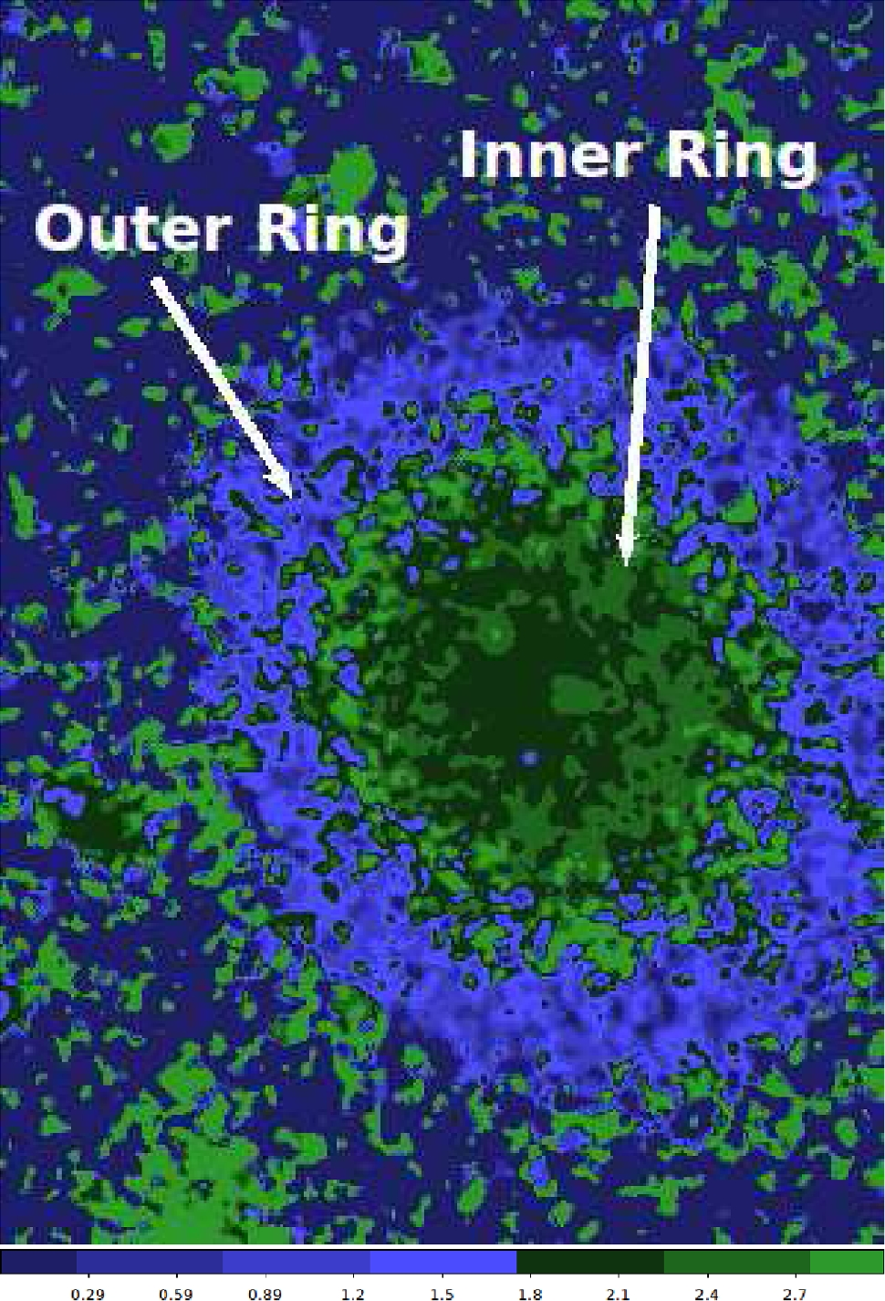
Figure 7. The 2D B − I colour index map is shown. Note that the light green colour scale reveals the existence of a ...
Notes:
Figure 7. The 2D B − I colour index map is shown. Note that the light green colour scale reveals the existence of a diffuse inner ring. Both the inner and outer ring are pointed by the white arrows. The size is 79 arcsec × 110 arcsec, and the north is up while the east is on the left.
Unless provided in the caption above, the following copyright applies to the content of this slide: © 2016 The Authors Published by Oxford University Press on behalf of the Royal Astronomical Society

Slide 8
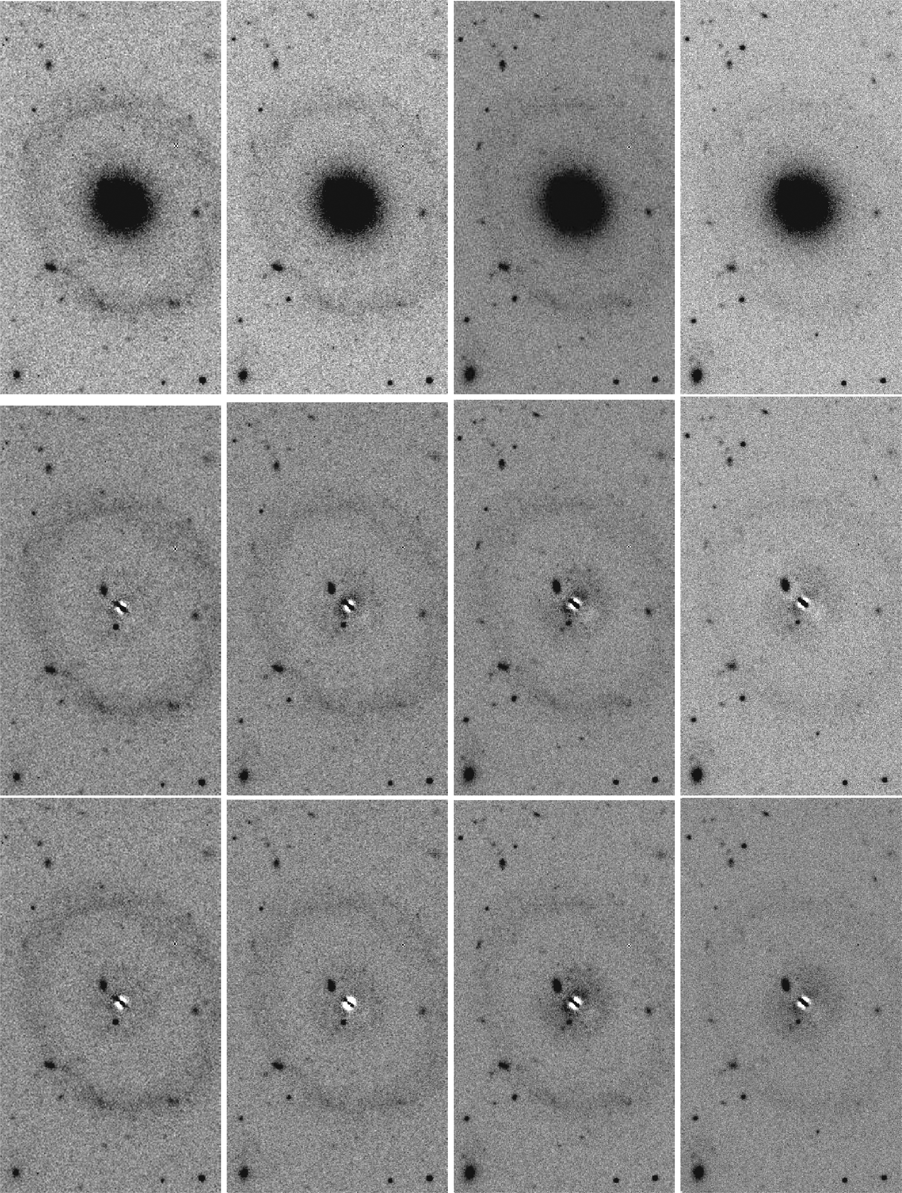
Figure 8. The 2D image decomposition is shown for the BVRI bands (from left to right, respectively). For each image, ...
Notes:
Figure 8. The 2D image decomposition is shown for the BVRI bands (from left to right, respectively). For each image, the size is 66 arcsec × 117 arcsec, and the north is up while the east is on the left. Top panel displays images of the original data, middle panel displays the residuals from Sérsic bulge model generated by galfit, in which the initial parameters are allowed to vary. Bottom panel displays the residuals from the Sérsic bulge model, but this time the initial parameters are fixed to the 1D fitting results obtain from MPFIT. While the presence of the inner ring is almost undetectable in the B-band residuals, it gradually becomes prominent in the VRI-band residuals.
Unless provided in the caption above, the following copyright applies to the content of this slide: © 2016 The Authors Published by Oxford University Press on behalf of the Royal Astronomical Society

Slide 9
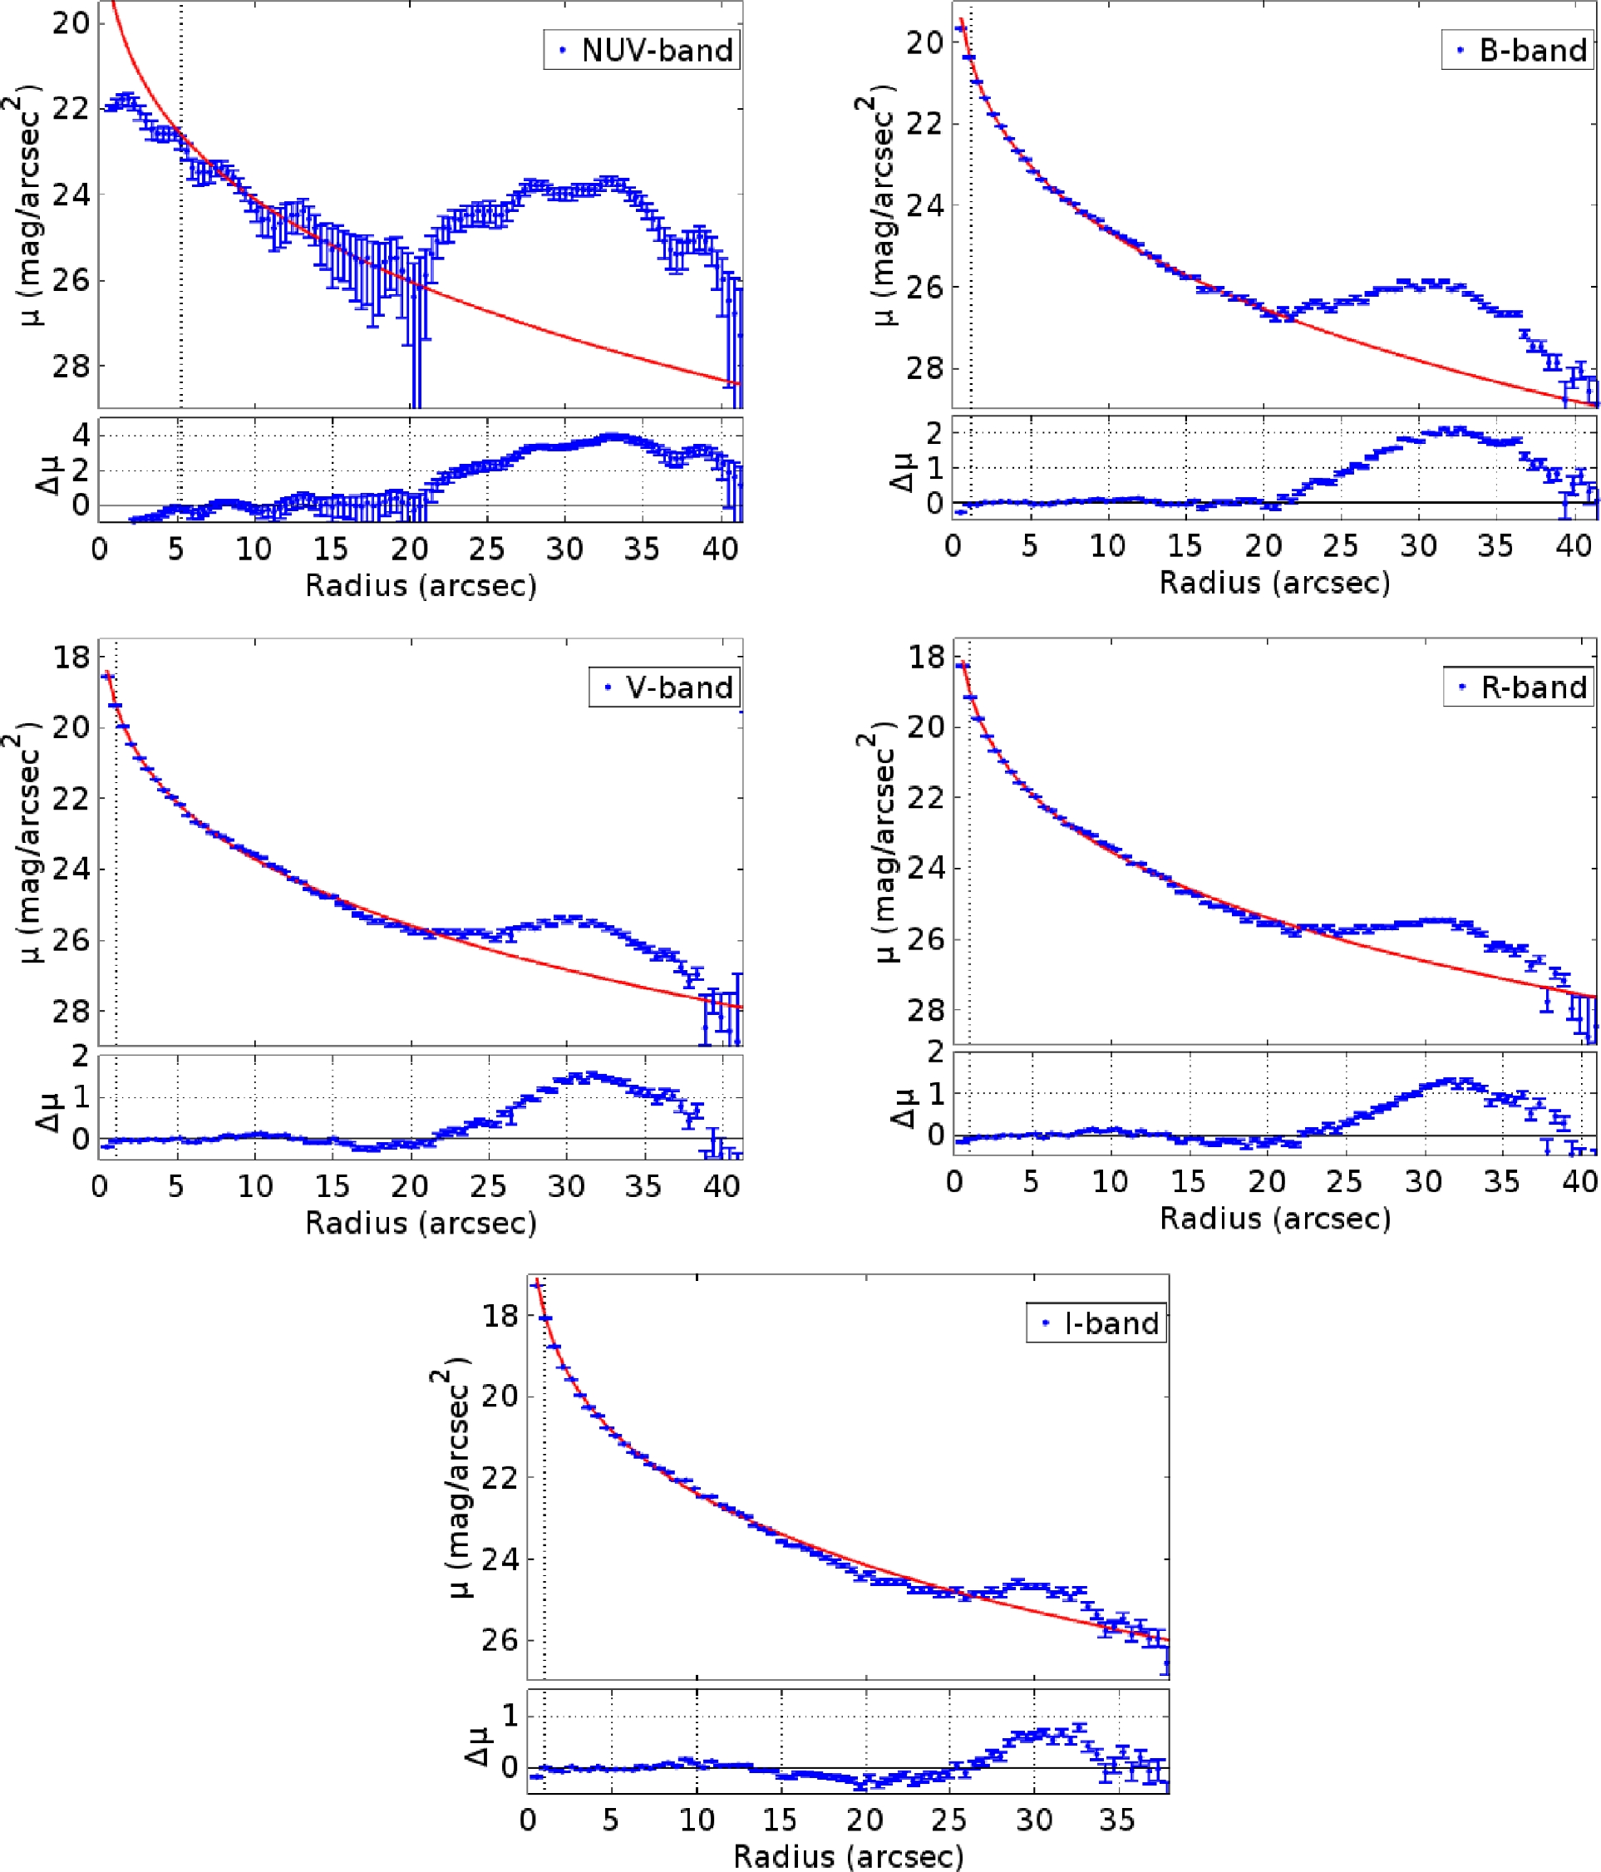
Figure 9. The light profiles of the galaxy with the outer ring are shown for the NUV and BVRI bands. The lower panels ...
Notes:
Figure 9. The light profiles of the galaxy with the outer ring are shown for the NUV and BVRI bands. The lower panels show the residual after the best-fitting core model in Fig. 6 is subtracted. The residuals reveal an inner ring at radius between ∼8 and ∼15 arcsec: it is very faint in the blue light and gets brighter towards redder light. In addition, the residuals show an outer ring at radius between ∼20 and ∼40 arcsec: It is very bright in the NUV light and gets fainter towards redder light.
Unless provided in the caption above, the following copyright applies to the content of this slide: © 2016 The Authors Published by Oxford University Press on behalf of the Royal Astronomical Society

Slide 10
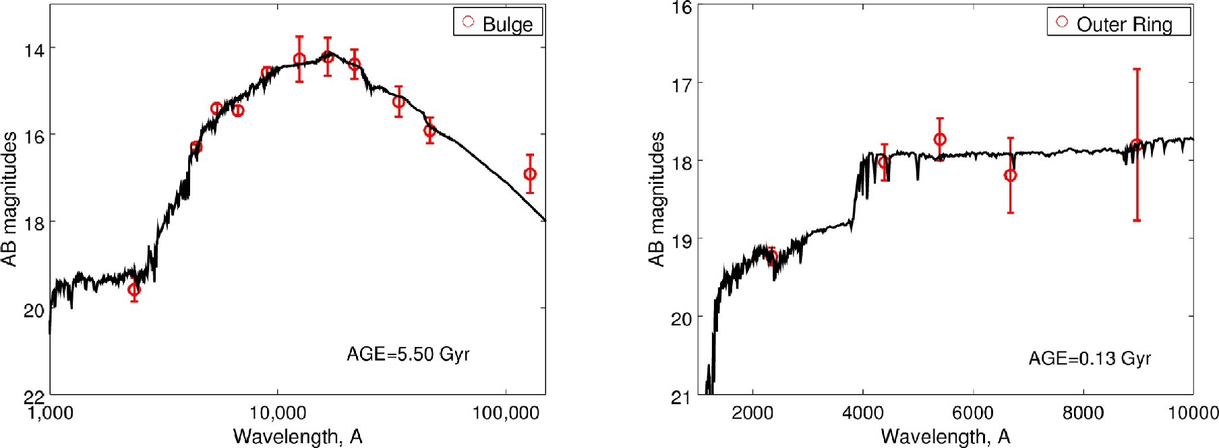
Figure 10. The observed SED of the core and the ring (red circles) with their best-fitting models (black solid lines) ...
Notes:
Figure 10. The observed SED of the core and the ring (red circles) with their best-fitting models (black solid lines) are shown. The y-axes show the flux units in AB magnitudes.
Unless provided in the caption above, the following copyright applies to the content of this slide: © 2016 The Authors Published by Oxford University Press on behalf of the Royal Astronomical Society

