Slide 1
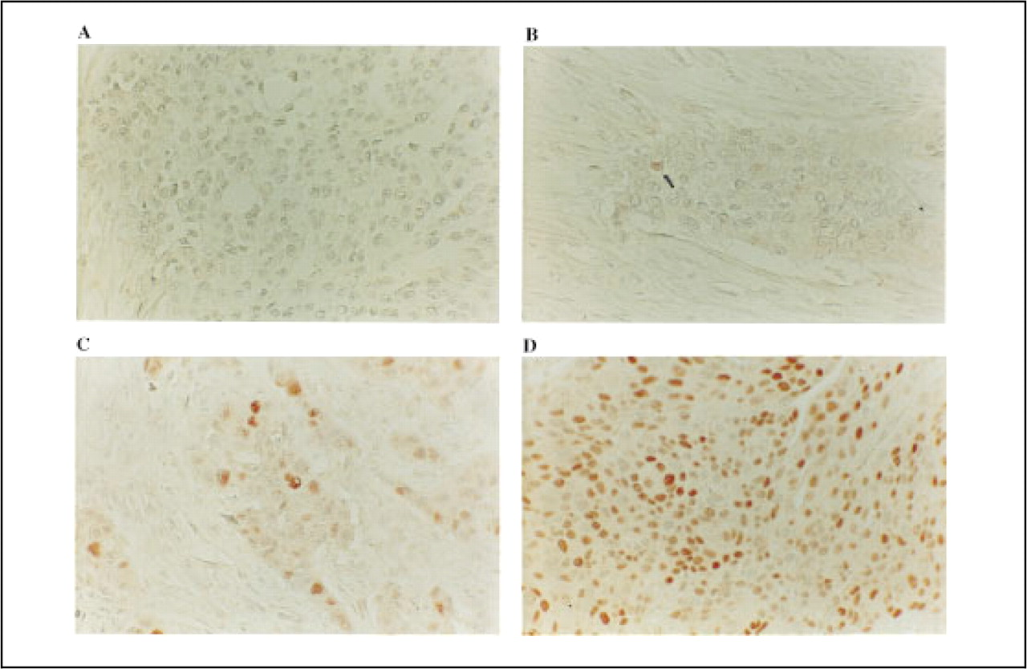
Fig. 1 Immunohistochemical detection of nuclear p21 protein in transitional cell carcinoma of the bladder by use of ...
Notes:
Fig. 1 Immunohistochemical detection of nuclear p21 protein in transitional cell carcinoma of the bladder by use of an anti-p21 monoclonal antibody [Waf(Ab1), dilution 1:20; (Oncogene Research Products)]. The hematoxylin counterstain is intentionally faint to better contrast nuclear immunoreactivity. A) No detectable nuclear reactivity [p21 (-)]; B) low-level nuclear reactivity [p21 (∓)]; single tumor cell nucleus shows p21 immunoreactivity (arrow); C) moderate nuclear reactivity [p21 (1°)]; and D) high-level nuclear reactivity [p21 (2°)]. All photomicrographs were taken at 200x magnification. See “Patients, Materials, and Methods” for more extensive definitions of p21 expression. Tumors with p21 (-) or (∓) immunoreactivity were considered p21 negative. Tumors with p21 (1°) or (2°) immunoreactivity were considered p21 positive.
Unless provided in the caption above, the following copyright applies to the content of this slide: © 1998 Oxford University Press

Slide 2
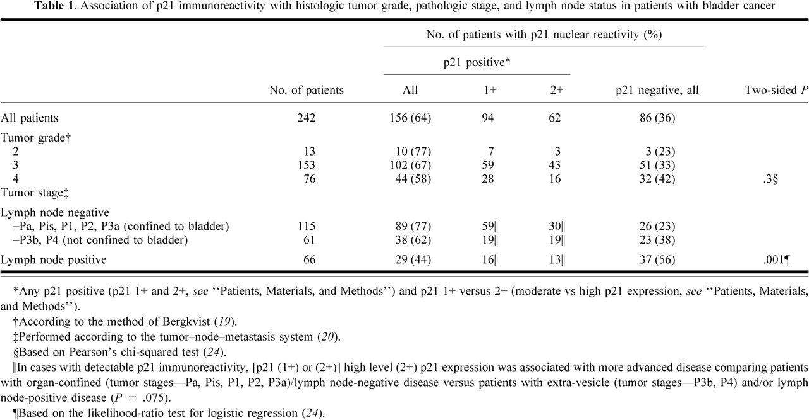
Notes:
Unless provided in the caption above, the following copyright applies to the content of this slide: © 1998 Oxford University Press

Slide 3
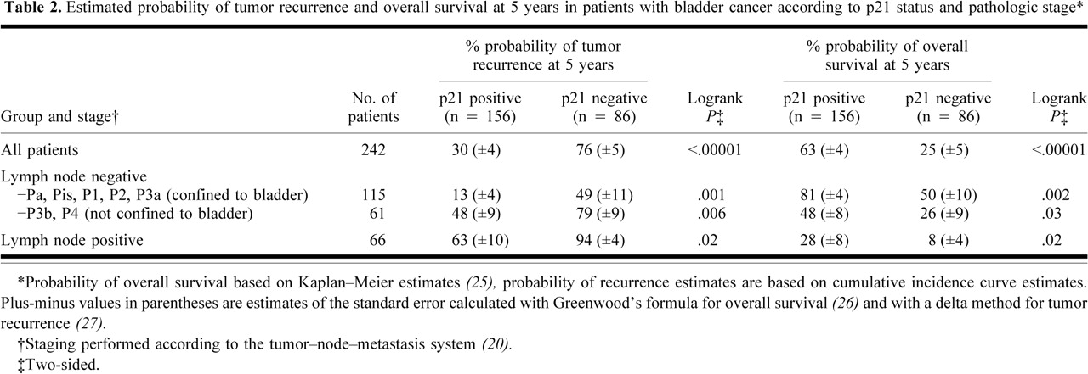
Notes:
Unless provided in the caption above, the following copyright applies to the content of this slide: © 1998 Oxford University Press

Slide 4
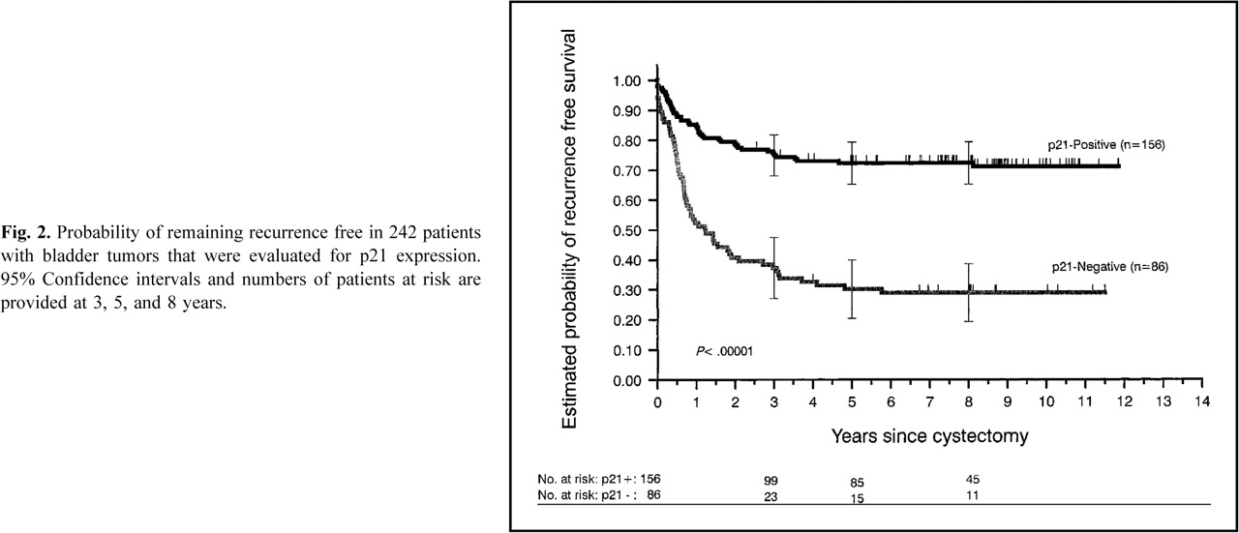
Fig. 2 Probability of remaining recurrence free in 242 patients with bladder tumors that were evaluated for p21 ...
Notes:
Fig. 2 Probability of remaining recurrence free in 242 patients with bladder tumors that were evaluated for p21 expression. 95% Confidence intervals and numbers of patients at risk are provided at 3, 5, and 8 years.
Unless provided in the caption above, the following copyright applies to the content of this slide: © 1998 Oxford University Press

Slide 5
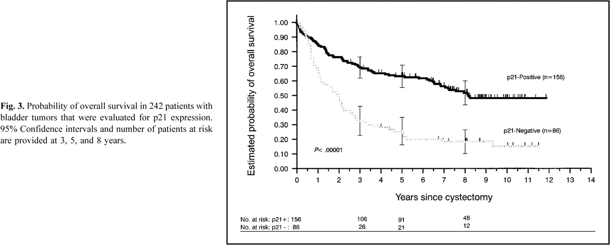
Fig. 3 Probability of overall survival in 242 patients with bladder tumors that were evaluated for p21 expression. ...
Notes:
Fig. 3 Probability of overall survival in 242 patients with bladder tumors that were evaluated for p21 expression. 95% Confidence intervals and number of patients at risk are provided at 3, 5, and 8 years.
Unless provided in the caption above, the following copyright applies to the content of this slide: © 1998 Oxford University Press

Slide 6
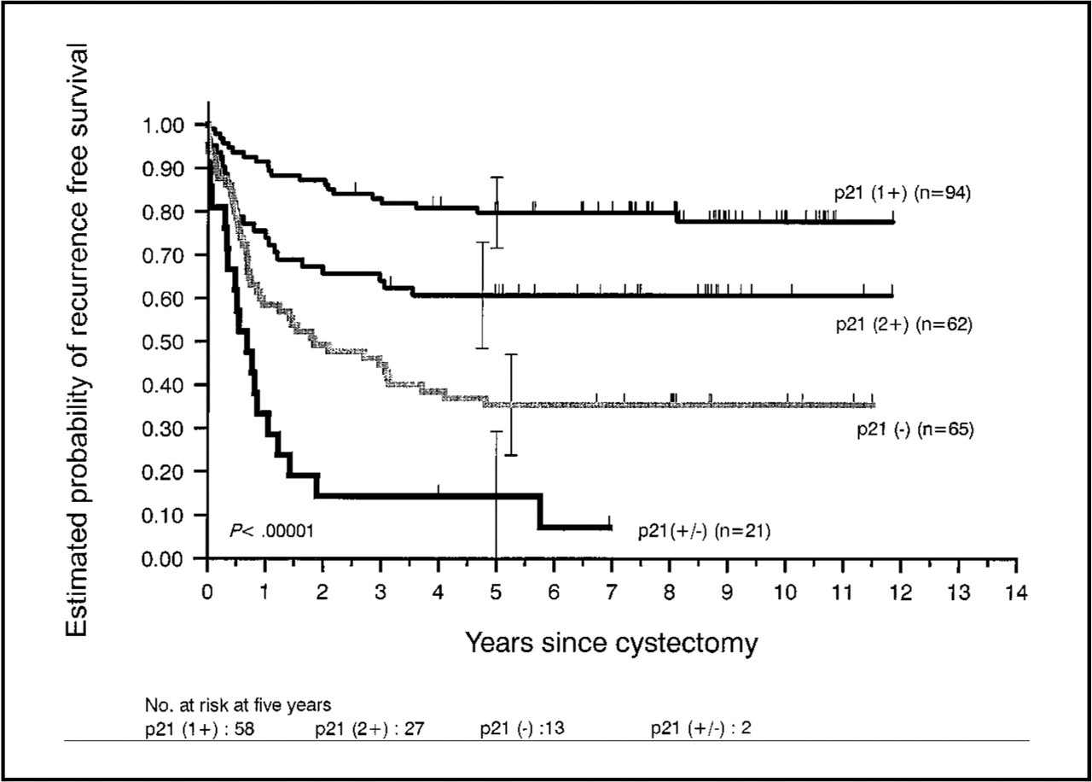
Fig. 4 Probability of remaining recurrence free in 242 patients with bladder tumor stratified by p21 status; p21 ...
Notes:
Fig. 4 Probability of remaining recurrence free in 242 patients with bladder tumor stratified by p21 status; p21 (-), (±), (1+), (2+) (see “Patients, Materials, and Methods” for more extensive definitions of p21 expression levels). 95% Confidence intervals and number of patients at risk are provided at 5 years.
Unless provided in the caption above, the following copyright applies to the content of this slide: © 1998 Oxford University Press

Slide 7
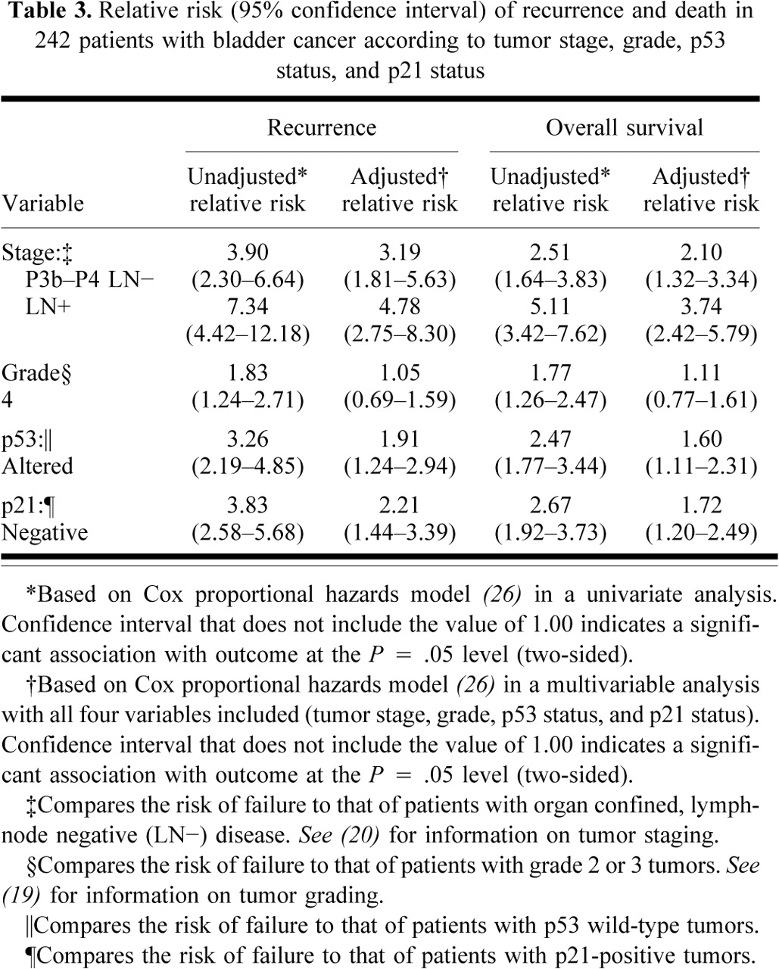
Notes:
Unless provided in the caption above, the following copyright applies to the content of this slide: © 1998 Oxford University Press

Slide 8
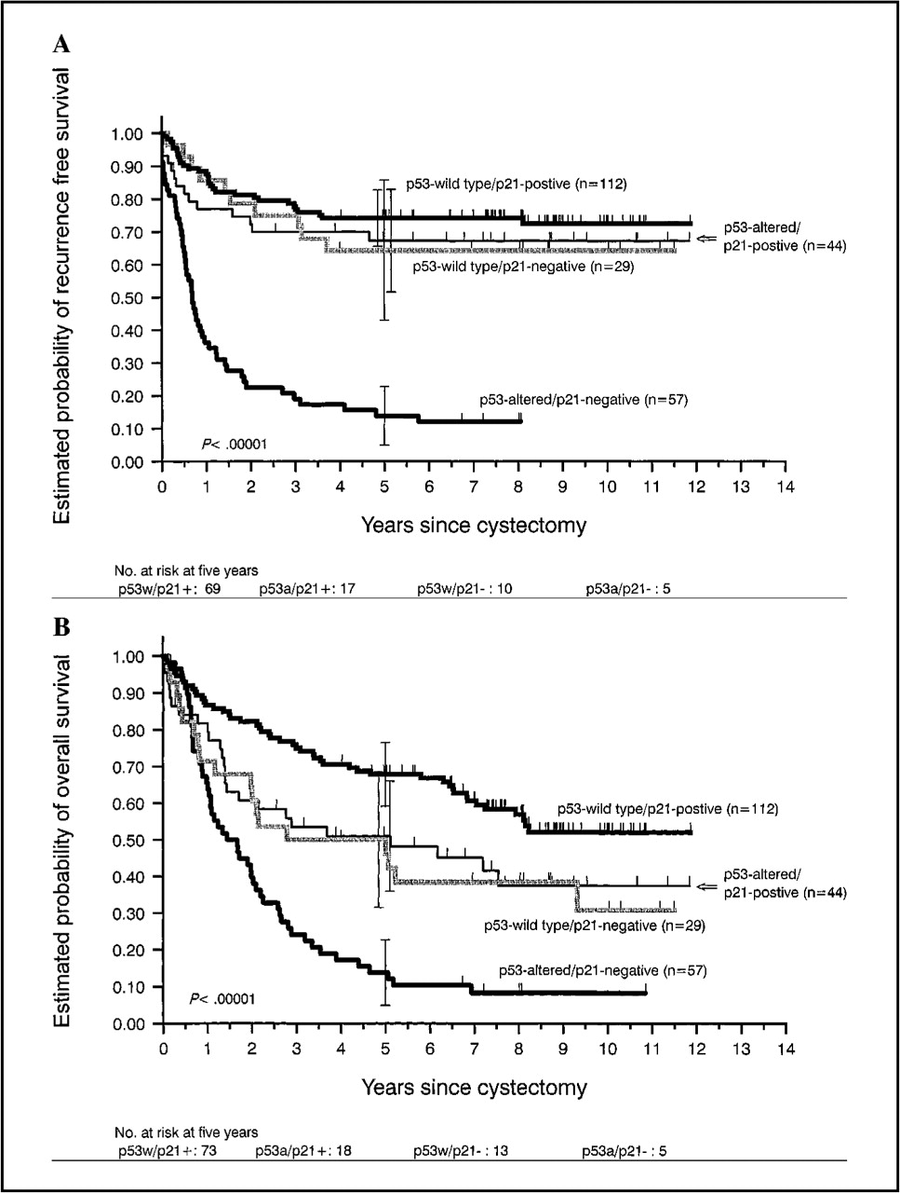
Fig. 5. Probability of A) remaining recurrence free and B) overall survival in 242 patients with bladder tumors ...
Notes:
Fig. 5. Probability of A) remaining recurrence free and B) overall survival in 242 patients with bladder tumors stratified by p53 and p21 status: p53 wild-type, no detectable p53 nuclear reactivity (p53 wild-type phenotype); p53 altered, nuclear p53 reactivity detected (p53- altered phenotype); p21-positive, p21 nuclear expression detected; p21-negative, no detectable p21 nuclear expression. (See “Patients, Materials, and Methods” for more details on immunohistochemical staining classifications.) The patients were stratified into four groups on the basis of p53 status and p21 status of their tumors. Patients with p53-altered/p21-negative tumors had a significantly higher rate of recurrence (two-sided P<.00001) and worse overall survival (two-sided P<.00001) in comparison with other patients. 95% Confidence intervals and number of patients at risk are provided at 5 years. Each tick mark represents a patient who had no evidence of tumor recurrence or who was alive at the time of last follow-up. The logrank test was used to compare the time to tumor recurrence and survival among the patient groups (25).
Unless provided in the caption above, the following copyright applies to the content of this slide: © 1998 Oxford University Press

