Slide 1
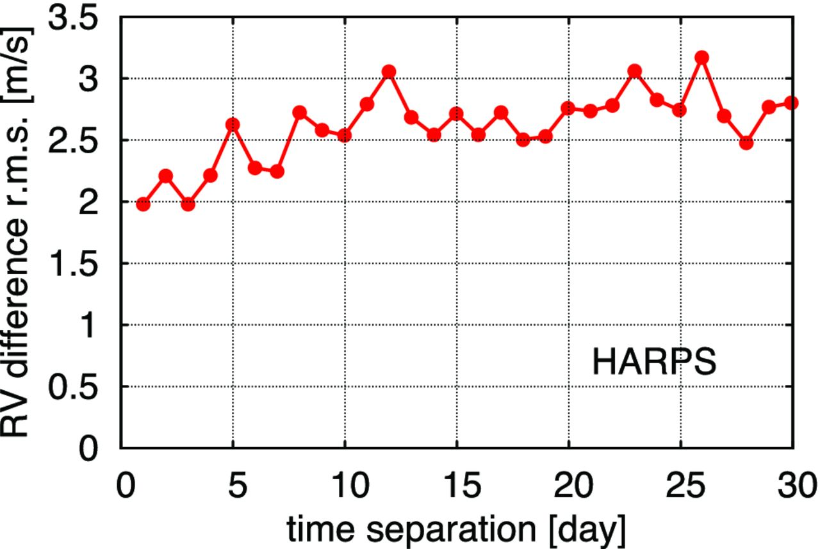
Figure 3. The red noise in the HARPS RV data for GJ 581 in the time domain. See the text for detailed description.
Notes:
Figure 3. The red noise in the HARPS RV data for GJ 581 in the time domain. See the text for detailed description.
Unless provided in the caption above, the following copyright applies to the content of this slide: © 2012 The Author Published by Oxford University Press on behalf of the Royal Astronomical Society

Slide 2
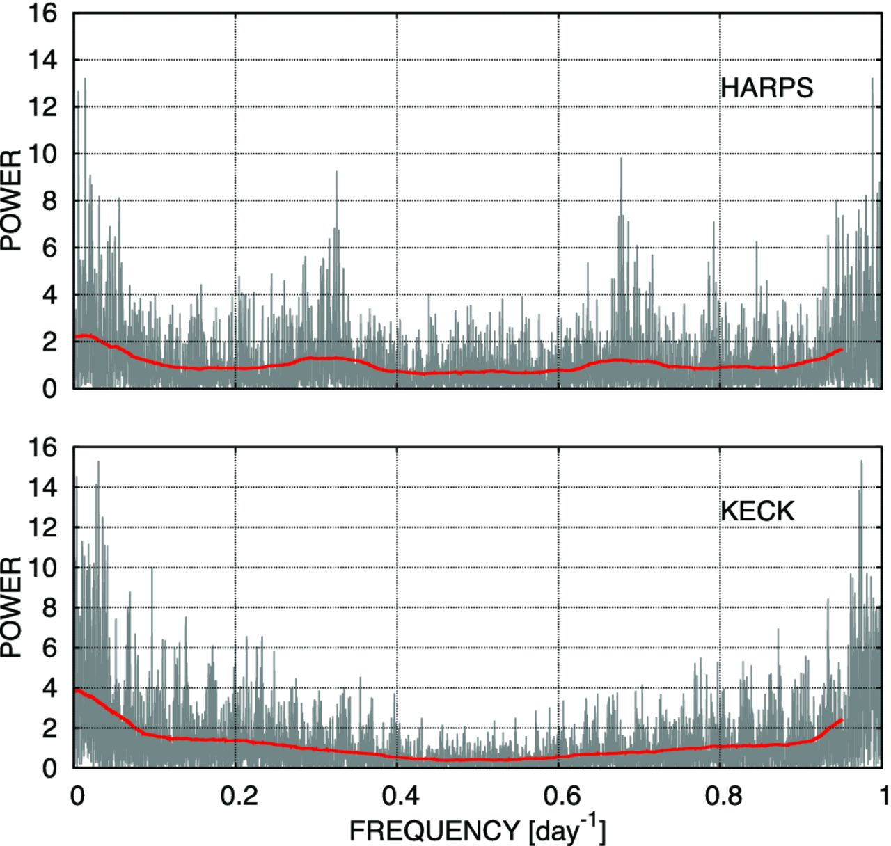
Figure 2. The red noise in the HARPS and Keck RV data for GJ 581 in the frequency domain. We plot the residual ...
Notes:
Figure 2. The red noise in the HARPS and Keck RV data for GJ 581 in the frequency domain. We plot the residual periodograms that remain after elimination of the compound four-planet signal. These periodograms are constructed separately for the HARPS and Keck data by means of adding the probe sinusoidal signal to the RV model of only HARPS or only Keck data set, but still fitting such RV model jointly to both the data sets. Each value of these periodograms represents the modified likelihood ratio statistic $\tilde{Z}$ defined in Baluev (2009). The smoothed curves represent the moving average of the raw periodograms obtained using the window of 0.1 d−1.
Unless provided in the caption above, the following copyright applies to the content of this slide: © 2012 The Author Published by Oxford University Press on behalf of the Royal Astronomical Society

Slide 3
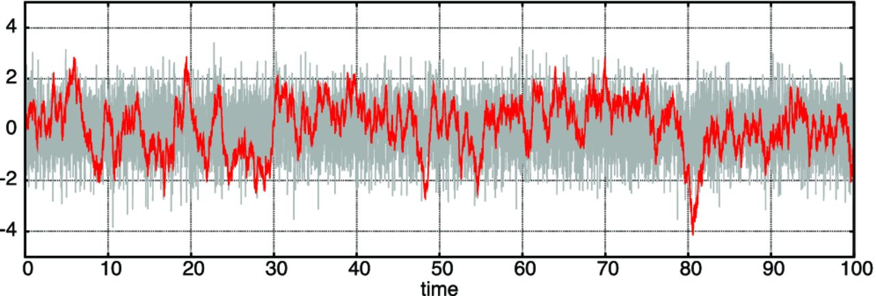
Figure 1. Foreground curve shows a simulated example of the red Gaussian noise with correlation function e<sup>− ...
Notes:
Figure 1. Foreground curve shows a simulated example of the red Gaussian noise with correlation function e− |τ|, while thick background band shows a simulated example of the white Gaussian noise of the same variance.
Unless provided in the caption above, the following copyright applies to the content of this slide: © 2012 The Author Published by Oxford University Press on behalf of the Royal Astronomical Society

Slide 4
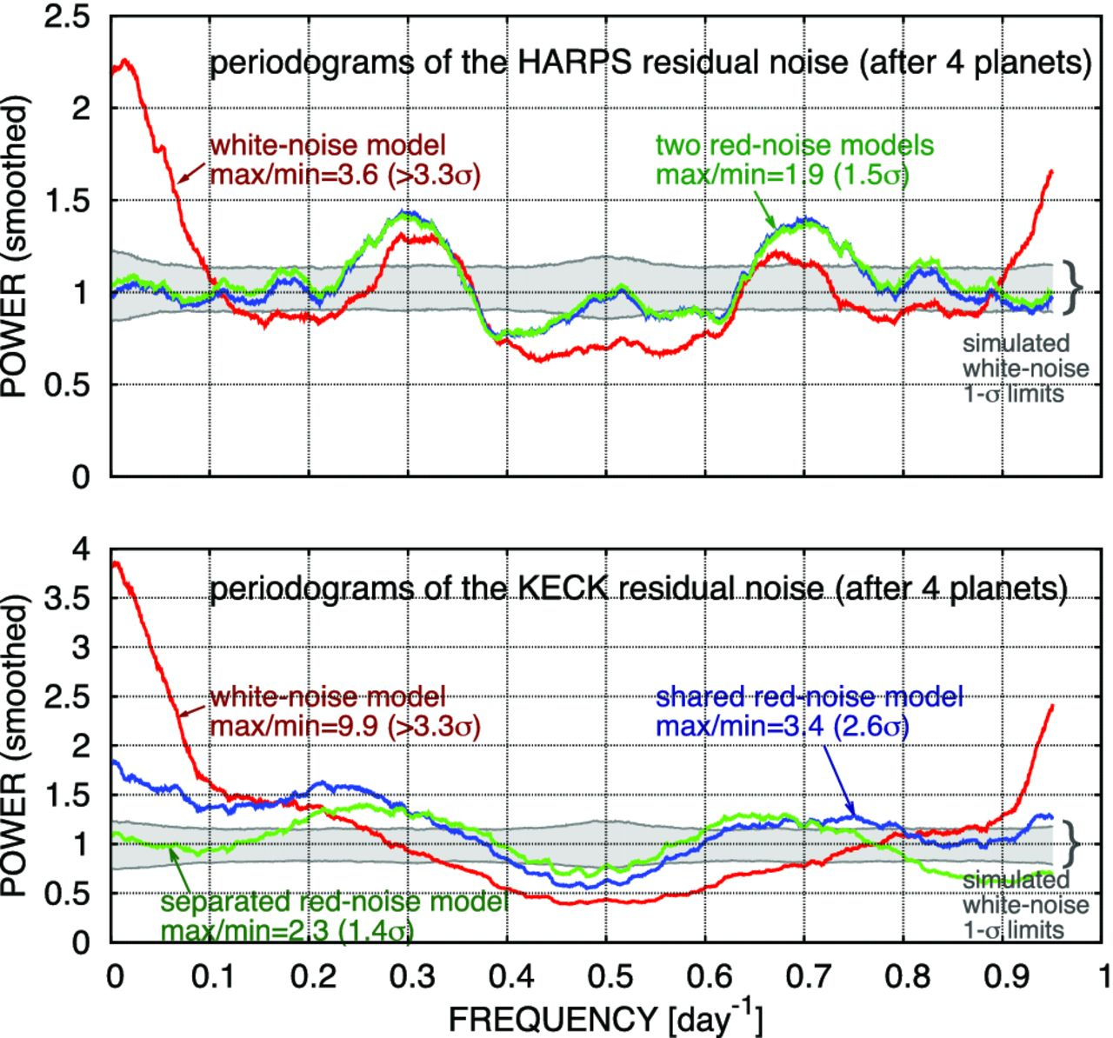
Figure 4. The periodograms of the HARPS and Keck residual noise constructed for various noise models, in comparison ...
Notes:
Figure 4. The periodograms of the HARPS and Keck residual noise constructed for various noise models, in comparison with simulated limits expected for the white-noise case. We can see that periodograms based on the white-noise model show large variations with max/min ratio well above the 3σ level, and using the red-noise models significantly suppresses these variations.
Unless provided in the caption above, the following copyright applies to the content of this slide: © 2012 The Author Published by Oxford University Press on behalf of the Royal Astronomical Society

Slide 5
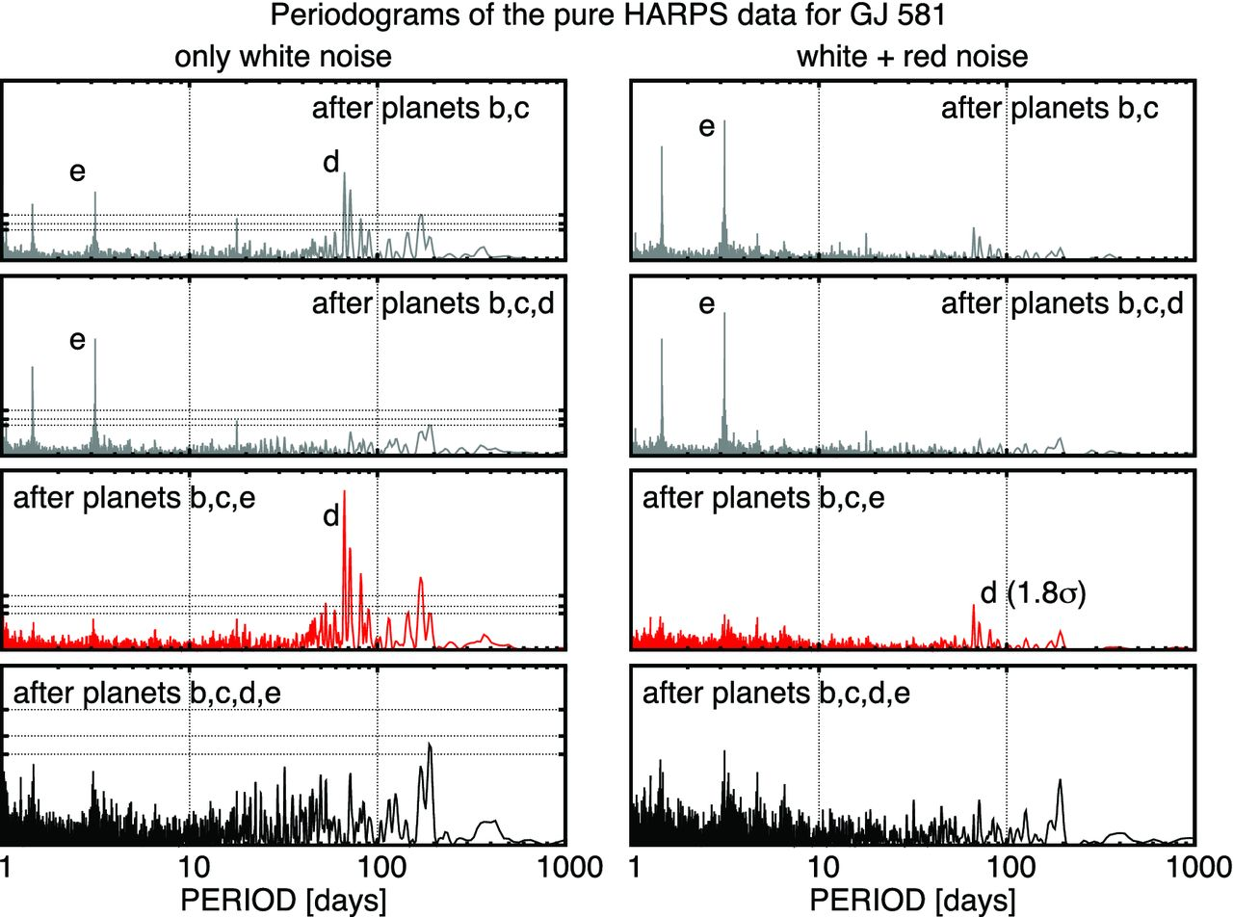
Figure 5. Residual periodograms of the HARPS RV data of GJ 581 constructed on the basis of various base RV curve ...
Notes:
Figure 5. Residual periodograms of the HARPS RV data of GJ 581 constructed on the basis of various base RV curve models. The base models include the compound multi-Keplerian signal from the planets labelled in a relevant plot. Note that the plots in the same row always have the same ordinate range. In the white-noise plots, we show the 1σ, 2σ and 3σ significance levels derived in accordance with Baluev (2008a). These levels are in good agreement with Monte Carlo simulations. The technique from Baluev (2008a) was not designed to work with correlated data, so for the red-noise plots we only show the simulated significance of the most interesting planet d peak (third periodogram in the red-noise column).
Unless provided in the caption above, the following copyright applies to the content of this slide: © 2012 The Author Published by Oxford University Press on behalf of the Royal Astronomical Society

Slide 6
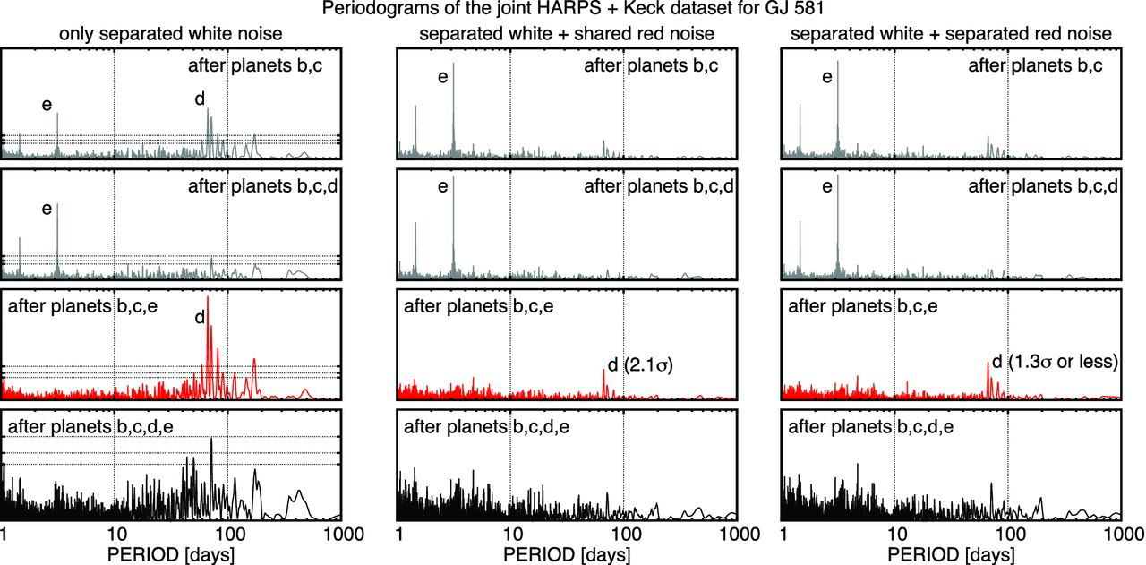
Figure 8. Same as Fig. 5, but for the combined HARPS+Keck data set.
Notes:
Figure 8. Same as Fig. 5, but for the combined HARPS+Keck data set.
Unless provided in the caption above, the following copyright applies to the content of this slide: © 2012 The Author Published by Oxford University Press on behalf of the Royal Astronomical Society

Slide 7
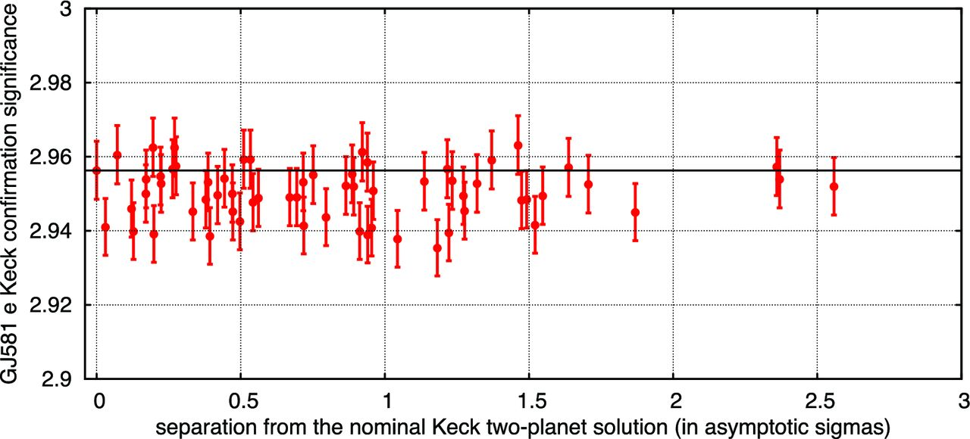
Figure 7. Simulated confirmation significance of the planet GJ 581 e, depending on the assumed true parameters of the ...
Notes:
Figure 7. Simulated confirmation significance of the planet GJ 581 e, depending on the assumed true parameters of the two-planet red-noise model of the Keck RV data. The graph shows a set of points, each corresponding to a different test ‘true’ vector of parameters, simulated according to the Monte Carlo algorithm B1. The abscissas of the points reflect the deviation of these trial ‘true’ parameters from the nominal best-fitting ones, expressed in terms of the asymptotic n–σ significance level, which was derived from the relevant value of $\tilde{Z}$. The ordinate of each point shows the confirmation significance of the planet e, as derived from 500 000 Monte Carlo simulations of the relevant Keck periodogram (see the text for details). The error bars reflect the statistical uncertainties inferred by these second-level Monte Carlo simulations. We can see that the confirmation significance almost reaches the 3σ level and is practically independent of the assumed two-planet configuration.
Unless provided in the caption above, the following copyright applies to the content of this slide: © 2012 The Author Published by Oxford University Press on behalf of the Royal Astronomical Society

Slide 8
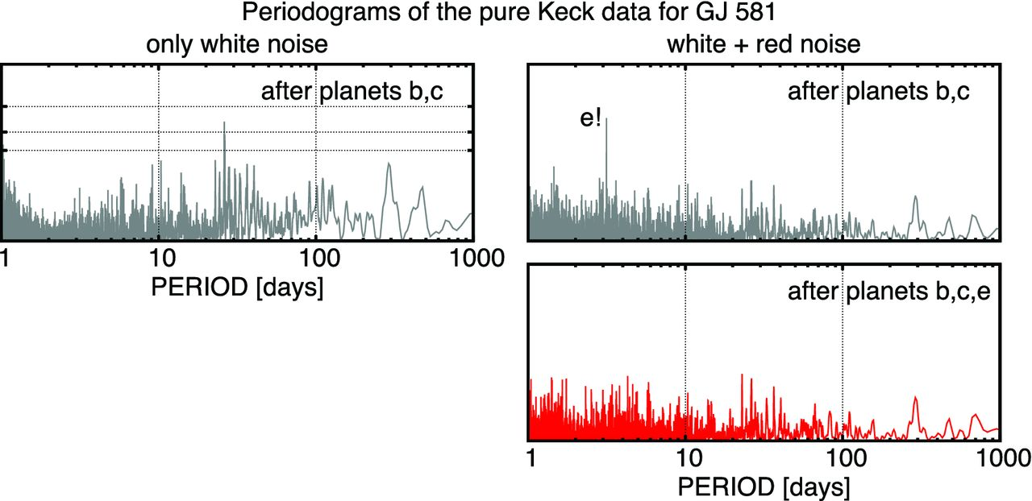
Figure 6. Same as Fig. 5, but for the Keck data set. We can see that the white-noise model does not allow robust ...
Notes:
Figure 6. Same as Fig. 5, but for the Keck data set. We can see that the white-noise model does not allow robust detection of any real planet except for the planets b and c (which both are undoubtful anyway), but applying the red-noise model allows us to confirm the existence of the planet e (see the text for the detailed calculation of its significance). No hints of the planet d can be revealed with any of these models, however.
Unless provided in the caption above, the following copyright applies to the content of this slide: © 2012 The Author Published by Oxford University Press on behalf of the Royal Astronomical Society

Slide 9
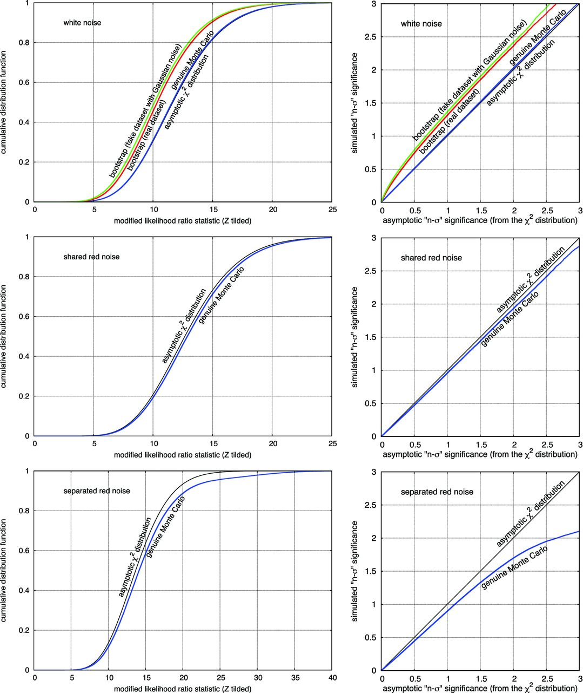
Figure C1. Simulated distributions of the statistic $\tilde{Z}$ from Baluev (2009) and their asymptotic χ² ...
Notes:
Figure C1. Simulated distributions of the statistic $\tilde{Z}$ from Baluev (2009) and their asymptotic χ2 approximation. The null hypothesis was that the model parameters are equal to the best-fitting values (which are treated as true during the relevant simulation), and the alternative was that all these parameters are unknown (free). The plots in the left-hand column show the simulated cumulative distributions as functions of $\tilde{Z}$, while the relevant simulated significance levels as functions of the asymptotic χ2 significance are shown in the right-hand column. The top, middle and bottom pairs of panels differ by the assumed RV noise model, according to the marks in each graph. The RV curve model is always the four-planet one. Note that different noise models imply different number of degrees of freedom, so the χ2 distributions become different too.
Unless provided in the caption above, the following copyright applies to the content of this slide: © 2012 The Author Published by Oxford University Press on behalf of the Royal Astronomical Society

Slide 10
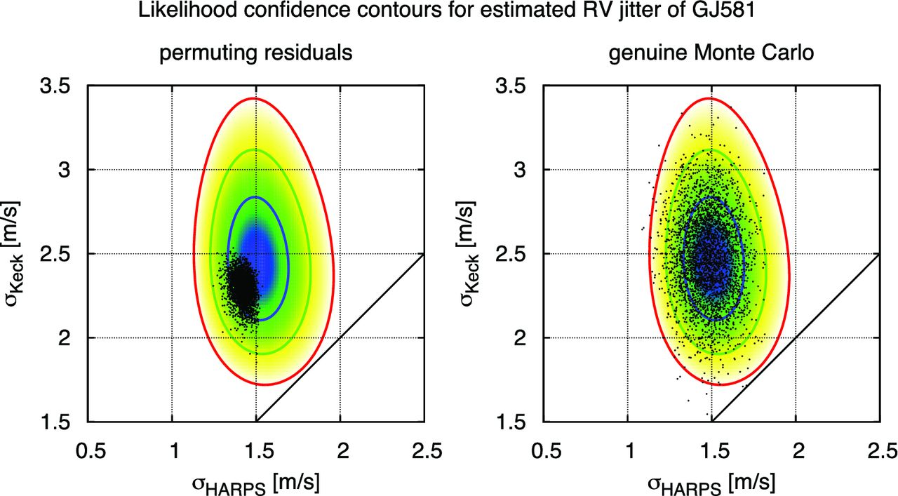
Figure C2. Same as Fig. C3, but for the RV jitter parameters of the HARPS and Keck data.
Notes:
Figure C2. Same as Fig. C3, but for the RV jitter parameters of the HARPS and Keck data.
Unless provided in the caption above, the following copyright applies to the content of this slide: © 2012 The Author Published by Oxford University Press on behalf of the Royal Astronomical Society

Slide 11
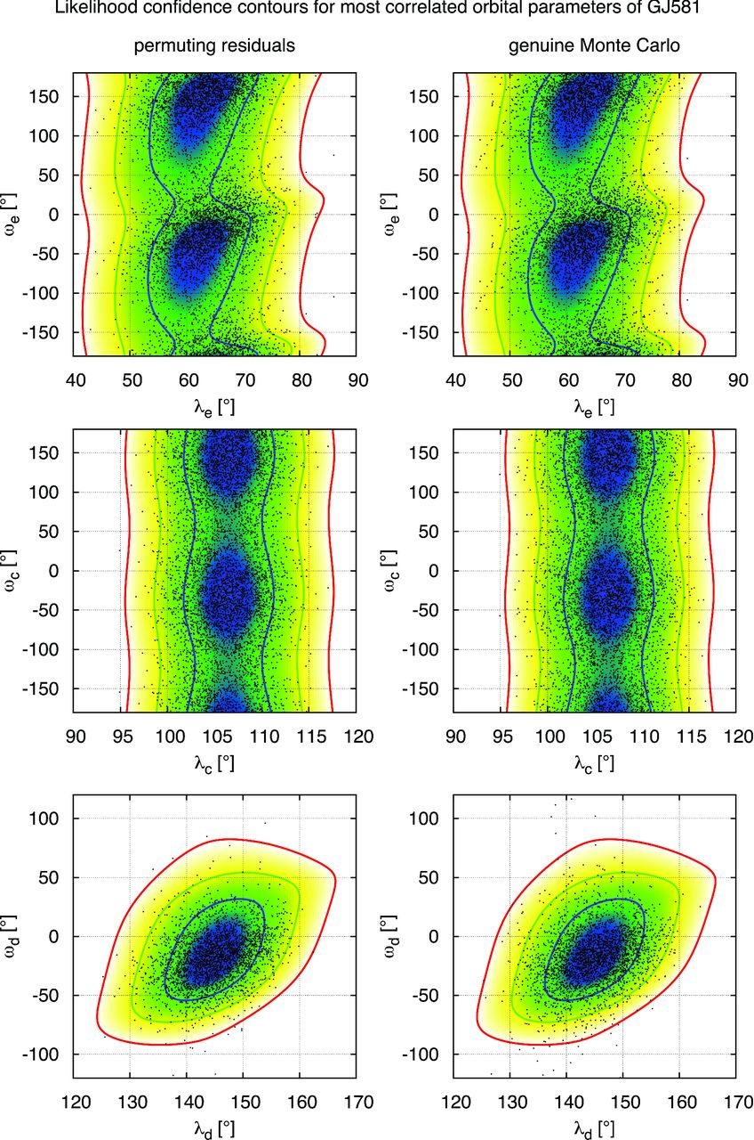
Figure C3. The asymptotic confidence contours for a few most correlated pairs of parameters of the GJ 581 four-planet ...
Notes:
Figure C3. The asymptotic confidence contours for a few most correlated pairs of parameters of the GJ 581 four-planet white-noise model, in comparison with Monte Carlo and bootstrap simulations. These asymptotic confidence contours represent the level curves of the modified likelihood ratio statistic $\tilde{Z}$ (Baluev 2009). These contours are shown by means of colour maps and three reference level curves corresponding to the asymptotic 1σ, 2σ and 3σ significance levels (derived using the asymptotic χ2 distribution of $\tilde{Z}$). These contours are identical for the plots in the left- and right-hand columns; the things that differ are the simulated points that were obtained by means of the bootstrap (permuting best-fitting RV residuals) or pure Monte Carlo (generating Gaussian noise based on the best-fitting model). The number of simulated points shown in each graph is 3333.
Unless provided in the caption above, the following copyright applies to the content of this slide: © 2012 The Author Published by Oxford University Press on behalf of the Royal Astronomical Society

Slide 12
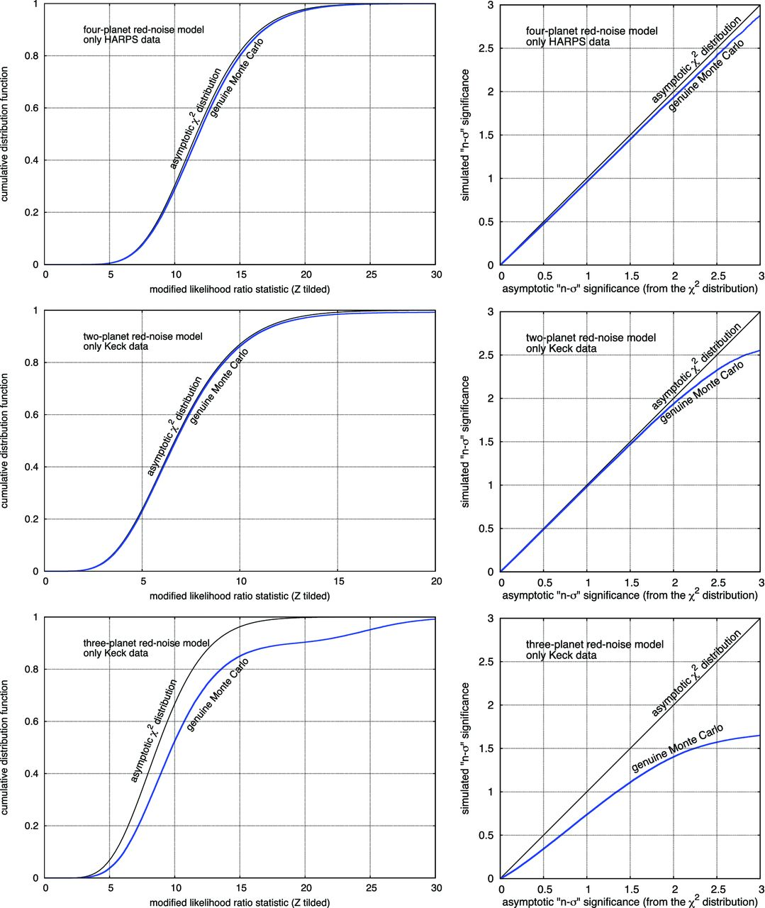
Figure C4. Same as Fig. C1, but fitting the HARPS and Keck time series entirely independently from each other. The top ...
Notes:
Figure C4. Same as Fig. C1, but fitting the HARPS and Keck time series entirely independently from each other. The top panels correspond to the HARPS data set with the four-planet model; the middle panels correspond to the Keck data set with the two-planet (b and c) model; the bottom panels correspond to the Keck data set with the three-planet (b, c and e) model. The noise model in each case always incorporated the red component.
Unless provided in the caption above, the following copyright applies to the content of this slide: © 2012 The Author Published by Oxford University Press on behalf of the Royal Astronomical Society

