Slide 1
Figure 1. Representative frames from a video clip presented during the observation task.
Notes:
Figure 1. Representative frames from a video clip presented during the observation task.
Unless provided in the caption above, the following copyright applies to the content of this slide: © The Author 2012. Published by Oxford University Press. All rights reserved. For permissions, please e-mail: journals.permissions@oup.com

Slide 2
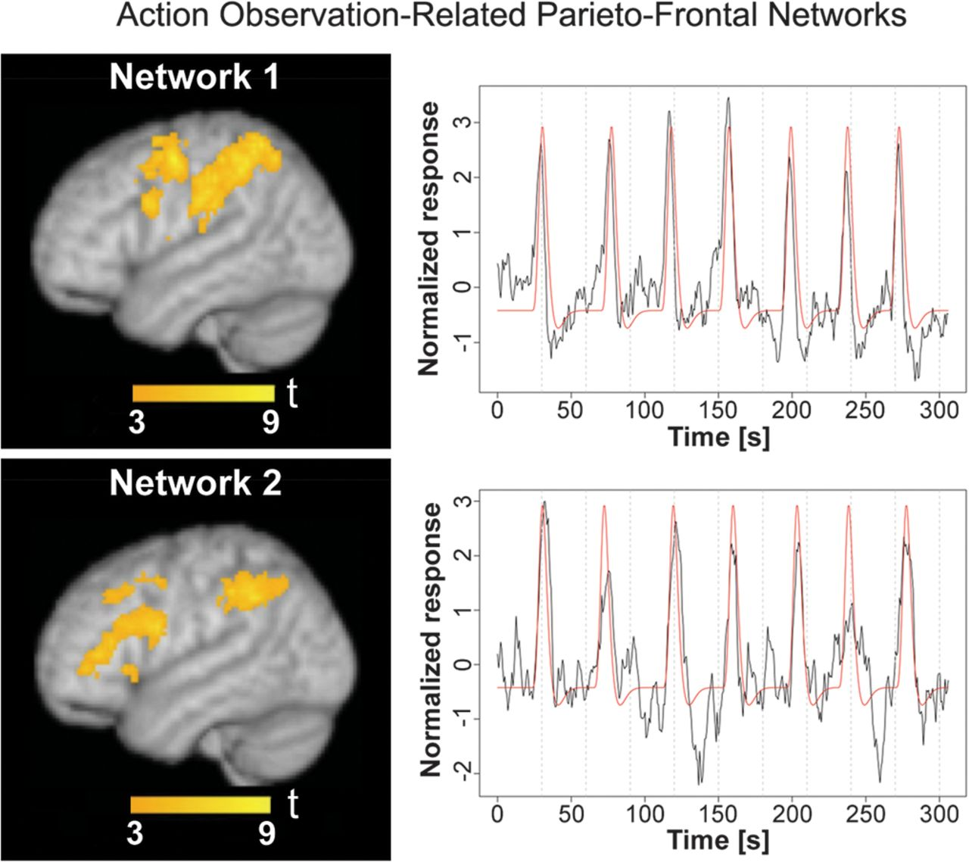
Figure 2. Two action observation–related nonoverlapping parietofrontal networks were identified by ICA from the MOVE ...
Notes:
Figure 2. Two action observation–related nonoverlapping parietofrontal networks were identified by ICA from the MOVE runs. For each one, the best representative from the 2 runs, that is, the IC component with the highest correlation coefficient (rt) between its time course and the task profile, is shown. Left: spatial maps overlaid onto a 3D rendering of an MNI template brain. Right: ICA associated time courses (in black) and task profiles (in red, after convolution with the hemodynamic response); the correlation coefficient rt was 0.77 and 0.78 for Networks 1 and 2, respectively. The color scale indicates t values.
Unless provided in the caption above, the following copyright applies to the content of this slide: © The Author 2012. Published by Oxford University Press. All rights reserved. For permissions, please e-mail: journals.permissions@oup.com

Slide 3
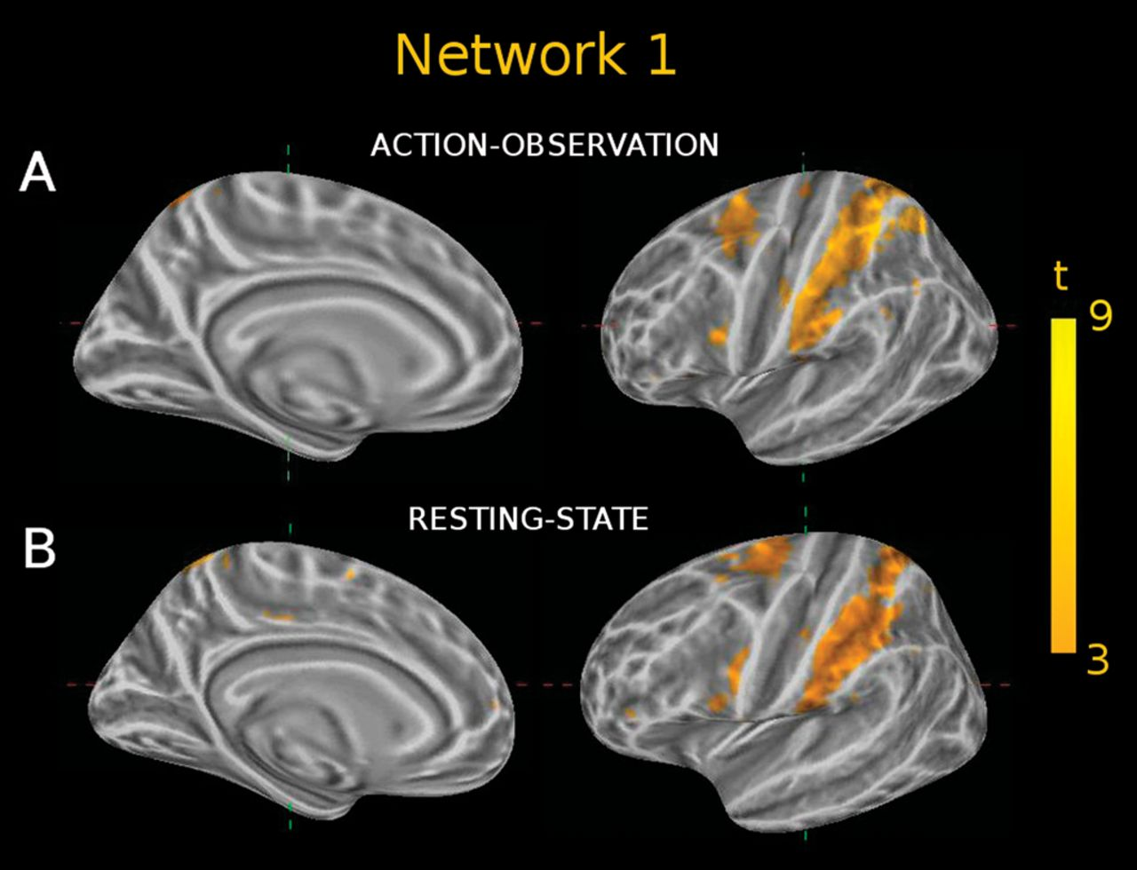
Figure 3. Network 1. ICA map related to action observation (A), in comparison with a spatially similar resting-state ...
Notes:
Figure 3. Network 1. ICA map related to action observation (A), in comparison with a spatially similar resting-state ICA map (B), shown on the lateral and medial aspects of the inflated brain (Freesurfer S/W package http://surfer.nmr.mgh.harvard.edu/). (A) ICA map MOVE run1-IC4; (B) ICA map REST-IC4. The percentage SO (relative to the task run) between the 2 maps was 52%.
Unless provided in the caption above, the following copyright applies to the content of this slide: © The Author 2012. Published by Oxford University Press. All rights reserved. For permissions, please e-mail: journals.permissions@oup.com

Slide 4
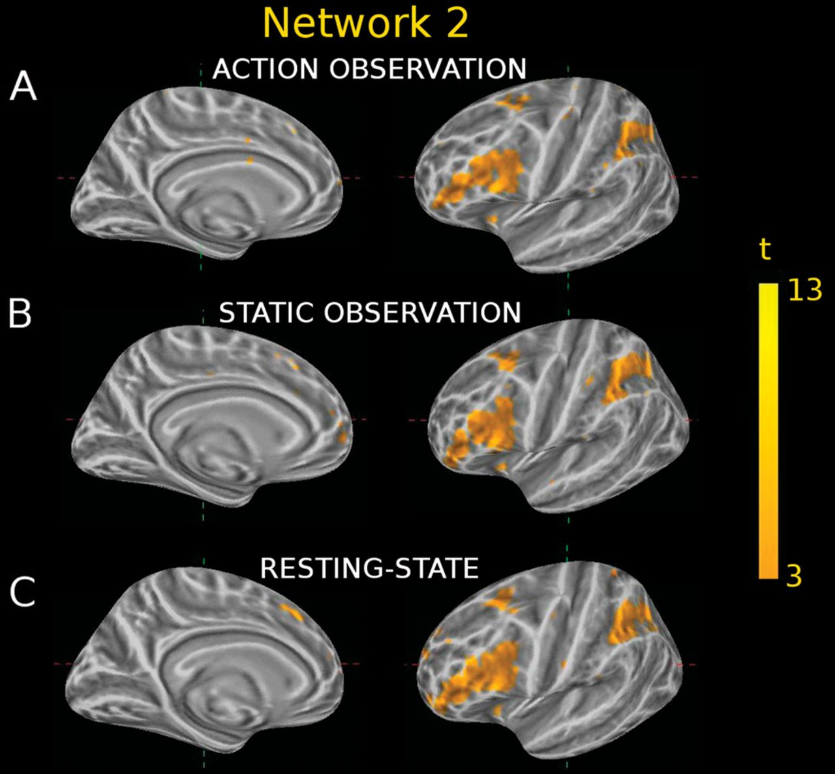
Figure 4. Network 2. ICA maps related to action (A) or to static (B) observation, in comparison with a spatially ...
Notes:
Figure 4. Network 2. ICA maps related to action (A) or to static (B) observation, in comparison with a spatially similar resting-state map (C), shown on the lateral and medial aspects of the inflated brain. (A) ICA map MOVE run2-IC2; (B) ICA map STAT run1-IC1; (C) ICA map REST-IC1. The percentage SO between map pairs AB,BC, and AC was 73%, 57%, and 63%, respectively.
Unless provided in the caption above, the following copyright applies to the content of this slide: © The Author 2012. Published by Oxford University Press. All rights reserved. For permissions, please e-mail: journals.permissions@oup.com

Slide 5
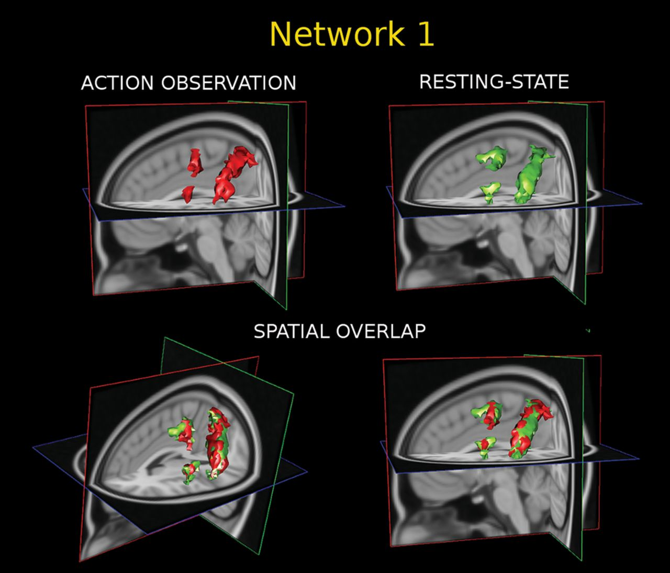
Figure 5. Illustration of spatial overlap between the 3 main clusters (parietal, dorsolateral premotor, and ...
Notes:
Figure 5. Illustration of spatial overlap between the 3 main clusters (parietal, dorsolateral premotor, and ventrolateral premotor) specifically related to action observation (Network 1), identified using task or rest conditions. Red: ICA, MOVE run1-IC4 component; green: ICA, REST-IC4 component. Top: 3D maps for the task condition (left) and for the rest condition (right). Bottom: Spatial overlap between clusters of the 2 maps, shown from 2 different angles to facilitate comparison.
Unless provided in the caption above, the following copyright applies to the content of this slide: © The Author 2012. Published by Oxford University Press. All rights reserved. For permissions, please e-mail: journals.permissions@oup.com

Slide 6
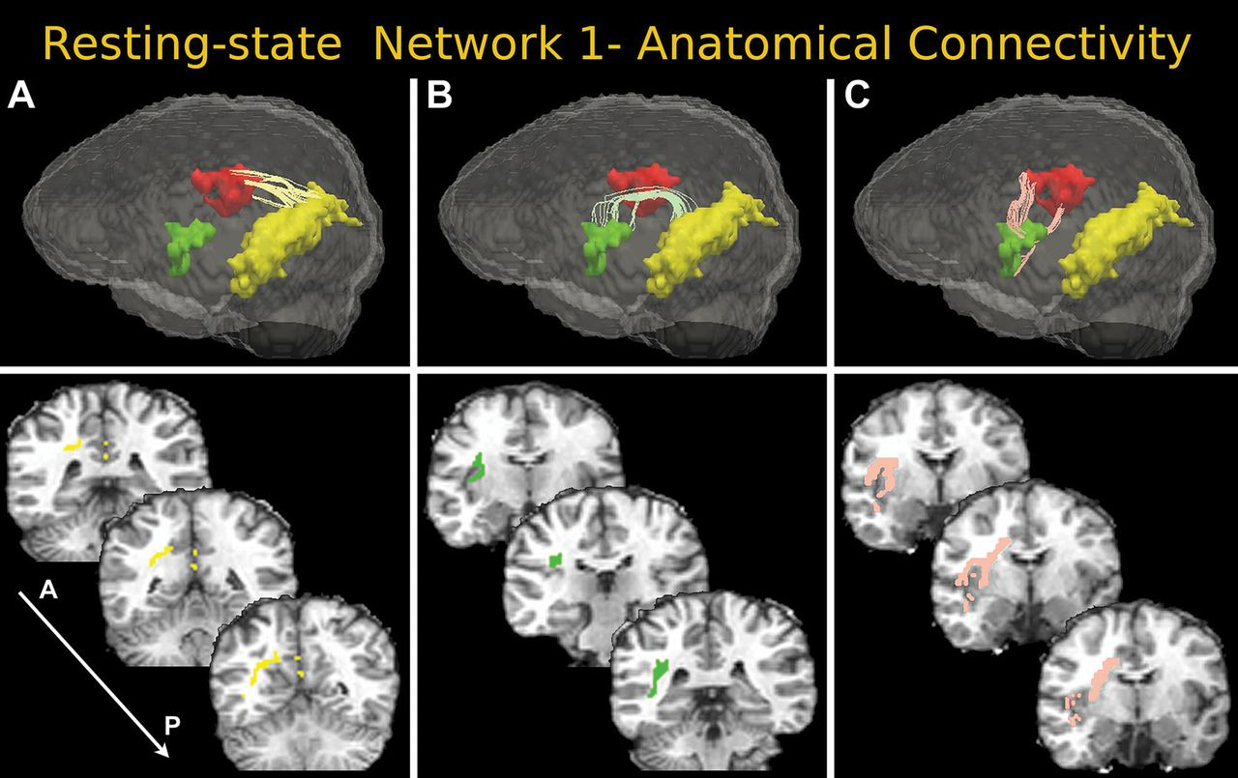
Figure 6. Fiber bundles connecting pairs of clusters of the REST-IC4 component, as assessed by DWI, PAS, and ...
Notes:
Figure 6. Fiber bundles connecting pairs of clusters of the REST-IC4 component, as assessed by DWI, PAS, and deterministic tractography. For a clearer visualization, the fibers shown were tracked only within an exclusion mask, which was obtained as follows: first, a map, where each voxel value was set to the number of streamlines intersecting it, was computed; then, a sum of this map values over a 3-voxel cubic neighborhood was computed for each voxel; finally, the latter map was thresholded at a value of 15, and the fibers were then tracked. Top: 3D visualization of ICA clusters and connecting fiber bundles; cluster colors: yellow: PPar; red: DLP; green: VLP. Abbreviations as in Table 4. Bottom: Coronal sections showing the location of connecting tracts in the white matter of the left hemisphere. Subfigures A,B,C illustrate connections between different cluster pairs (see main text).
Unless provided in the caption above, the following copyright applies to the content of this slide: © The Author 2012. Published by Oxford University Press. All rights reserved. For permissions, please e-mail: journals.permissions@oup.com

