Slide 1
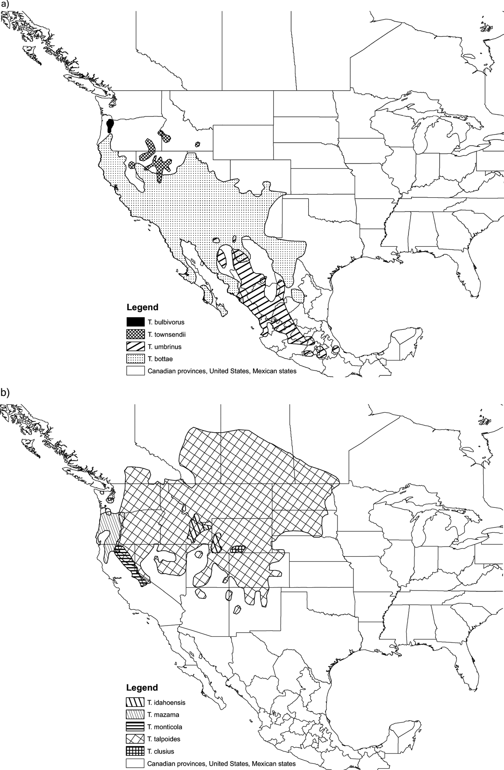
Figure 1 Map of North America with ranges of each Thomomys species shown. (a) Subgenus Megascapheus. (b) Subgenus ...
Notes:
Figure 1 Map of North America with ranges of each Thomomys species shown. (a) Subgenus Megascapheus. (b) Subgenus Thomomys. Ranges depicted on this map are based on those in Reid (2006) except south of the United States, where they are taken from Patterson et al. 2005.
Unless provided in the caption above, the following copyright applies to the content of this slide: © 2008 Society of Systematic BiologistsThis article is published and distributed under the terms of the Oxford University Press, Standard Journals Publication Model (https://academic.oup.com/journals/pages/open_access/funder_policies/chorus/standard_publication_model)

Slide 2
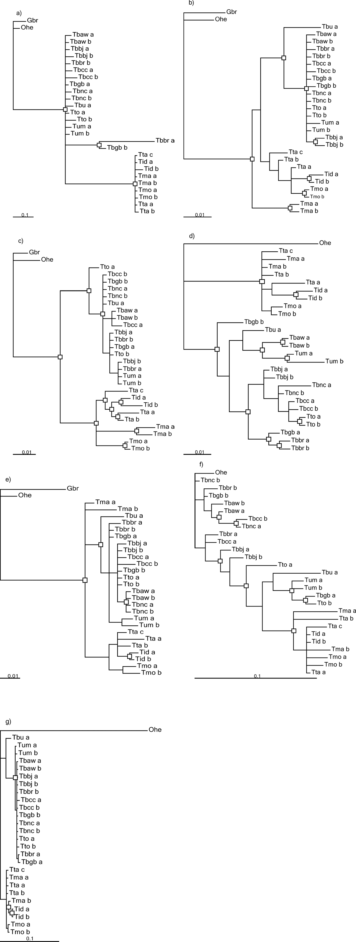
Figure 2 Distinct gene tree topologies. Nodes with greater than 90% posterior probability support from analysis of ...
Notes:
Figure 2 Distinct gene tree topologies. Nodes with greater than 90% posterior probability support from analysis of seven individual loci (TBOXX) in MrBayes are marked with a box (□). Branch lengths are in substitutions/site. (a) TBO26; (b) TBO29; (c) TBO47; (d) TBO53; (e) TBO59; (f) TBO64; (g) TBO72. (Continued)
Unless provided in the caption above, the following copyright applies to the content of this slide: © 2008 Society of Systematic BiologistsThis article is published and distributed under the terms of the Oxford University Press, Standard Journals Publication Model (https://academic.oup.com/journals/pages/open_access/funder_policies/chorus/standard_publication_model)

Slide 3
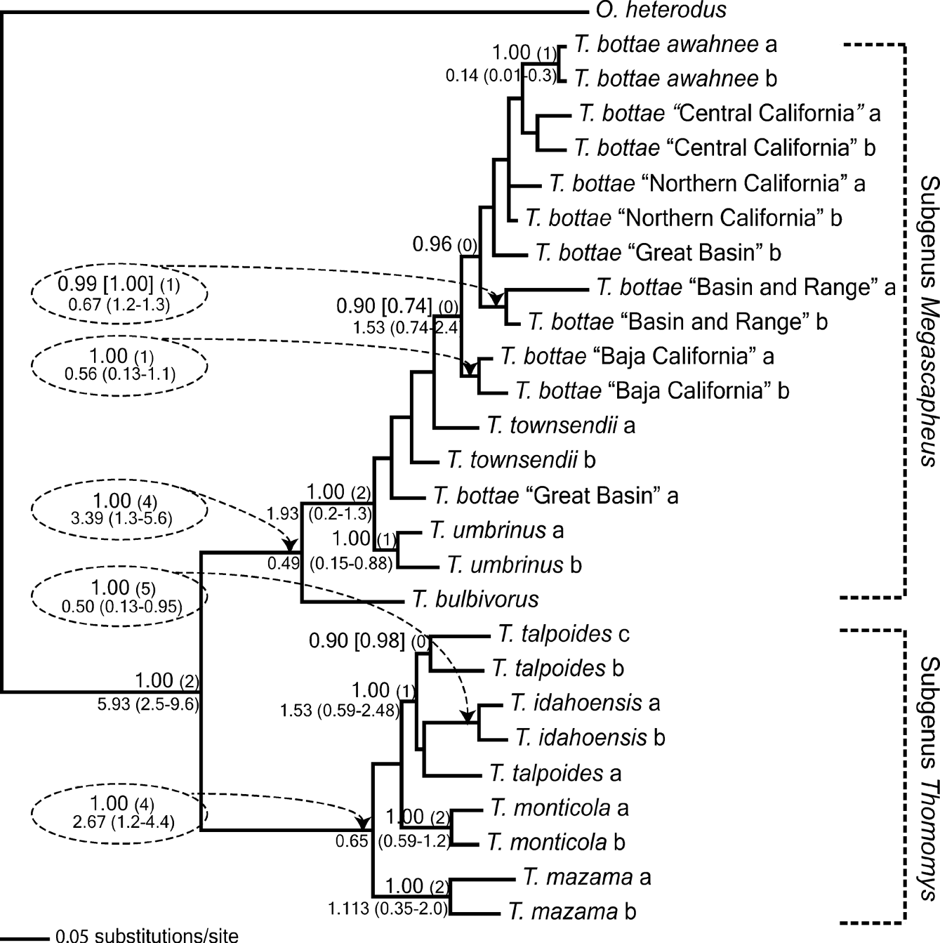
Figure 3 Majority-rule consensus tree generated by MrBayes, from seven concatenated loci, plus a partition that ...
Notes:
Figure 3 Majority-rule consensus tree generated by MrBayes, from seven concatenated loci, plus a partition that included coding for all gaps. Nodes are labeled with the posterior probability derived from the analysis including gaps (left). Posterior probabilities excluding gaps are shown only if they differ from those for the analysis including gaps (right, in square brackets above the branch). Labels in parentheses above the branch show the number of individual gene trees (out of seven) containing this node with > 90% posterior probability. Divergence time means, with 95% highest posterior density, for each node as estimated using BEAST are indicated below each branch. Branch lengths are in substitutions/site. Tree deposited in TreeBASE (Study no. S1997).
Unless provided in the caption above, the following copyright applies to the content of this slide: © 2008 Society of Systematic BiologistsThis article is published and distributed under the terms of the Oxford University Press, Standard Journals Publication Model (https://academic.oup.com/journals/pages/open_access/funder_policies/chorus/standard_publication_model)

Slide 4
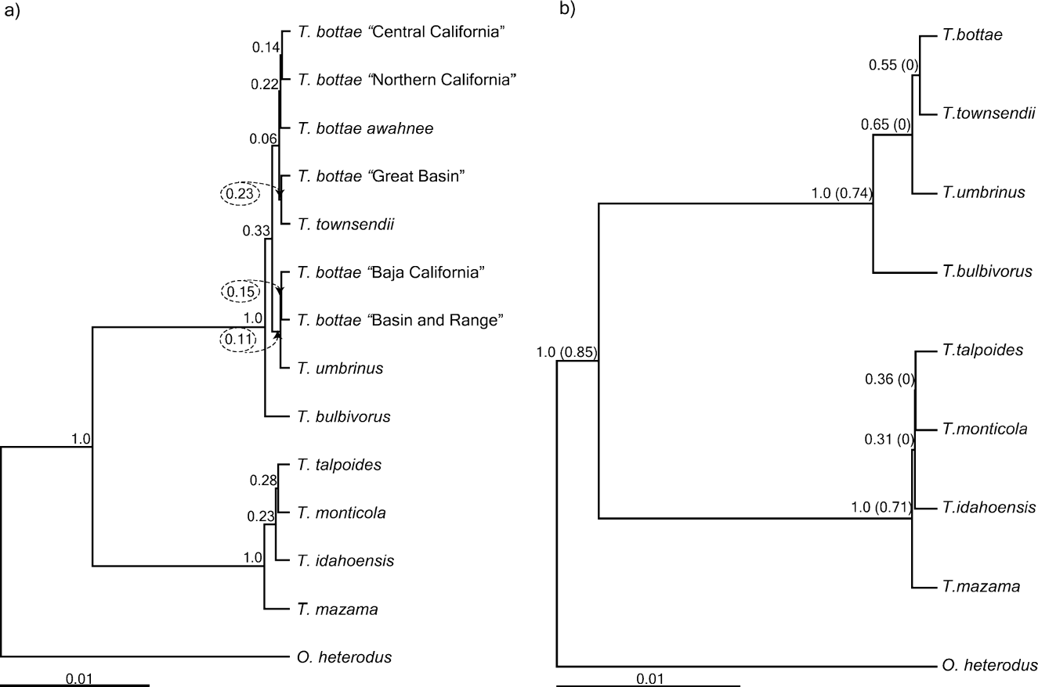
Figure 4 Majority-rule consensus tree generated in PAUP* from BEST output. Nodes are labeled with their posterior ...
Notes:
Figure 4 Majority-rule consensus tree generated in PAUP* from BEST output. Nodes are labeled with their posterior probabilities. Branch lengths are in substitutions/site. Trees deposited in TreeBASE (Study no. S1997). (a) Tree estimated for 14 named taxa (genetic group or species; see text for details). (b) Tree estimated for 9 named taxa (species). Posterior probability obtained for the same nodes from a single-allele analysis in BEST are shown in parentheses after the multiallele posterior probabilities.
Unless provided in the caption above, the following copyright applies to the content of this slide: © 2008 Society of Systematic BiologistsThis article is published and distributed under the terms of the Oxford University Press, Standard Journals Publication Model (https://academic.oup.com/journals/pages/open_access/funder_policies/chorus/standard_publication_model)

Slide 5
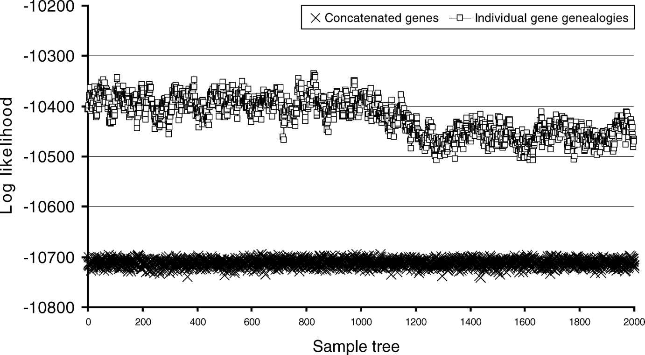
Figure 5 Plot of the log likelihoods for 2000 posterior trees (after burn-in trees are removed) from the concatenated ...
Notes:
Figure 5 Plot of the log likelihoods for 2000 posterior trees (after burn-in trees are removed) from the concatenated analysis and the individual gene genealogy analysis performed by BEST. The Bayes factor calculated from the minimum log likelihood among the BEST trees, minus the maximum log likelihood among the concatenated trees, is 186.529.
Unless provided in the caption above, the following copyright applies to the content of this slide: © 2008 Society of Systematic BiologistsThis article is published and distributed under the terms of the Oxford University Press, Standard Journals Publication Model (https://academic.oup.com/journals/pages/open_access/funder_policies/chorus/standard_publication_model)

Slide 6
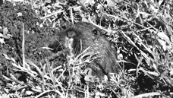
Bottae's pocket gopher, San Mateo County, California; photo credit: Pauline Kamath.
Notes:
Bottae's pocket gopher, San Mateo County, California; photo credit: Pauline Kamath.
Unless provided in the caption above, the following copyright applies to the content of this slide: © 2008 Society of Systematic BiologistsThis article is published and distributed under the terms of the Oxford University Press, Standard Journals Publication Model (https://academic.oup.com/journals/pages/open_access/funder_policies/chorus/standard_publication_model)

