Slide 1
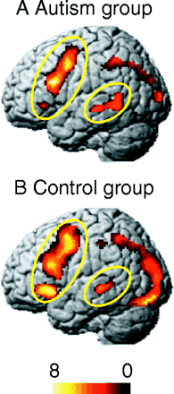
Fig. 1 Brain activation of autistic (A) and control (B) groups (Sentence versus Fixation contrast). Autistic ...
Notes:
Fig. 1 Brain activation of autistic (A) and control (B) groups (Sentence versus Fixation contrast). Autistic participants show less activation in the left inferior frontal gyrus (LIFG) than the control group, but more activation in the left posterior superior temporal gyrus (LSTG) than the control group. Circled areas indicate the first three clusters for each group listed in Table 1.
Unless provided in the caption above, the following copyright applies to the content of this slide: Brain Vol. 127 No. 8 © Guarantors of Brain 2004; all rights reserved

Slide 2
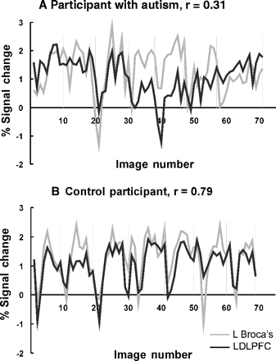
Fig. 2 Examples of functional connectivity between LDLPFC and LIFG (Broca's area) in individual participants, shown ...
Notes:
Fig. 2 Examples of functional connectivity between LDLPFC and LIFG (Broca's area) in individual participants, shown as the activation time series in the two brain regions, with vertical bars indicating boundaries between seven epochs of sentences of the same type. (A) Autistic participant with low functional connectivity, r = 0.31, where the two time series do not closely track each other. (B) Control participant with high functional connectivity, r = 0.79, where the activation time series in the two regions is highly similar.
Unless provided in the caption above, the following copyright applies to the content of this slide: Brain Vol. 127 No. 8 © Guarantors of Brain 2004; all rights reserved

Slide 3
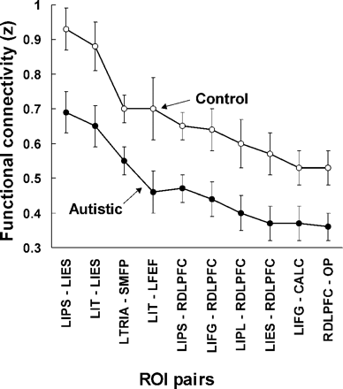
Fig. 3 Functional connectivity for autistic and control participants in the 10 ROI pairs with a reliable (P < 0.05) ...
Notes:
Fig. 3 Functional connectivity for autistic and control participants in the 10 ROI pairs with a reliable (P < 0.05) difference between autistic and control participants (presented in descending order of mean connectivity). The pattern of functional connectivities across these 10 ROI pairs is very similar for the two groups (r = 0.98). Error bars represent the standard error of the mean. L = left; R = right; CALC = calcarine fissure; DLPFC = dorsolateral prefrontal cortex; FEF = frontal eye field; IES = inferior extrastriate; IFG = inferior frontal gyrus; IPL = inferior parietal lobe; IPS = intraparietal sulcus; IT = inferior temporal; TRIA = triangularis; OP = occipital pole; SMFP = superior medial frontal paracingulate.
Unless provided in the caption above, the following copyright applies to the content of this slide: Brain Vol. 127 No. 8 © Guarantors of Brain 2004; all rights reserved

