Slide 1
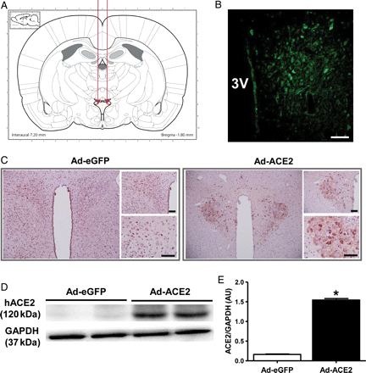
Figure 1 Overexpression of ACE2 in the PVN. (A) Schematic showing delivery of Adenovirus to the PVN. (B) Increased ...
Notes:
Figure 1 Overexpression of ACE2 in the PVN. (A) Schematic showing delivery of Adenovirus to the PVN. (B) Increased ACE2 immunofluorescence within the PVN after Ad-ACE2 injection (C) ACE2 immunoreactivity was increased in the PVN following Ad-ACE2 injection when compared with Ad-eGFP injection. Scale bar, 100 µm. (D) Western blot using specific antibody against human ACE2 (hACE2) and (E) densitometric analysis showing a significant increase in hACE2 protein expression in the PVN compared with control Ad-eGFP. *P< 0.05 compared with Ad-eGFP.
Unless provided in the caption above, the following copyright applies to the content of this slide: Published on behalf of the European Society of Cardiology. All rights reserved. © The Author 2011. For permissions please email: journals.permissions@oup.com.

Slide 2
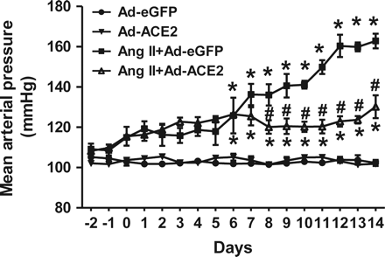
Figure 2 Overexpression of ACE2 in the PVN reduces Ang II hypertension. Ang II infusion significantly increased MAP in ...
Notes:
Figure 2 Overexpression of ACE2 in the PVN reduces Ang II hypertension. Ang II infusion significantly increased MAP in Ad-eGFP injected control rats. Overexpression of ACE2 by bilateral PVN microinjection of Ad-ACE2 virus alone did not produce any significant change in MAP when compared with control Ad-eGFP rats. In contrast, bilateral ACE2 overexpression in the PVN significantly reduced Ang II-mediated hypertension, though the MAP was not decreased to control levels. n= 5–6/group; *P< 0.05 compared with Ad-eGFP; #P< 0.05 compared with Ang II + Ad-eGFP.
Unless provided in the caption above, the following copyright applies to the content of this slide: Published on behalf of the European Society of Cardiology. All rights reserved. © The Author 2011. For permissions please email: journals.permissions@oup.com.

Slide 3
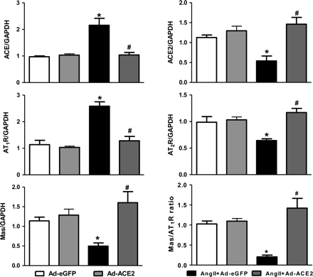
Figure 3 Effect of ACE2 overexpression on RAS components expression in the PVN. Ang II infusion significantly ...
Notes:
Figure 3 Effect of ACE2 overexpression on RAS components expression in the PVN. Ang II infusion significantly increased mRNA expression of ACE and AT1R, and decreased ACE2, AT2R, Mas mRNA expression, and Mas/AT1 ratio in the PVN when compared with control rats. Bilateral overexpression of ACE2 in the PVN reversed these gene expression changes. n= 9/group; *P< 0.05 compared with Ad-eGFP; #P< 0.05 compared with Ang II + Ad-eGFP.
Unless provided in the caption above, the following copyright applies to the content of this slide: Published on behalf of the European Society of Cardiology. All rights reserved. © The Author 2011. For permissions please email: journals.permissions@oup.com.

Slide 4
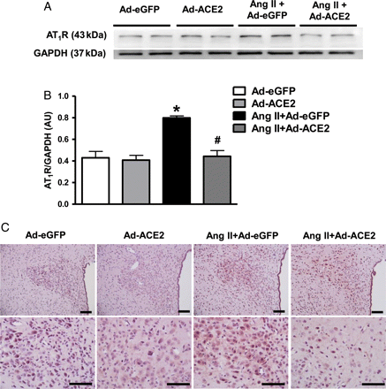
Figure 4 Overexpression of ACE2 down-regulates AT₁R expression in the PVN of Ang II-infused rats. Western ...
Notes:
Figure 4 Overexpression of ACE2 down-regulates AT1R expression in the PVN of Ang II-infused rats. Western blot (A), and quantitative data (B) showing a reduction in AT1R expression in the PVN of Ang II-infused rats following ACE2 overexpression. (C) This was further confirmed by immunohistochemistry against AT1R. Scale bar, 100 µm; n= 6/group; *P< 0.05 compared with Ad-eGFP; #P< 0.05 compared with Ang II + Ad-eGFP.
Unless provided in the caption above, the following copyright applies to the content of this slide: Published on behalf of the European Society of Cardiology. All rights reserved. © The Author 2011. For permissions please email: journals.permissions@oup.com.

Slide 5
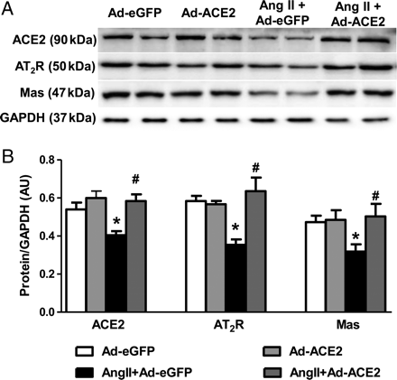
Figure 5 Effect of ACE2 overexpression on ACE2, AT₂R and Mas protein expression in the PVN. Protein ...
Notes:
Figure 5 Effect of ACE2 overexpression on ACE2, AT2R and Mas protein expression in the PVN. Protein expression was measured by western blot using specific antibodies against ACE2, AT2R and the Mas receptor and data were normalized using GAPDH expression. Densitometric analysis of western blot shows that 14 days Ang II infusion reduced protein expression of ACE2, AT2R and Mas receptor in the PVN. ACE2 overexpression reversed these changes in the PVN. n= 6/group; *P< 0.05 compared with Ad-eGFP; #P< 0.05 compared with Ang II + Ad-eGFP.
Unless provided in the caption above, the following copyright applies to the content of this slide: Published on behalf of the European Society of Cardiology. All rights reserved. © The Author 2011. For permissions please email: journals.permissions@oup.com.

Slide 6
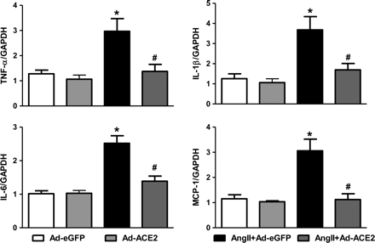
Figure 6 Overexpression of ACE2 reduces pro-inflammatory cytokine and chemokine expression in the PVN. mRNA expression ...
Notes:
Figure 6 Overexpression of ACE2 reduces pro-inflammatory cytokine and chemokine expression in the PVN. mRNA expression in the PVN was measured using real-time-RT–PCR and normalized to GAPDH expression. ACE2 overexpression significantly reduced the Ang II-induced increases in TNF-α, IL-1β, IL-6 and MCP-1 mRNA expression in the PVN. n= 6–9/group; * P< 0.05 compared with Ad-eGFP; #P< 0.05 compared with Ang II + Ad-eGFP.
Unless provided in the caption above, the following copyright applies to the content of this slide: Published on behalf of the European Society of Cardiology. All rights reserved. © The Author 2011. For permissions please email: journals.permissions@oup.com.

