Slide 1
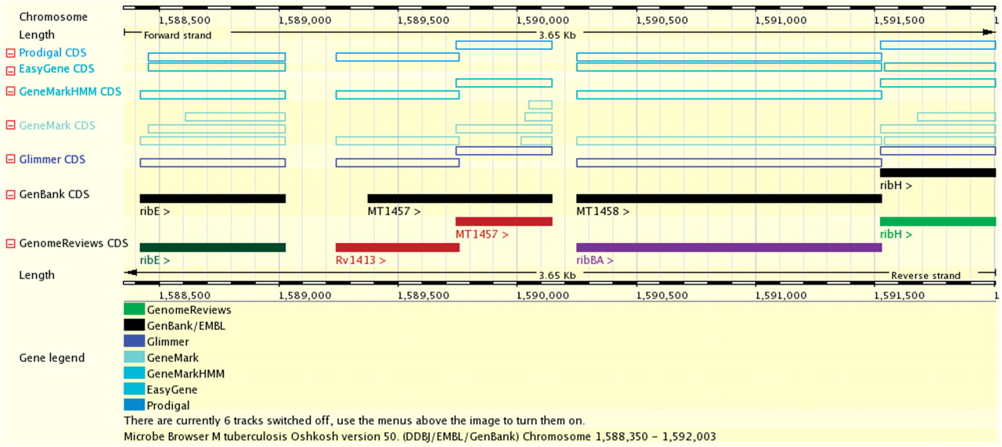
Figure 1. Chromosome view of Mycobacterium tuberculosis CDC 1551. GenBank source annotation (black full boxes), Genome ...
Notes:
Figure 1. Chromosome view of Mycobacterium tuberculosis CDC 1551. GenBank source annotation (black full boxes), Genome Reviews reference annotation from UniProtKB (coloured full boxes) and predictions from five software packages (hollow boxes). UniProtKB curators have altered the most likely translational start site of the MT1457 gene by similarity to other genomes and created a novel conserved gene identical to M. tuberculosis H37Rv gene Rv1413.
Unless provided in the caption above, the following copyright applies to the content of this slide: © 2009 The Author(s)This is an Open Access article distributed under the terms of the Creative Commons Attribution Non-Commercial License (http://creativecommons.org/licenses/by-nc/2.0/uk/) which permits unrestricted non-commercial use, distribution, and reproduction in any medium, provided the original work is properly cited.

Slide 2
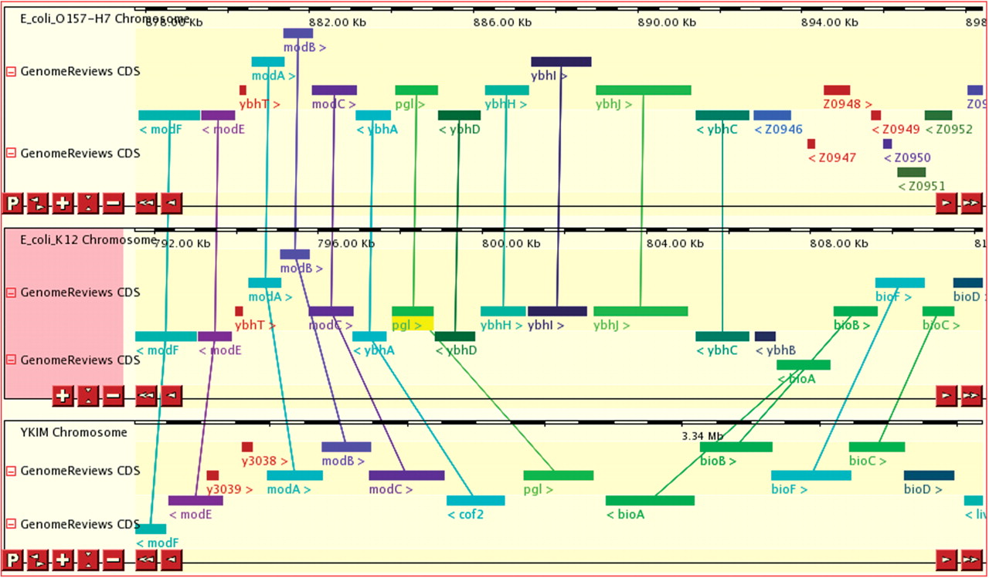
Figure 2. Chromosome comparison view of regions around the pgl gene in Escherichia coli O157:H7, E. coli K12 and ...
Notes:
Figure 2. Chromosome comparison view of regions around the pgl gene in Escherichia coli O157:H7, E. coli K12 and Yersinia pestis KIM5. Genes are coloured by InterPro families, and orthologous gene pairs are connected. Among the adjacent mod, ybh and bio genes present in E. coli K12, only two are conserved in synteny in each species.
Unless provided in the caption above, the following copyright applies to the content of this slide: © 2009 The Author(s)This is an Open Access article distributed under the terms of the Creative Commons Attribution Non-Commercial License (http://creativecommons.org/licenses/by-nc/2.0/uk/) which permits unrestricted non-commercial use, distribution, and reproduction in any medium, provided the original work is properly cited.

