Slide 1
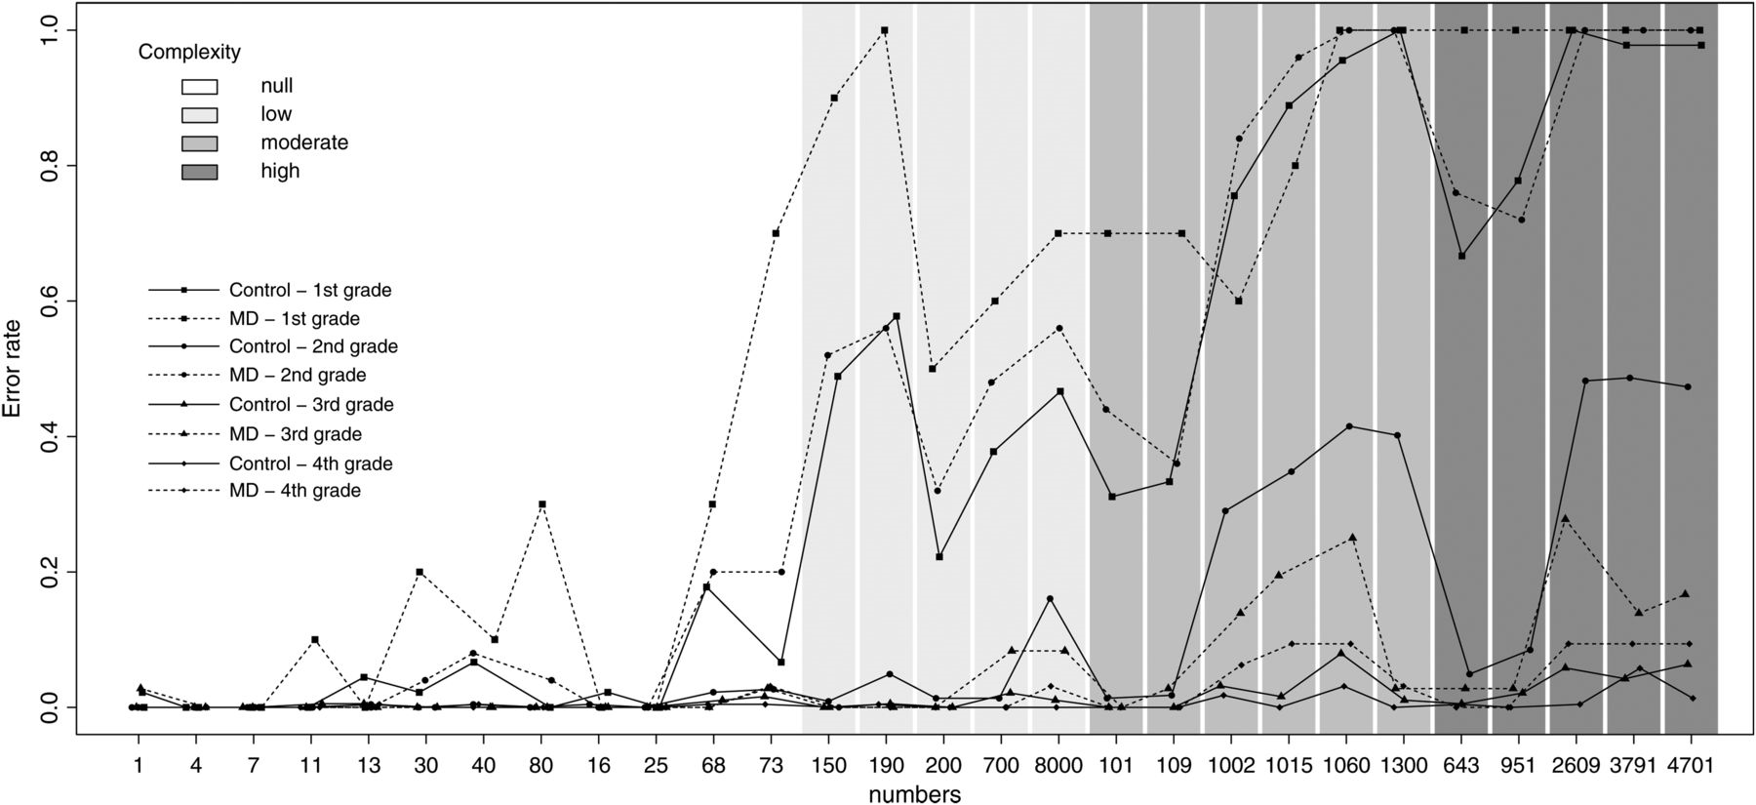
Fig. 1. Error rates on individual items according to children's group and school grade.
Notes:
Fig. 1. Error rates on individual items according to children's group and school grade.
Unless provided in the caption above, the following copyright applies to the content of this slide: © The Author 2014. Published by Oxford University Press. All rights reserved. For permissions, please e-mail: journals.permissions@oup.com.

Slide 2
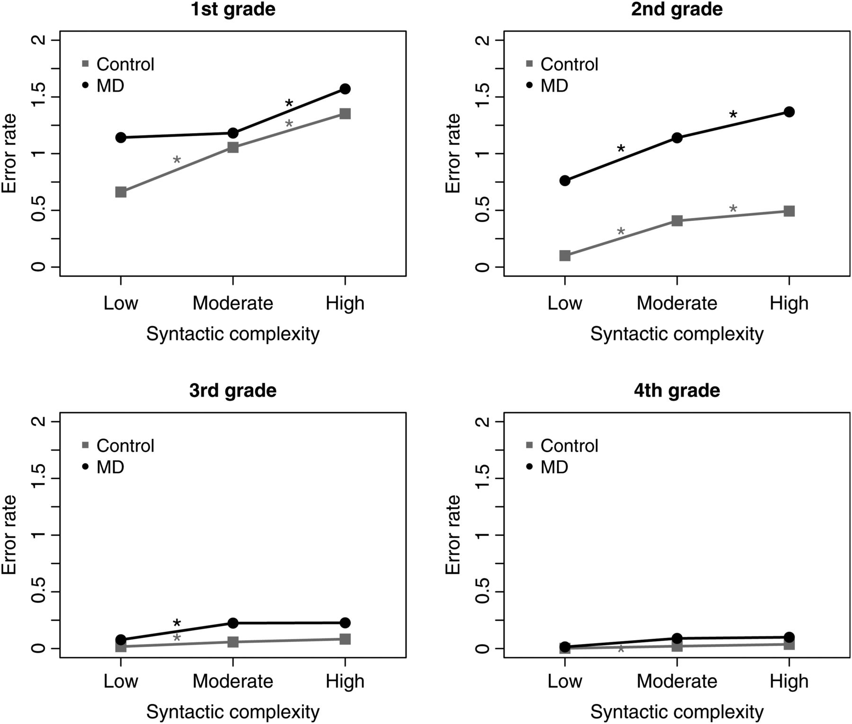
Fig. 2. Error rates as a function of numerical complexity and mathematical ability for each school grade.
Notes:
Fig. 2. Error rates as a function of numerical complexity and mathematical ability for each school grade.
Unless provided in the caption above, the following copyright applies to the content of this slide: © The Author 2014. Published by Oxford University Press. All rights reserved. For permissions, please e-mail: journals.permissions@oup.com.

