Slide 1
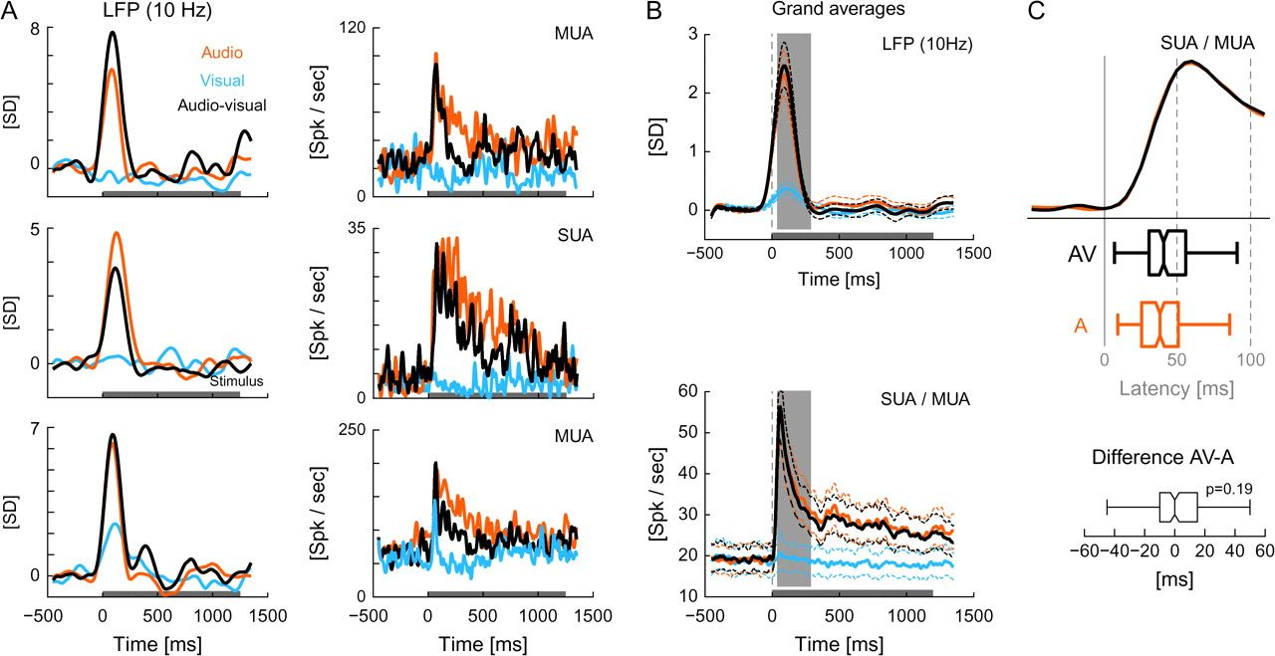
Figure 1. Example data, grand averages, and response latency. (A) Example data for the low-frequency LFP (left) and ...
Notes:
Figure 1. Example data, grand averages, and response latency. (A) Example data for the low-frequency LFP (left) and spiking activity (right, 2 MUA and 1 SUA site). The curves display the mean for all 3 conditions, and the horizontal gray box at the bottom indicates the stimulus interval. The LFP is shown in units of SDs from baseline (z-score). (B) Grand mean responses. Solid lines represent the mean across all sites or units (n= 146 for the LFP, n= 207 for the units), and dashed lines indicate the 1% confidence interval (bootstrap estimate of the mean from 1000 samples). The vertical gray box indicates the window for which the response amplitudes were computed in Figure 2. (C) Response latency. The graph displays the enlarged response onsets from panel (B) for auditory and audiovisual conditions, and boxplots indicate the median (middle vertical line), 25th and 75th percentile (box), and the full range of the latencies for all SUA/MUA sites. The bottom panel displays the difference between auditory and audiovisual conditions for all units; the Pvalue refers to a Wilcoxon test.
Unless provided in the caption above, the following copyright applies to the content of this slide: © The Author 2008. Published by Oxford University Press. All rights reserved. For permissions, please e-mail: journals.permissions@oxfordjournals.org

Slide 2
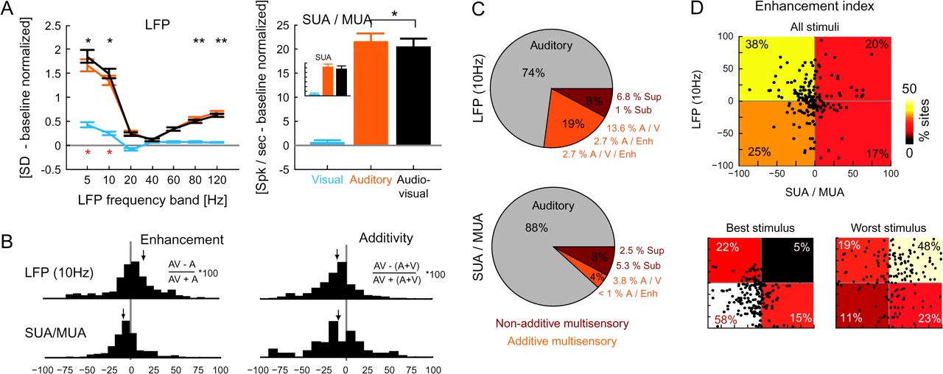
Figure 2. Response amplitudes and multisensory indices. (A) Response amplitudes for the different LFP frequency bands ...
Notes:
Figure 2. Response amplitudes and multisensory indices. (A) Response amplitudes for the different LFP frequency bands and firing rates during the initial response window (50–250 msec). The inset indicates the firing rates averaged for single units (SUA) only. Error bars indicate the mean and standard error of the mean, black stars indicate a significant difference (paired t-test) between the auditory and audiovisual conditions, and red stars indicate a significant visual response (t-test vs. zero); *P<0.05, **P<0.01. (B) Distribution of the enhancement index and the additivity index across sites for LFP and SUA/MUA. Arrows indicate the mean values. The enhancement index characterizes whether the auditory response was enhanced or suppressed by the visual stimulus, and the additivity index characterizes how much the audiovisual response deviates from an additive summation of the auditory and visual responses. (C) Distribution of sites with significant (P<0.01) multisensory effects. Gray: sites with only auditory responses. Orange: sites with additive multisensory effects. Red: sites with nonadditive multisensory effects. Additive multisensory sites have (in addition to an auditory response A) either a significant visual response (V) or a significant enhancement or suppression effect (Enh) or both. Nonadditive multisensory sites have a significant response in at least 1 condition and have either a significant supra-additive (Sup) or a significant subadditive response (Sub). (D) Scatter plots of the enhancement index in the SUA/MUA and low-frequency LFP at the same electrode, shown for all stimuli (upper panel) and restricted to responses to the worst and the best stimulus category for each site (lower panels). Numbers and color coding indicate the percentage of units in each quadrant. On average across all stimuli, the firing rates and LFP at individual electrodes often show a differential modulation, enhancement of the LFP, and suppression of the firing rates. This imbalance is shifted toward common enhancement or suppression when considering only the best or worst category.
Unless provided in the caption above, the following copyright applies to the content of this slide: © The Author 2008. Published by Oxford University Press. All rights reserved. For permissions, please e-mail: journals.permissions@oxfordjournals.org

Slide 3
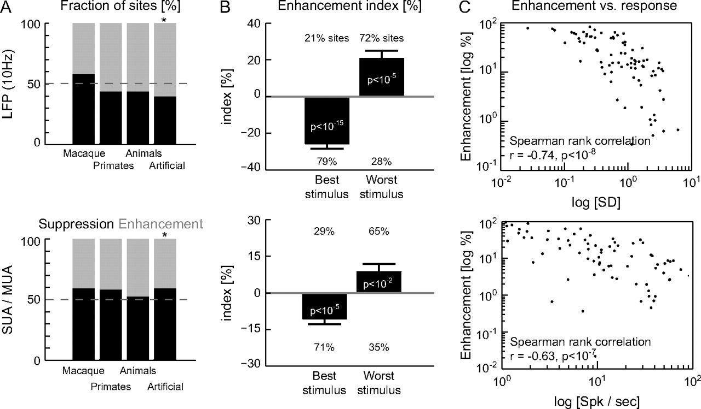
Figure 3. Relevance of stimulus category and stimulus effectiveness. (A) Fraction of sites (units) showing enhancement ...
Notes:
Figure 3. Relevance of stimulus category and stimulus effectiveness. (A) Fraction of sites (units) showing enhancement or suppression for each of the stimulus categories (time window 50–250 msec). For this analysis, the enhancement index was averaged across all stimuli within each category. Stars indicate significant deviations from chance level (χ2test, *P<0.05). (B) Average enhancement index for the best and worst category. Error bars indicate the mean and standard error of the mean across sites, Pvalues refer to a t-test versus zero, and numbers indicate the fraction of sites (or units) with a positive or negative index. (C) Logarithmic scatter plot of the response strength versus the enhancement index. Each dot represents 1 site; for simplicity, only sites with positive enhancement index are shown.
Unless provided in the caption above, the following copyright applies to the content of this slide: © The Author 2008. Published by Oxford University Press. All rights reserved. For permissions, please e-mail: journals.permissions@oxfordjournals.org

Slide 4
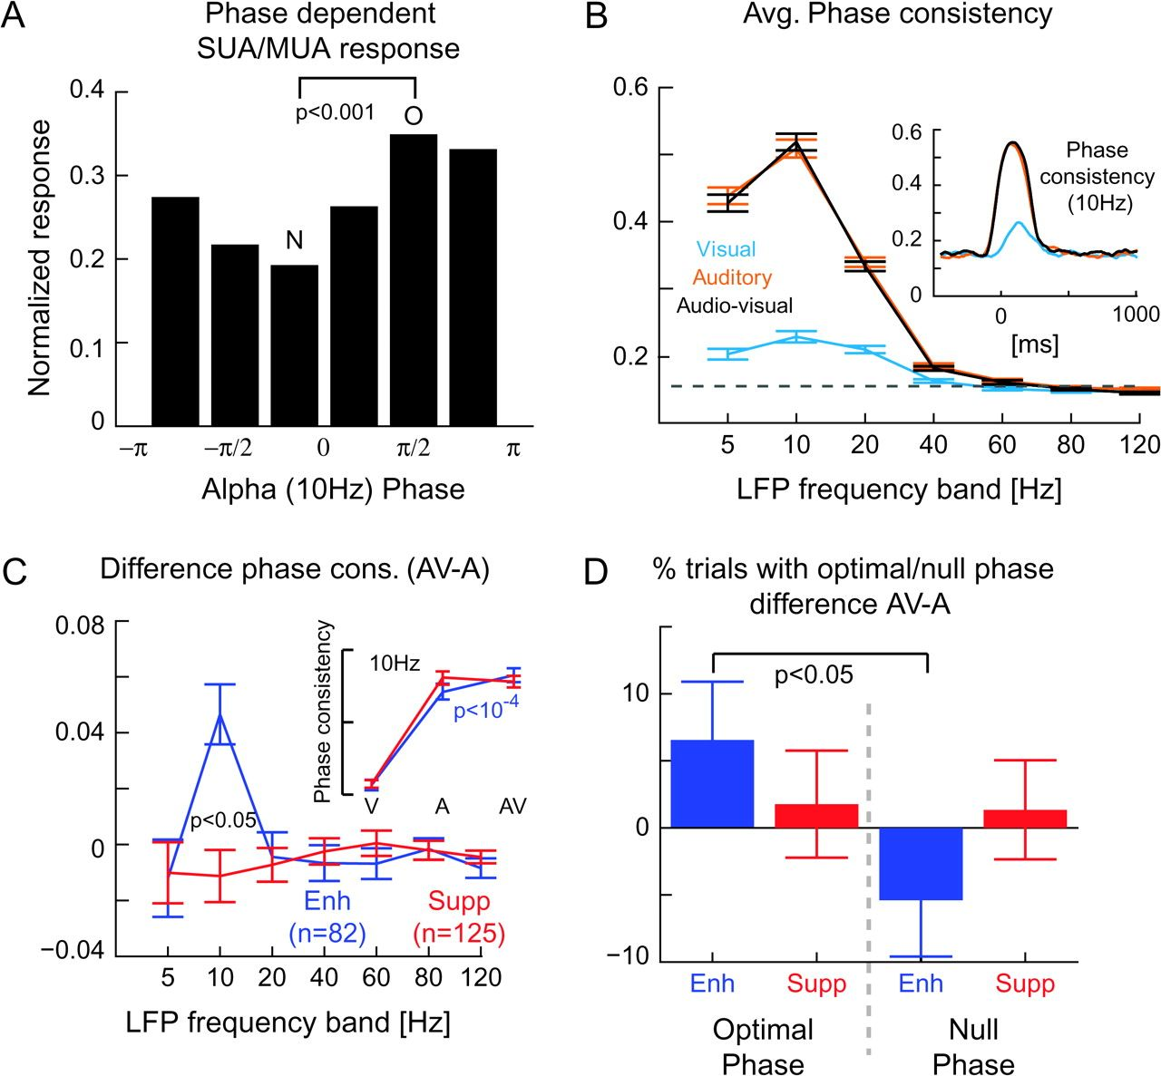
Figure 8. Oscillatory phase of field potentials and cross-modal interaction. (A) Normalized response amplitude as a ...
Notes:
Figure 8. Oscillatory phase of field potentials and cross-modal interaction. (A) Normalized response amplitude as a function of alpha (10 Hz) phase. The SUA/MUA responses (in the time window 50–250 msec) were averaged across trials according to the binned alpha phase (at t= 0) and normalized to the range of [0,1]. Bars indicate the mean of the normalized histogram across units (n= 46). The optimal (O) and null phases (N) are indicated, their amplitudes are significantly different; the Pvalue refers to a 2-sample t-test. (B) The main graph displays the average phase consistency for each condition and LFP frequency band (mean and standard error of the mean [SEM]). The dashed line indicates the phase consistency expected by change (randomization test, P<0.05). The inset displays the time course of the 10-Hz phase consistency (mean value). (C) Difference in phase consistency between auditory and audiovisual conditions (mean and SEM), separately for units with enhanced (blue) or suppressed (red) responses (for each unit the LFP from the same electrode was used). The Pvalue refers to a 2-sample t-test. The inset displays the average 10-Hz phase for each condition (mean and SEM). Stars indicate a significant difference between conditions; Pvalue refers to a paired t-test. (D) The bars (mean and SEM) display the difference between the audiovisual and auditory conditions in the fraction of trials where the response occurred in the optimal and null phases, separately for units showing enhancement (blue) or suppression (red). In other words, for each unit and condition, we counted the number of trials at which the response occurred at the respective phase; then, the difference between the audiovisual and auditory conditions of the percentage of trials was computed for each phase and the result averaged separately for units with enhancement and suppression; the Pvalue refers to a paired t-test.
Unless provided in the caption above, the following copyright applies to the content of this slide: © The Author 2008. Published by Oxford University Press. All rights reserved. For permissions, please e-mail: journals.permissions@oxfordjournals.org

Slide 5
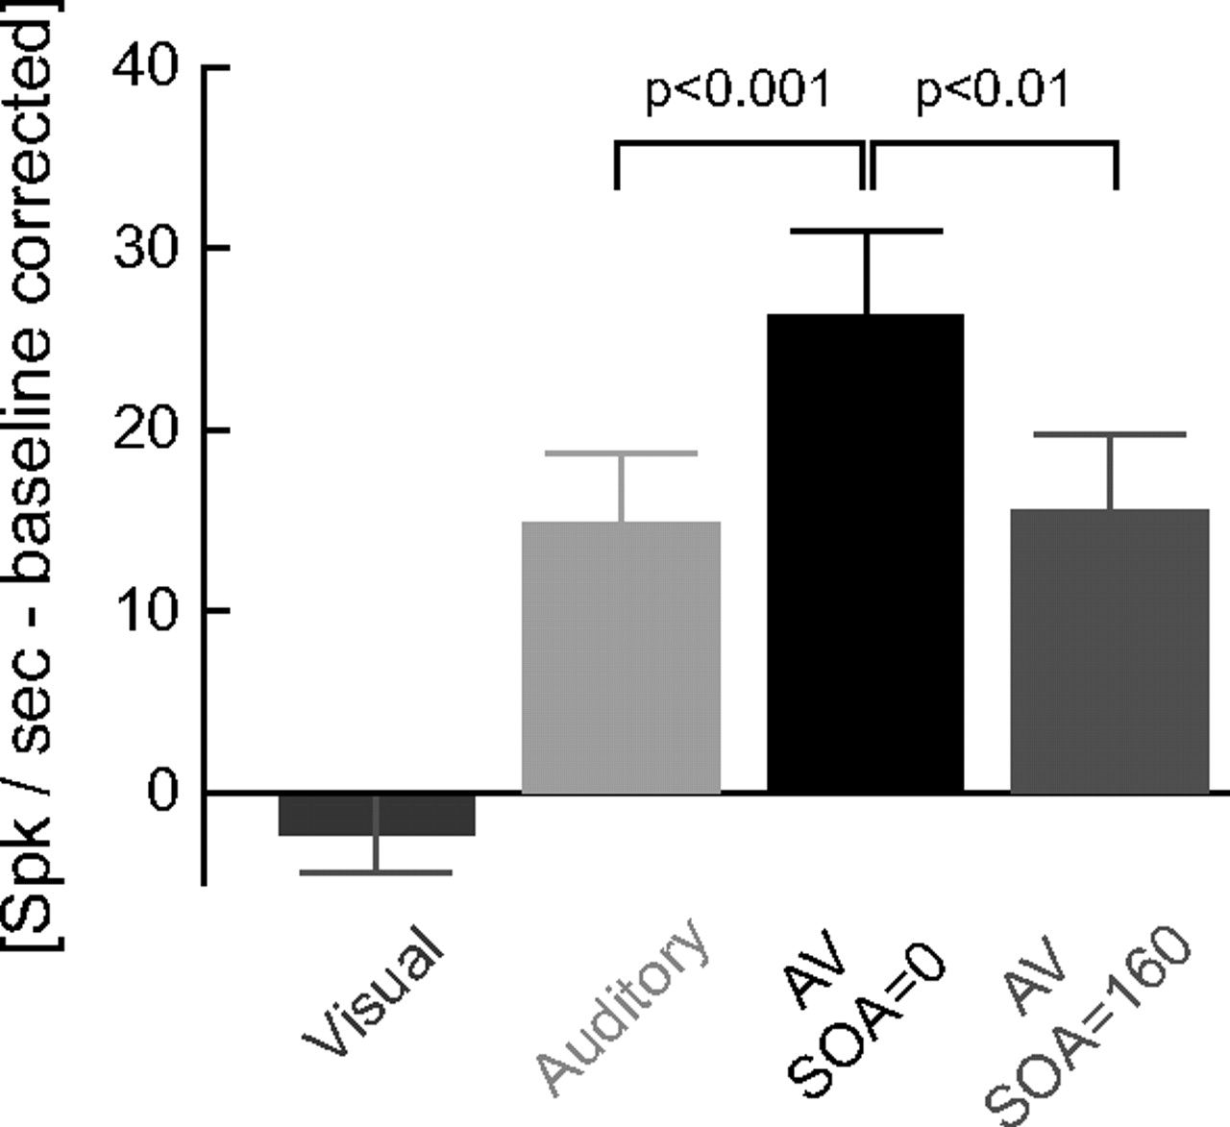
Figure 7. Impact of stimulus timing—naturalistic stimuli. In a separate paradigm, we presented audiovisual scenes ...
Notes:
Figure 7. Impact of stimulus timing—naturalistic stimuli. In a separate paradigm, we presented audiovisual scenes either as the synchronous audiovisual pair (SOA = 0) or with the visual stimulus starting (SOA=) 160 msec before the auditory stimulus. The error bars indicate the mean (and standard error of the mean) responses for each condition, for a set of units showing response enhancement (n= 32). Pvalues refer to paired t-tests.
Unless provided in the caption above, the following copyright applies to the content of this slide: © The Author 2008. Published by Oxford University Press. All rights reserved. For permissions, please e-mail: journals.permissions@oxfordjournals.org

Slide 6
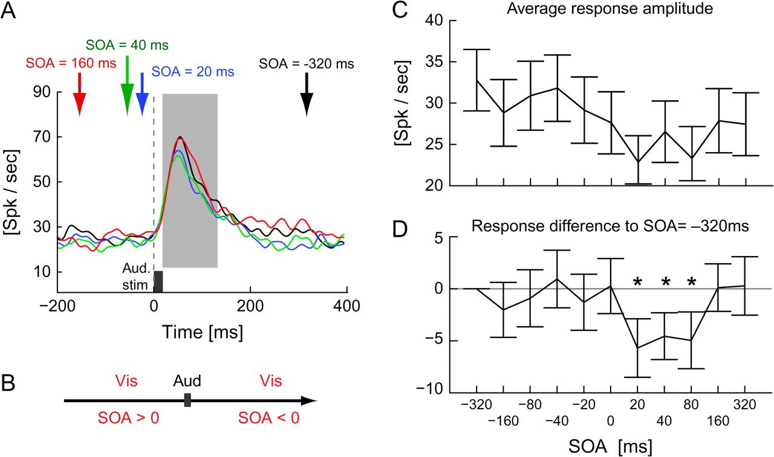
Figure 6. Impact of stimulus timing—simplistic stimuli. (A) Average firing rates for different SOA values (n= 97 ...
Notes:
Figure 6. Impact of stimulus timing—simplistic stimuli. (A) Average firing rates for different SOA values (n= 97 units). The auditory stimulus was always presented at zero (small gray box at bottom), and arrows indicate the time point of the visual stimulus. The vertical gray box indicates the 150-msec response window for which the amplitudes were used in panels (C). (B) The paradigm. For positive SOA values, the visual stimulus was occurring before, for negative SOA values after, the auditory stimulus. (C) Average responses for the different SOA values (mean and standard error of the mean [SEM], baseline corrected). (D) Response difference for each condition to the auditory only baseline, defined by the SOA = −320 ms condition (mean and SEM). Stars indicate significant differences from zero (t-test, *P<0.05, **P<0.01).
Unless provided in the caption above, the following copyright applies to the content of this slide: © The Author 2008. Published by Oxford University Press. All rights reserved. For permissions, please e-mail: journals.permissions@oxfordjournals.org

Slide 7
Figure 5. Comparison of auditory core and belt regions. (A) Distribution of recording sites with regard to the ...
Notes:
Figure 5. Comparison of auditory core and belt regions. (A) Distribution of recording sites with regard to the core/belt division in 1 animal. Sites with significant multisensory effects are distributed across both regions. (B) Response amplitudes to audiovisual stimuli in the LFP (left) and SUA/MUA (right) in core and belt regions (Fig. 2A). Error bars indicate the mean and standard error of the mean across sites (core: n= 111, belt: n= 96 for SUA/MUA). The only significant difference between core and belt is a stronger visual response in the belt LFP (paired t-test). (C) Histograms display the enhancement index for LFP and SUA/MUA, and arrows indicate the mean values (cf., Fig. 2B). No significant difference between core and belt (2-sample t-test, P>0.05). (D) Enhancement of SUA/MUA firing rates for individual stimulus categories. Bars indicate the fraction of units showing response enhancement and suppression for each stimulus category (cf., Fig. 3A). No significant difference between core and belt (χ2-test, P>0.05).
Unless provided in the caption above, the following copyright applies to the content of this slide: © The Author 2008. Published by Oxford University Press. All rights reserved. For permissions, please e-mail: journals.permissions@oxfordjournals.org

Slide 8
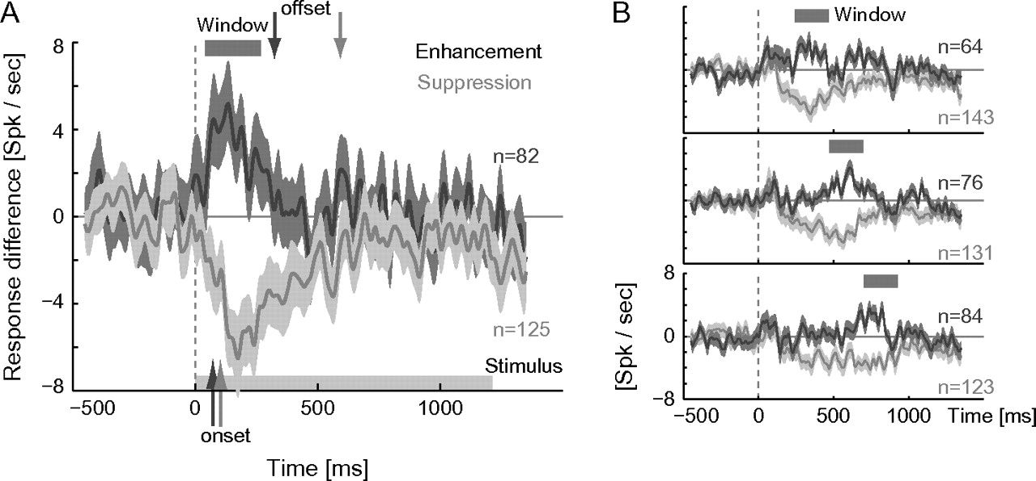
Figure 4. Time course of cross-modal interaction. (A) Difference between the audiovisual and auditory responses ...
Notes:
Figure 4. Time course of cross-modal interaction. (A) Difference between the audiovisual and auditory responses separately for units showing response enhancement (dark gray) and suppression (light gray). For this panel, units were sorted according to their main effect during the initial response window (see gray box). Solid lines indicate the mean, whereas the shaded area indicates the 1% confidence interval (bootstrap estimate). The number of units in each average is indicated on the side. Arrows at the bottom indicate the mean onset latency of the effect; arrows on top indicate the offset (see text). (B) Difference between the audiovisual and auditory responses separately for units sorted according to their main effect during later response windows (see gray boxes on top).
Unless provided in the caption above, the following copyright applies to the content of this slide: © The Author 2008. Published by Oxford University Press. All rights reserved. For permissions, please e-mail: journals.permissions@oxfordjournals.org

