Slide 1
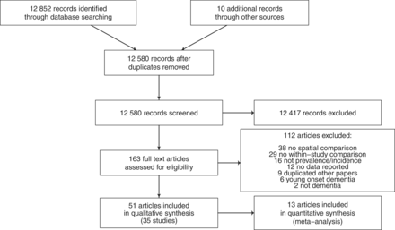
Figure 1 PRISMA diagram showing selection of studies for inclusion in systematic review of geographical clustering of ...
Notes:
Figure 1 PRISMA diagram showing selection of studies for inclusion in systematic review of geographical clustering of dementia prevalence and incidence
Unless provided in the caption above, the following copyright applies to the content of this slide: Published by Oxford University Press on behalf of the International Epidemiological Association © The Author 2012; all rights reserved.

Slide 2
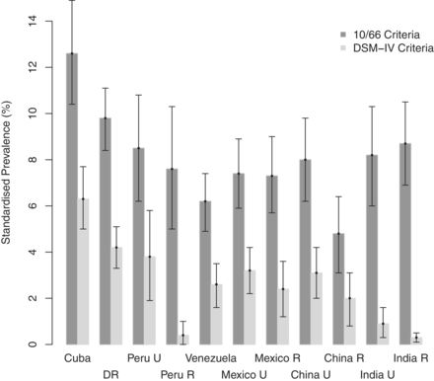
Figure 2 Comparison of standardized dementia prevalence (95% CI) with different diagnostic criteria. Constructed from ...
Notes:
Figure 2 Comparison of standardized dementia prevalence (95% CI) with different diagnostic criteria. Constructed from 10/66 Dementia Research Group data.23 DR = Dominican Republic, U = urban, R = rural
Unless provided in the caption above, the following copyright applies to the content of this slide: Published by Oxford University Press on behalf of the International Epidemiological Association © The Author 2012; all rights reserved.

Slide 3
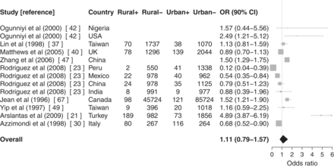
Figure 3 Meta-analysis with forest plot of urban/rural differences in dementia prevalence (using DSM-IV criteria for ...
Notes:
Figure 3 Meta-analysis with forest plot of urban/rural differences in dementia prevalence (using DSM-IV criteria for Ref. 23). Rural+: dementia cases in rural areas, Rural−: non-dementia cases in rural areas, Urban+: dementia cases in urban areas and Urban−: non-dementia cases in urban areas. Articles without case numbers reported ORs and 95% CIs rather than raw numbers. Urban areas form the referent
Unless provided in the caption above, the following copyright applies to the content of this slide: Published by Oxford University Press on behalf of the International Epidemiological Association © The Author 2012; all rights reserved.

Slide 4
Figure 4 Meta-analysis with forest plot of urban/rural differences in dementia incidence. Rural⁺: dementia ...
Notes:
Figure 4 Meta-analysis with forest plot of urban/rural differences in dementia incidence. Rural+: dementia cases in rural areas, Rural−: non-dementia cases in rural areas, Urban+: dementia cases in urban areas and Urban−: non-dementia cases in urban areas. Articles without case numbers reported ORs and 95% CIs rather than raw numbers. Urban areas form the referent
Unless provided in the caption above, the following copyright applies to the content of this slide: Published by Oxford University Press on behalf of the International Epidemiological Association © The Author 2012; all rights reserved.

