Slide 1
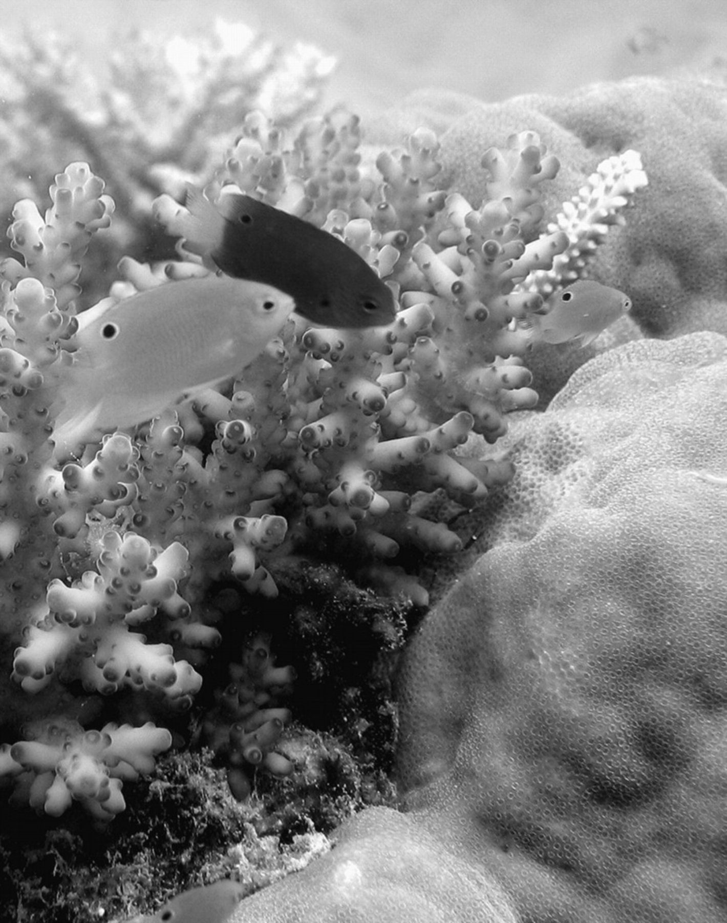
Figure 1 Dusky yellow Pomacentrus amboinensis juveniles are frequently observed co-occurring in shallow coral reef ...
Notes:
Figure 1 Dusky yellow Pomacentrus amboinensis juveniles are frequently observed co-occurring in shallow coral reef habitats with other closely related pomacentrids, such as the bright blue Pomacentrus nagasakiensis. Juveniles of both species are characterized by a black eyespot on the posterior dorsal fin.
Unless provided in the caption above, the following copyright applies to the content of this slide: © The Author 2008. Published by Oxford University Press on behalf of the International Society for Behavioral Ecology. All rights reserved. For permissions, please e-mail: journals.permissions@oxfordjournals.org

Slide 2
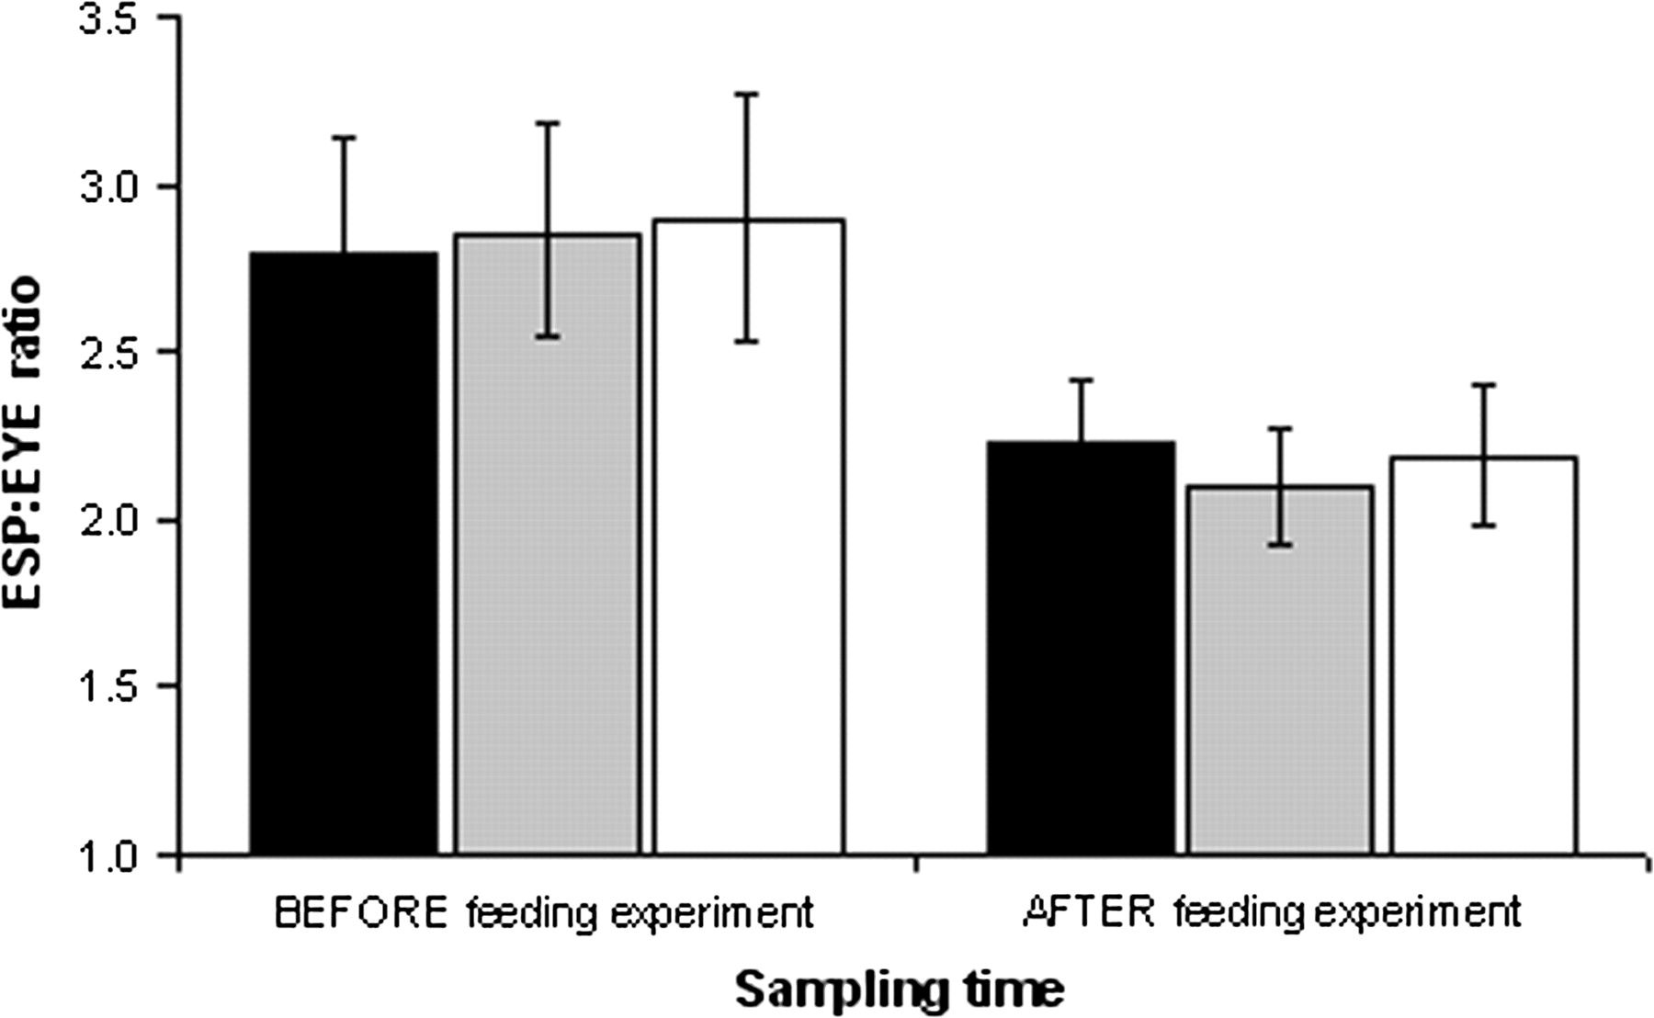
Figure 2 Size of eyespots relative to real eyes (ESP:EYE ratio) of Pomacentrus amboinensis measured before ...
Notes:
Figure 2 Size of eyespots relative to real eyes (ESP:EYE ratio) of Pomacentrus amboinensis measured before experimental feeding manipulations and remeasured in the same individuals after a 30-day experimental period. Individual fish were fed ad lib 3 times each day (black bars), fed once only in the morning of every second day (gray bars), or once only in the morning of every third day (white bars). Data are means ± 95% confidence intervals.
Unless provided in the caption above, the following copyright applies to the content of this slide: © The Author 2008. Published by Oxford University Press on behalf of the International Society for Behavioral Ecology. All rights reserved. For permissions, please e-mail: journals.permissions@oxfordjournals.org

Slide 3
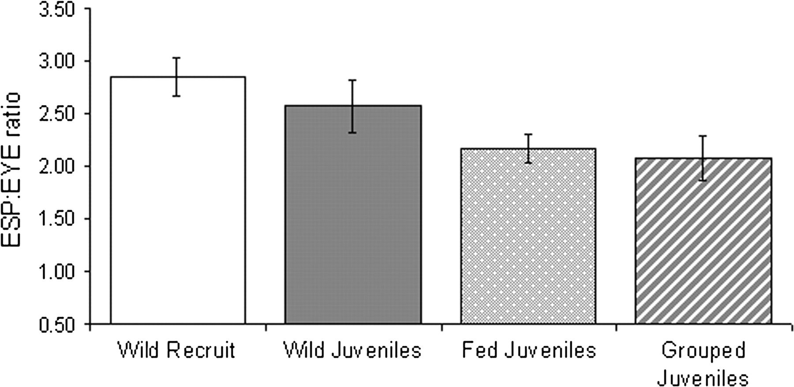
Figure 3 Mean size of eyespots relative to real eyes (ESP:EYE ratio) of the survivors recaptured after 1 month on the ...
Notes:
Figure 3 Mean size of eyespots relative to real eyes (ESP:EYE ratio) of the survivors recaptured after 1 month on the reef (white bar) compared with that of wild recruits at settlement (gray bar) and that of same-age conspecifics that were either fed individually in the laboratory (stippled bar) or maintained in small groups (striped bar) in a predator-free environment. Error bars represent means ± 95% confidence intervals.
Unless provided in the caption above, the following copyright applies to the content of this slide: © The Author 2008. Published by Oxford University Press on behalf of the International Society for Behavioral Ecology. All rights reserved. For permissions, please e-mail: journals.permissions@oxfordjournals.org

Slide 4
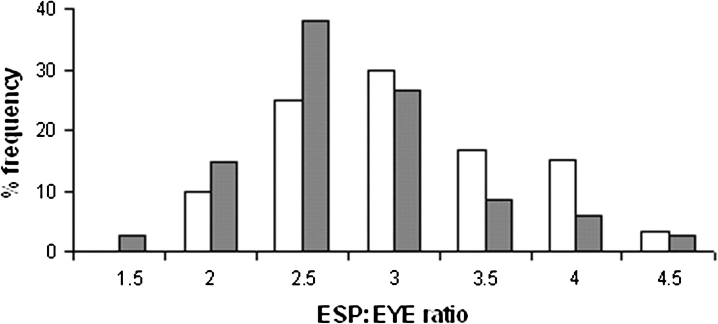
Figure 4 Frequency distribution of EYE:ESP ratio of 1-month-old survivors collected from the reef compared with that ...
Notes:
Figure 4 Frequency distribution of EYE:ESP ratio of 1-month-old survivors collected from the reef compared with that of wild recruits collected at settlement (i.e., representing a sample of the cohort at settlement from which the survivors originated).
Unless provided in the caption above, the following copyright applies to the content of this slide: © The Author 2008. Published by Oxford University Press on behalf of the International Society for Behavioral Ecology. All rights reserved. For permissions, please e-mail: journals.permissions@oxfordjournals.org

