Slide 1
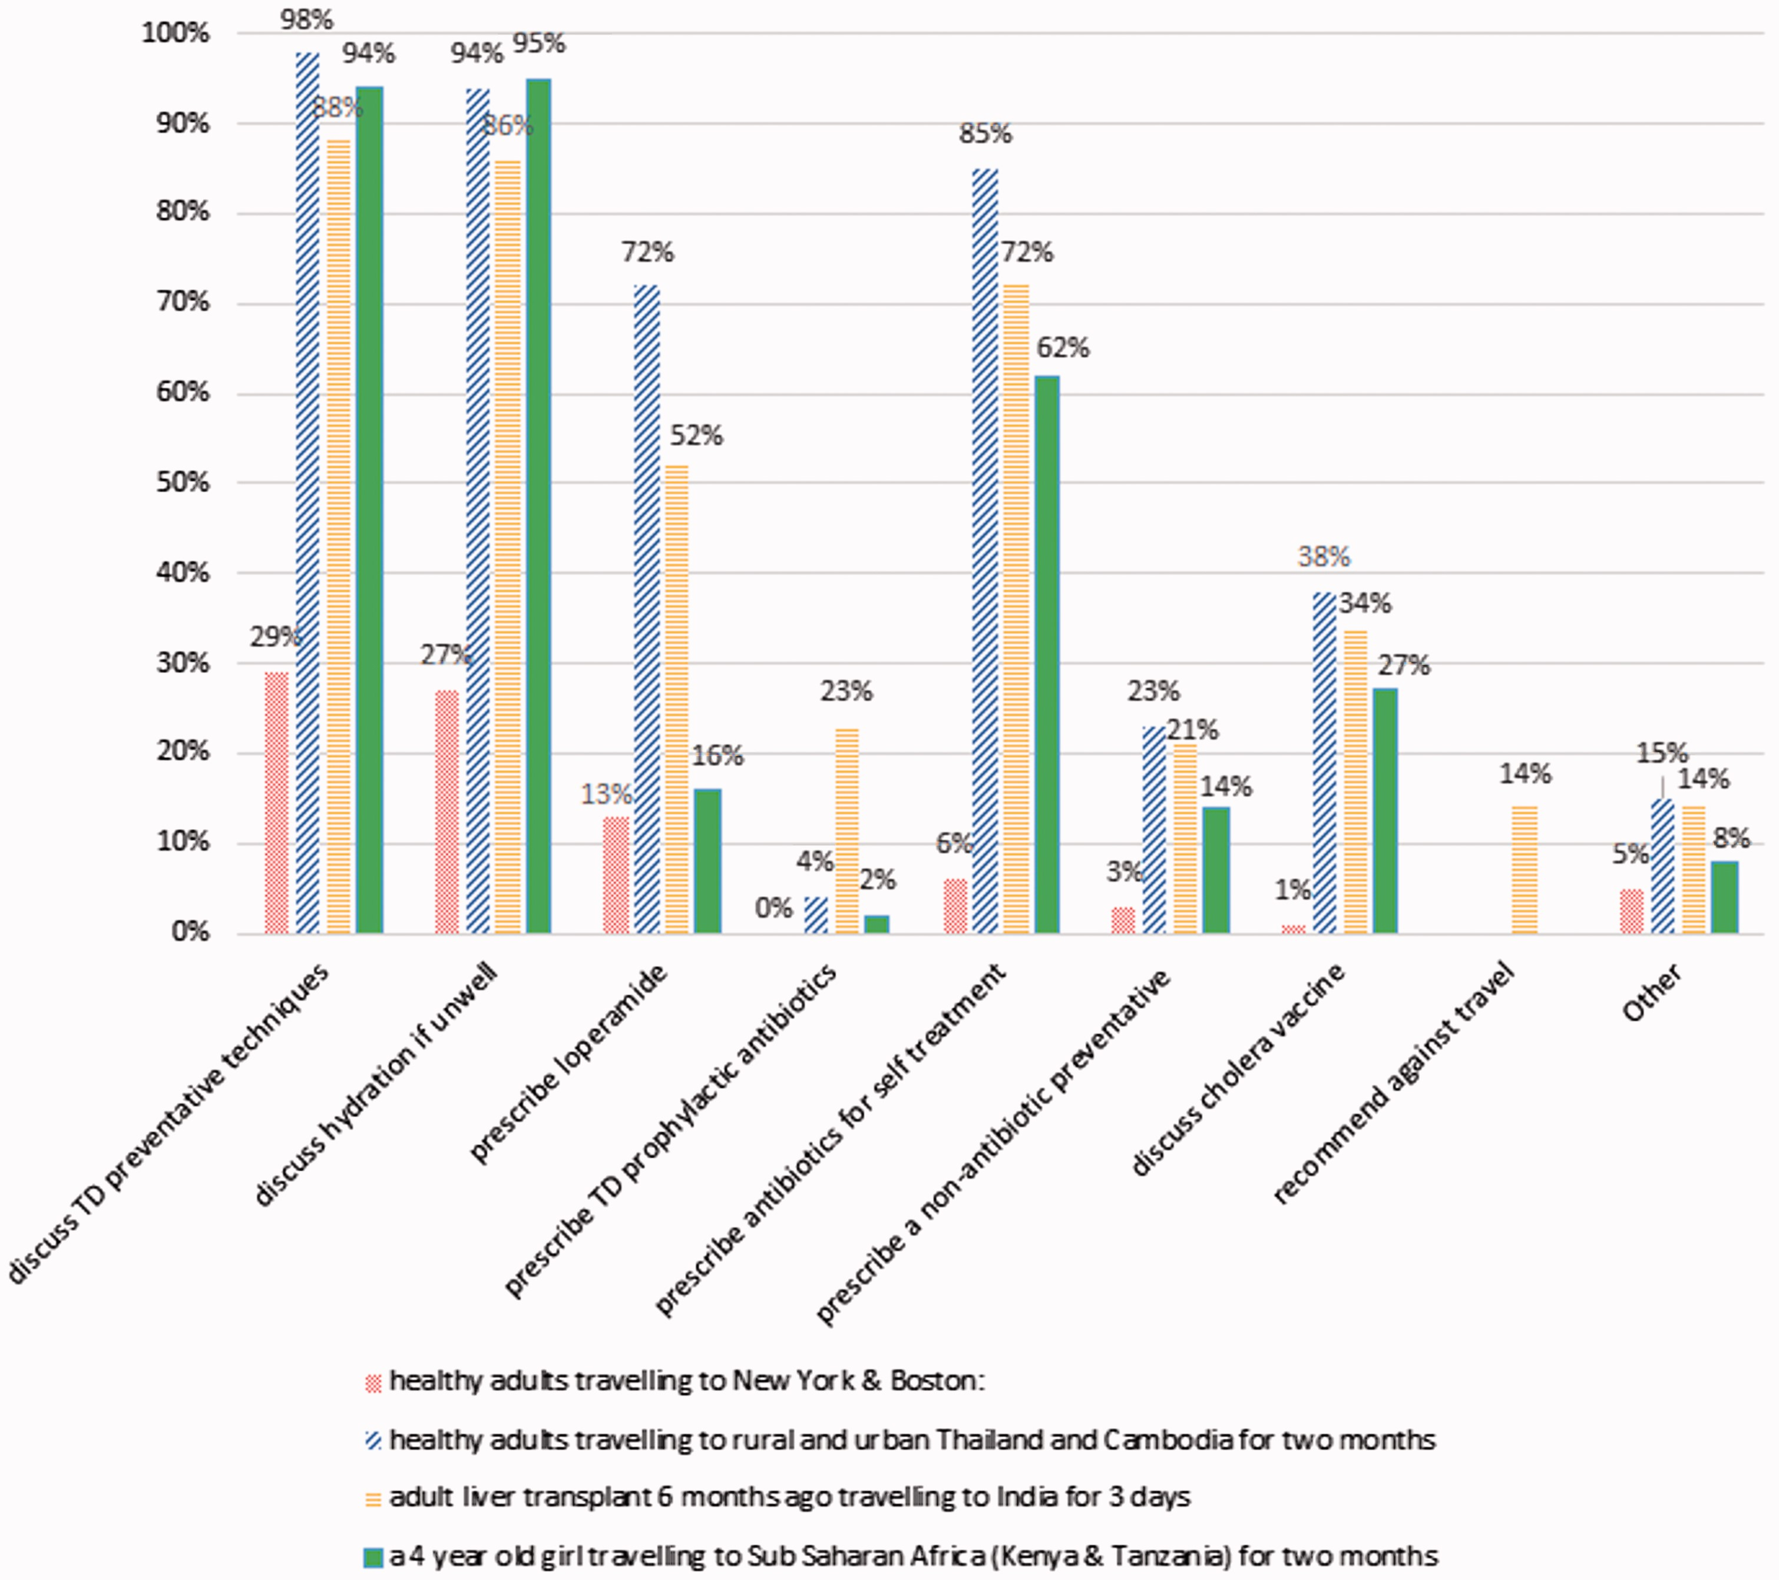
Figure 1 Percentage of respondents who would discuss the following in each group
Notes:
Figure 1 Percentage of respondents who would discuss the following in each group
Unless provided in the caption above, the following copyright applies to the content of this slide: © International Society of Travel Medicine, 2017. Published by Oxford University Press. All rights reserved. For Permissions, please e-mail: journals.permissions@oup.com

Slide 2
Figure 2 Clinical approach to mild travellers’ diarrhoea (one loose motion, no systemic features)
Notes:
Figure 2 Clinical approach to mild travellers’ diarrhoea (one loose motion, no systemic features)
Unless provided in the caption above, the following copyright applies to the content of this slide: © International Society of Travel Medicine, 2017. Published by Oxford University Press. All rights reserved. For Permissions, please e-mail: journals.permissions@oup.com

Slide 3
Figure 3 Clinical approach to moderate travellers’ diarrhoea (three loose motions, change of plans)
Notes:
Figure 3 Clinical approach to moderate travellers’ diarrhoea (three loose motions, change of plans)
Unless provided in the caption above, the following copyright applies to the content of this slide: © International Society of Travel Medicine, 2017. Published by Oxford University Press. All rights reserved. For Permissions, please e-mail: journals.permissions@oup.com

Slide 4
Figure 4 Clinical approach to severe travellers’ diarrhoea (greater than 10 blood motions and fever)
Notes:
Figure 4 Clinical approach to severe travellers’ diarrhoea (greater than 10 blood motions and fever)
Unless provided in the caption above, the following copyright applies to the content of this slide: © International Society of Travel Medicine, 2017. Published by Oxford University Press. All rights reserved. For Permissions, please e-mail: journals.permissions@oup.com

