Slide 1
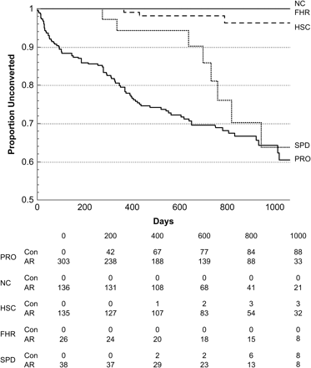
Fig. 2. Time to Conversion to Psychosis Among Subjects in the 5 Groups. Solid black line—prodromal patients (n = 303, ...
Notes:
Fig. 2. Time to Conversion to Psychosis Among Subjects in the 5 Groups. Solid black line—prodromal patients (n = 303, 89 converters). One patient in the prodromal group converted at 1006 days. Thin black line—normal comparison subjects (136, 0 converters, P < .001 vs prodromals). Dashed black line—help-seeking comparison subjects (n = 135, 3 converters, P < .001 vs prodromals). Solid gray line—familial high-risk subjects (n = 26, 0 converters, P < .001 vs prodromals). Dotted line—schizotypal personality disorders (n = 38, 8 converters, P = .230 vs prodromals). PRO—prodromals, NC—normal comparison subjects, HSC—help-seeking comparison subjects, FHR—familial high-risk subjects, SPD—schizotypal personality disorder patients, Con—cumulative number of converters, AR—number of at-risk subjects remaining.
Unless provided in the caption above, the following copyright applies to the content of this slide: © The Author 2009. Published by Oxford University Press on behalf of the Maryland Psychiatric Research Center. All rights reserved. For permissions, please email: journals.permissions@oxfordjournals.org.

Slide 2
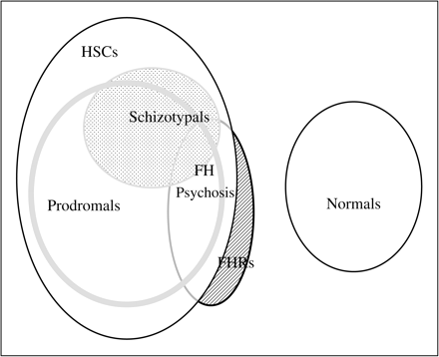
Fig. 1. Description of Subject Groupings. Sample sizes and overlaps are approximately proportional to oval areas. ...
Notes:
Fig. 1. Description of Subject Groupings. Sample sizes and overlaps are approximately proportional to oval areas. Subjects within the largest oval were clinically referred because of psychotic like symptoms. Within this large group (n = 624), subjects who met prodrome criteria (n = 377) are shown inside the widely outlined oval, and subjects who met schizotypal personality disorder (SPD) criteria are shown inside the lightly hatched oval (n = 147). Among the 147 schizotypal patients, 98 also met prodrome criteria (67% of schizotypals and 26% of prodromals). The remaining clinically referred subjects who met neither prodrome nor schizotypal criteria are labeled help-seeking comparison (HSC) subjects (n = 198). The crosshatched oval containing subjects with a definite first-degree family history of psychosis (n = 125) includes 40 subjects who were not clinically referred (familial high risk subjects, FHR, darkly hatched region). A total of 19% of prodromals, 11% of HSC subjects, and 5% of the SPD analysis group had a definite first-degree family history of psychosis (table 6). All subjects meeting prodromal criteria were retained in the prodromal analysis group, regardless of schizotypal comorbidity or family history. The SPD analysis group was restricted to schizotypal patients who did not meet prodrome criteria, without regard to family history (n = 49). All HSC subjects were retained in the HSC analysis group, without regard to family history. In addition to these subjects, 196 subjects referred as healthy volunteers and who had no first-degree family history of psychosis defined the normal comparison group.
Unless provided in the caption above, the following copyright applies to the content of this slide: © The Author 2009. Published by Oxford University Press on behalf of the Maryland Psychiatric Research Center. All rights reserved. For permissions, please email: journals.permissions@oxfordjournals.org.

