Slide 1
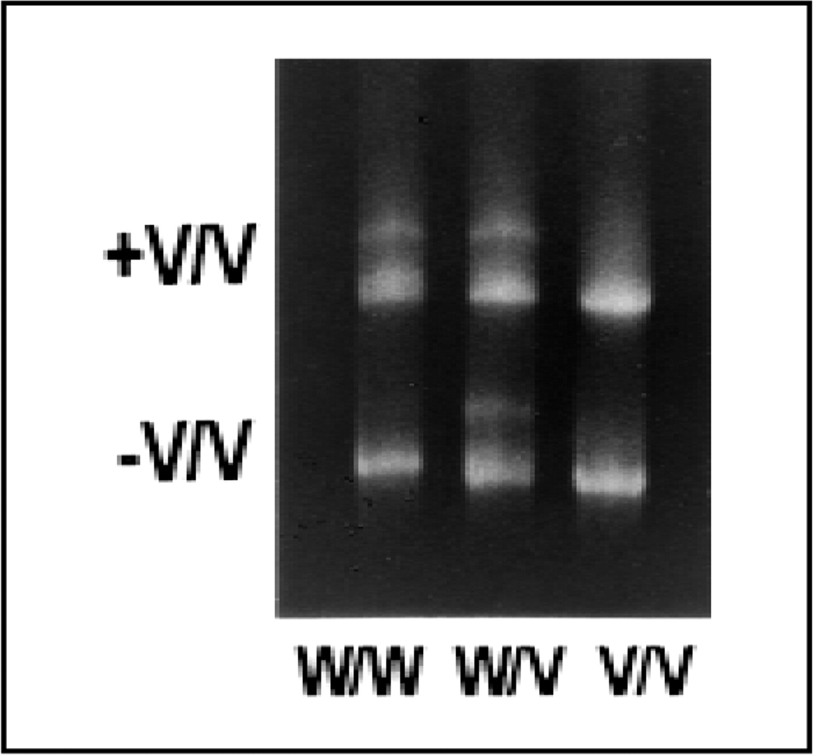
Fig. 1 Analysis of the nifedipine-specific element variant at CYP3A4 by conformation-sensitive gel electrophoresis ...
Notes:
Fig. 1 Analysis of the nifedipine-specific element variant at CYP3A4 by conformation-sensitive gel electrophoresis (CSGE). The appearance of homozygous variants (V/V) and heterozygotes (W/V) is identical in the presence (+) and absence (-) of homozygous variant (V/V) DNA. The addition of V/V DNA to homozygous W/W samples induces the generation of heteroduplexes in CSGE analysis and results in the presence of an additional band.
Unless provided in the caption above, the following copyright applies to the content of this slide: © 1998 Oxford University Press

Slide 2
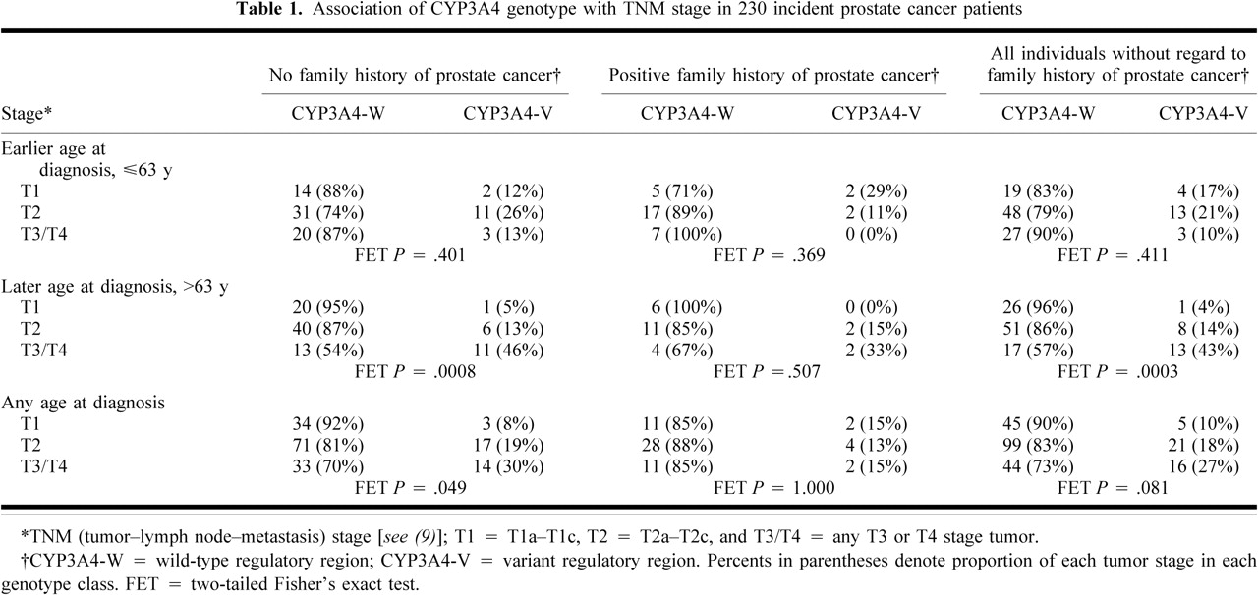
Notes:
Unless provided in the caption above, the following copyright applies to the content of this slide: © 1998 Oxford University Press

Slide 3
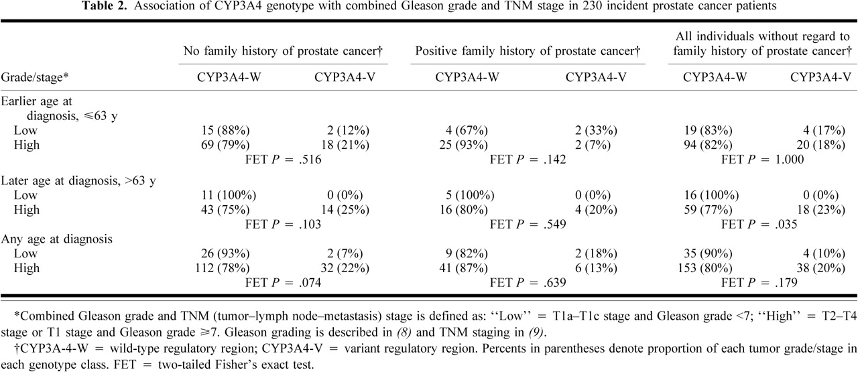
Notes:
Unless provided in the caption above, the following copyright applies to the content of this slide: © 1998 Oxford University Press

