Slide 1
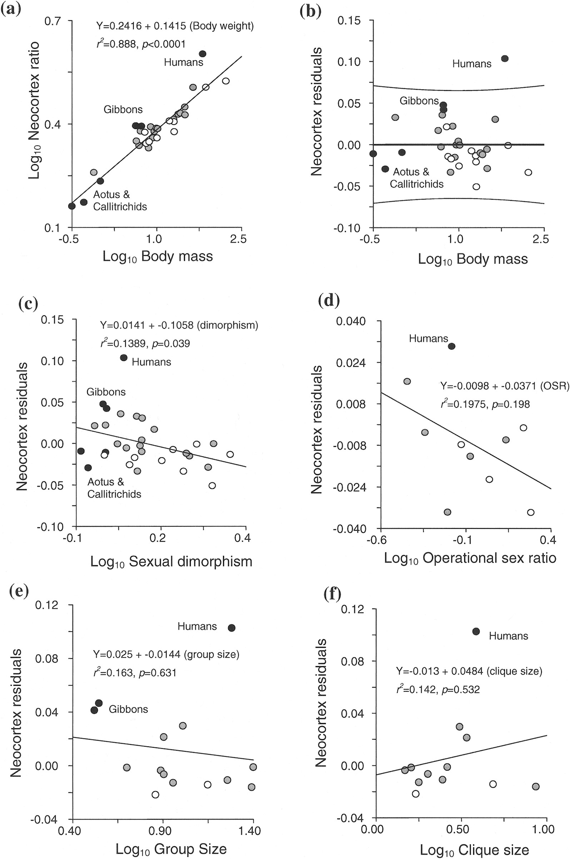
Fig. 1 Bivariate plots describing a) regression of the log₁₀ values of neocortex ratio on the ...
Notes:
Fig. 1 Bivariate plots describing a) regression of the log10 values of neocortex ratio on the log10 values of male body mass, b) regression of neocortex residuals on log10 values of male body mass, c) regression of neocortex residuals on log10 values of sexual dimorphism, d) regression of neocortex residuals on log10 values of the operational sex ratio, e) regression of neocortex residuals on log10 values of group size, and f) regression of neocortex residuals on log10 values of social clique size. Species with multimale–multifemale mating systems are represented by gray-filled circles, whereas species with single-male systems are represented by open circles. Monogamous species are represented by black-filled circles and are labeled.
Unless provided in the caption above, the following copyright applies to the content of this slide: © 2008 American Society of Mammalogists

Slide 2
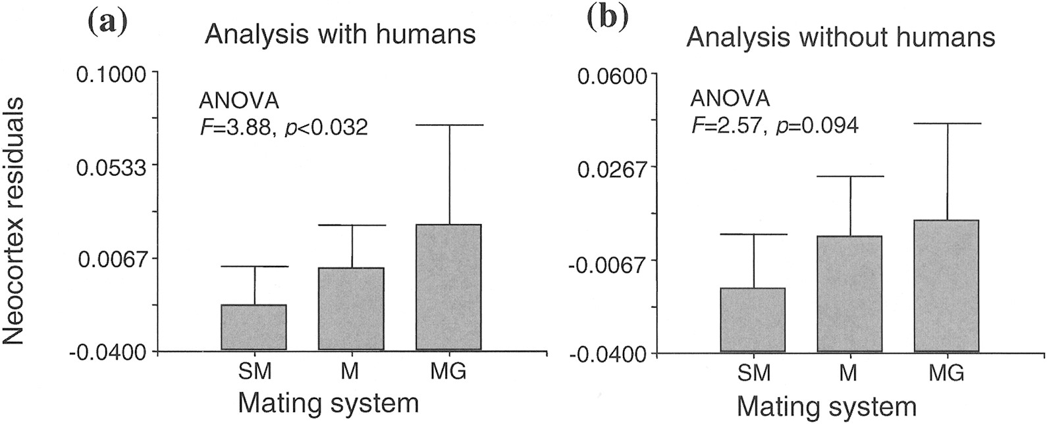
Fig. 2 Error-bar charts describing the distribution of neocortex residuals across mating systems including a) and ...
Notes:
Fig. 2 Error-bar charts describing the distribution of neocortex residuals across mating systems including a) and excluding b) humans. Error bars equal 1 standard error of the mean. Mating systems are labeled as SM = single-male; M = multimale–multifemale; and MG = monogamous.
Unless provided in the caption above, the following copyright applies to the content of this slide: © 2008 American Society of Mammalogists

