Slide 1
Figure 1. Schematic representation of a chromatographic column of cylindrical geometry.
Notes:
Figure 1. Schematic representation of a chromatographic column of cylindrical geometry.
Unless provided in the caption above, the following copyright applies to the content of this slide: © The Author 2017. Published by Oxford University Press. All rights reserved. For Permissions, please email: journals.permissions@oup.com

Slide 2
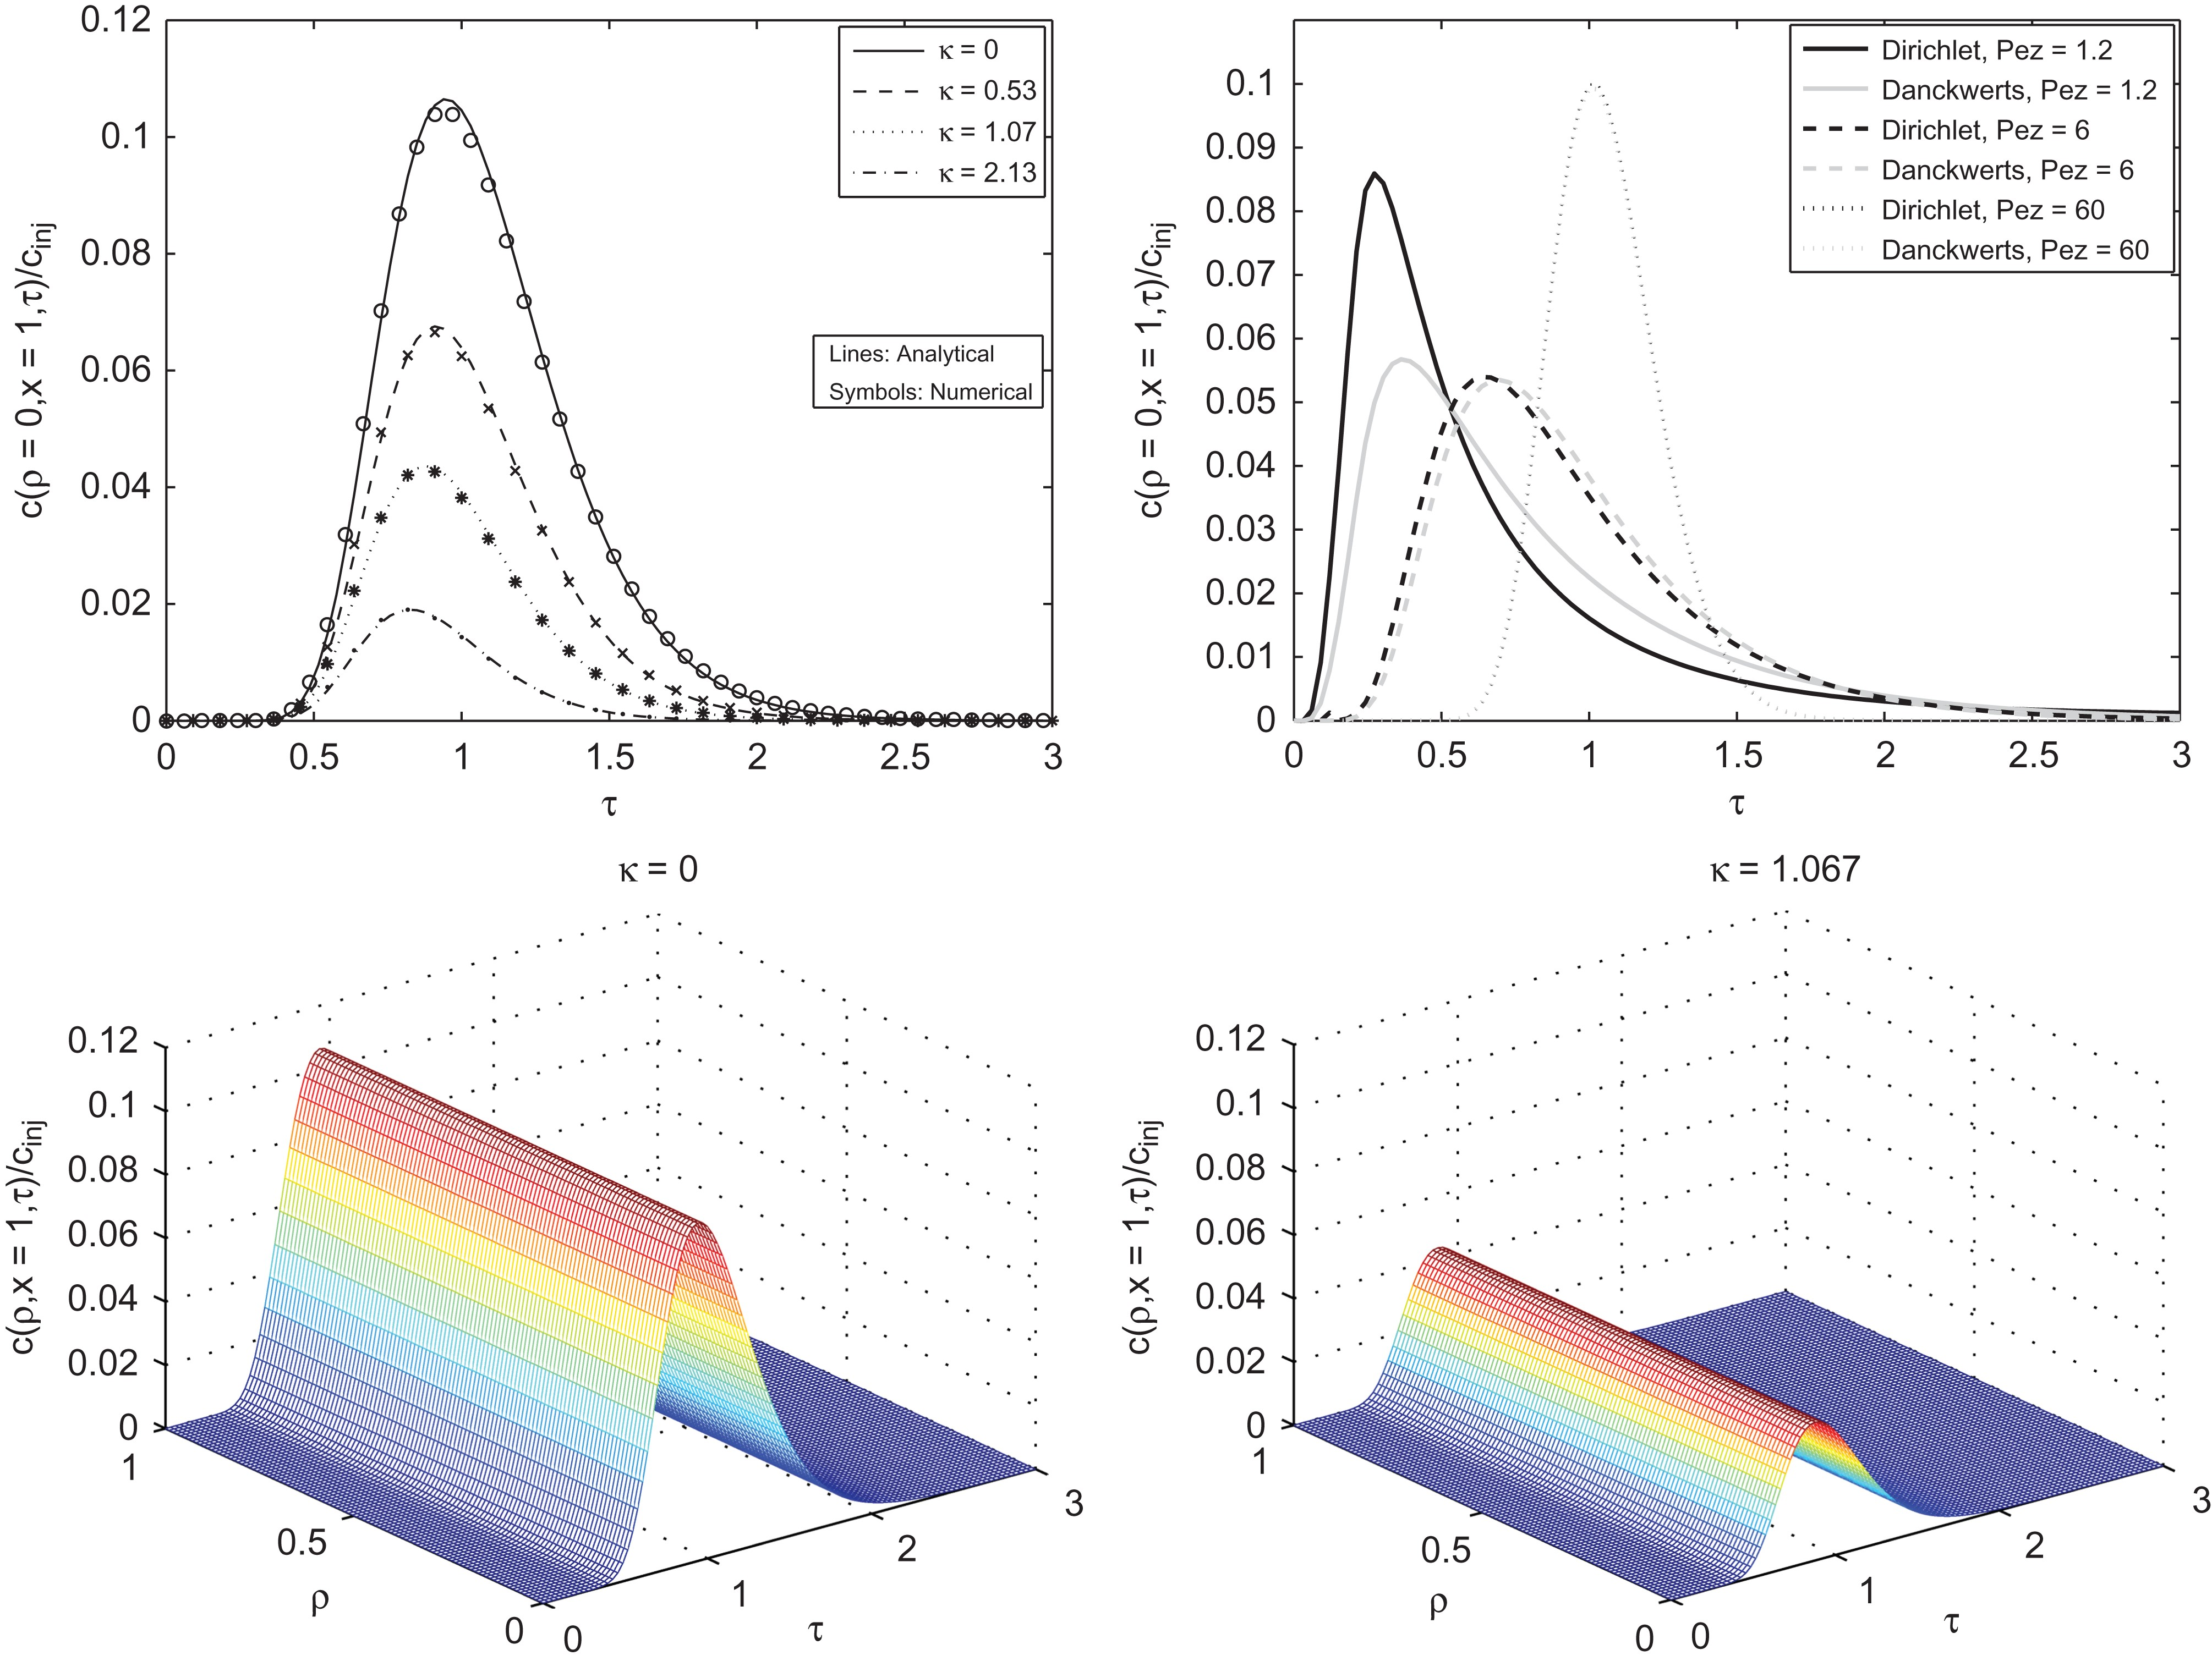
Figure 2. Injection through inner zone. Comparison of solutions for different values of κ and Pez with fixed Per=0.5. ...
Notes:
Figure 2. Injection through inner zone. Comparison of solutions for different values of κ and Pez with fixed Per=0.5. Other parameters are given in Table I.
Unless provided in the caption above, the following copyright applies to the content of this slide: © The Author 2017. Published by Oxford University Press. All rights reserved. For Permissions, please email: journals.permissions@oup.com

Slide 3
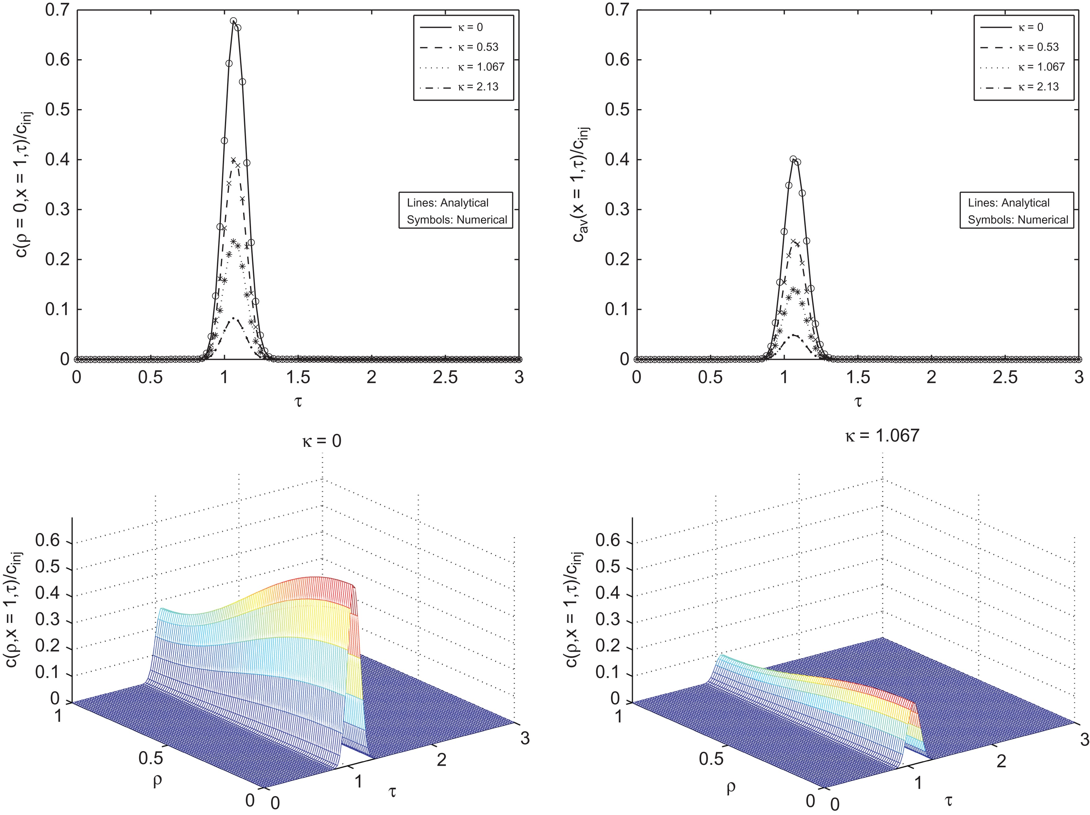
Figure 3. Injection through inner zone. Comparison of solutions for different values of κ with fixed ...
Notes:
Figure 3. Injection through inner zone. Comparison of solutions for different values of κ with fixed Pez=600⁢⁢ and⁢ Per=15. Other parameters are given in Table I.
Unless provided in the caption above, the following copyright applies to the content of this slide: © The Author 2017. Published by Oxford University Press. All rights reserved. For Permissions, please email: journals.permissions@oup.com

Slide 4
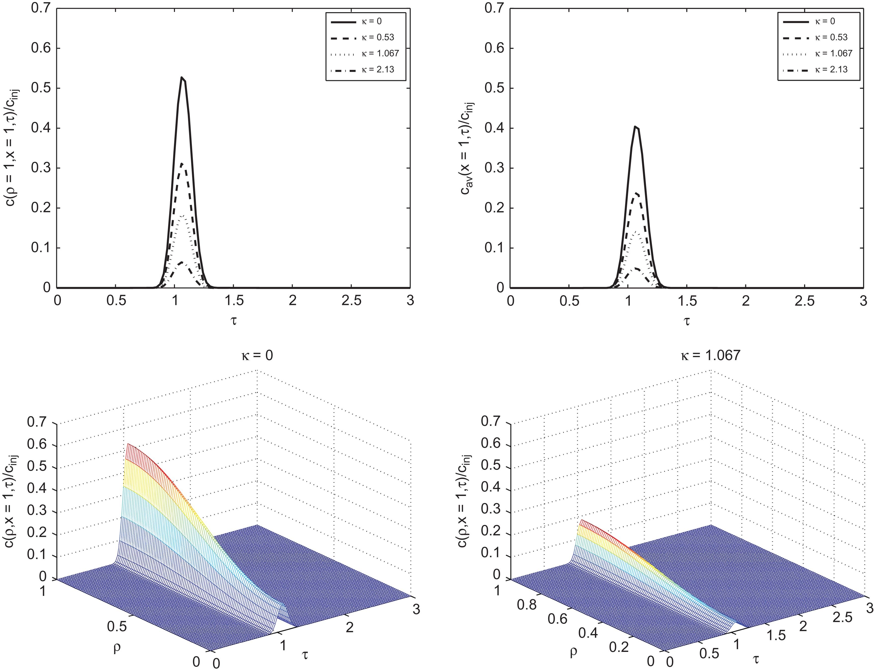
Figure 4. Injection through outer annular zone. Comparison of solutions for different values of κ with fixed Pez=600 ...
Notes:
Figure 4. Injection through outer annular zone. Comparison of solutions for different values of κ with fixed Pez=600 and Per=15. Other parameters are given in Table I.
Unless provided in the caption above, the following copyright applies to the content of this slide: © The Author 2017. Published by Oxford University Press. All rights reserved. For Permissions, please email: journals.permissions@oup.com

Slide 5
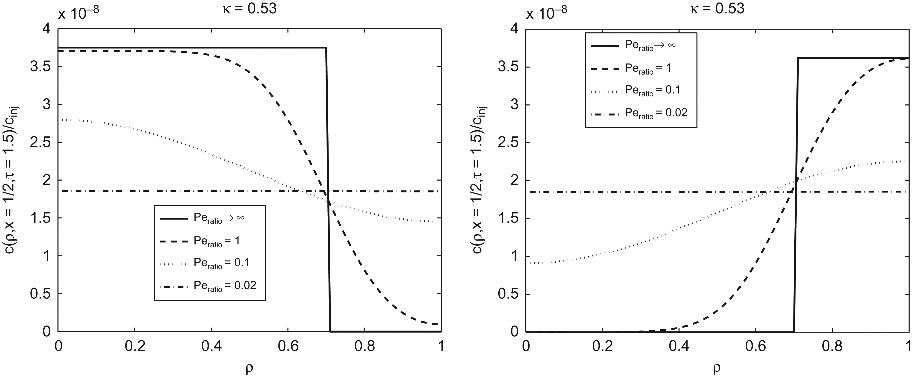
Figure 5. Comparison of solutions for different values of Peratio=R2Dz/L2Dr with fixed Pez=600 and κ=0.53. Left: inner ...
Notes:
Figure 5. Comparison of solutions for different values of Peratio=R2Dz/L2Dr with fixed Pez=600 and κ=0.53. Left: inner zone injection, right: outer zone injection. Other parameters are given in Table I.
Unless provided in the caption above, the following copyright applies to the content of this slide: © The Author 2017. Published by Oxford University Press. All rights reserved. For Permissions, please email: journals.permissions@oup.com

Slide 6
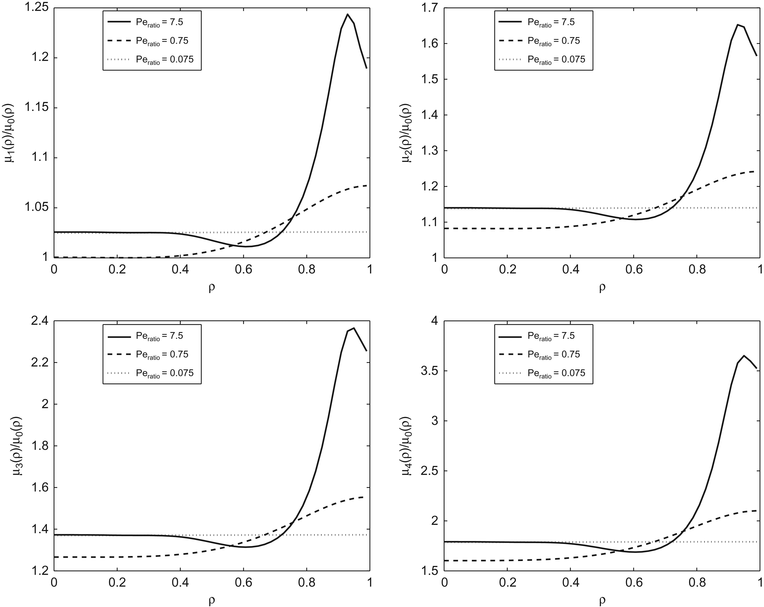
Figure 6. Inner zone injection: Effect of Dr on the local moments μi(ρ)(c.f. Eq.(41)) for fixed ...
Notes:
Figure 6. Inner zone injection: Effect of Dr on the local moments μi(ρ)(c.f. Eq.(41)) for fixed Dz=0.3cm2/min(Pez=20)andκ=0.53. Varied is the ratio Peratio=R2Dz/L2Dr. Table I gives other parameters.
Unless provided in the caption above, the following copyright applies to the content of this slide: © The Author 2017. Published by Oxford University Press. All rights reserved. For Permissions, please email: journals.permissions@oup.com

Slide 7
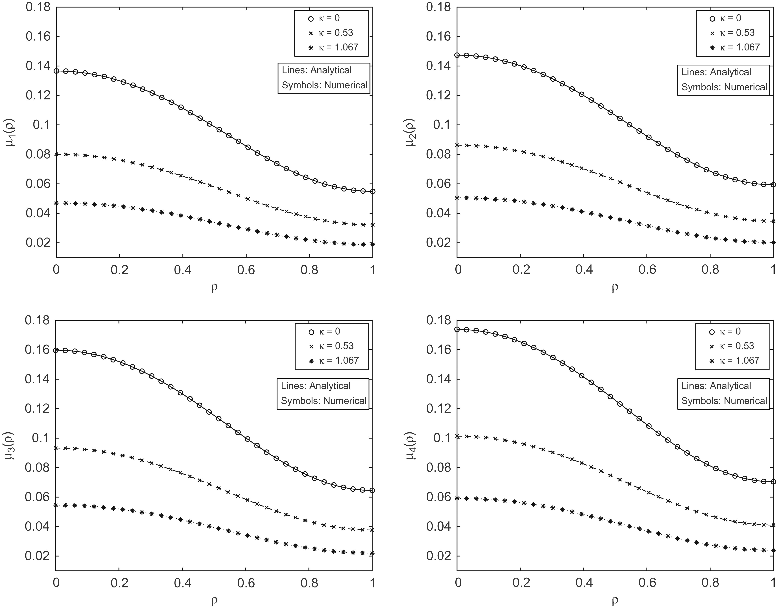
Figure 7. Inner zone injection: Comparison of analytical and numerical moments for different values of κ and fixed ...
Notes:
Figure 7. Inner zone injection: Comparison of analytical and numerical moments for different values of κ and fixed Dz=0.01cm2/min and Dr=0.001cm2/min. Other parameters are given in Table I.
Unless provided in the caption above, the following copyright applies to the content of this slide: © The Author 2017. Published by Oxford University Press. All rights reserved. For Permissions, please email: journals.permissions@oup.com

Slide 8
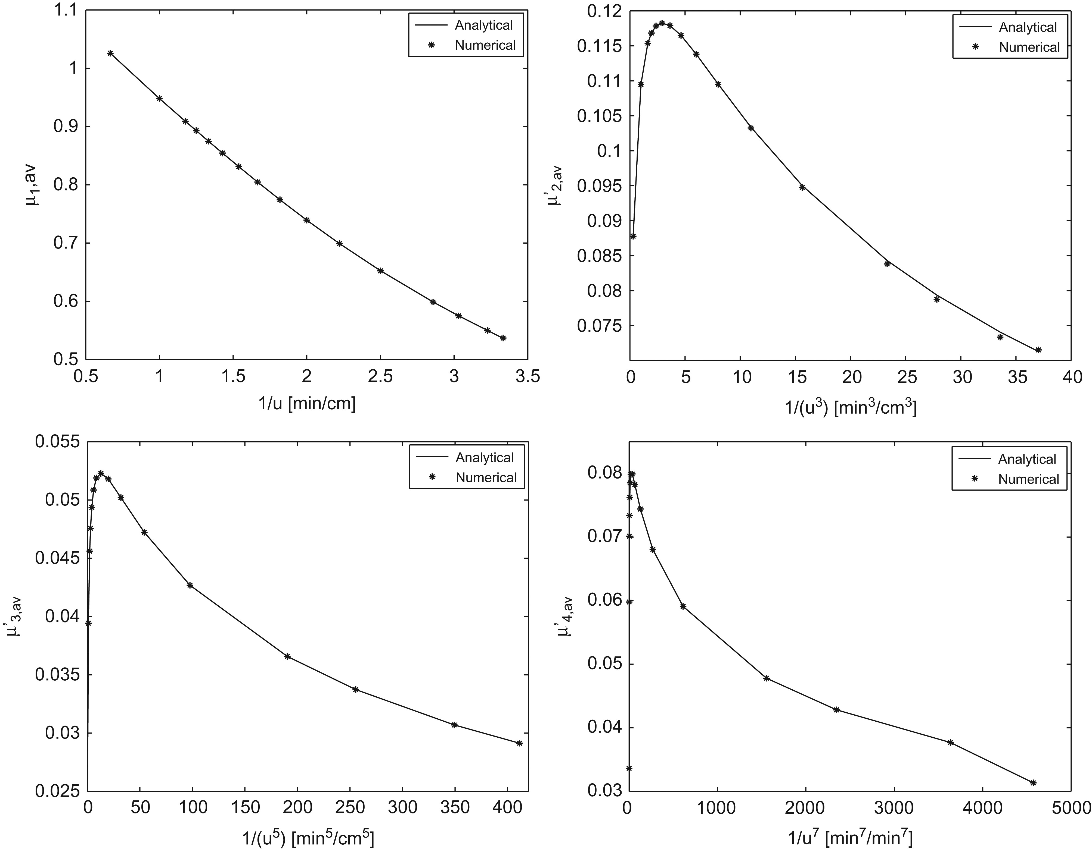
Figure 8. Inner zone injection: Comparison of analytical and numerical averaged central moments for ...
Notes:
Figure 8. Inner zone injection: Comparison of analytical and numerical averaged central moments for Dz=0.3cm2/min and ⁢Dr=0.03cm2/min and μ=0.2min−1. Other parameters are given in Table I.
Unless provided in the caption above, the following copyright applies to the content of this slide: © The Author 2017. Published by Oxford University Press. All rights reserved. For Permissions, please email: journals.permissions@oup.com

Slide 9
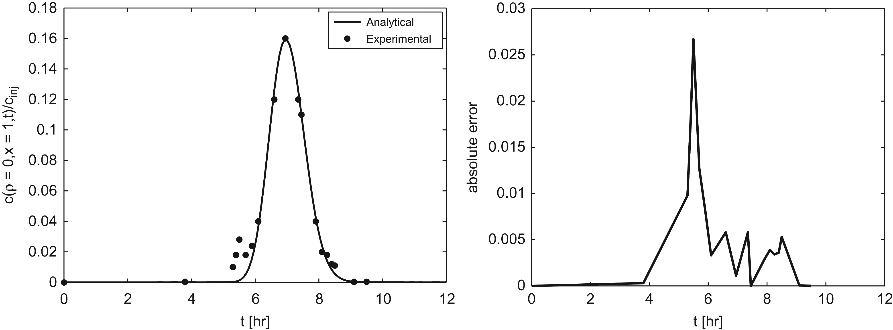
Figure 9. Plots of analytical and experimental solutions along with absolute errors between them.
Notes:
Figure 9. Plots of analytical and experimental solutions along with absolute errors between them.
Unless provided in the caption above, the following copyright applies to the content of this slide: © The Author 2017. Published by Oxford University Press. All rights reserved. For Permissions, please email: journals.permissions@oup.com

