Slide 1
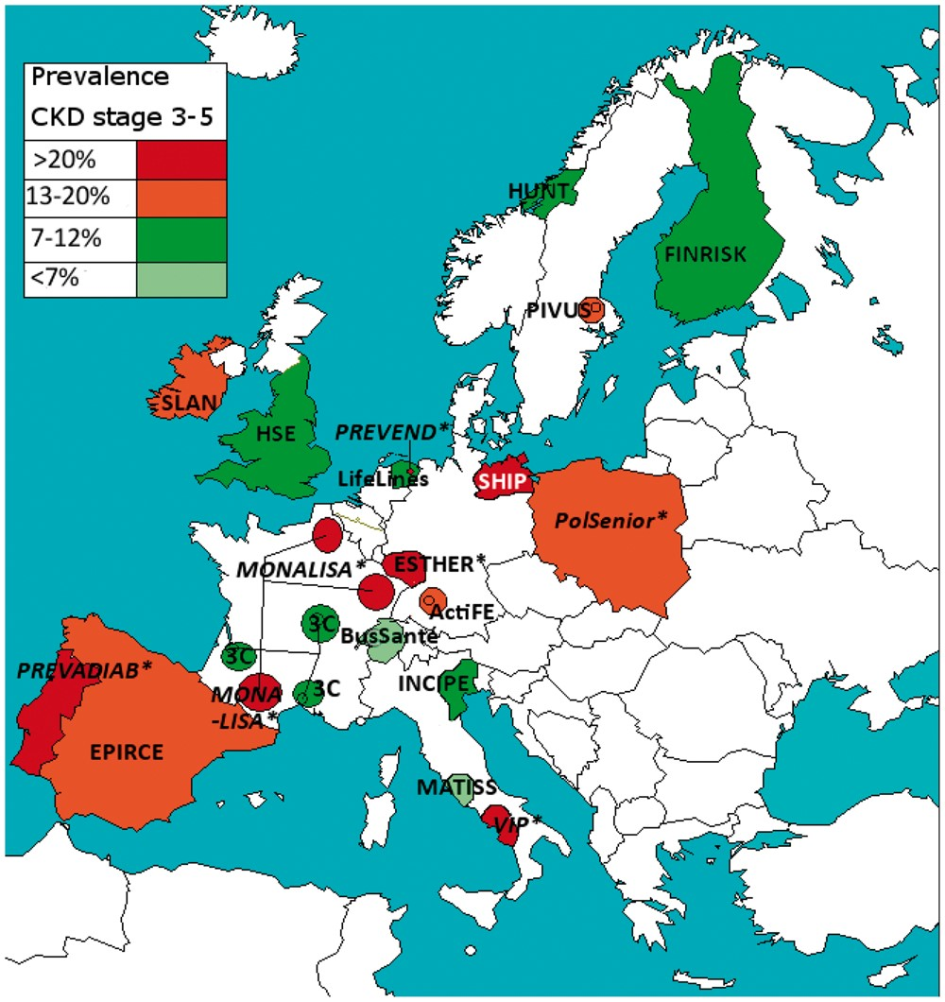
FIGURE 1 The age- and sex-adjusted prevalence of CKD stages 3–5 in the general population aged 65–74 years in Europe. ...
Notes:
FIGURE 1 The age- and sex-adjusted prevalence of CKD stages 3–5 in the general population aged 65–74 years in Europe. * Non-IDMS studies.
Unless provided in the caption above, the following copyright applies to the content of this slide: © The Author 2017. Published by Oxford University Press on behalf of ERA-EDTA. All rights reserved.

Slide 2
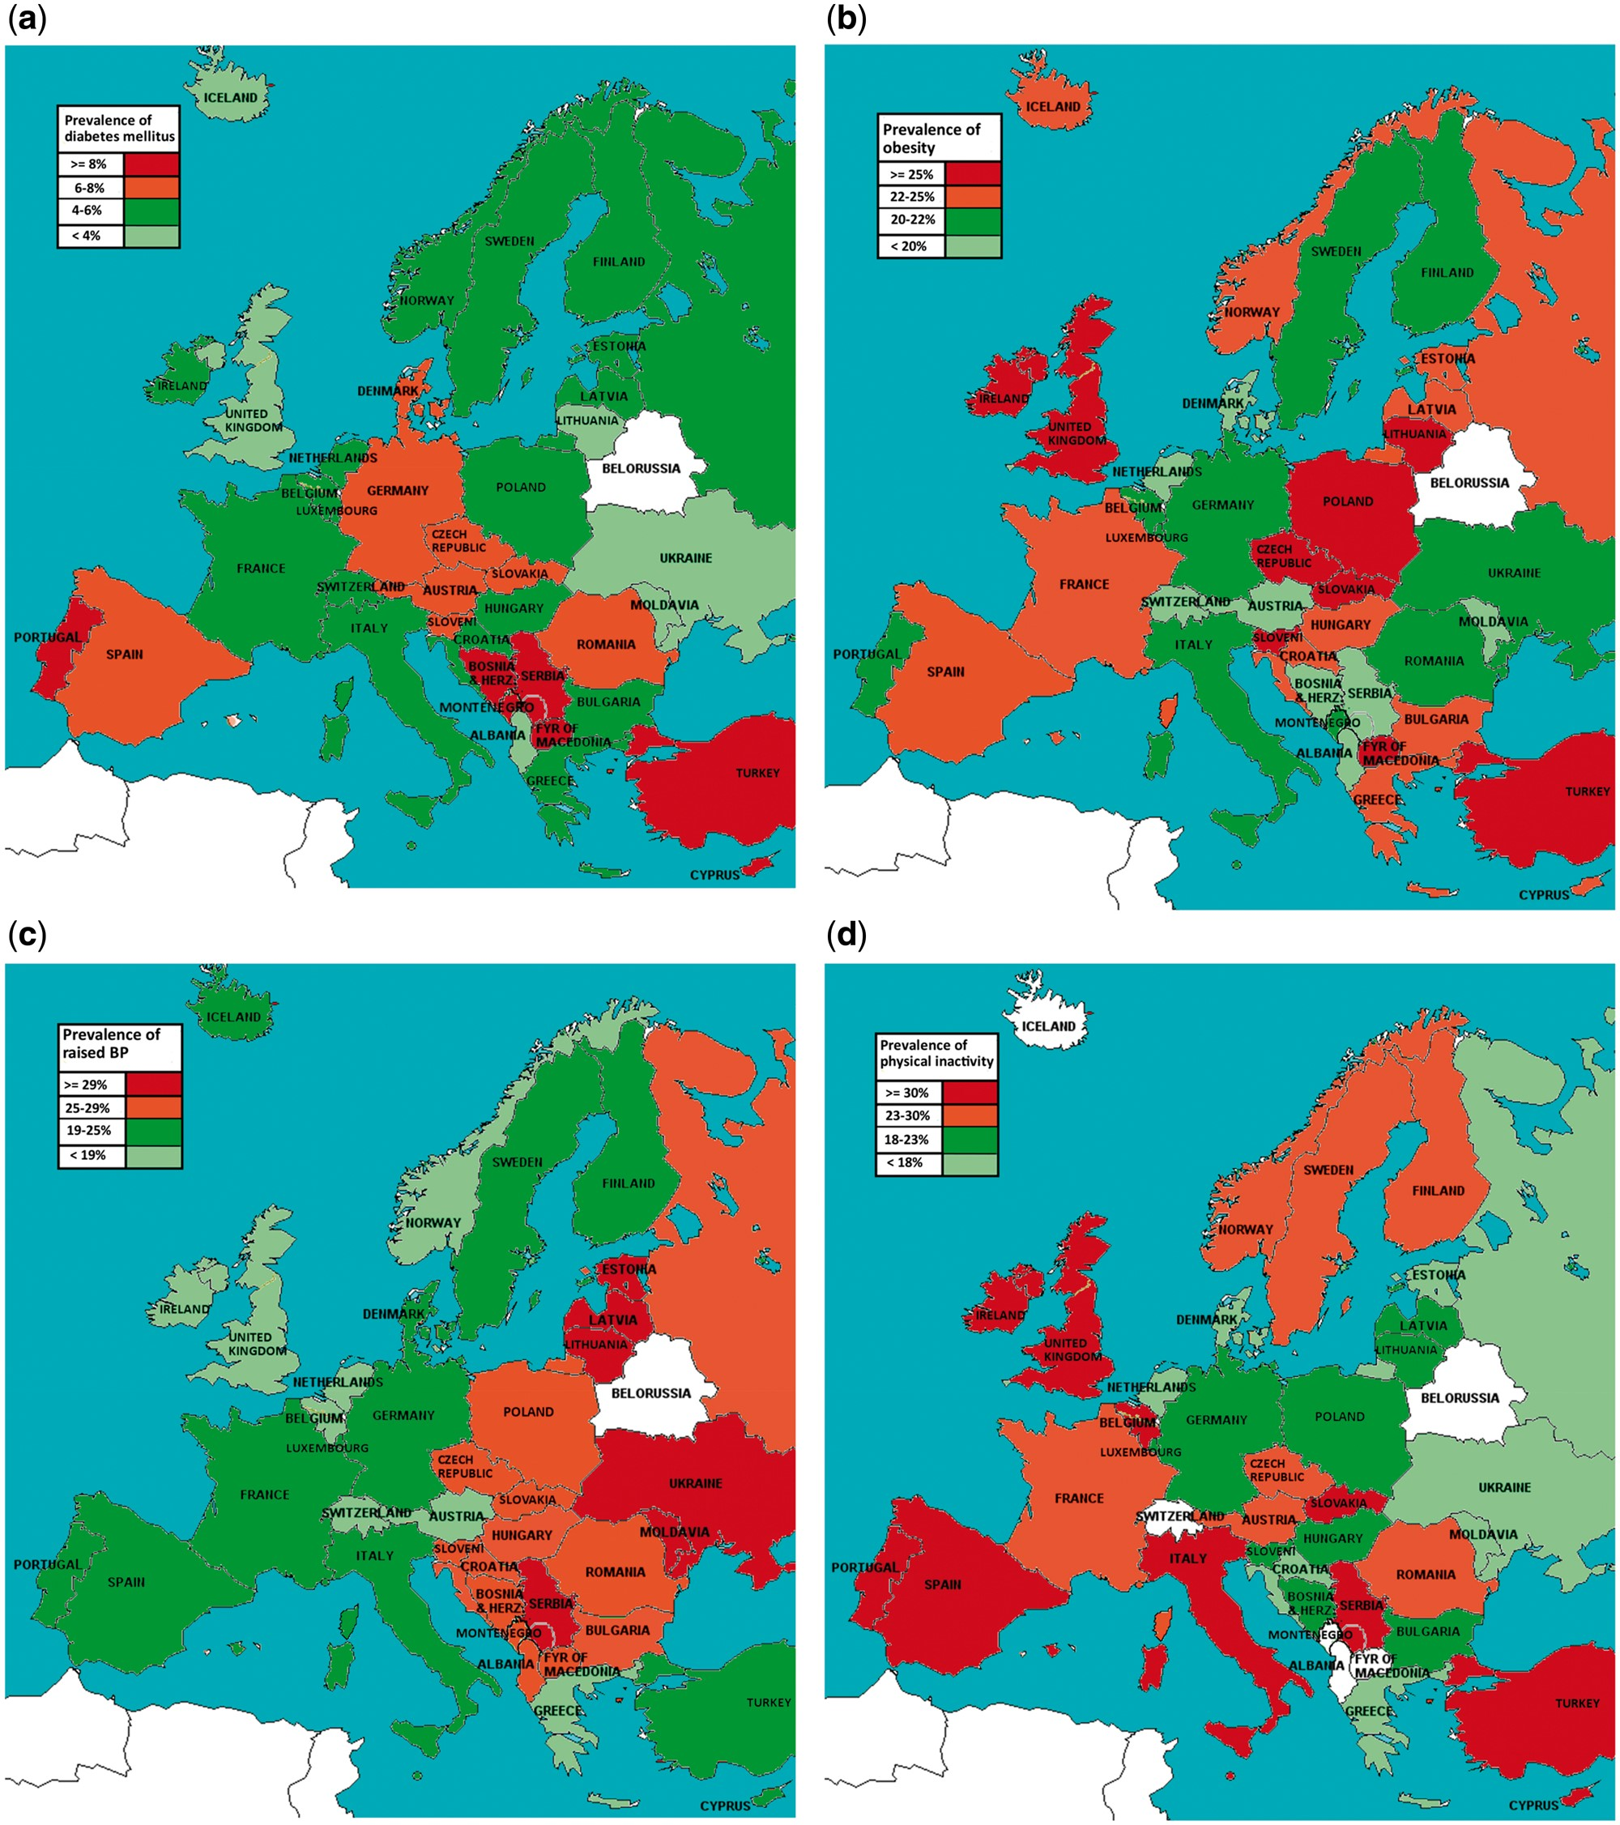
FIGURE 2 (a) Prevalence of diabetes mellitus among adults aged 20–79 years in 2015 (data from World Bank). (b) ...
Notes:
FIGURE 2 (a) Prevalence of diabetes mellitus among adults aged 20–79 years in 2015 (data from World Bank). (b) Prevalence of age-standardized obesity (body mass index ≥30 kg/m3) among adults (18+ years) in 2014 (data from WHO). (c) Prevalence of age-standardized raised blood pressure among adults (18+ years) in 2010–2014 (data from WHO). (d) Prevalence of age-standardized insufficient physical activity among adults (18+) in 2010 (data from WHO). *Insufficient physical activity was defined as <150 min of moderate-intensity physical activity/week or < 75 min of vigorous-intensity physical activity per week or equivalent. (e) Prevalence of age-standardized current smoking of any tobacco product among adults (18+ years) in 2013 (data from WHO). (f) Estimates of salt intake among adults in g/day. The year varies per country from 2000 to 2010 (data from Survey 2012 EU Salt Reduction Framework, EU Commission).
Unless provided in the caption above, the following copyright applies to the content of this slide: © The Author 2017. Published by Oxford University Press on behalf of ERA-EDTA. All rights reserved.

Slide 3
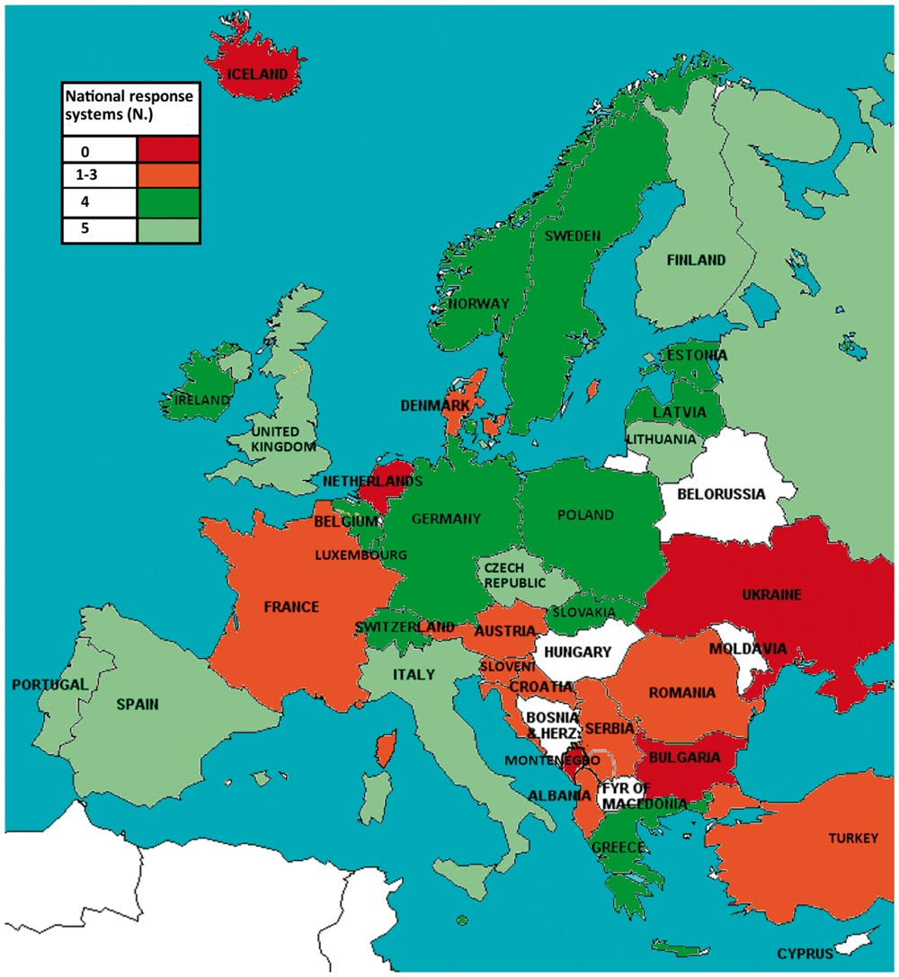
FIGURE 3 National response systems to noncommunicable diseases (data from WHO: Noncommunicable Diseases Country ...
Notes:
FIGURE 3 National response systems to noncommunicable diseases (data from WHO: Noncommunicable Diseases Country Profiles 2014).
Unless provided in the caption above, the following copyright applies to the content of this slide: © The Author 2017. Published by Oxford University Press on behalf of ERA-EDTA. All rights reserved.

