Slide 1
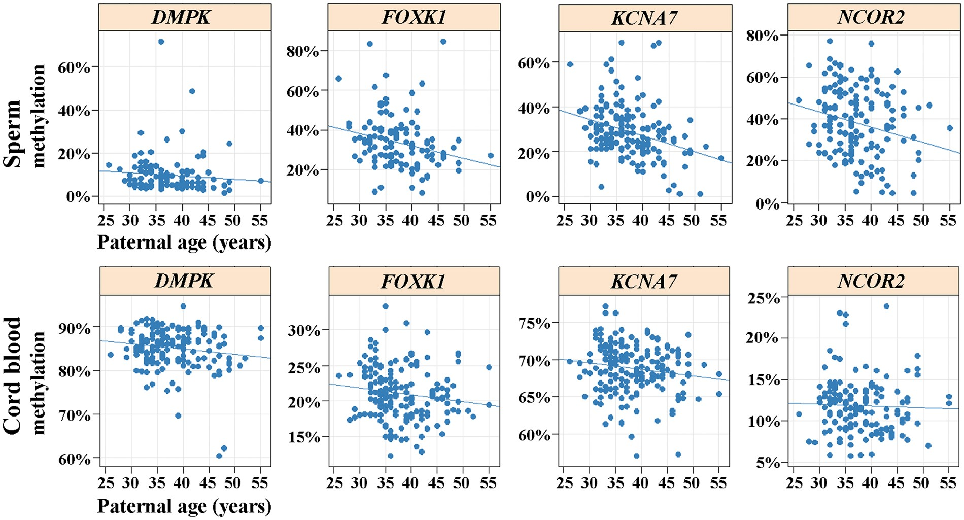
Figure 1. Correlation between DMPK, FOXK1, KCNA7, and NCOR2 methylation and paternal age in sperm cohort 1 (upper ...
Notes:
Figure 1. Correlation between DMPK, FOXK1, KCNA7, and NCOR2 methylation and paternal age in sperm cohort 1 (upper panel) and cord blood (lower panel). Each dot represents average methylation of several target CpGs in an individual sperm or cord blood sample, measured by bisulfite pyrosequencing. Regression lines suggest a negative correlation with paternal age. Spearman correlation of paternal age with DNA methylation of sperm and foetal cord blood (of resulting children), respectively. P-values were corrected for multiple testing by the Benjamini and Hochberg method. Data are represented as mean ± standard deviation (SD) of percent methylation values. Gene/RepeatSpermFoetal cord bloodCorrelation coefficientAdjusted P-valueMean ± SDCorrelation coefficientAdjusted P-valueMean ± SDDMPK−0.240.019.7 ± 8.3−0.070.5785.2 ± 4.6DRD4−0.040.5524.3 ± 14.7n.d.n.d.n.d.FOXK1−0.35<0.00133.6 ± 12.8−0.200.0421.1 ± 3.7GET4−0.090.379.9 ± 7.4n.d.n.d.n.d.KCNA7−0.34<0.00128.7 ± 12−0.150.1568.8 ± 3.3NCOR2−0.240.0138.0 ± 16.1−0.090.5711.9 ± 3.3NKX2−0.060.451.4 ± 2.0n.d.n.d.n.d.PDE4C−0.060.454.8 ± 6.7n.d.n.d.n.d.TNXB−0.150.1536.80 ±13.2n.d.n.d.n.d.LINE10.120.1969.8 ± 6.6n.d.n.dn.d.
Unless provided in the caption above, the following copyright applies to the content of this slide: © The Author 2016. Published by Oxford University Press.This is an Open Access article distributed under the terms of the Creative Commons Attribution Non-Commercial License (http://creativecommons.org/licenses/by-nc/4.0/), which permits non-commercial re-use, distribution, and reproduction in any medium, provided the original work is properly cited. For commercial re-use, please contact journals.permissions@oup.com

Slide 2
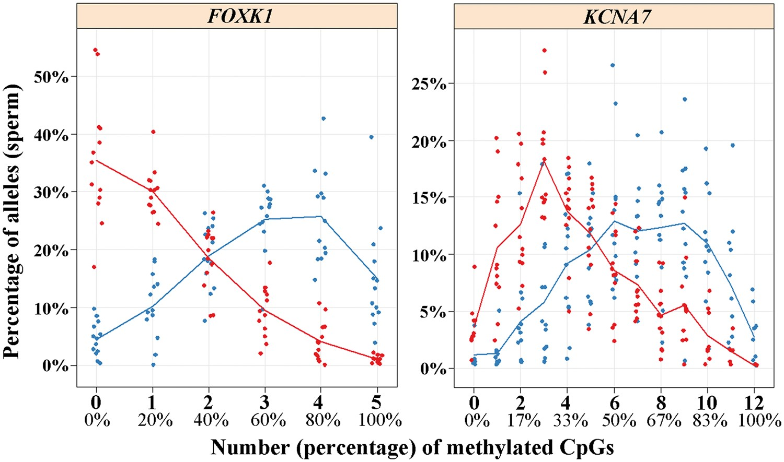
Figure 2. Distribution of single sperm (allele) methylation of FOXK1 (left diagram) and KCNA7 (right). Red dots ...
Notes:
Figure 2. Distribution of single sperm (allele) methylation of FOXK1 (left diagram) and KCNA7 (right). Red dots represent sperm samples of older (40–55 years) and blue dots of younger (25–35 years) donors. The FOXK1 assay targets 5 and the KCNA7 assay 12 CpG sites. The Y axis indicates the percentage of reads (individual sperm) with 0, 1, 2, 3, 4 or 5 methylated CpGs for FOXK1 and 0–12 methylated CpGs for KCNA7, respectively. Methylation measurements were performed using deep bisulfite sequencing. Average methylation values for the measured CpG sites are provided in Supplementary Material, Table S10.
Unless provided in the caption above, the following copyright applies to the content of this slide: © The Author 2016. Published by Oxford University Press.This is an Open Access article distributed under the terms of the Creative Commons Attribution Non-Commercial License (http://creativecommons.org/licenses/by-nc/4.0/), which permits non-commercial re-use, distribution, and reproduction in any medium, provided the original work is properly cited. For commercial re-use, please contact journals.permissions@oup.com

Slide 3
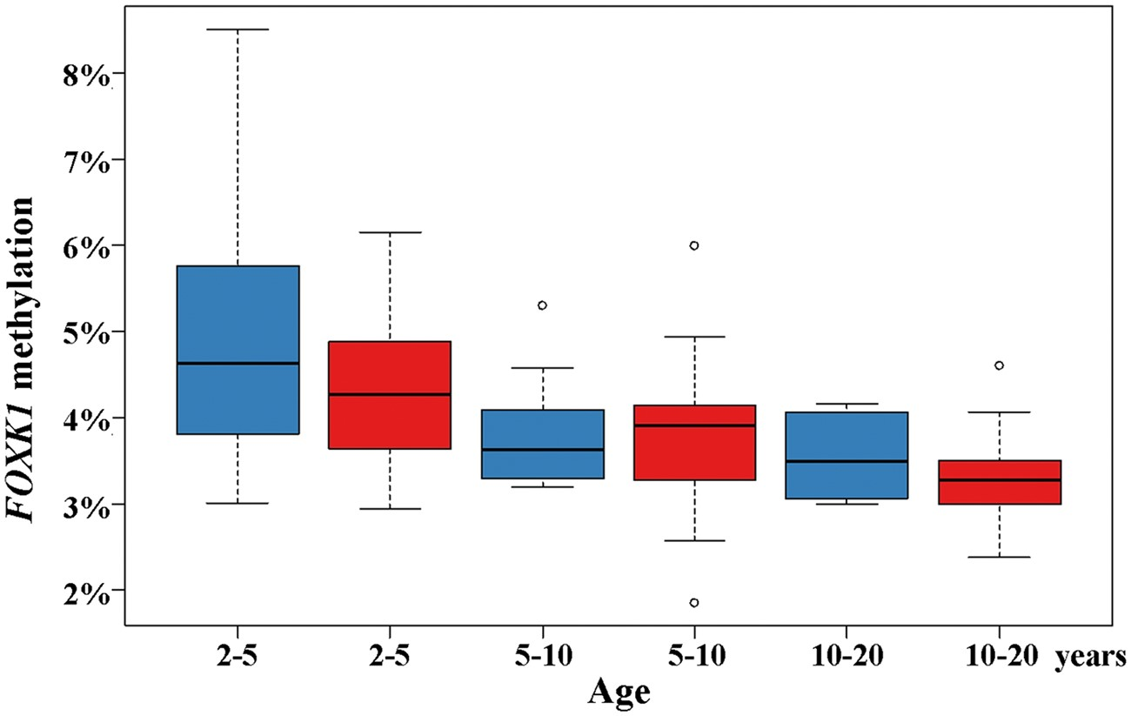
Figure 3. Boxplots showing the distribution of FOXK1 methylation in 74 male ASD patients (red boxes) and 41 age and ...
Notes:
Figure 3. Boxplots showing the distribution of FOXK1 methylation in 74 male ASD patients (red boxes) and 41 age and sex-matched controls (blue boxes) in three different age groups (2–5, 5–10, and 10–20 years). The median is represented by a horizontal black line. The bottom of the box indicates the 25th, the top the 75th percentile. Outliers are shown as open circles.
Unless provided in the caption above, the following copyright applies to the content of this slide: © The Author 2016. Published by Oxford University Press.This is an Open Access article distributed under the terms of the Creative Commons Attribution Non-Commercial License (http://creativecommons.org/licenses/by-nc/4.0/), which permits non-commercial re-use, distribution, and reproduction in any medium, provided the original work is properly cited. For commercial re-use, please contact journals.permissions@oup.com

Slide 4
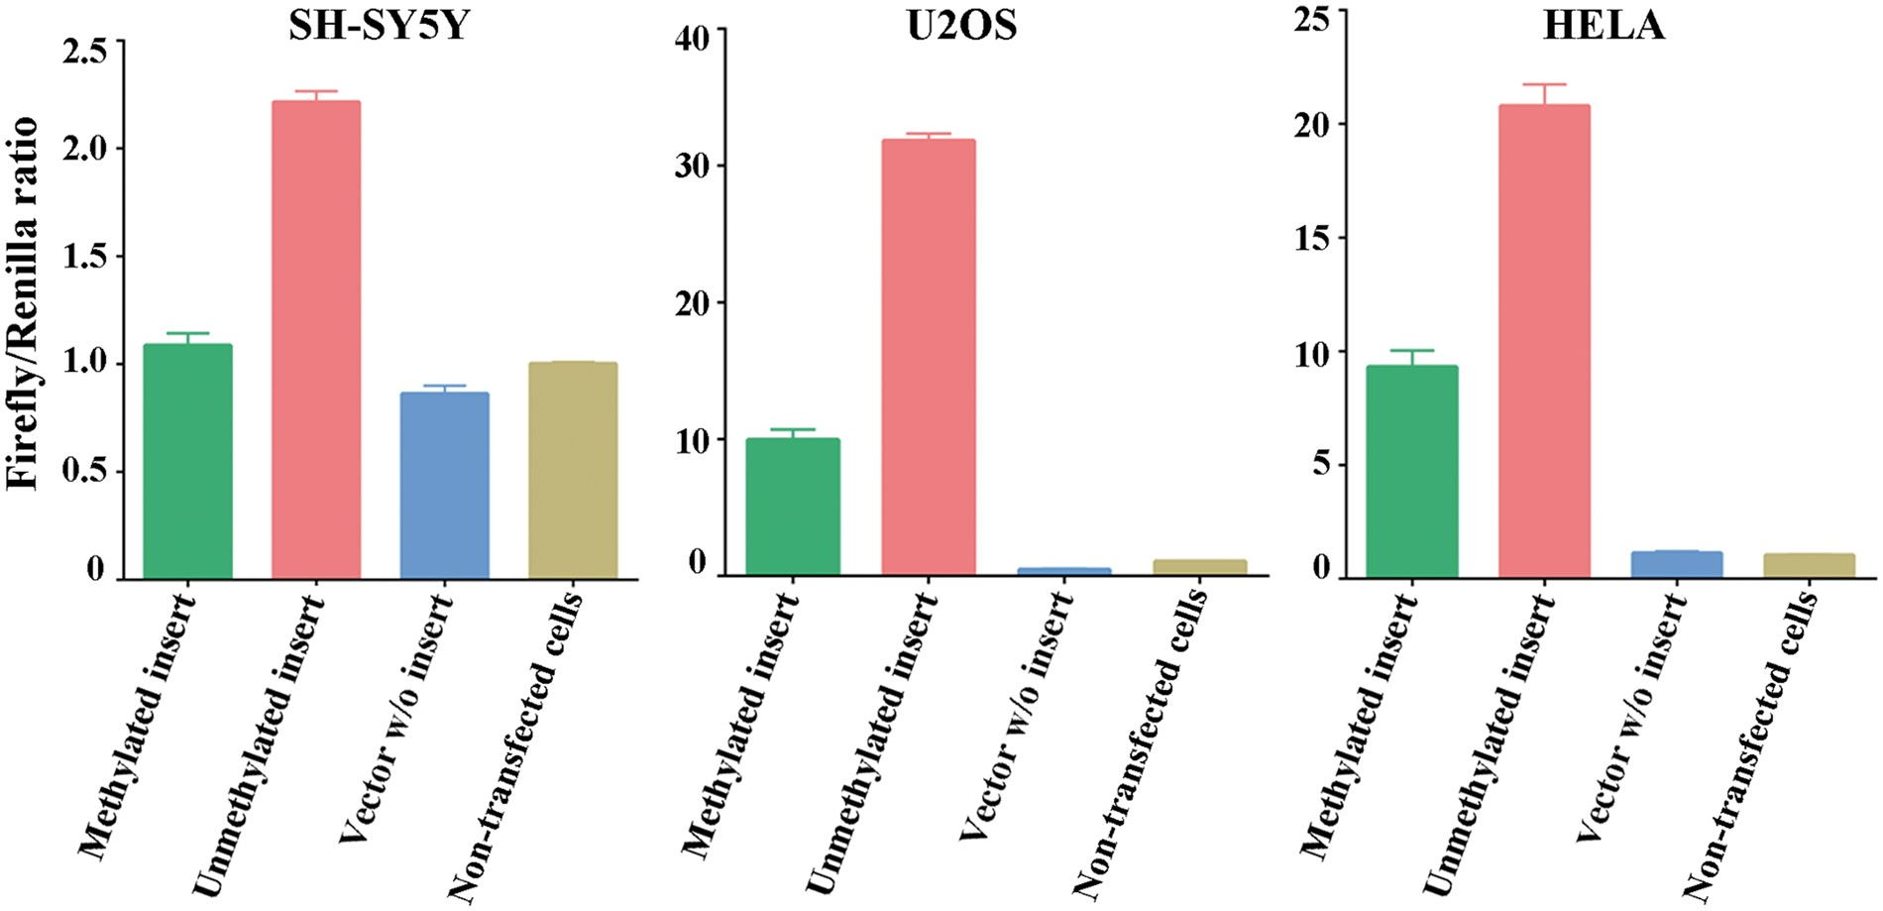
Figure 4. Luciferase activity of pCpGL vector containing either methylated or unmethylated FOXK1 promoter, normalized ...
Notes:
Figure 4. Luciferase activity of pCpGL vector containing either methylated or unmethylated FOXK1 promoter, normalized to activity of an internal control vector (Firefly/Renilla ratio). pCpGL and control vector were co-transfected in a 500:1 ratio in three different cell lines, SH-SY5Y, U2OS, and HELA. Empty vector and non-transfected cells served as negative controls. All measurements were done in duplicates.
Unless provided in the caption above, the following copyright applies to the content of this slide: © The Author 2016. Published by Oxford University Press.This is an Open Access article distributed under the terms of the Creative Commons Attribution Non-Commercial License (http://creativecommons.org/licenses/by-nc/4.0/), which permits non-commercial re-use, distribution, and reproduction in any medium, provided the original work is properly cited. For commercial re-use, please contact journals.permissions@oup.com

