Slide 1
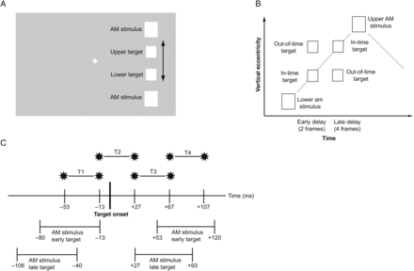
Figure 1. Stimuli and experimental design. (A) Schematic depiction of the visual stimulus (not in scale). The apparent ...
Notes:
Figure 1. Stimuli and experimental design. (A) Schematic depiction of the visual stimulus (not in scale). The apparent motion inducing stimuli flashed alternately at a frequency of 3.75 Hz in the periphery. We flashed targets on the apparent motion trace at either an upper or a lower position. (B) Space-time plot of on apparent motion cycle. Targets were flashed either in-time with the illusory motion token, that is, at the expected place and time assuming a linear motion trajectory, or out-of-time with the token, that is, spatio-temporally incongruently. (C) Time windows of TMS. We applied double-pulse TMS either before target onset (T1), around target onset (T2), shortly after target onset (T3), or slightly later (T4). The interpulse interval was 40 ms.
Unless provided in the caption above, the following copyright applies to the content of this slide: © The Author 2013. Published by Oxford University Press.This is an Open Access article distributed under the terms of the Creative Commons Attribution License (http://creativecommons.org/licenses/by/3.0/), which permits unrestricted reuse, distribution, and reproduction in any medium, provided the original work is properly cited.

Slide 2
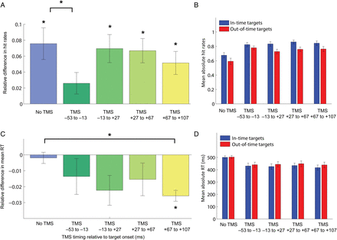
Figure 2. Experimental results for TMS over left V5 (n = 17). (A) Relative differences between in-time and out-of-time ...
Notes:
Figure 2. Experimental results for TMS over left V5 (n = 17). (A) Relative differences between in-time and out-of-time targets for hit rates. Positive values mean that in-time targets were better detected than out-of-time targets. Stars directly above or below the bars indicate significant (P < 0.003) 1-sample t-test results against 0 (Bonferroni-corrected). Stars above the brackets indicate t-test results of comparisons with the no-TMS condition (P < 0.05, Bonferroni-corrected). (B) Absolute mean hit rates (proportion of trials) for in-time and out-of-time targets. (C) Relative differences between in-time and out-of-time targets for reaction times. Negative values indicate that in-time targets were detected faster. (D) Absolute mean reaction times (ms). All error bars represent SEM.
Unless provided in the caption above, the following copyright applies to the content of this slide: © The Author 2013. Published by Oxford University Press.This is an Open Access article distributed under the terms of the Creative Commons Attribution License (http://creativecommons.org/licenses/by/3.0/), which permits unrestricted reuse, distribution, and reproduction in any medium, provided the original work is properly cited.

Slide 3
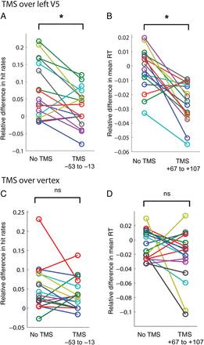
Figure 3. Individual subject data for the critical time windows. (A) Individual subject data for the significant TMS ...
Notes:
Figure 3. Individual subject data for the critical time windows. (A) Individual subject data for the significant TMS effect during V5 stimulation, that is, relative hit rate difference in the no-TMS condition and T1. (B) Individual subject data for relative RT difference in the no-TMS condition and T4 during V5 stimulation. (C) Individual subject data for the comparison between no-TMS condition and T1, equivalent to A, for vertex stimulation. (D) Individual subject data for relative RT difference for the no-TMS condition compared with V4, equivalent to B, for TMS over the vertex.
Unless provided in the caption above, the following copyright applies to the content of this slide: © The Author 2013. Published by Oxford University Press.This is an Open Access article distributed under the terms of the Creative Commons Attribution License (http://creativecommons.org/licenses/by/3.0/), which permits unrestricted reuse, distribution, and reproduction in any medium, provided the original work is properly cited.

Slide 4
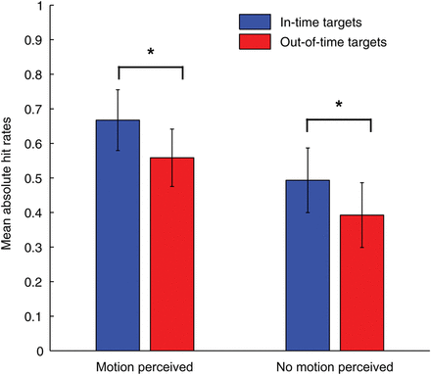
Figure 4. Results of the behavioral control experiment. Mean absolute hit rates for predictable in-time and out-of-time ...
Notes:
Figure 4. Results of the behavioral control experiment. Mean absolute hit rates for predictable in-time and out-of-time targets for trials when subjects reported to have consciously perceived apparent motion and when they report no apparent motion perception (just flicker) (n = 15). Error bars indicate SEM, stars indicate P < 0.05.
Unless provided in the caption above, the following copyright applies to the content of this slide: © The Author 2013. Published by Oxford University Press.This is an Open Access article distributed under the terms of the Creative Commons Attribution License (http://creativecommons.org/licenses/by/3.0/), which permits unrestricted reuse, distribution, and reproduction in any medium, provided the original work is properly cited.

