Slide 1
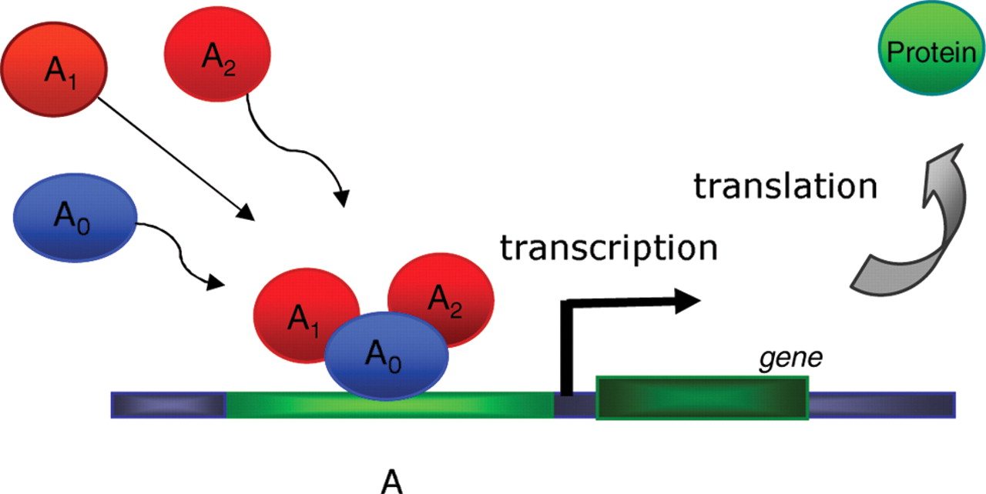
Fig. 1. An illustration for a TC participating in transcription process.
Notes:
Fig. 1. An illustration for a TC participating in transcription process.
Unless provided in the caption above, the following copyright applies to the content of this slide: © The Author 2007. Published by Oxford University Press. All rights reserved. For Permissions, please email: journals.permissions@oxfordjournals.org

Slide 2
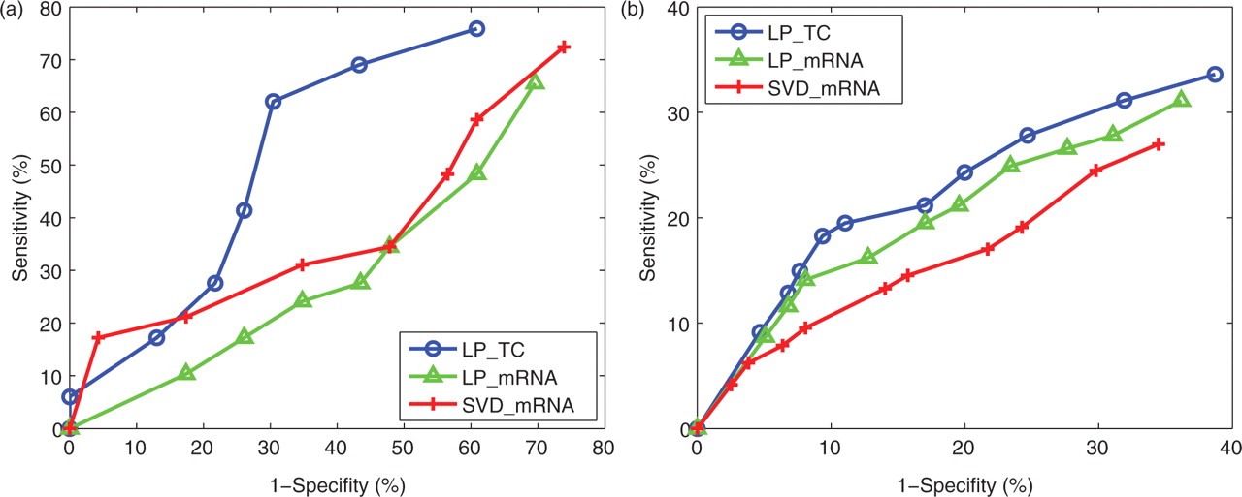
Fig. 5. The comparison results of LP method based on TCs (LP_TC), LP method based on only mRNA levels of TFs ...
Notes:
Fig. 5. The comparison results of LP method based on TCs (LP_TC), LP method based on only mRNA levels of TFs (LP_mRNA) and SVD method based on mRNA levels of TFs (SVD_mRNA). (a) on yeast cell cycle data set; (b) on yeast polyphosphate metabolism data set.
Unless provided in the caption above, the following copyright applies to the content of this slide: © The Author 2007. Published by Oxford University Press. All rights reserved. For Permissions, please email: journals.permissions@oxfordjournals.org

Slide 3
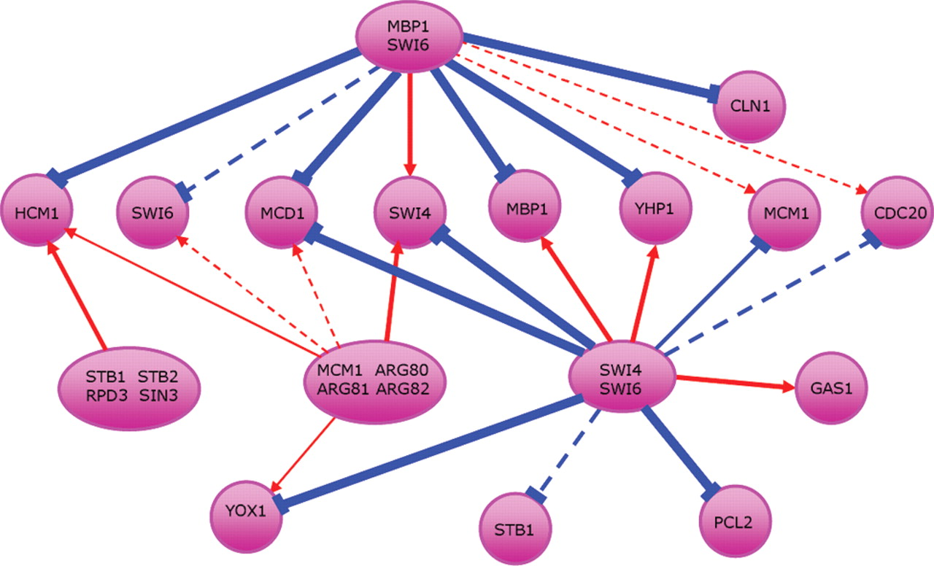
Fig. 4. The inferred yeast cell cycle TRN. The red arrows in the figure indicate activation while the blue arrows ...
Notes:
Fig. 4. The inferred yeast cell cycle TRN. The red arrows in the figure indicate activation while the blue arrows indicate repression.
Unless provided in the caption above, the following copyright applies to the content of this slide: © The Author 2007. Published by Oxford University Press. All rights reserved. For Permissions, please email: journals.permissions@oxfordjournals.org

Slide 4
Fig. 3. The mixing diagram of the seven hemoglobin solutions from three pure components.
Notes:
Fig. 3. The mixing diagram of the seven hemoglobin solutions from three pure components.
Unless provided in the caption above, the following copyright applies to the content of this slide: © The Author 2007. Published by Oxford University Press. All rights reserved. For Permissions, please email: journals.permissions@oxfordjournals.org

Slide 5
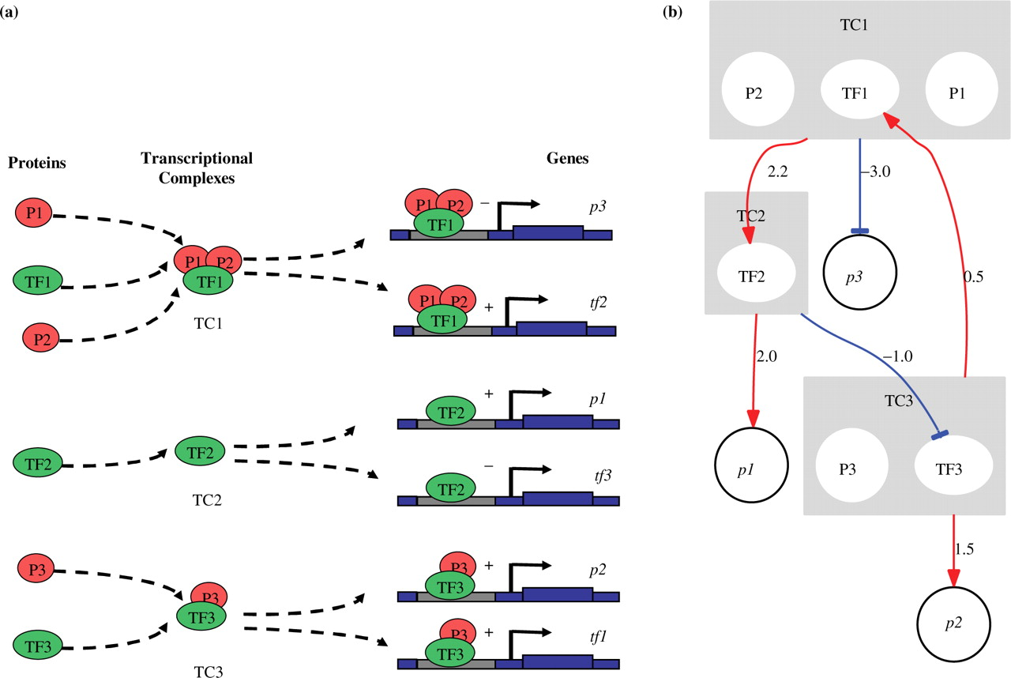
Fig. 2. A simulated TRN. Genes p1, p2, p3, tf 1, tf 2 and tf 3 synthesize proteins P1, P2, P3, TF1, TF2 and TF3, ...
Notes:
Fig. 2. A simulated TRN. Genes p1, p2, p3, tf 1, tf 2 and tf 3 synthesize proteins P1, P2, P3, TF1, TF2 and TF3, respectively. The red arrows in the figure indicate activation while the blue arrows indicate repression. (a) Transcription processes; (b) TRN.
Unless provided in the caption above, the following copyright applies to the content of this slide: © The Author 2007. Published by Oxford University Press. All rights reserved. For Permissions, please email: journals.permissions@oxfordjournals.org

Slide 6
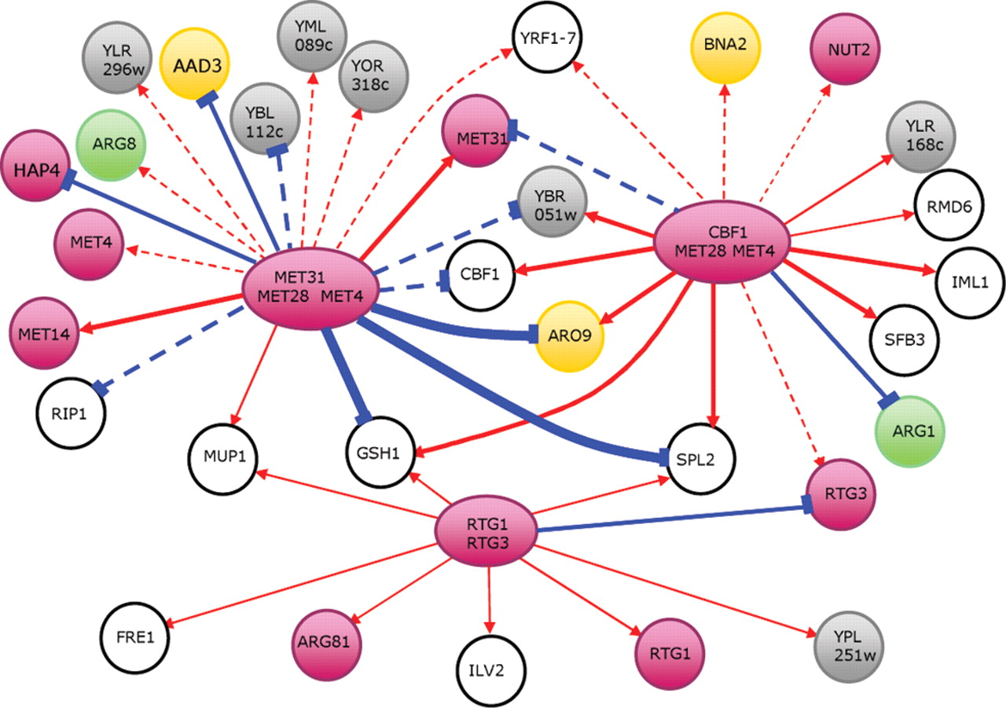
Fig. 6. The inferred TRN for polyphosphate metabolism. The red arrows in the figure indicate activation while the ...
Notes:
Fig. 6. The inferred TRN for polyphosphate metabolism. The red arrows in the figure indicate activation while the blue arrows indicate repression. The nodes in the same color indicate that the genes have the same biological function.
Unless provided in the caption above, the following copyright applies to the content of this slide: © The Author 2007. Published by Oxford University Press. All rights reserved. For Permissions, please email: journals.permissions@oxfordjournals.org

