Slide 1
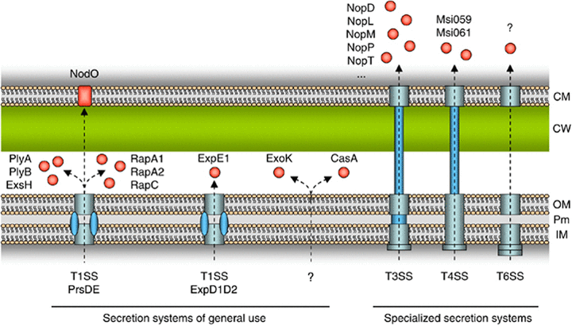
1 Schematic overview of rhizobial secreted proteins that play a role in the rhizobium–legume symbiosis. CasA, ...
Notes:
1 Schematic overview of rhizobial secreted proteins that play a role in the rhizobium–legume symbiosis. CasA, ExoK, ExpE1, ExsH, NodO, PlyA, PlyB, RapA1, RapA2 and RapC are secreted by secretion systems that are also involved in processes other than bacterium–host interactions. Nops (NopD, NopL, NopM, NopP, NopT, etc.), Msi059 and Msi061 are secreted by specialized host-targeting secretion systems. Dotted arrows represent transportation routes. Unknown secretion systems and substrates are indicated by a question mark. CM, plant host cell membrane; CW, plant cell wall; IM, bacterial inner membrane; OM, bacterial outer membrane; Pm, periplasm; T1SS, T3SS, T4SS, T6SS: type I, III, IV and VI secretion system, respectively. See text for further details.
Unless provided in the caption above, the following copyright applies to the content of this slide: © 2008 Federation of European Microbiological Societies. Published by Blackwell Publishing Ltd. All rights reserved

