Slide 1
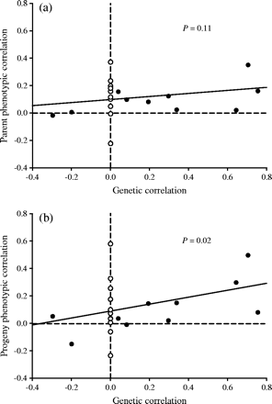
Figure 3. Regressions of (a) parent phenotypic correlations and (b) progeny phenotypic correlations on genetic ...
Notes:
Figure 3. Regressions of (a) parent phenotypic correlations and (b) progeny phenotypic correlations on genetic correlations among phenotypic traits in pink salmon from Likes Creek, Alaska. Genetic correlations that could not be estimated because of negative or zero covariances between parental and offspring traits are represented by open circles (see text for details).
Unless provided in the caption above, the following copyright applies to the content of this slide: © 2005 The American Genetic Association

Slide 2
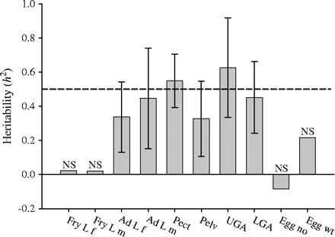
Figure 2. Heritability estimates and 95% confidence intervals for female and male fry fork length (Fry L f and Fry L m, ...
Notes:
Figure 2. Heritability estimates and 95% confidence intervals for female and male fry fork length (Fry L f and Fry L m, respectively), female and male adult fork length (Ad L f and Ad L m, respectively), pectoral (Pect) and pelvic (Pelv) fin ray counts, upper (UGA) and lower (LGA) gill raker counts, egg number (Egg no), and egg weight (Egg wt) in pink salmon from Likes Creek, Alaska. NS indicates heritabilities that were not significantly different from zero.
Unless provided in the caption above, the following copyright applies to the content of this slide: © 2005 The American Genetic Association

Slide 3
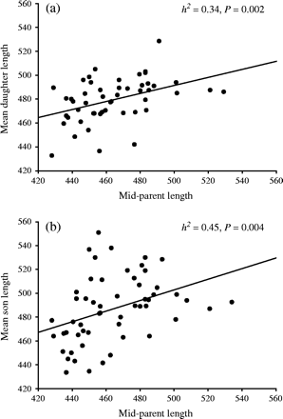
Figure 1. Regressions of (a) mean daughter fork length and (b) mean son fork length on midparent fork length. The ...
Notes:
Figure 1. Regressions of (a) mean daughter fork length and (b) mean son fork length on midparent fork length. The heritability of length is the slope of the regression line.
Unless provided in the caption above, the following copyright applies to the content of this slide: © 2005 The American Genetic Association

