Slide 1
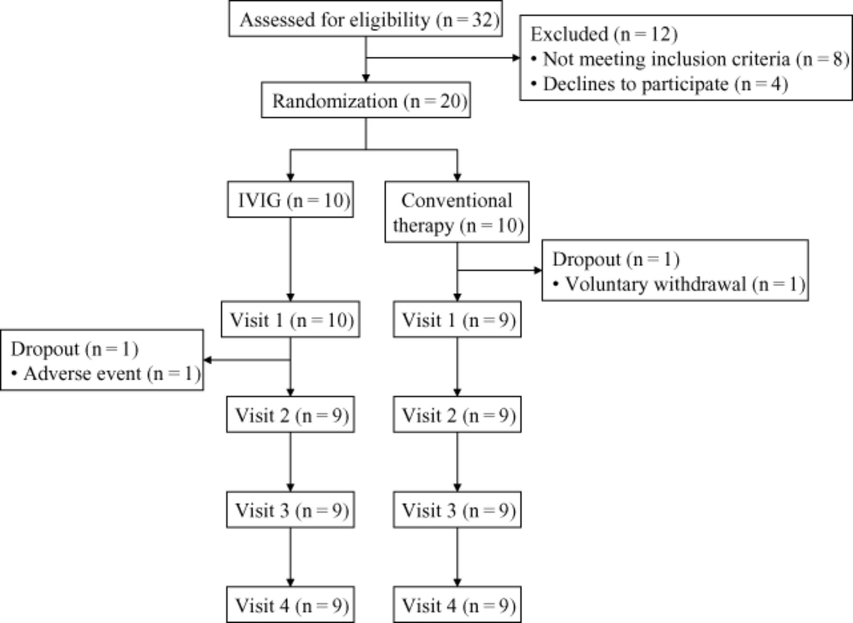
Figure 1 Flow of patients through the study. IVIG = intravenous immunoglobulin.
Notes:
Figure 1 Flow of patients through the study. IVIG = intravenous immunoglobulin.
Unless provided in the caption above, the following copyright applies to the content of this slide: Wiley Periodicals, Inc.

Slide 2
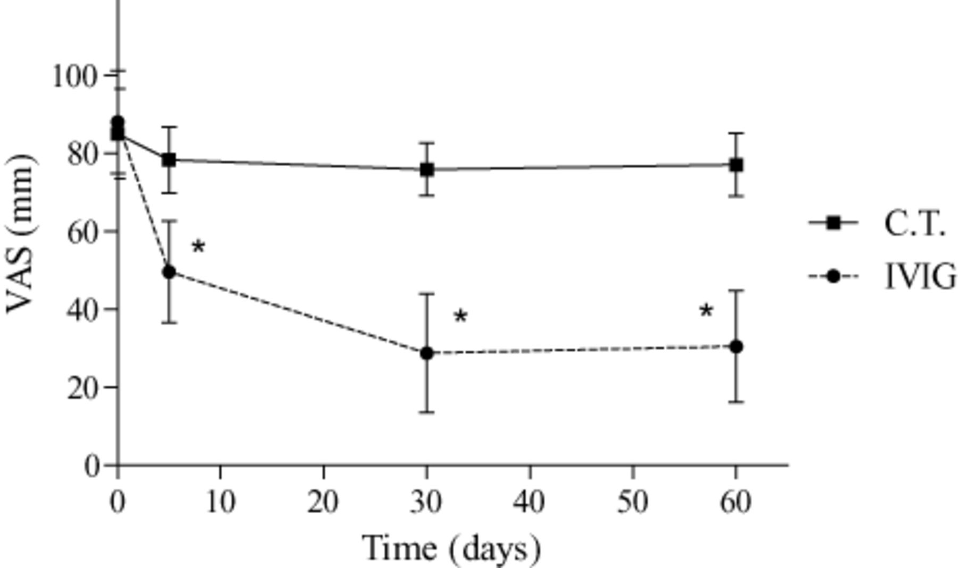
Figure 2 Pain intensity evaluated according to a visual analog scale (VAS) at visit 1 (baseline), visit 2 (5 days), ...
Notes:
Figure 2 Pain intensity evaluated according to a visual analog scale (VAS) at visit 1 (baseline), visit 2 (5 days), visit 3 (30 days), and visit 4 (60 days) in patients treated with intravenous immunoglobulin (IVIG; N = 8) or with conventional therapy (C.T.; N = 9). * P < 0.01 in visits 2, 3, and 4 vs baseline, in visits 3 and 4 vs visit 2, and in IVIG vs C.T.
Unless provided in the caption above, the following copyright applies to the content of this slide: Wiley Periodicals, Inc.

Slide 3
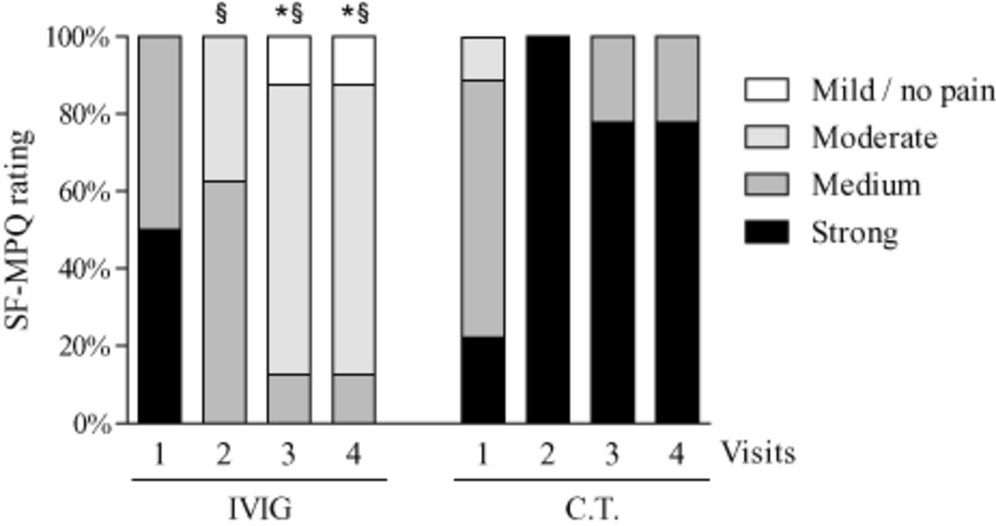
Figure 3 Pain experience evaluated with the Short Form McGill Pain Questionnaire (SF-MPQ) at visit 1 (baseline), visit ...
Notes:
Figure 3 Pain experience evaluated with the Short Form McGill Pain Questionnaire (SF-MPQ) at visit 1 (baseline), visit 2 (5 days), visit 3 (30 days), and visit 4 (60 days) in patients treated with intravenous immunoglobulin (IVIG; N = 8) or with conventional therapy (C.T.; N = 9). * P < 0.01 in visits 3 and 4 vs baseline; § P < 0.01 in IVIG vs C.T.
Unless provided in the caption above, the following copyright applies to the content of this slide: Wiley Periodicals, Inc.

Slide 4
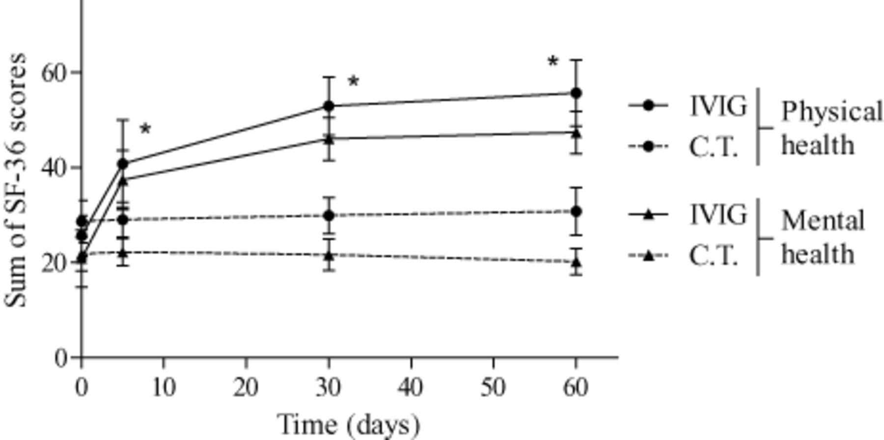
Figure 4 Quality of life evaluated with the Short Form 36 (SF-36) questionnaire at visit 1 (baseline), visit 2 (5 ...
Notes:
Figure 4 Quality of life evaluated with the Short Form 36 (SF-36) questionnaire at visit 1 (baseline), visit 2 (5 days), visit 3 (30 days), and visit 4 (60 days) in patients treated with intravenous immunoglobulin (IVIG; N = 8) or with conventional therapy (C.T.; N = 9). * P < 0.01 in visits 2, 3, and 4 vs baseline and in IVIG vs C.T.
Unless provided in the caption above, the following copyright applies to the content of this slide: Wiley Periodicals, Inc.

Slide 5
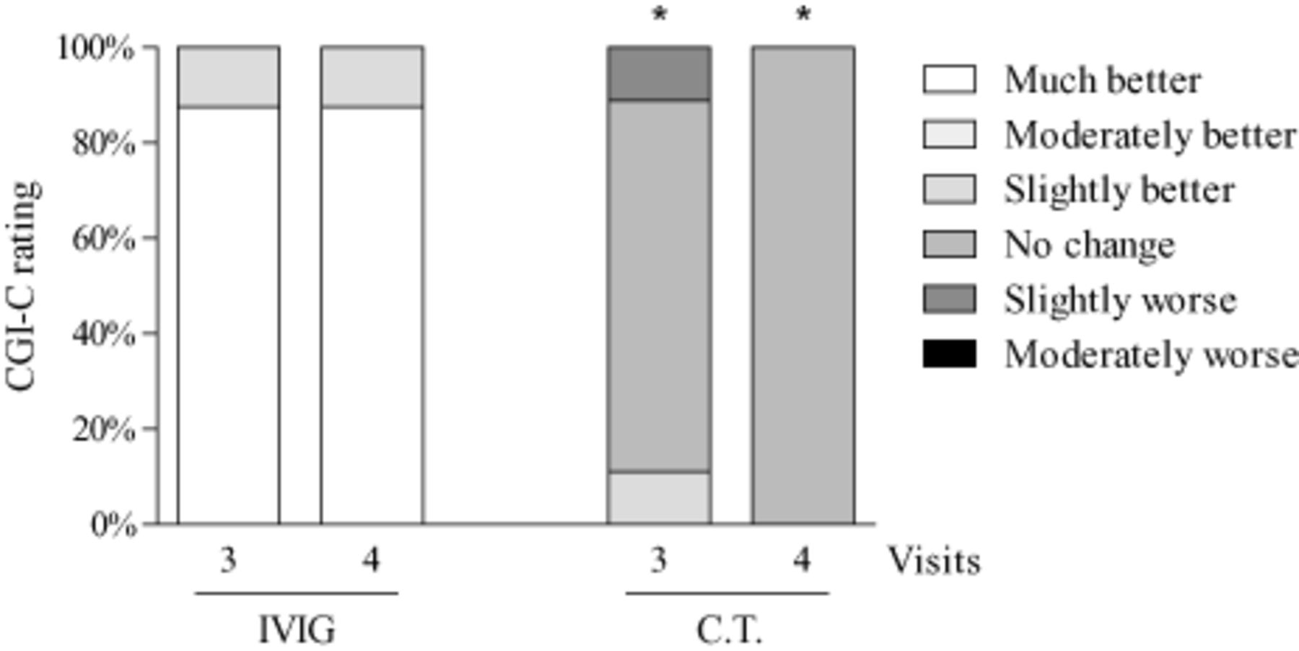
Figure 5 Clinical condition evaluated with the Clinical Global Impression of Change (CGI-C) at visit 3 (30 days) and ...
Notes:
Figure 5 Clinical condition evaluated with the Clinical Global Impression of Change (CGI-C) at visit 3 (30 days) and visit 4 (60 days) in patients treated with intravenous immunoglobulin (IVIG; N = 8) or with conventional therapy (C.T.; N = 9). * P < 0.01 in IVIG vs C.T.
Unless provided in the caption above, the following copyright applies to the content of this slide: Wiley Periodicals, Inc.

Slide 6
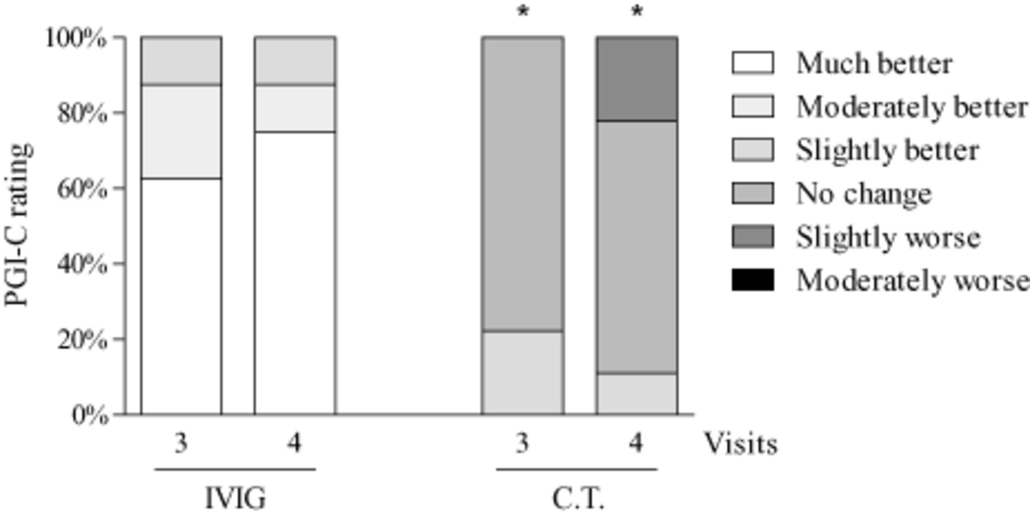
Figure 6 Clinical condition evaluated with the Patient Global Impression of Change (PGI-C) at visit 3 (30 days) and ...
Notes:
Figure 6 Clinical condition evaluated with the Patient Global Impression of Change (PGI-C) at visit 3 (30 days) and visit 4 (60 days) in patients treated with intravenous immunoglobulin (IVIG; N = 8) or with conventional therapy (C.T.; N = 9). * P < 0.01 in IVIG vs C.T.
Unless provided in the caption above, the following copyright applies to the content of this slide: Wiley Periodicals, Inc.

