Slide 1
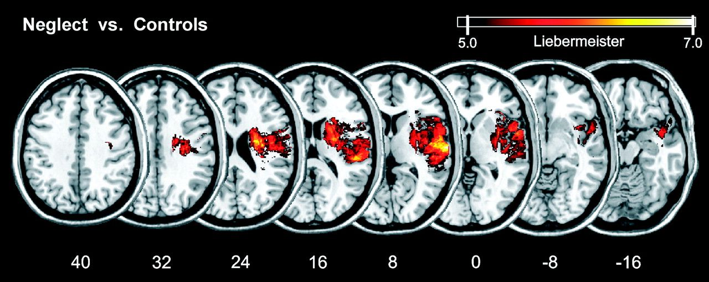
Figure 1. Statistical VLBM analysis comparing the 78 neglect patients with 62 control patients by using the ...
Notes:
Figure 1. Statistical VLBM analysis comparing the 78 neglect patients with 62 control patients by using the Liebermeister measure (Rorden et al. 2007). Presented are all voxels that were damaged significantly more frequently in neglect patients than in control patients that survived a Bonferroni-corrected alpha level of P < 0.05. No voxels were found that were significantly more likely to be damaged in control patients than in patients with spatial neglect. MNI coordinates of each transverse section are given.
Unless provided in the caption above, the following copyright applies to the content of this slide: © The Author 2009. Published by Oxford University Press. All rights reserved. For permissions, please e-mail: journals.permissions@oxfordjournals.org

Slide 2
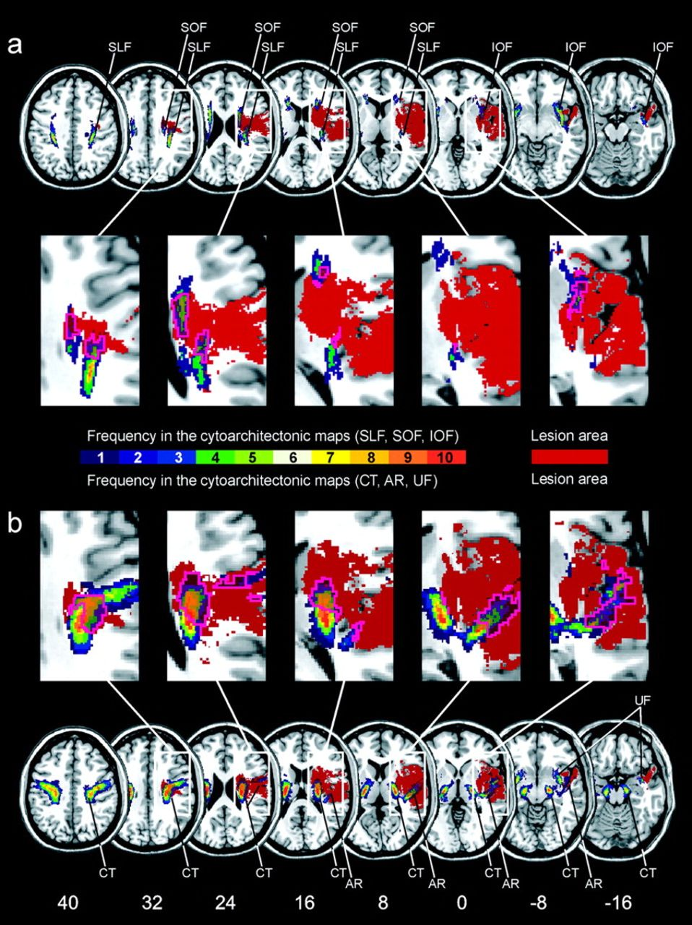
Figure 2. Overlap of the statistical lesion map from Figure 1 (in homogenous brown color) with the probabilistic, ...
Notes:
Figure 2. Overlap of the statistical lesion map from Figure 1 (in homogenous brown color) with the probabilistic, cytoarchitectonic maps of the white matter fiber tracts from the Jülich atlas (right hemisphere only). The color coding of the atlas from 1 (dark blue, observed in 1 postmortem brain) to 10 (red, overlap in all 10 postmortem brains) represents the absolute frequency for which in each voxel of the atlas a respective fiber tract was present (e.g., a 30% value of a fiber tract in a certain voxel of the reference brain indicates that the fiber tract was present in that voxel in 3 out of 10 postmortem brains). The pink contour demarks the area of the fiber tracts affected by the statistical lesion map. (a) Overlap illustrated for fiber tracts SLF, superior longitudinal fasciculus; IOF, inferior occipitofrontal fasciculus; and SOF, superior occipitofrontal fasciculus. (b) Overlap illustrated for fiber tracts CT, corticospinal tract; AR, acoustic radiation; and UF, uncinate fascicle.
Unless provided in the caption above, the following copyright applies to the content of this slide: © The Author 2009. Published by Oxford University Press. All rights reserved. For permissions, please e-mail: journals.permissions@oxfordjournals.org

Slide 3
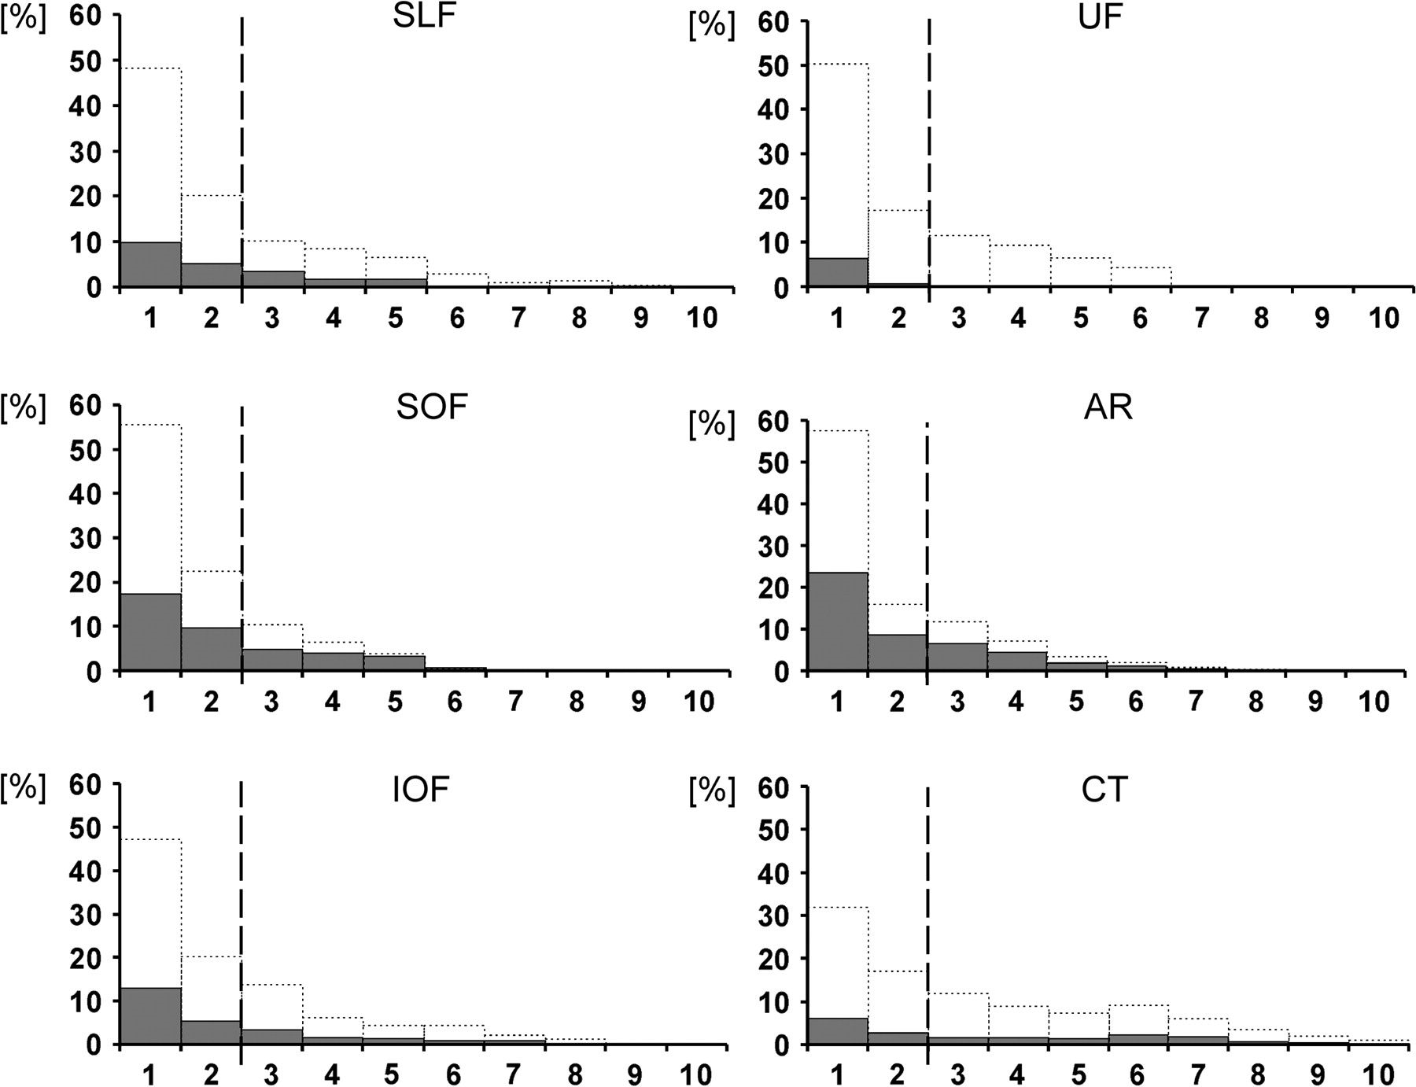
Figure 3. Quantitative analysis of the data presented in Figure 2. In each of the 6 panels, the area under the dotted ...
Notes:
Figure 3. Quantitative analysis of the data presented in Figure 2. In each of the 6 panels, the area under the dotted lines represents the entire area of a certain anatomical fiber tract from the Jülich atlas (100% of, e.g., the SLF). Along the x-axis, this area is subdivided and plotted according to the percentage with which in each voxel of the atlas the respective fiber tract was present (from 1 to 10). The numbers along the x-axis thus correspond with the color coded illustration of the respective voxel category from Figure 2 (frequency 1–10). The gray bars on top of the dotted bars indicate the percentage of involvement of each of the voxel categories (frequency 1–10) from the respective fiber tract by the statistical map (e.g., a 20% value of a gray bar in category “5” indicates that 20% of all category 5 voxels of that particular fiber tract had been covered by the statistical lesion map). The dashed line indicates the 30% isocontours of the maps from the Jülich atlas. SLF, superior longitudinal fasciculus; IOF, inferior occipitofrontal fasciculus; SOF, superior occipitofrontal fasciculus; CT, corticospinal tract; AR, acoustic radiation; and UF, uncinate fascicle.
Unless provided in the caption above, the following copyright applies to the content of this slide: © The Author 2009. Published by Oxford University Press. All rights reserved. For permissions, please e-mail: journals.permissions@oxfordjournals.org

