Slide 1
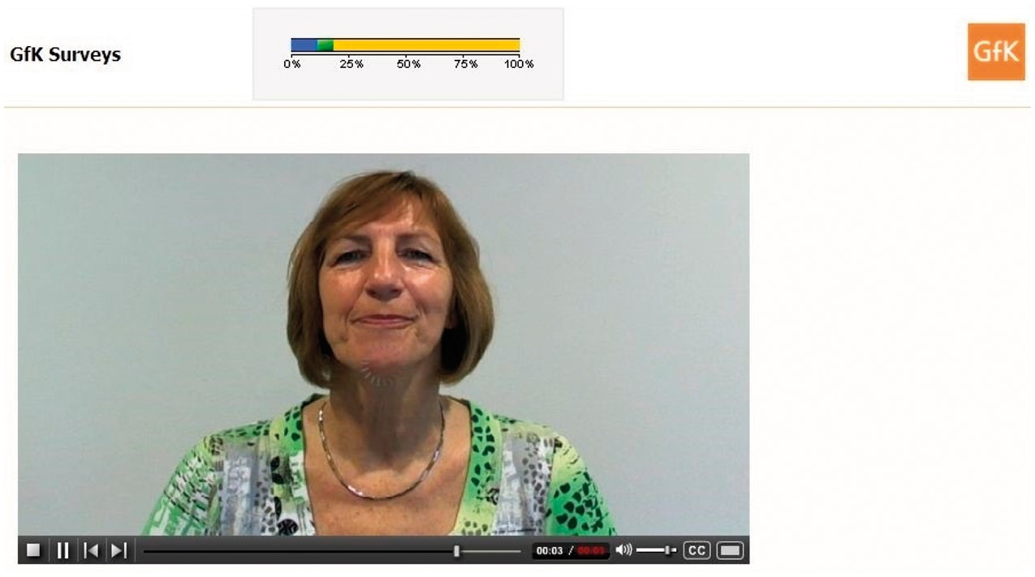
Figure 1. Video-Web Display.
Notes:
Figure 1. Video-Web Display.
Unless provided in the caption above, the following copyright applies to the content of this slide: © The Author 2016. Published by Oxford University Press on behalf of the American Association for Public Opinion Research. All rights reserved. For Permissions, please email: journals.permissions@oup.com

