Slide 1
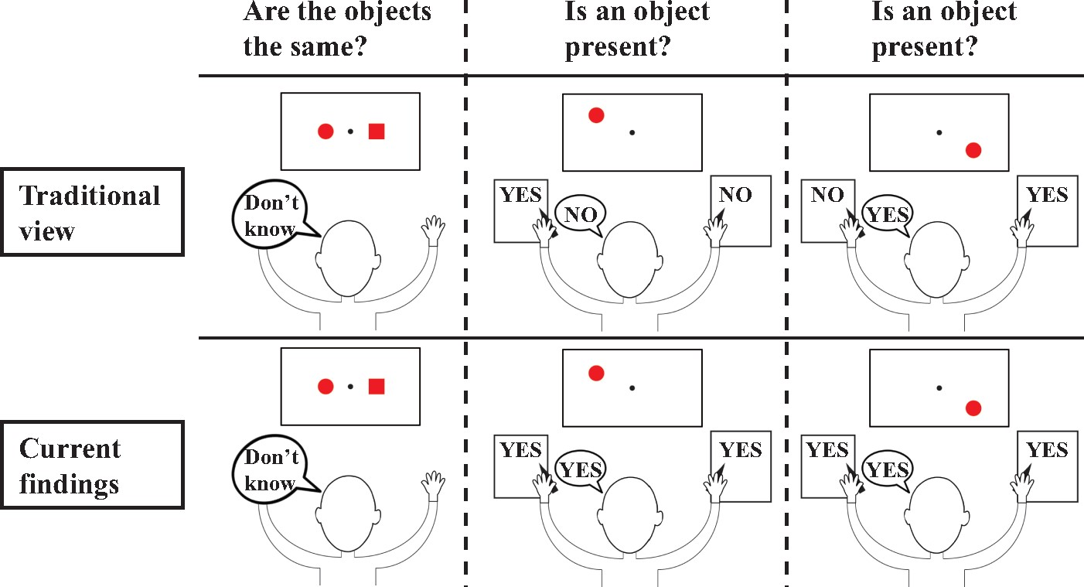
Figure 1 A depiction of the traditional view of the split brain syndrome (top) versus what we actually found in two ...
Notes:
Figure 1 A depiction of the traditional view of the split brain syndrome (top) versus what we actually found in two split-brain patients across a wide variety of tasks (bottom). The canonical idea of split-brain patients is that they cannot compare stimuli across visual half-fields (left), because visual processing is not integrated across hemispheres. This is what we found as well. However, another key element of the traditional view is that split-brain patients can only respond accurately to stimuli in the left visual field with their left hand and to stimuli in the right visual field with their right hand and verbally. This is not what we found. Across a wide variety of tasks, we observed that split-brain patients could reliably indicate presence, location, orientation and identity of stimuli throughout the entire visual field regardless of how they responded.
Unless provided in the caption above, the following copyright applies to the content of this slide: © The Author (2017). Published by Oxford University Press on behalf of the Guarantors of Brain. All rights reserved. For Permissions, please email: journals.permissions@oup.com

Slide 2
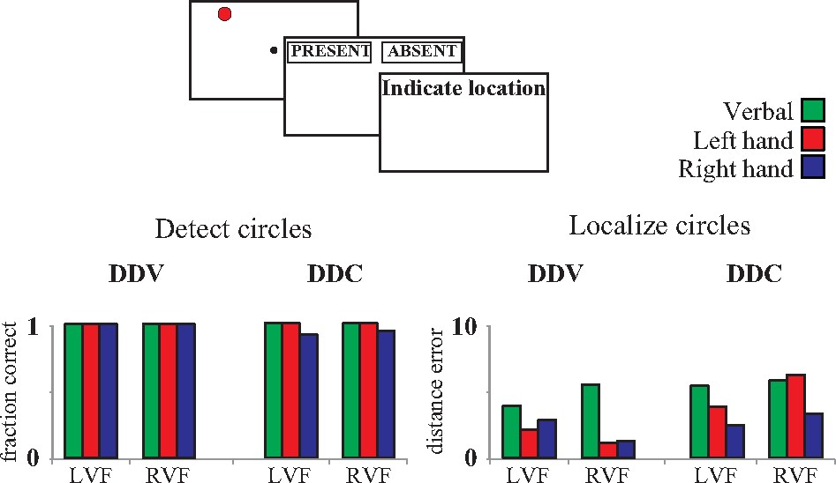
Figure 2 An overview of the results of Experiment 1. Both split-brain patients, Patients DDC and DDV, accurately ...
Notes:
Figure 2 An overview of the results of Experiment 1. Both split-brain patients, Patients DDC and DDV, accurately indicated presence and location (distance error is in degrees of visual angle) of stimuli appearing throughout the entire visual field, regardless of response type (verbally, left hand or right hand). These findings challenge the canonical view that split-brain patients can only respond correctly to the left visual field with the left hand and vice versa.
Unless provided in the caption above, the following copyright applies to the content of this slide: © The Author (2017). Published by Oxford University Press on behalf of the Guarantors of Brain. All rights reserved. For Permissions, please email: journals.permissions@oup.com

Slide 3
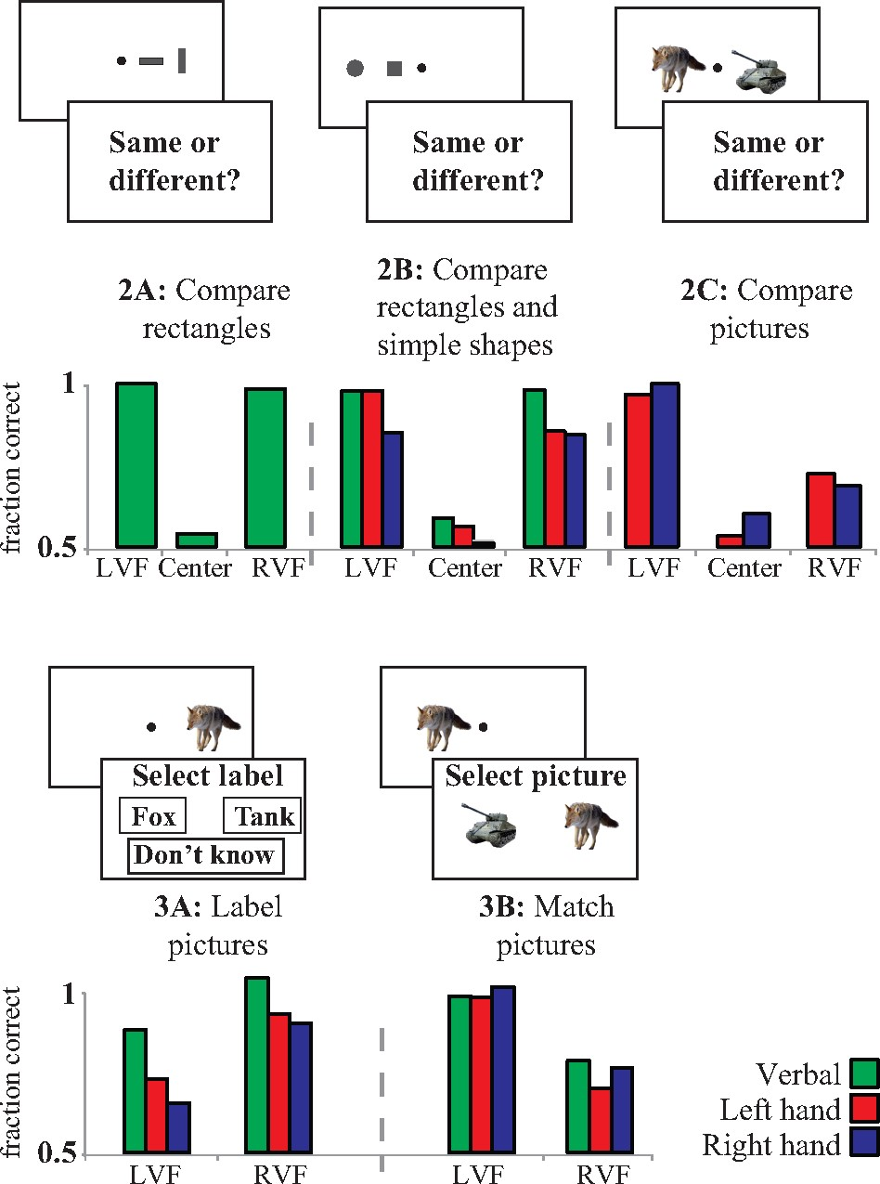
Figure 3 An overview of the results of Experiments 2 and 3. Patient DDC was not able to compare stimuli across visual ...
Notes:
Figure 3 An overview of the results of Experiments 2 and 3. Patient DDC was not able to compare stimuli across visual half-fields, although he was able to do so within one visual half-field (Experiment 2A–C). Moreover, he was better at labelling stimuli in the right visual field (Experiment 3A) and better at matching stimuli in the left visual field (Experiment 3B). Crucially, although visual information remained unintegrated across visual half-fields, there was still no response type × visual field interaction.
Unless provided in the caption above, the following copyright applies to the content of this slide: © The Author (2017). Published by Oxford University Press on behalf of the Guarantors of Brain. All rights reserved. For Permissions, please email: journals.permissions@oup.com

Slide 4
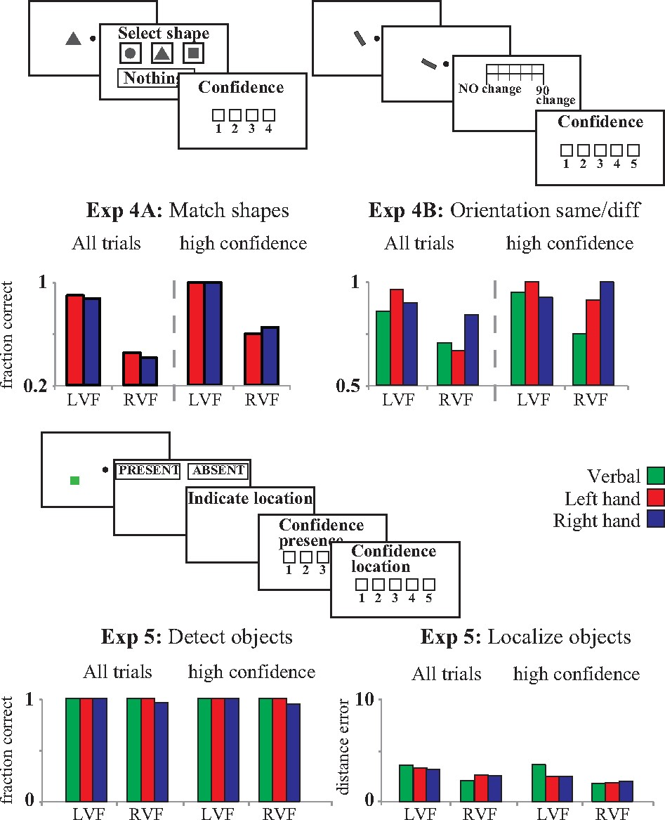
Figure 4 Across three experiments Patient DDC performed better on high confidence than on low confidence trials, ...
Notes:
Figure 4 Across three experiments Patient DDC performed better on high confidence than on low confidence trials, suggesting accurate metacognition. Moreover, also for high confidence trials we observed no response type × visual field interaction, suggesting that unity in responding was based on conscious perception, not on blindsight-like processes.
Unless provided in the caption above, the following copyright applies to the content of this slide: © The Author (2017). Published by Oxford University Press on behalf of the Guarantors of Brain. All rights reserved. For Permissions, please email: journals.permissions@oup.com

