Slide 1
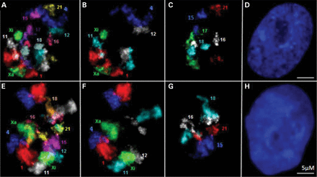
Figure 1. Multi-FISH labeling of CT in MCF10. 2D projection images of: (A) 10 CT (1, 4, 11, 12, 15, 16, 17, 18, 21 and ...
Notes:
Figure 1. Multi-FISH labeling of CT in MCF10. 2D projection images of: (A) 10 CT (1, 4, 11, 12, 15, 16, 17, 18, 21 and X) in MCF10A; (E) nine CT (1, 4, 11, 12, 15, 16, 18, 21 and X) in MCF10CA1a; (B and F) larger chromosomes (1, 4, 11, 12 and X); (C and G) smaller chromosomes (15, 16, 17, 18 and 21); and (D and H) DAPI staining to visualize the nuclei.
Unless provided in the caption above, the following copyright applies to the content of this slide: © The Author 2014. Published by Oxford University Press. All rights reserved. For Permissions, please email: journals.permissions@oup.com

Slide 2
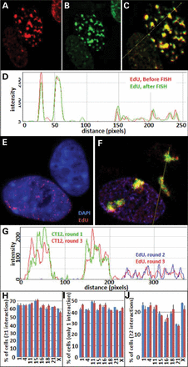
Figure 2. Relabeling CT and replication sites in successive rounds. EdU labeling of replication sites before and after ...
Notes:
Figure 2. Relabeling CT and replication sites in successive rounds. EdU labeling of replication sites before and after FISH demonstrate that replication sites from small to large and their nuclear positions are not altered by FISH. (A) EdU sites before FISH (red); (B), EdU sites after FISH (green); (C) merged image of A and B; (D) line profile of the merged image; (E) EdU-labeled replication sites (red) and DAPI staining (blue); (F) merged image of DAPI (blue), EdU-labeled sites (rounds 2 and 3) and CT 12 labeling in rounds 1 (green) and round 3 (red); (G) line profile through the merged image F; (H–J) comparison interaction profiles of CT 12 with the other eight CT after labeling in the first round (blue bars) and relabeling of CT 12 in the third round (red bars).
Unless provided in the caption above, the following copyright applies to the content of this slide: © The Author 2014. Published by Oxford University Press. All rights reserved. For Permissions, please email: journals.permissions@oup.com

Slide 3
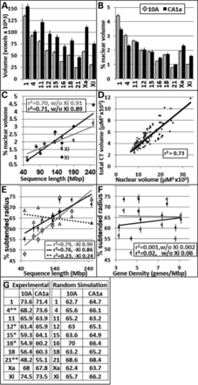
Figure 3. Nuclear volumes and radial positions of CT in 10A and CA1a cells. For (A)–(F), gray corresponds to 10A and ...
Notes:
Figure 3. Nuclear volumes and radial positions of CT in 10A and CA1a cells. For (A)–(F), gray corresponds to 10A and black to CA1A. (A) CT absolute volumes; (B) CT volumes as a percent of total nuclear volume; (C) relationship between the total volume of CT and sequence length; (D) relationship between total CT and nuclear volumes; the relationships for 10A and CA1a CT are virtually identical as indicated by the superimposition of the trend lines; (E and F) relationship between sequence length, gene density and radial positioning (% SR), triangle points and the dashed trend line in (E) show random simulation of 10A cells; (G) % SR values for peripheral positions determined experimentally versus random simulation. *P < 0.05, **P = 0.001.
Unless provided in the caption above, the following copyright applies to the content of this slide: © The Author 2014. Published by Oxford University Press. All rights reserved. For Permissions, please email: journals.permissions@oup.com

Slide 4
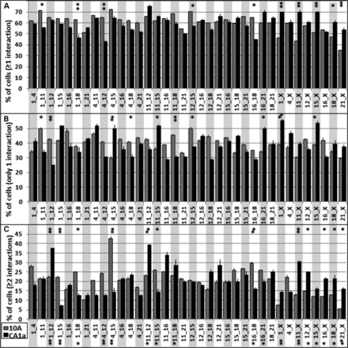
Figure 4. Interaction profiles of CT in 10A and CA1a cells. Since each CT has two homologs, there are four possible ...
Notes:
Figure 4. Interaction profiles of CT in 10A and CA1a cells. Since each CT has two homologs, there are four possible interactions in each nucleus. The percent of cells with at least one interaction (A), percent of cells with only one interaction (B) and the percent of cells that have two or more interactions (C) are shown. 10A (gray bars), n = 108; CA1a (black bars), n = 56; error bars = SEM. Fishers exact test demonstrated significant alterations in ≥1, = 1, ≥2, and = 1 and ≥2 together. *P < 0.1, **P < 0.05.
Unless provided in the caption above, the following copyright applies to the content of this slide: © The Author 2014. Published by Oxford University Press. All rights reserved. For Permissions, please email: journals.permissions@oup.com

Slide 5
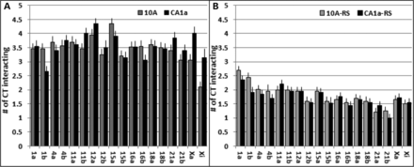
Figure 5. Total CT interactions. Within each nucleus, the larger homolog was designated ‘a’ and the smaller homolog was ...
Notes:
Figure 5. Total CT interactions. Within each nucleus, the larger homolog was designated ‘a’ and the smaller homolog was ‘b’. The total number of interactions to each CT was calculated. The average number of CT interactions is shown for experimental (A) and random simulations (B). All experimental values were significant higher than random simulations (t-test, P < 0.001). Values of 10A cells are in gray and CA1a in black.
Unless provided in the caption above, the following copyright applies to the content of this slide: © The Author 2014. Published by Oxford University Press. All rights reserved. For Permissions, please email: journals.permissions@oup.com

Slide 6
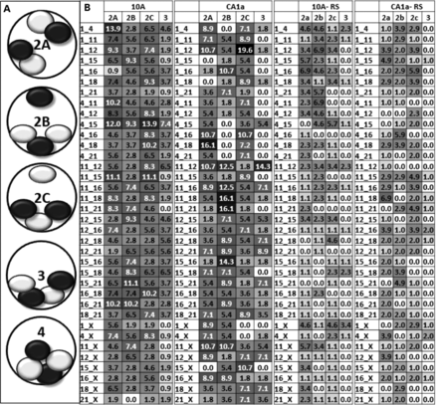
Figure 6. Patterns of multiple interactions of CT pairs. (A) Categories of multiple interactions of CT pairs for 2, 3 ...
Notes:
Figure 6. Patterns of multiple interactions of CT pairs. (A) Categories of multiple interactions of CT pairs for 2, 3 and 4 interactions are illustrated; (B) the percent of total cells that have type 2a, 2b and 3 interactions were calculated and are shown for 10A, CA1a, and their corresponding random simulations (RS). Type 4 interactions were extremely rare (0–2%) and are not shown. Values are shaded in grayscale from white (low) to black (high) levels, gray are intermediate values. The top 15% of values are written in white type. None of the random simulations values were in the top 15%.
Unless provided in the caption above, the following copyright applies to the content of this slide: © The Author 2014. Published by Oxford University Press. All rights reserved. For Permissions, please email: journals.permissions@oup.com

Slide 7
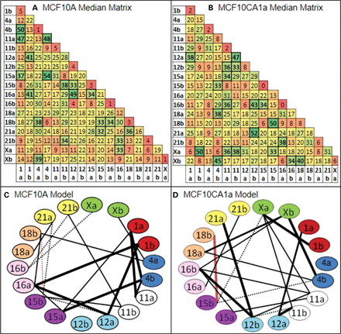
Figure 7. Chromatic median analysis and preferred probabilistic models of chromosome interactions in 10A and CA1a. The ...
Notes:
Figure 7. Chromatic median analysis and preferred probabilistic models of chromosome interactions in 10A and CA1a. The chromatic median algorithm determines correspondence between homologs across nuclei based upon which other CT it interacts (see Supplementary Data). This algorithm determined a median matrix for CT interactions in MCF10A (A) and MCF10CA1a (B) in which each cell in the matrix represents the percent of input nuclei that have an interaction between those homologs. Hot spots are green, cold spots are red and yellow spots are intermediate values. Thresholding of the 10A and CA1a matrices above a level of 32% interactions reveals 20 CT interactions in both 10A (C) and malignant CA1a (D). Thirty-two percent is the threshold level where there are no connections in randomizations of input matrices or random simulations (Supplementary Data). A comparison of the models generated from this analysis indicates massive differences between 10A and CA1a. Nineteen of the 20 preferred pairwise associations were unique to both10A and CA1a (black lines) with only one pairwise association in common (CT 15b–18b, red line). Thick connections are within the top third of percent pairwise associations within the model while dashed connections are within the bottom third. Any given nucleus will contain an average of 39.2% (10A) and 39.4% (CA1a) of the connections within these models (41).
Unless provided in the caption above, the following copyright applies to the content of this slide: © The Author 2014. Published by Oxford University Press. All rights reserved. For Permissions, please email: journals.permissions@oup.com

