Slide 1
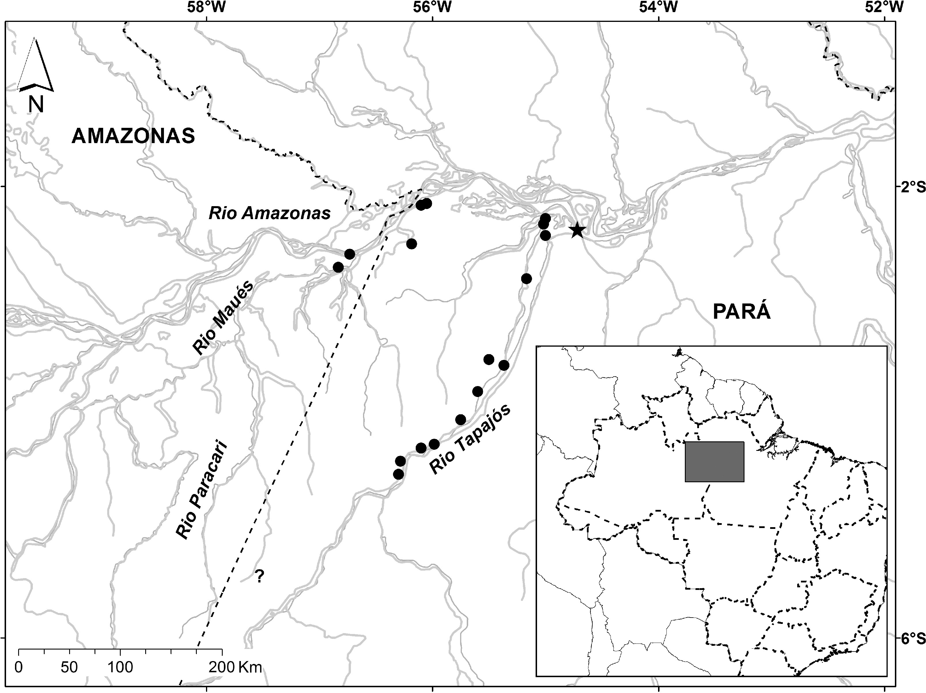
Fig. 4. Geographic distribution of Mico humeralifer. Black dots obtained from de Vivo (1991) and museum specimens ...
Notes:
Fig. 4. Geographic distribution of Mico humeralifer. Black dots obtained from de Vivo (1991) and museum specimens analyzed by the authors. The star represents the type locality.
Unless provided in the caption above, the following copyright applies to the content of this slide: © 2014 American Society of Mammalogists

Slide 2
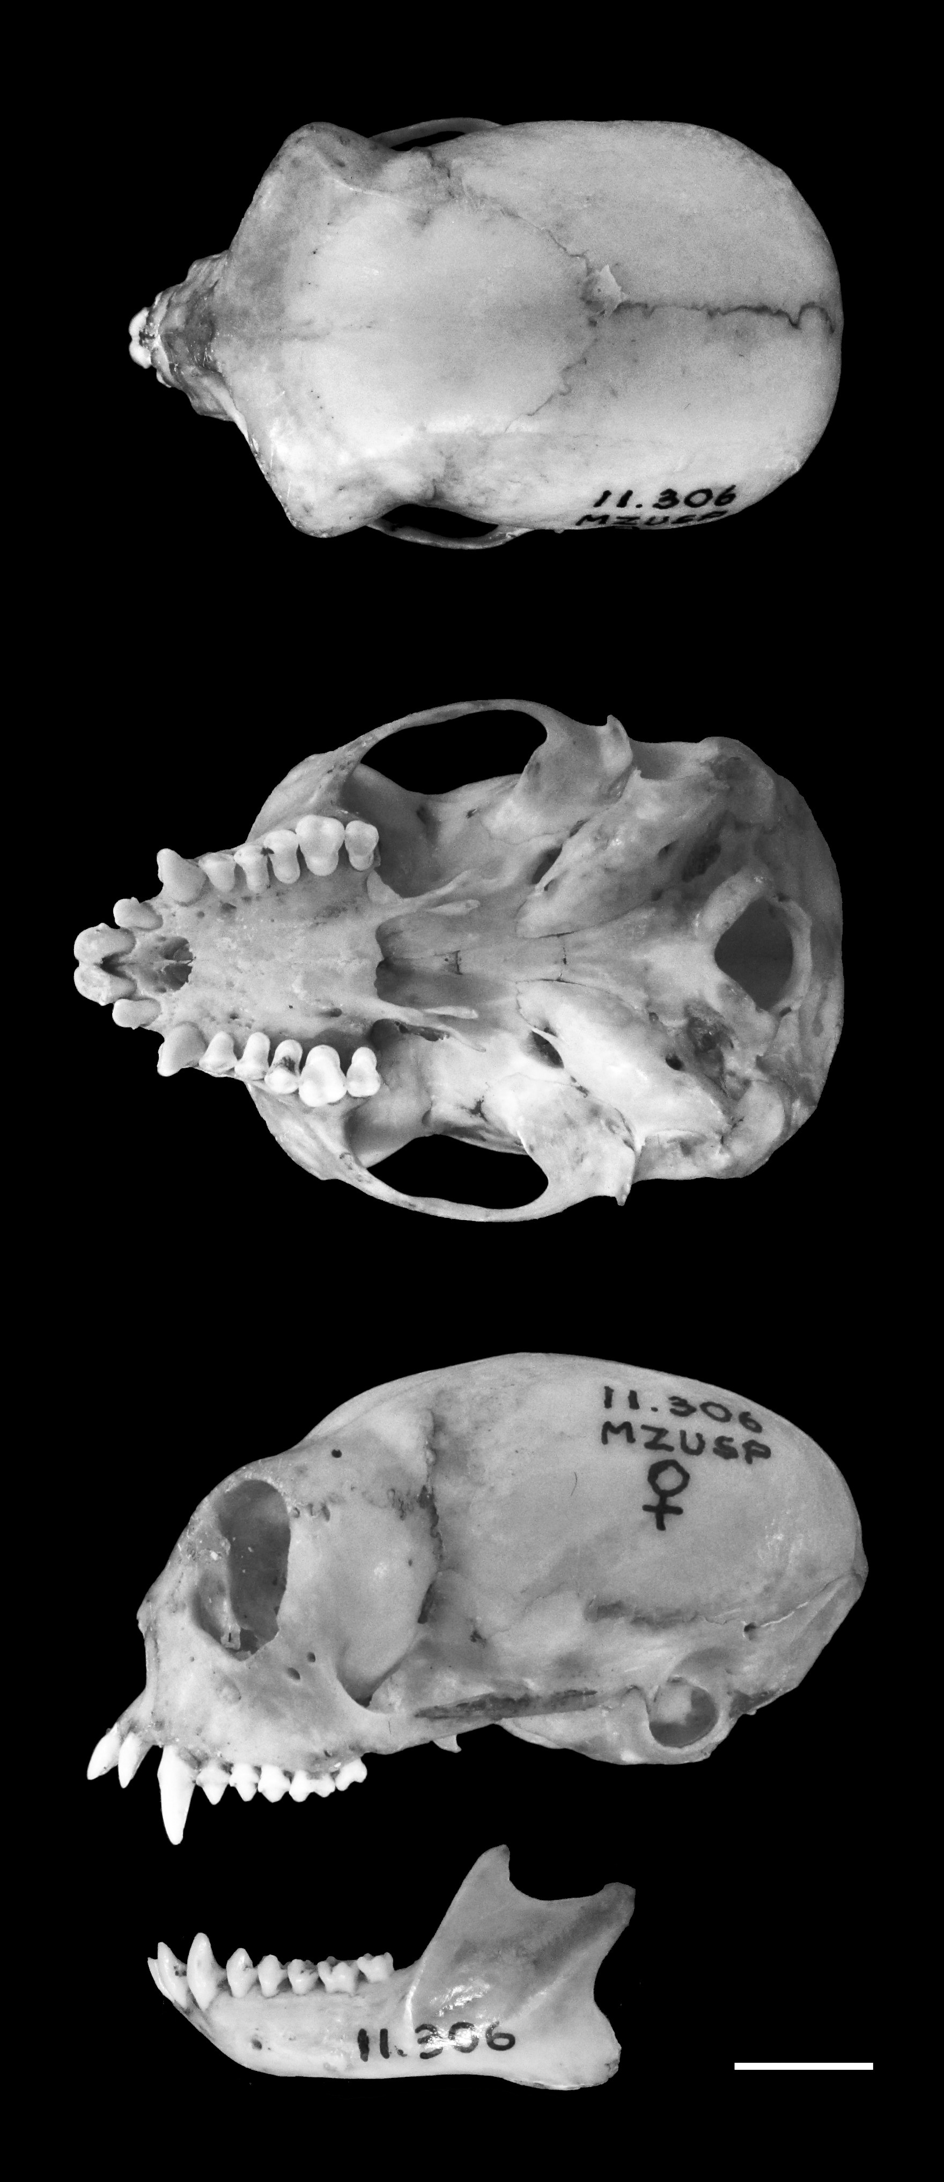
Fig. 3. Dorsal, ventral, and lateral views of skull and lateral view of mandible of an adult female Mico humeralifer ...
Notes:
Fig. 3. Dorsal, ventral, and lateral views of skull and lateral view of mandible of an adult female Mico humeralifer (MZUSP [Museu de Zoologia da Universidade de São Paulo mammal collection] 11306) from Brasília Legal, state of Pará, Brazil. Scale bar = 10 mm. Photo by G. S. T. Garbino.
Unless provided in the caption above, the following copyright applies to the content of this slide: © 2014 American Society of Mammalogists

Slide 3
Fig. 2. Face of an adult captive Mico humeralifer (unknown sex) taken at Marco Schwarz's captive facility, Brazil. ...
Notes:
Fig. 2. Face of an adult captive Mico humeralifer (unknown sex) taken at Marco Schwarz's captive facility, Brazil. Used with permission of photographer Noel Rowe/alltheworldsprimates.org.
Unless provided in the caption above, the following copyright applies to the content of this slide: © 2014 American Society of Mammalogists

Slide 4
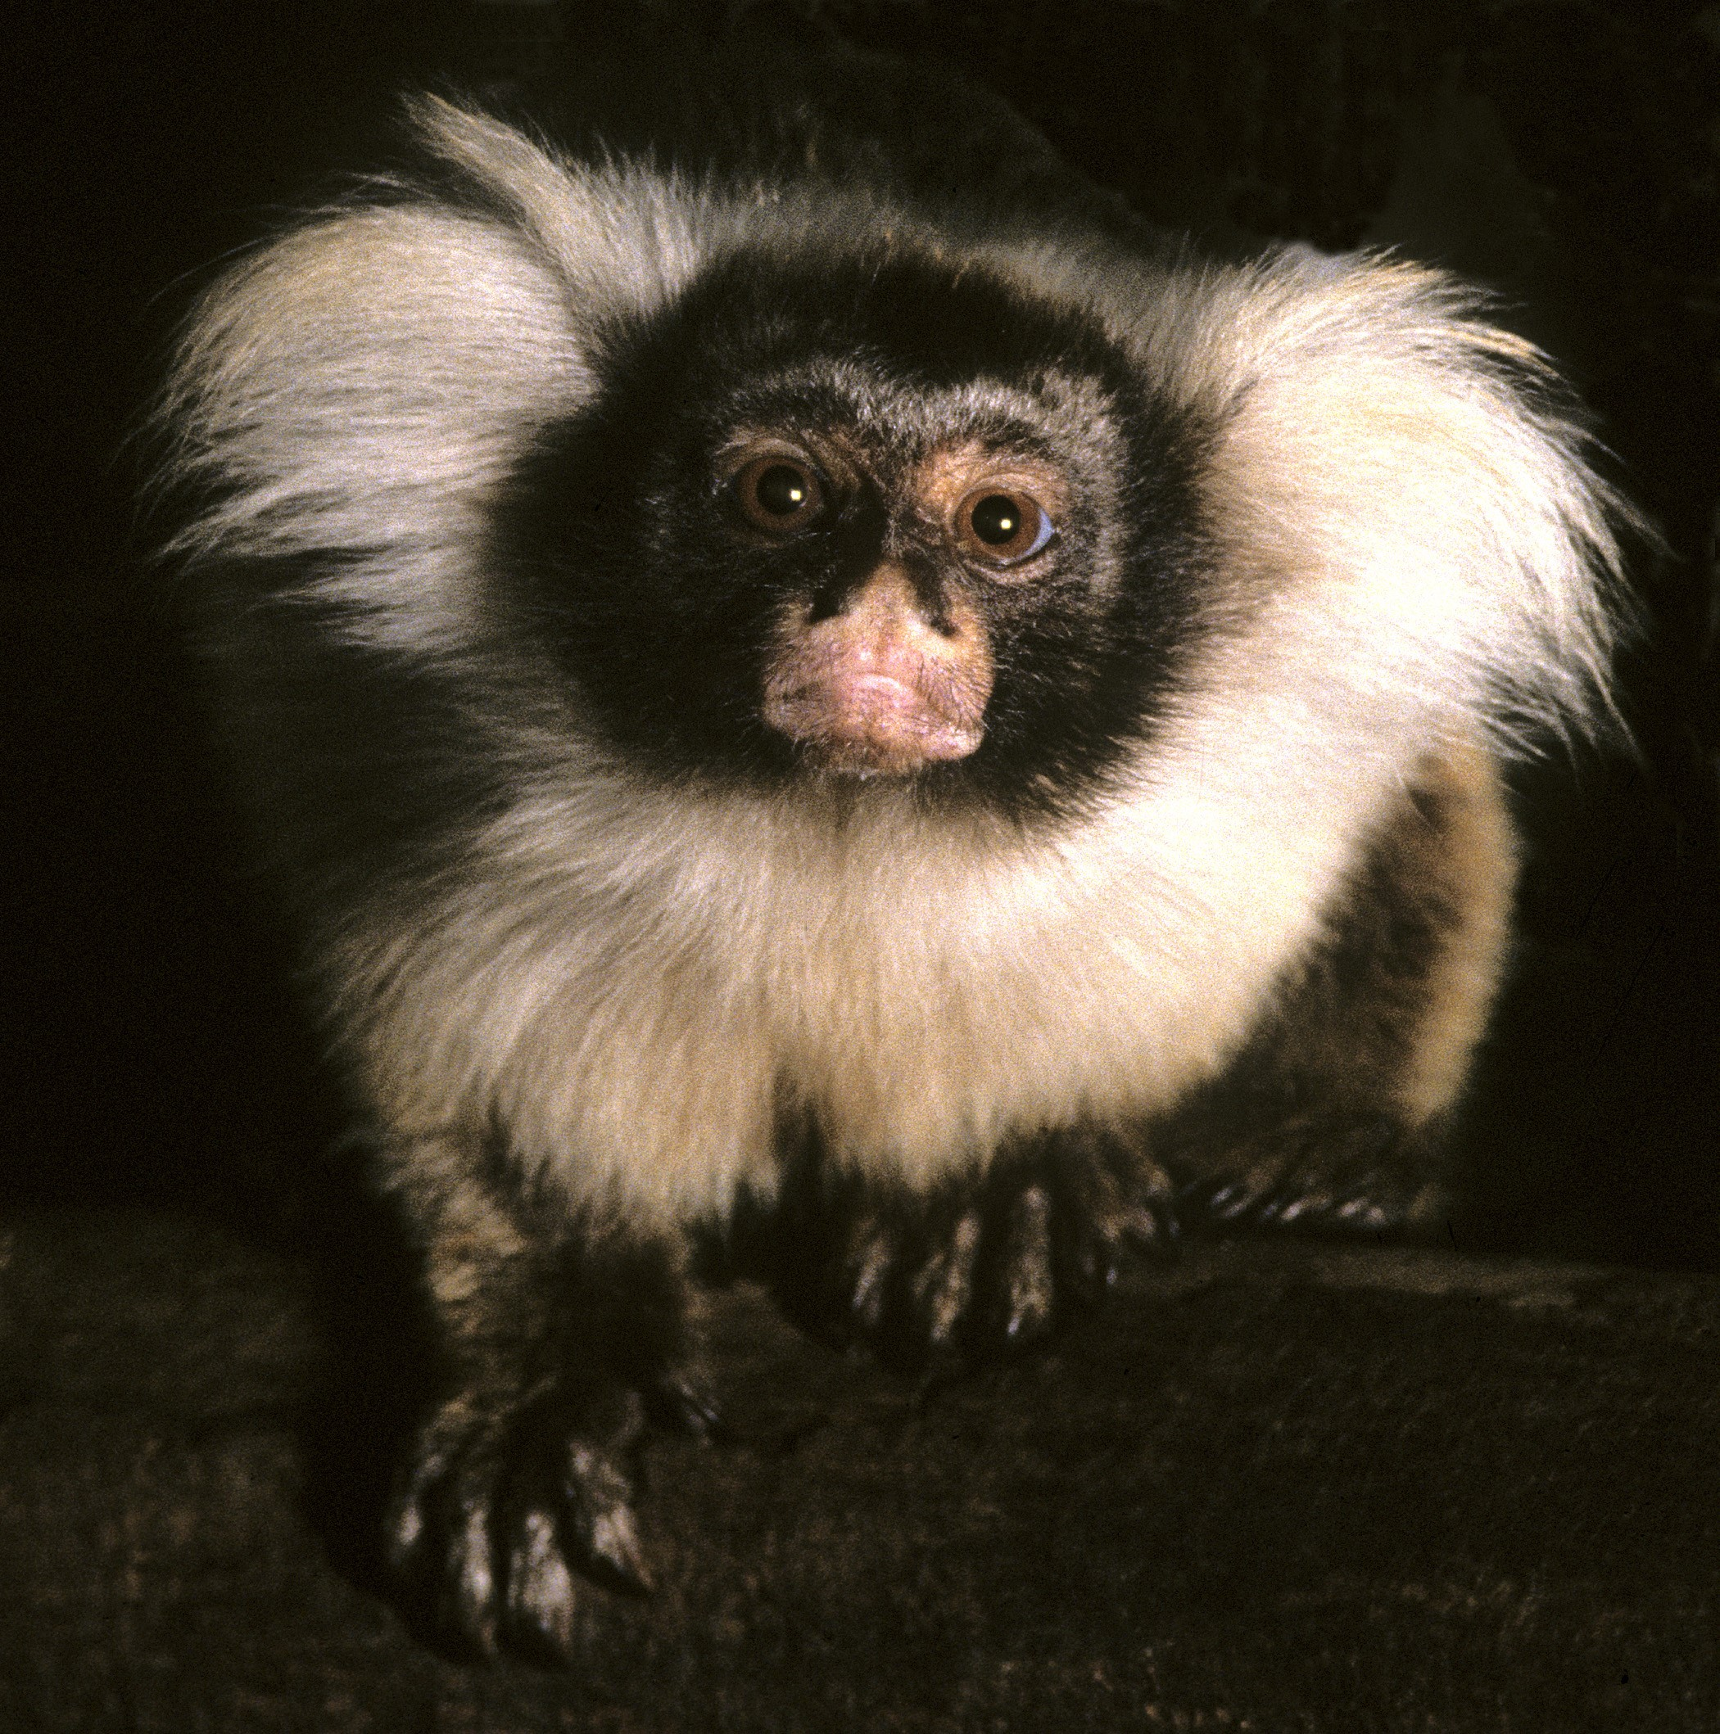
Fig. 1. An adult captive Mico humeralifer (unknown sex) from Japan Monkey Centre, Aichi. Used with permission of ...
Notes:
Fig. 1. An adult captive Mico humeralifer (unknown sex) from Japan Monkey Centre, Aichi. Used with permission of photographer Noel Rowe/alltheworldsprimates.org.
Unless provided in the caption above, the following copyright applies to the content of this slide: © 2014 American Society of Mammalogists

