Slide 1
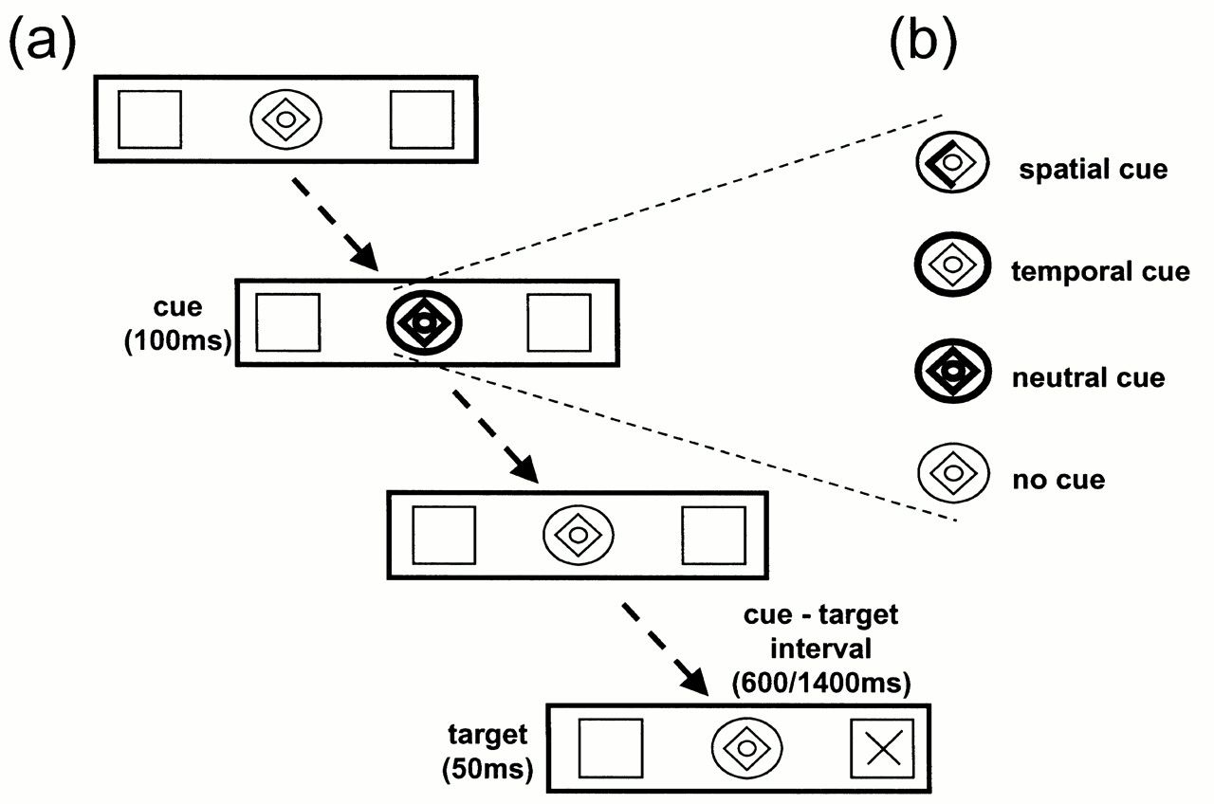
Figure 1. (a) A typical trial which, in this example, contains a neutral cue. Stimuli are white, presented on a black ...
Notes:
Figure 1. (a) A typical trial which, in this example, contains a neutral cue. Stimuli are white, presented on a black background. Discrete elements (according to condition) of the central cue brighten for 100 ms and act to guide subjects attention. The cue–target interval is either 600 or 1400 ms (short/long cue–target interval) and then the target appears for 50 ms in either the left or right box. The central attentional cue can be one of four types. (b) The spatial cue directs the subjects' attention to the left or right, the temporal cue directs attention to a short or long cue–target interval and the neutral cue provides neither spatial nor temporal information. In the no-cue condition, the central cue remains unchanged for the duration of the trial.
Unless provided in the caption above, the following copyright applies to the content of this slide: © Oxford University Press

Slide 2
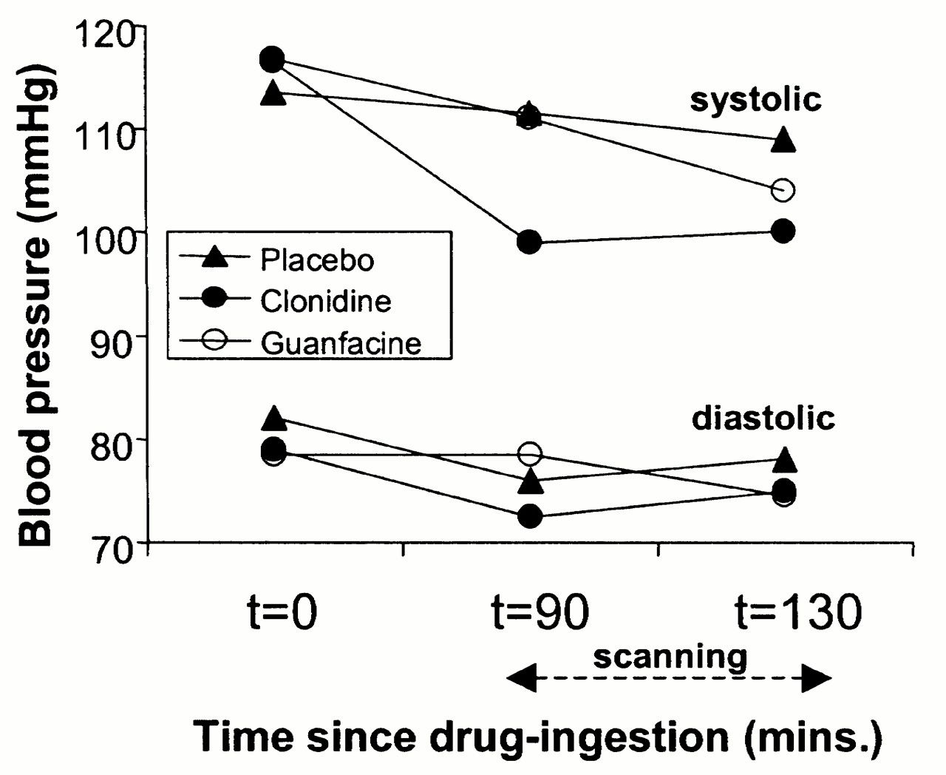
Figure 2. Systolic and diastolic blood pressure following administration of placebo, 200 μg clonidine or 1 mg ...
Notes:
Figure 2. Systolic and diastolic blood pressure following administration of placebo, 200 μg clonidine or 1 mg guanfacine at three discrete time points: at the time of administration of the drug (t = 0), immediately before scanning (t = 90 min) and immediately after scanning (t = ~130 min).
Unless provided in the caption above, the following copyright applies to the content of this slide: © Oxford University Press

Slide 3
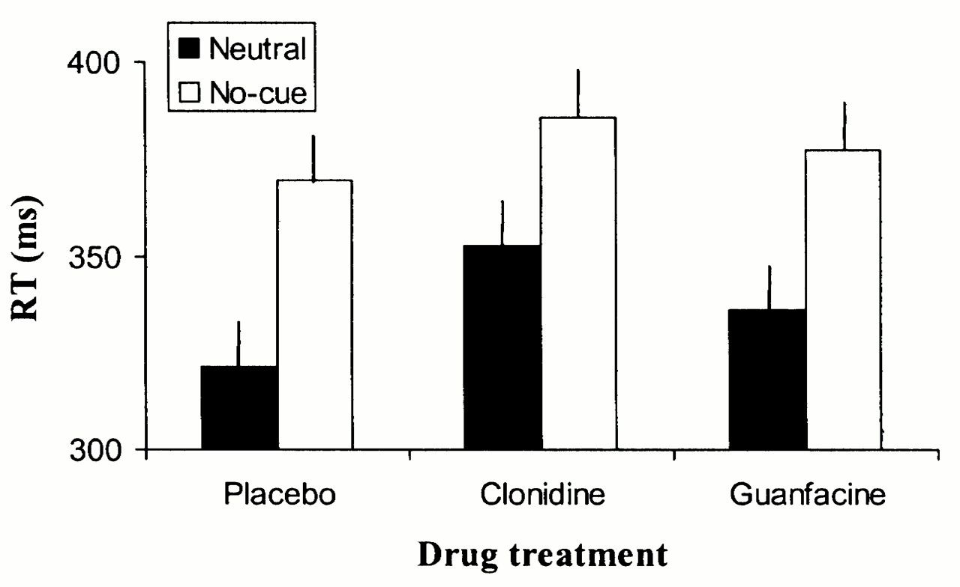
Figure 3. Reaction times (RT) demonstrating the alerting effect in placebo subjects (the beneficial effect that a ...
Notes:
Figure 3. Reaction times (RT) demonstrating the alerting effect in placebo subjects (the beneficial effect that a neutral warning cue confers to RT) and the attenuation of this benefit following administration of 200 μg clonidine, but not 1 mg guanfacine.
Unless provided in the caption above, the following copyright applies to the content of this slide: © Oxford University Press

Slide 4
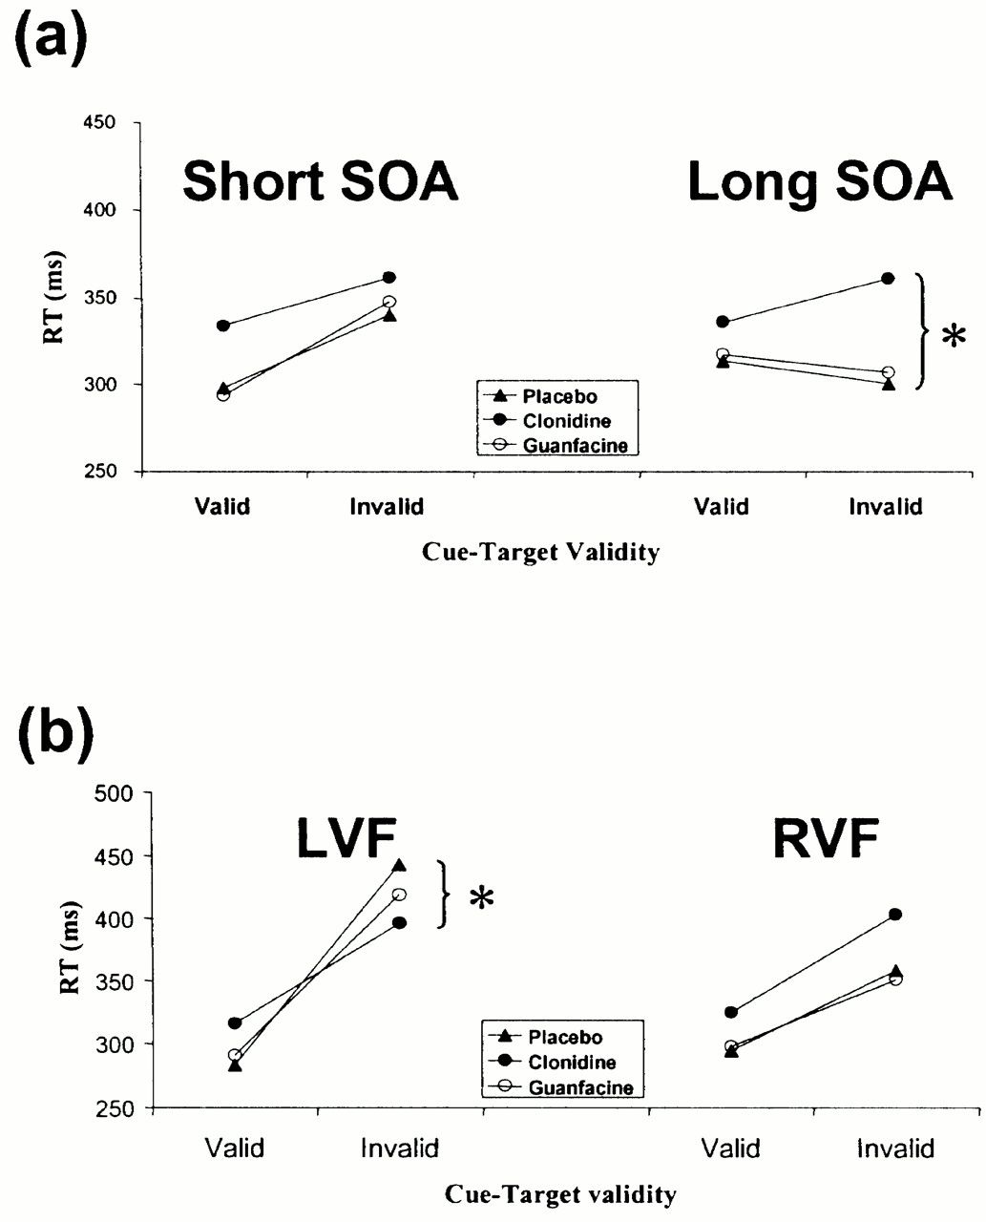
Figure 4. Reaction times (RT) during (a)temporal orienting and (b) spatial orienting, following administration of ...
Notes:
Figure 4. Reaction times (RT) during (a)temporal orienting and (b) spatial orienting, following administration of placebo, 200 μg clonidine or 1 mg guanfacine. RTs are shown separately for targets appearing after a 600 ms (short SOA) or 1400 ms (long SOA) cue-target interval during temporal orienting and for targets appearing in the left visual field (LVF) or right visual field (RVF) during spatial orienting. Target onset time or location were either correctly (valid) or incorrectly (invalid) predicted by the cue. The significant simple main effects is indicated by *.
Unless provided in the caption above, the following copyright applies to the content of this slide: © Oxford University Press

Slide 5
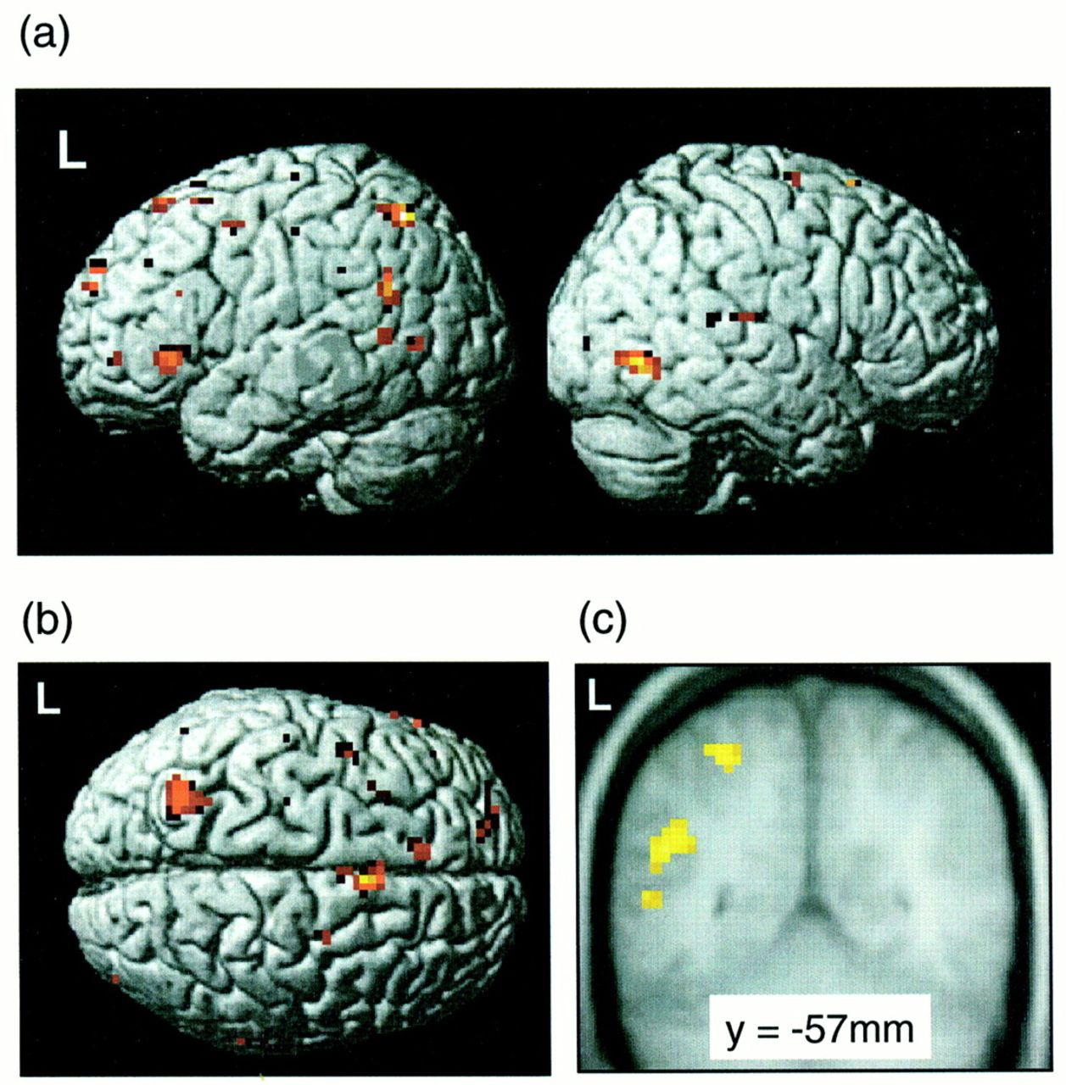
Figure 5. Neuroanatomical correlates of the alerting effect: brain regions significantly more activated during neutral ...
Notes:
Figure 5. Neuroanatomical correlates of the alerting effect: brain regions significantly more activated during neutral cue than no-cue trials rendered onto (a) lateral and (b) dorsal views of a standardized template brain. Superior and inferior parietal cortex activations are shown in greater detail in (c) and are superimposed over the averaged structural MRI of all 10 subjects.
Unless provided in the caption above, the following copyright applies to the content of this slide: © Oxford University Press

Slide 6
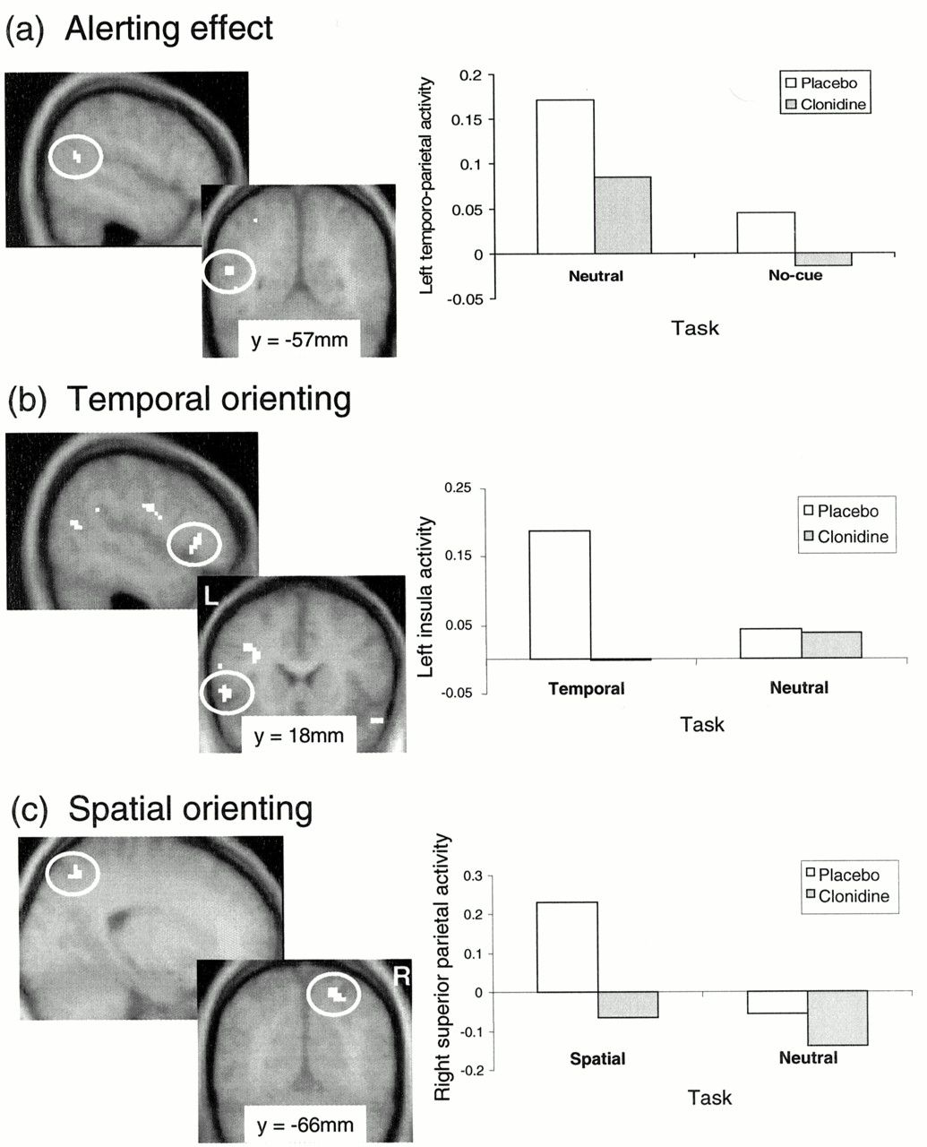
Figure 6. Clondine attenuates task-related activity in the (a) left temporo-parietal junction during the alerting ...
Notes:
Figure 6. Clondine attenuates task-related activity in the (a) left temporo-parietal junction during the alerting effect (neutral minus no-cue), (b) left anterior insula during temporal orienting (temporal minus neutral) and (c) right superior parietal cortex during spatial orienting (spatial minus neutral). Areas of attenuated activity are shown superimposed over the averaged structural MRI of all 10 subjects. Changes in BOLD signal at each of these regions are shown in the corresponding plots. Data are shown for each of the comparisons of interest, following administration of placebo or clonidine. In all cases clonidine decreases activity more during the task of interest than during the control condition.
Unless provided in the caption above, the following copyright applies to the content of this slide: © Oxford University Press

