Slide 1
Figure 1. Variation in human pigmentation apparent through skin colour. An alignment of forearms from darkest to ...
Notes:
Figure 1. Variation in human pigmentation apparent through skin colour. An alignment of forearms from darkest to lightest skin colour illustrating a range of skin types.
Unless provided in the caption above, the following copyright applies to the content of this slide: © The Author 2009. Published by Oxford University Press. All rights reserved. For Permissions, please email: journals.permissions@oxfordjournals.org

Slide 2
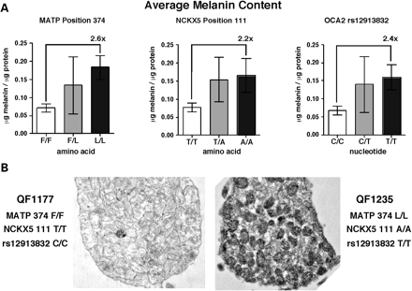
Figure 2. Melanin content of human melanocyte cultures characterized by pigmentation genotype. (A) Average melanin ...
Notes:
Figure 2. Melanin content of human melanocyte cultures characterized by pigmentation genotype. (A) Average melanin content of primary human melanocytes grown in cell culture based on independent genotypes for SLC45A2 (MATP Leu374Phe), SLC24A5 (NCKX5 Ala111Thr) and OCA2 (r12913832 T/C) (53). The ratio of the homozygous strains is designated in each panel. (B) Representative transmission electron micrographs showing differences in melanosome maturation of a lightly pigmented strain, showing predominant stages I and II, and a darkly pigmented strain showing more mature stage III and IV melanosomes. Genotypes are as indicated.
Unless provided in the caption above, the following copyright applies to the content of this slide: © The Author 2009. Published by Oxford University Press. All rights reserved. For Permissions, please email: journals.permissions@oxfordjournals.org

Slide 3
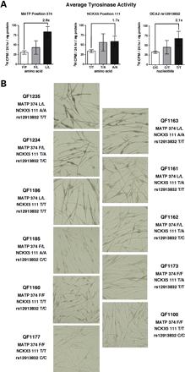
Figure 3. Measured and in situ tyrosinase activity of human melanocyte cultures characterized by pigmentation genotype. ...
Notes:
Figure 3. Measured and in situ tyrosinase activity of human melanocyte cultures characterized by pigmentation genotype. (A) Average tyrosinase activity determined for primary human melanocytes grown in cell culture based on independent genotypes for SLC45A2 (MATP Leu374Phe), SLC24A5 (NCKX5 Ala111Thr) and OCA2 (r12913832 T/C) (53). The ratio of the homozygous strains is designated in each panel. (B) An alignment of primary human melanocytes grown in cell culture based on L-DOPA reactivity from darkest to lightest colour as visualized by bright field light photomicroscopy. QF strains and genotypes are as indicated.
Unless provided in the caption above, the following copyright applies to the content of this slide: © The Author 2009. Published by Oxford University Press. All rights reserved. For Permissions, please email: journals.permissions@oxfordjournals.org

